Slide 1
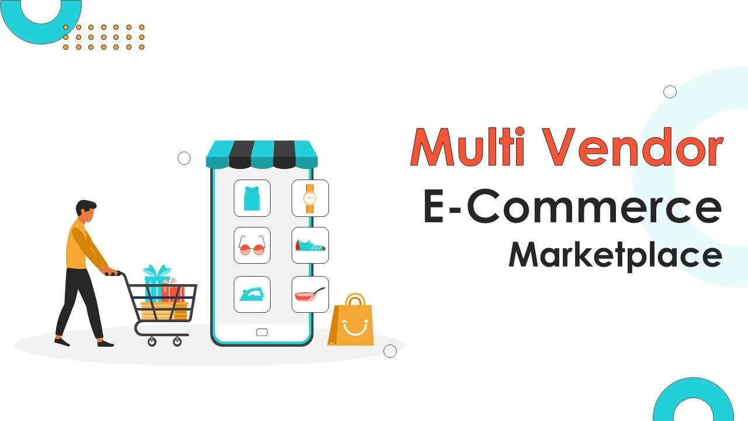
SHOP Smart
One stop for All your needs !

Slide 2
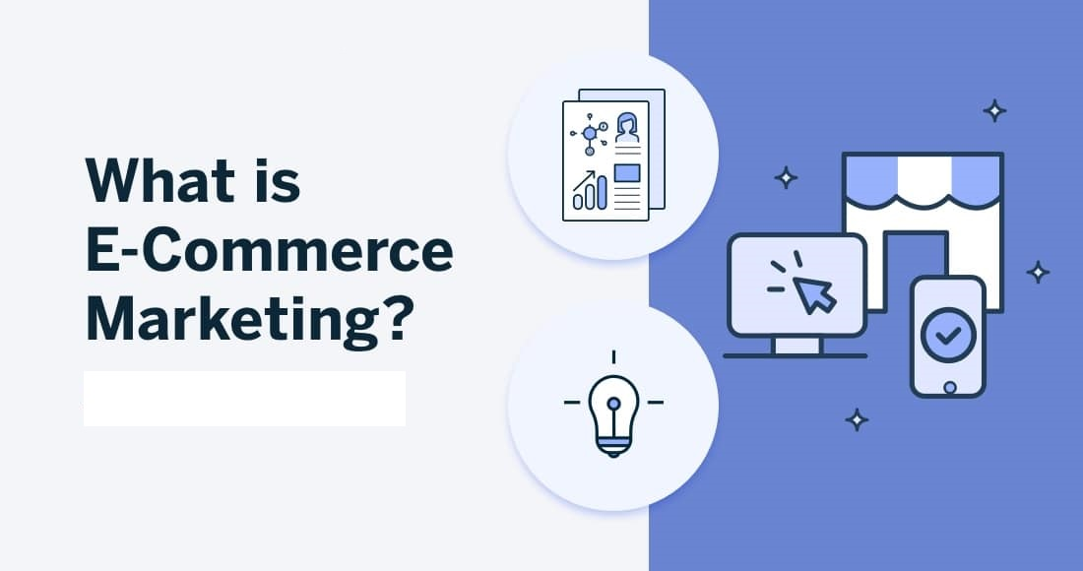
SHOP Smart

Slide 3
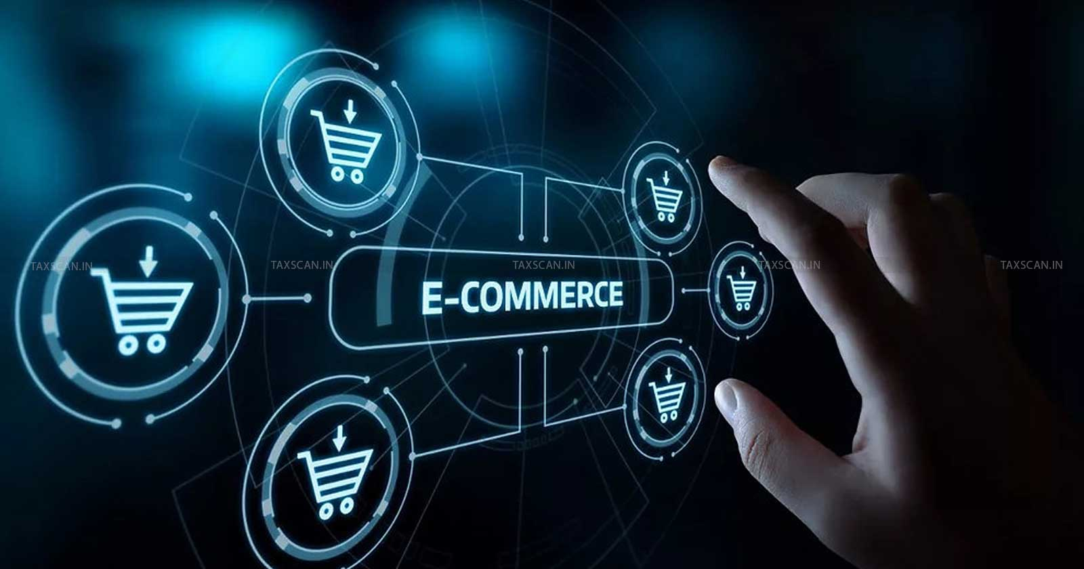
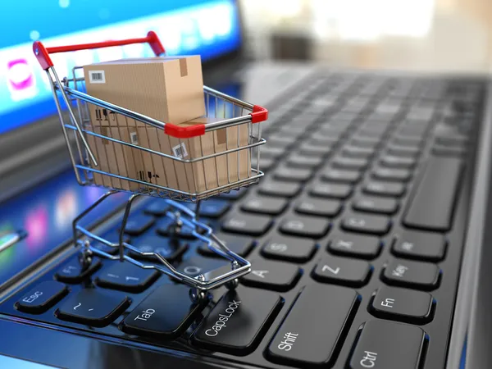
SHOP Smart
E-Commerce :
An e-commerce website is a place where people can buy and sell things online. It has features like product lists, shopping carts, and payment options, making it easy to shop anytime and from anywhere. Businesses use these websites to reach more customers and sell their products or services.

Slide 4
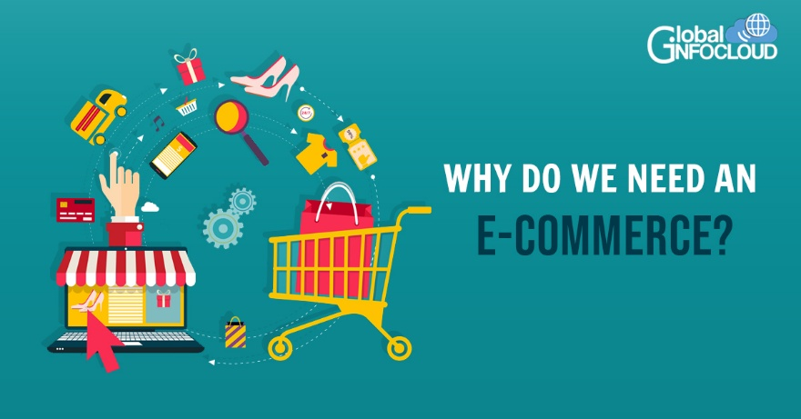
SHOP Smart

Slide 5
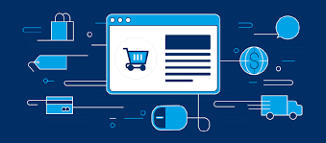
WITHOUT E-Commerce -
SHOP Smart
MANF. UNIT
10%
DISTRIBUTOR
10%
WHOLE SALER
10%
RETAILER
10%
CUSTOMER
100%
MANF. UNIT
10%
ADVERTISEMENT
50%
WITH E-Commerce -
COMPANY
CUSTOMER

Slide 6
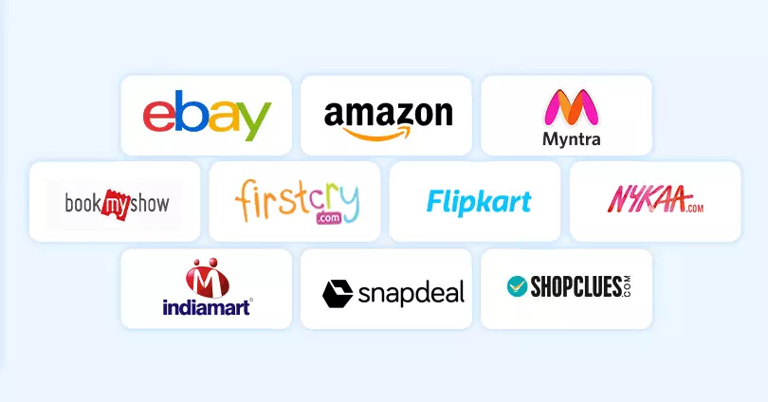
SHOP Smart
Some Famous E-Commerce Websites are -

Slide 7
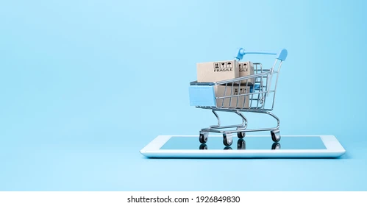
SHOP Smart
Technologies :
Frontend -
React.js -
It is a combination of HTML , CSS , JavaScript.
Backend -
Node JS.
Frame Work -
Express JS.
Data Base -
Mongo DB.

Slide 8
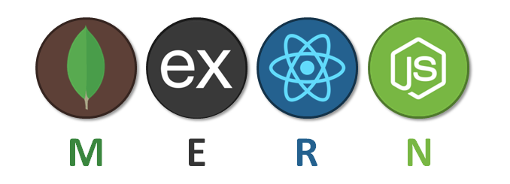
SHOP Smart
Technical Overview :
React.js - Frontend in MERN stack uses React.js for dynamic UIs, state management, routing, API integration, and responsive design, ensuring an interactive and smooth user experience.
Node.js - Node.js is a JavaScript runtime environment that enables server-side development, handling asynchronous events, APIs, and database interactions, providing scalability and performance for web applications.
Express.js - Express.js is a minimal web framework for Node.js, simplifying API development, routing, middleware integration, and handling HTTP requests, enabling efficient and scalable server-side applications.
Mongo DB - A database stores and manages data for applications, with Mongo DB (No SQL) in the MERN stack, offering flexibility, scalability, and efficient data retrieval in JSON-like format.

Slide 9
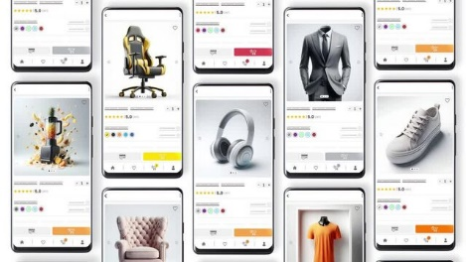

SHOP Smart
Advantages of E-Commerce :
Faster buying process
Because of E-Commerce website the buying process will become very fast. Because everyone will shop in online
Cost Reduction
Reduced expenses compared to physical stores, such
as rent and utilities.
24/7 Availability
Customers can shop anytime, increasing convenience and sales opportunities.
Faster Transactions
Streamlined processes for browsing, purchasing, and checkout.
Global reach
Businesses can reach customers worldwide, breaking geographical barriers.

Slide 10

SHOP Smart

