Slide 1
7PAM2000 Applied Data Science 1 Assignment 3: Clustering And Fitting
STUDENT NAME: DONTHU RAJU
STUDENT ID: 21084824

Slide 2
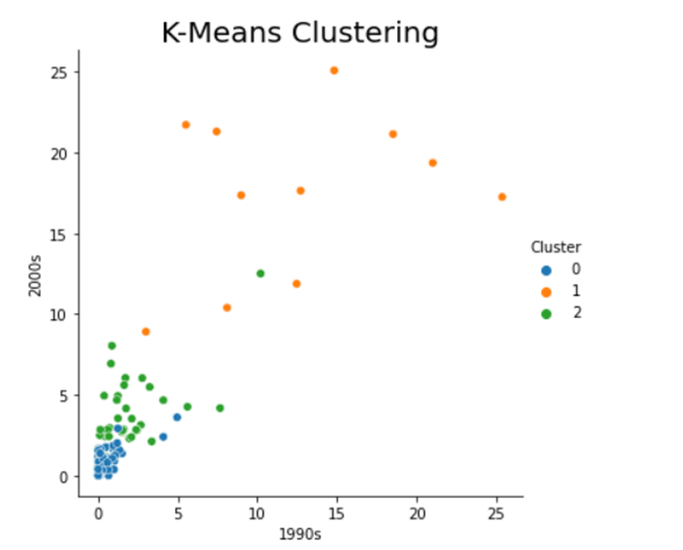
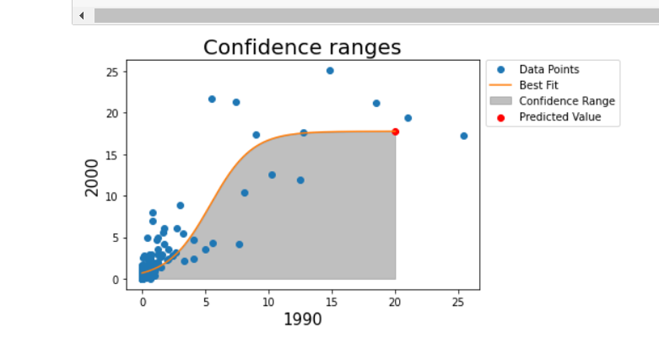
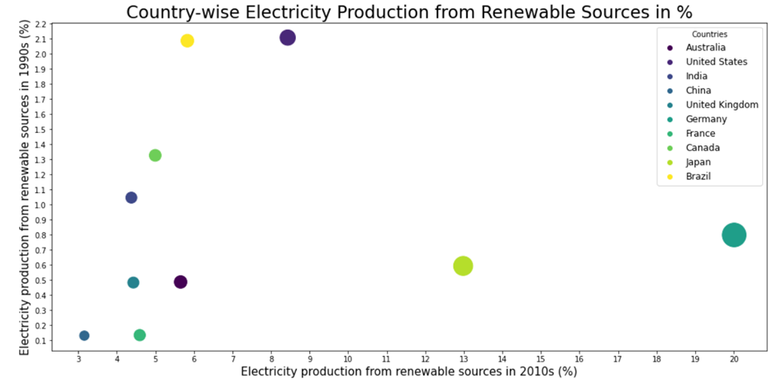
Electricity Production of Different Countries
Executive Summary
Electricity production based clustering with K means
Algorithm
K-means Clustering Algorithm
Dataset
World bank dataset of Urban population growth of different countries
Results
It was found that some countries experienced rapid population growth while others experienced more moderate growth.
The graphic shows the year-specific clustering graph. The principal data component with the indicator name electricity is grouped here. The clustered data represent clients' electricity utilisation. The data given here are just for 2000 (y-axis) and 1990 (x-axis). The graph depicts the data in three colours, while the legend divides the data into three groups. The 0 clusters contain most values. The 1 cluster values are scattered around the graph, but they are most concentrated at the high note. The graph shows values from the 2 clusters concentrated and scattered.
Introduction
This project analyses data using machine learning algorithms and graphical methods to present research results. The initiative prioritises clustering. Clustering divides a population or set of data points into groups that are more similar to each other than to the other groupings. At its core, it is a collection of items sorted by similarity or difference. Curve fit is another project tool. Curve fitting involves finding the optimal parameters for a function to fit a set of data. Curve fitting optimises. Curve fitting requires a function to convert specific inputs into outputs, unlike supervised learning. Before starting, this change must occur.
Confidence range and curve fit graph
The graph shows the data points in the columns on the x- and y-axes, the best fit line for the curve fit function, the confidence range derived by developing a variety of functions, and the forecasted value. The x-axis uses 1990 and the y-axis 2000. Data points are dispersed around the graph because the characteristics have so many data values. The red dot in the upper-right corner of the graph depicts the expected value, which is 20 on the x-axis.
Country-wise electricity production(annual %)
The graphic shows the scatter plot of user electrical power utilisation. This graphic shows a nation's renewable electricity percentage. The x-axis data is from 2010 and the y-axis from 1990. Country-based chart. The graph shows just data for those 10 nations, coloured by significance.
Conclusion
The clustering algorithm is used to the dataset with the indicator "electricity usage" among consumers in each country. The graphing tool then plotted the clusters. This suggests that the data is split into three clusters with distinct centres. Cluster 0 has concentrated values, cluster 1 has dispersed values, and cluster 2 has both. After that, we used the curve fit to present the best fit line in the confidence range, which projected 20. With the anticipated value and best fit line, we created a data confidence range.

