Slide 1
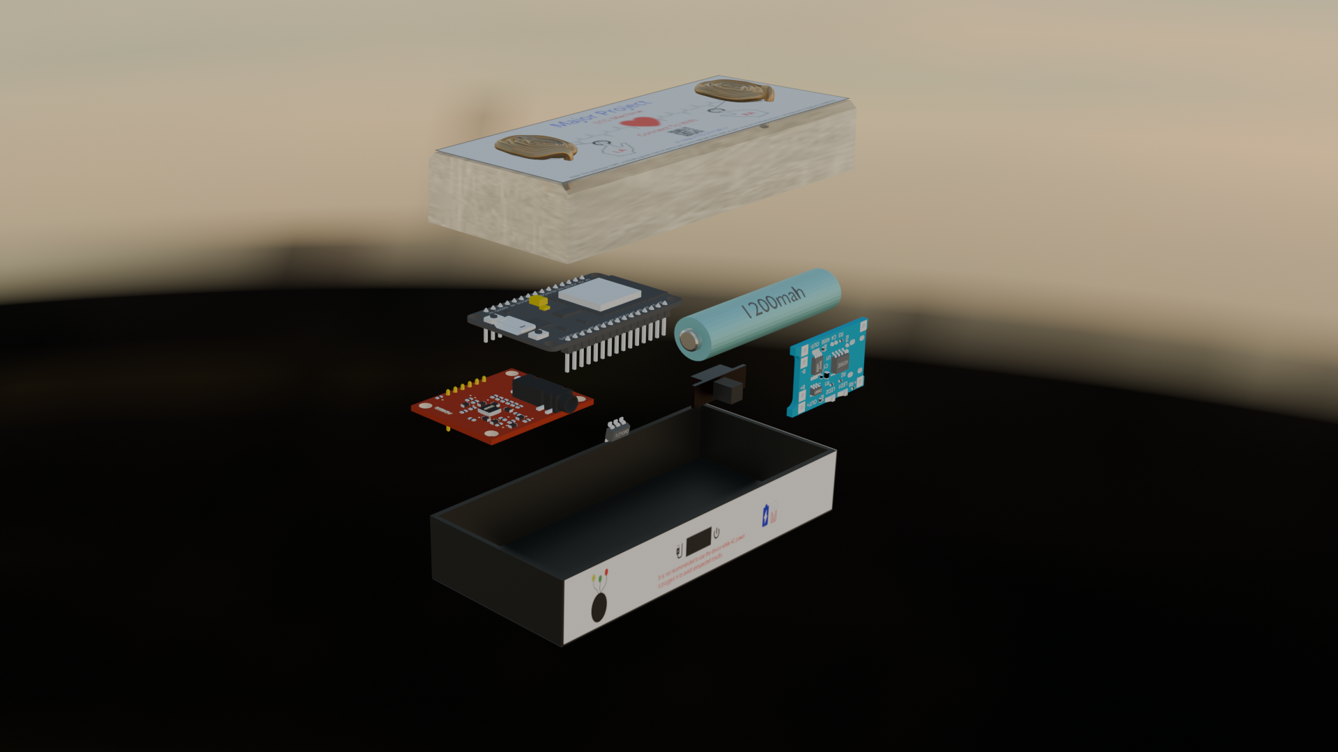
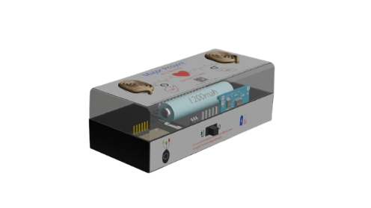
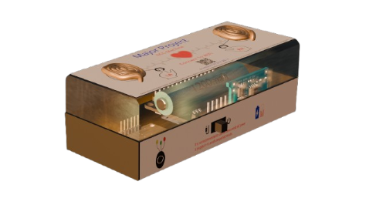
MicroECG : A Single lead Mobile ECG Machine Major Project Presentation
Under the guidance of
Lec (Mr.) Souvik Bag
Group Members
Tanima Ghosh
Goutam Ambali
Sudipta Sen
Ruma Mandi
Raju Adhikary

Slide 2
Understanding the Needs
Lack of ECG access in rural India
High cost of clinical ECG units
Tech barrier: apps, Bluetooth, OS compatibility issues
Need for low cost, office first diagnostic

Slide 3
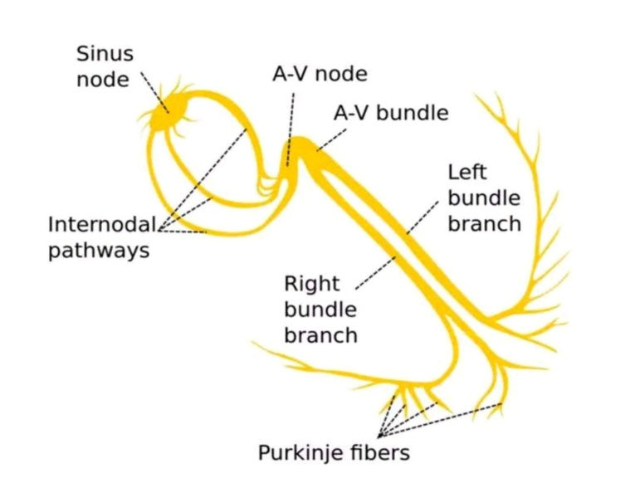
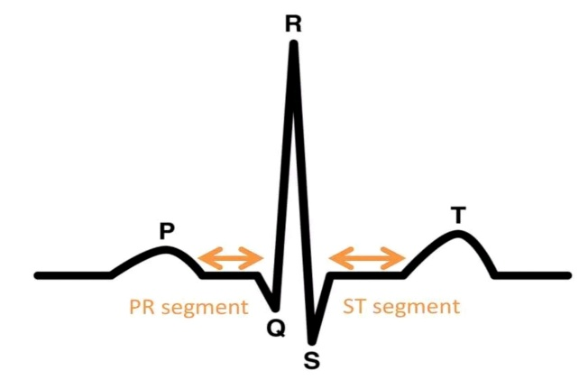
Know your Heart
The Heart’s functions an electrical organ
What is an ECG

Slide 4
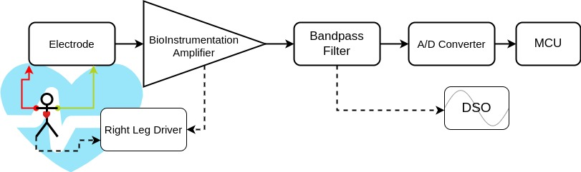
Previous Design
Signal Flow

Slide 5
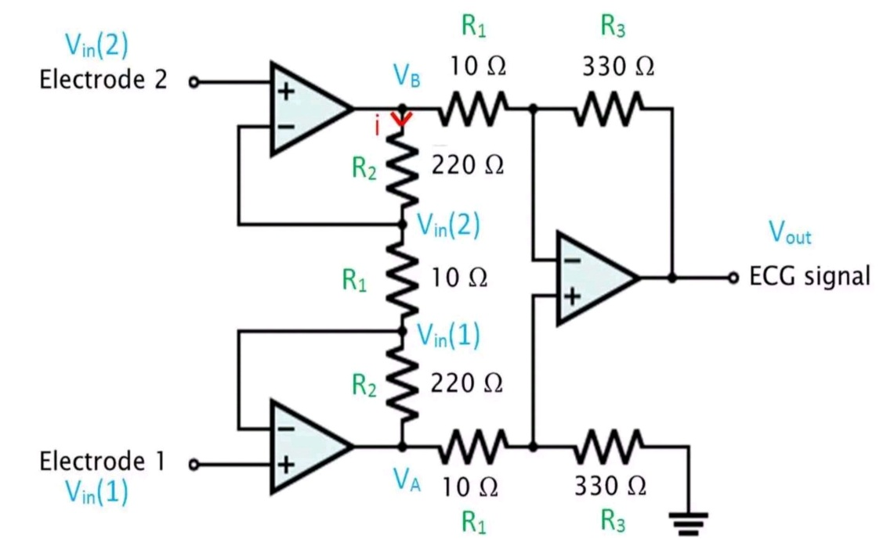
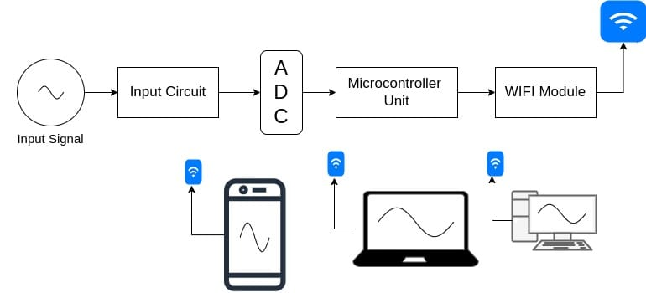
Previous Design
What is this instrumentation amplifier
How our DIY DSO works

Slide 6

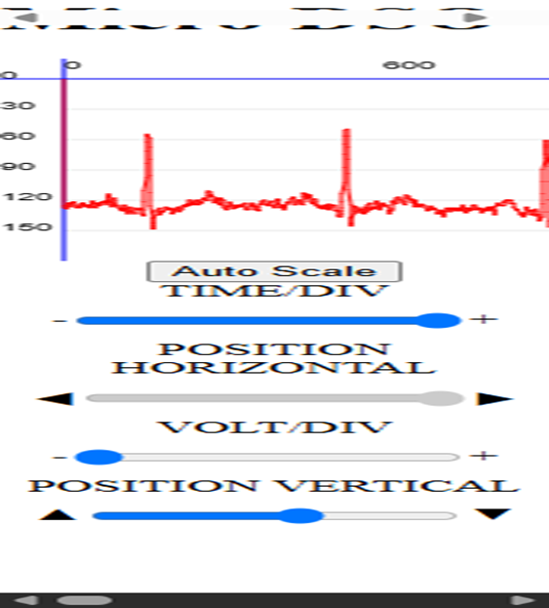
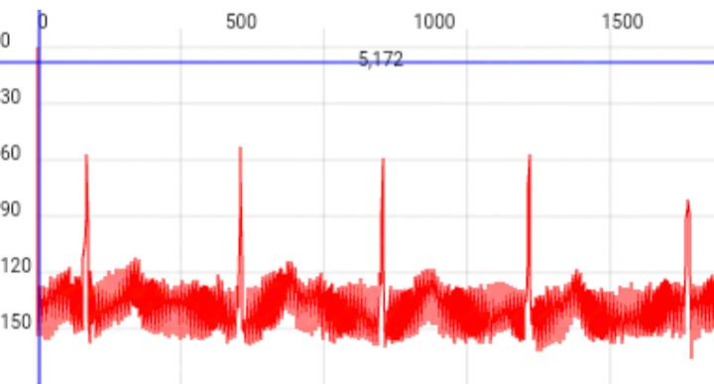
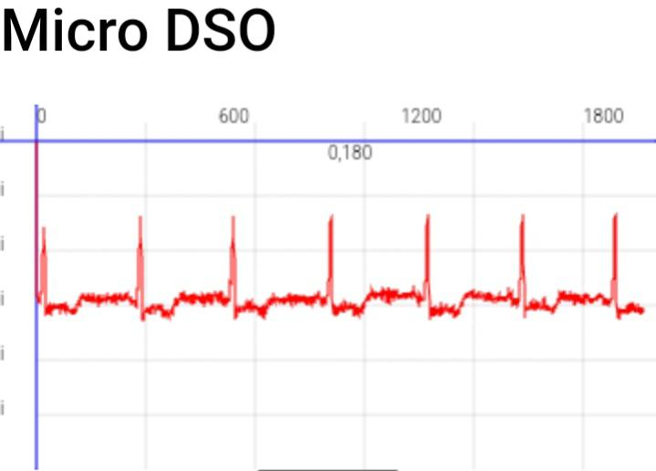
Past Limitations
No recording
Limited controls
Basic UI
Noisy and Buggy
Limited Features

Slide 7

The upgrades We planned
Initial problems addressed
Data logging solution (store data)
Automatic Detection (AI and algorithmic detection)
Enhanced display control (ability to capture, hold, clear the display)
Addressed core challenges (cost, complexity, accessibility)

Slide 8
Hardware Design
Presenter: Gautam Ambali

Slide 9
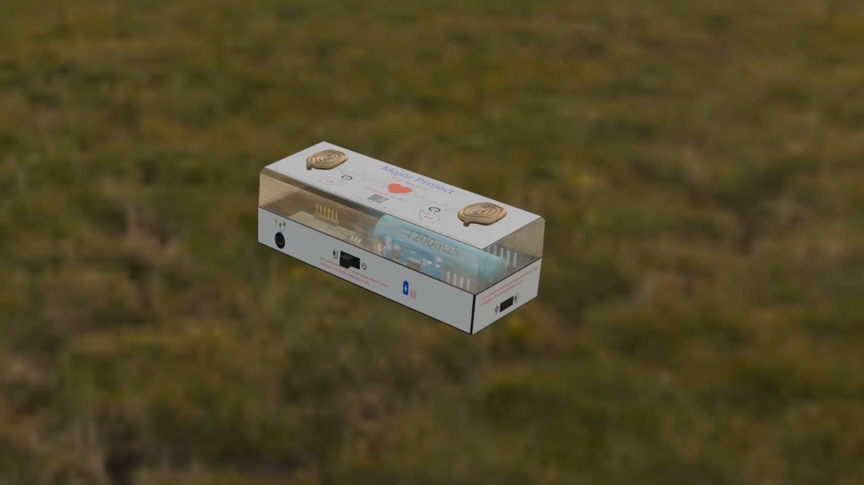
Hardware Components
I/O Interface
Power Section Analog circuitry Compute

Slide 10

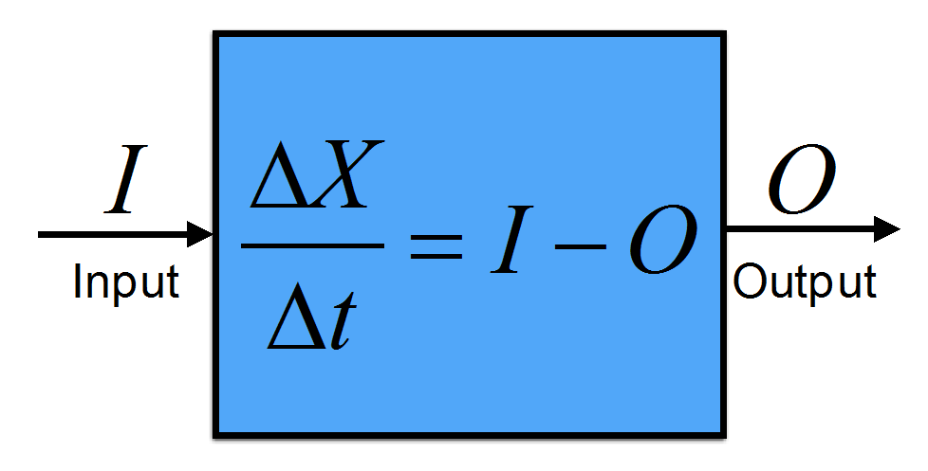
Input/Output Interface
Top: LA/RA finger contact + Heart LED
Front: external electrode chest port + power switch + charge Indicator
Right Side: Micro-USB
Heart LED: blinks with rhythm
This Photo by Unknown Author is licensed under CC BY-NC

Slide 11

Power Section
3.7v 1200mAh fixed battery
RT9080 LDO 3.3V
TP4056 charging (Red/Blue LED)
3-position power switch (CHARGE - OFF - ON)

Slide 12
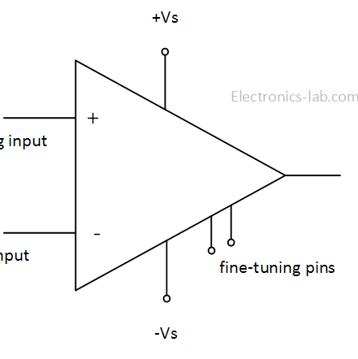
Analog circuitry
AD8232 AFE IC Overview
Internal HP/LP filtering
High-Pass Filter (HPF): ~0.5Hz
Low-Pass Filter (LPF): ~40Hz
External LP (1kΩ + 10µF RC)
Attenuate 50Hz power-line noise
Output swing: ~1Vpp

Slide 13
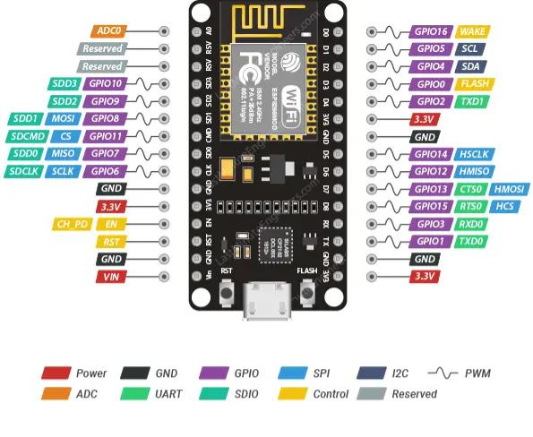
Compute
ESP8266 Overview
32-bit Tensilica Xtensa LX106 80-160MHz MCU
Supports 802.11 b/g/n Wi-Fi
Affordable option
ADC – 1
RAM 160KB - 64KB Instruction - 96KB Data
Flash Extern QSPI - 512KB A 4MB
Connection topology

Slide 14

Firmware Design
Presenter : Sudipta Sen

Slide 15
ESP8266 Firmware Design
Firmware is written using the Arduino core for ESP8266. Major modules include:
WiFi Access Point: Default SSID “Micro_ECG_RANMPGroupF”, no password.
Captive Portal: Uses DNS hijack and local HTTP server.
WebSocket Server: For real-time ADC streaming.
ADC Sampling: Samples analog ECG at 250Hz using a timer interrupt.
Frame Batching: Sends 70-80 samples per WebSocket frame for efficiency.

Slide 16
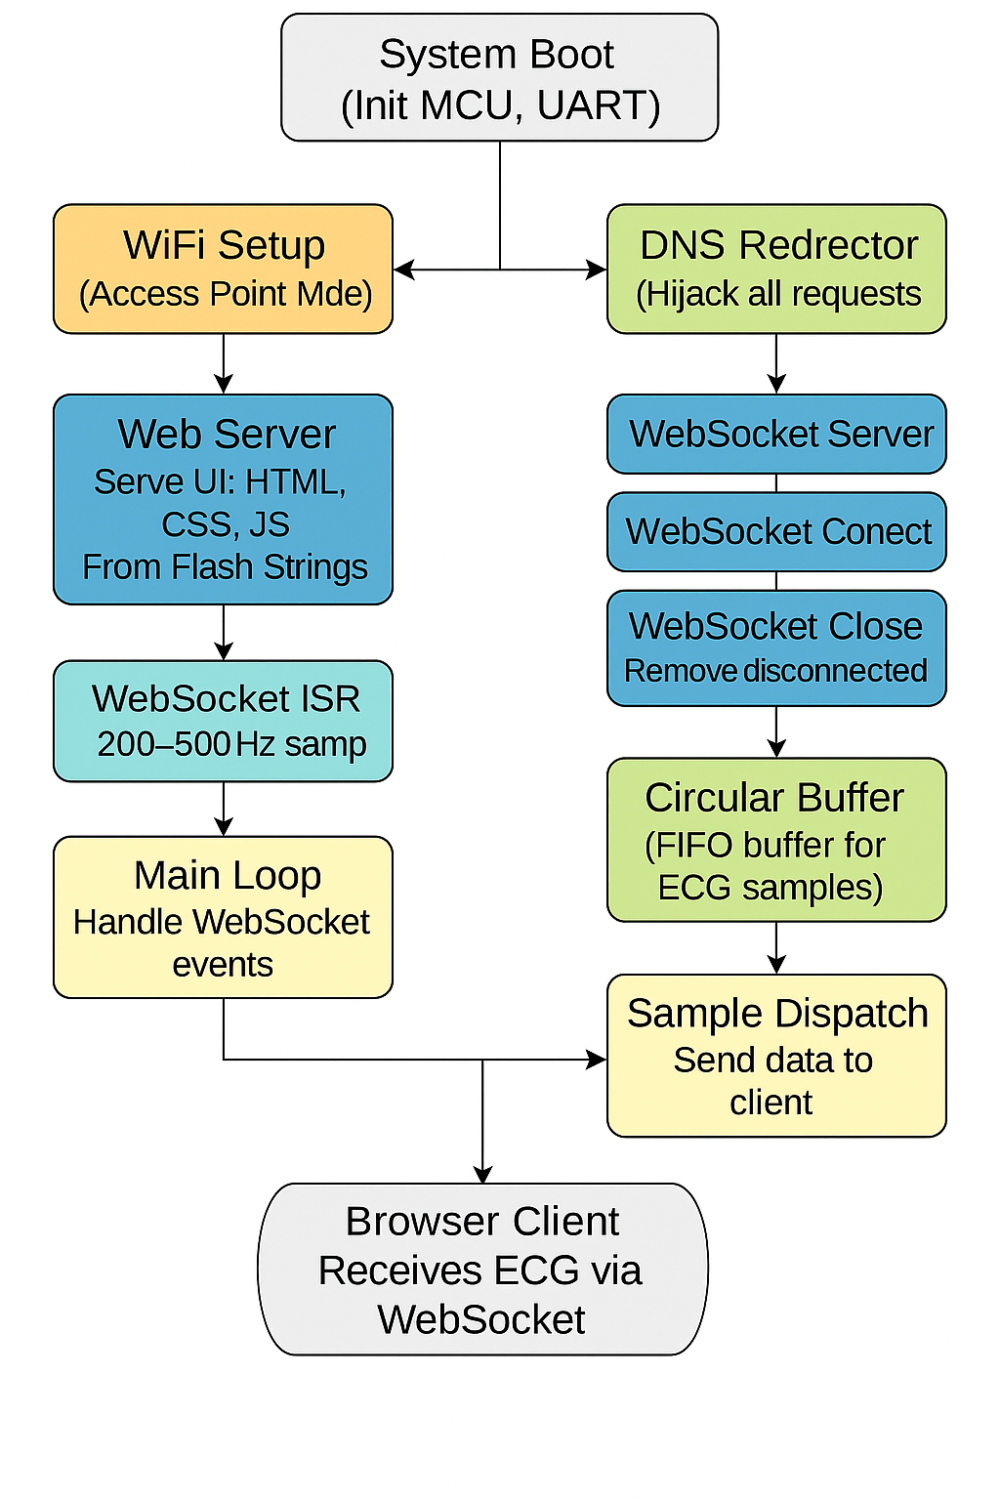
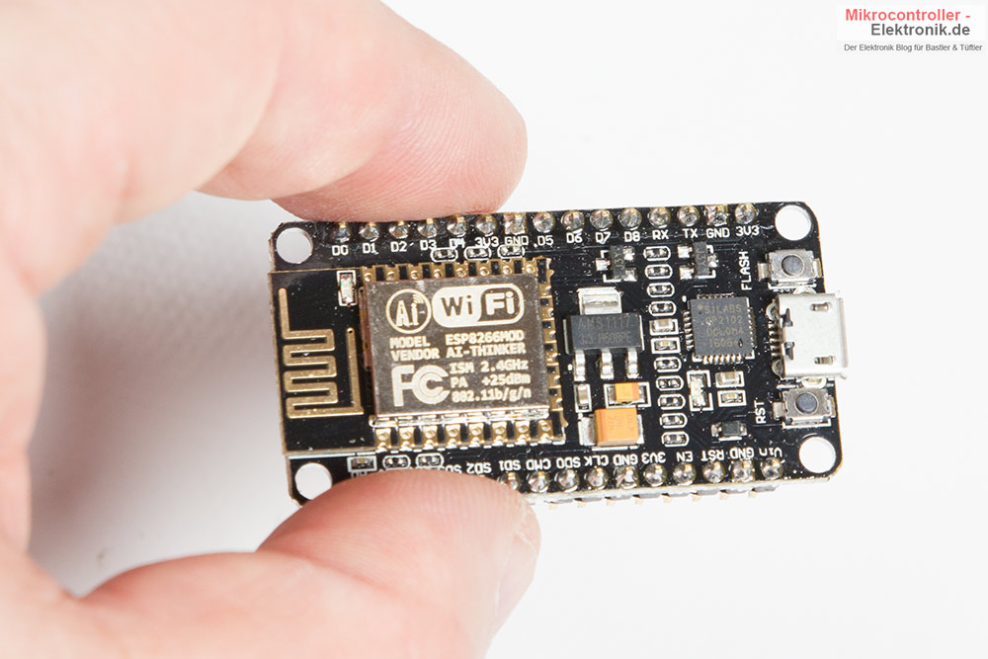
ESP8266 Firmware Architecture
This Photo by Unknown Author is licensed under CC BY-SA-NC

Slide 17
Working principle
System Initialization
DNS Redirection
WebSocket Event Handling
ECG Data Acquisition
OTA and Updates

Slide 18
Frontend and UI
Presenter : Ruma Mandi

Slide 19

Demonstration and Testing
Presenter: Raju Adhikary

Slide 20

User Guide
Turn ON → LED blinks Connect to WiFi Browser opens automatically (or `182.217.28.1`) Touch electrodes / attach chest lead Live ECG on screen

Slide 21

Tips for Best Signal
Use clean, dry fingers Sit still during scan Use chest electrode for cleaner baseline Avoid phone lock while recording

Slide 22
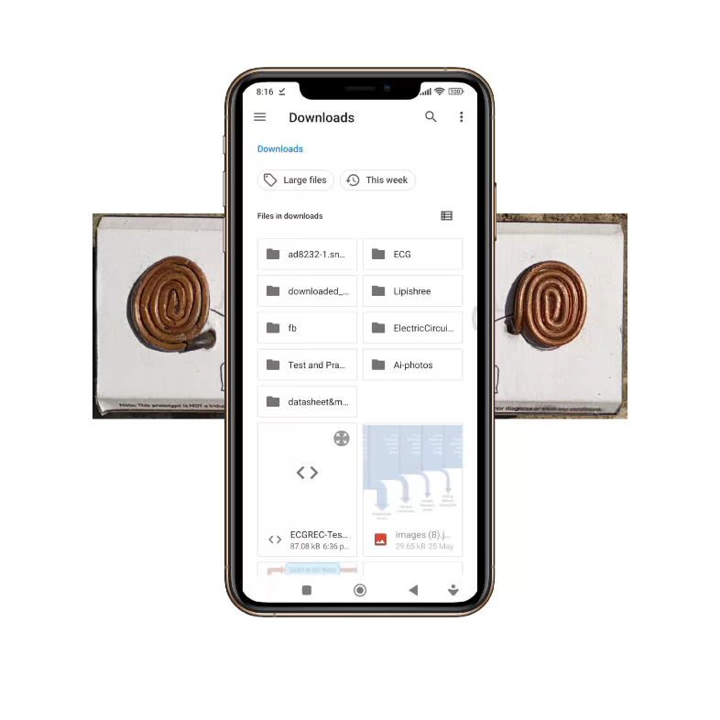

DEMO

Slide 23

Testing Outcomes
15 FPS waveform at 250Hz data Stable QRS/R peaks Cross-platform: Android, iOS, Windows 30+ min continuous use tested
AI Integration working normally
Algorithmic detection works fine but creates confusion on live update
Captive portal and WiFi AP has some base system limitations
Download not works in captive portal
AP doesn’t allow internet from other network

Slide 24

Future Prospects
Multi-lead (ESP32 + mux)
Bluetooth fallback mode
TinyML for offline AI
Remote cloud sync
IP-rated medical enclosure
Clinical validation

Slide 25

Conclusion
Fully offline ECG Machine Clean signal from low-cost hardware Works with any browser Strong foundation for real deployment Designed for healthcare inclusion

Slide 26
Study Outcome
Applied analog design with real bio-signal circuits Gained experience in embedded firmware (ESP + ISR + WiFi) Understood biomedical signal processing techniques Learned full-stack system integration (hardware + software + UI) Developed practical skills in power systems, and real-time data handling Strengthened documentation, and presentation abilities
This Photo by Unknown Author is licensed under CC BY-SA-NC

Slide 27



