Slide 1

SSC GD constable 2024 notification Government Jobs Alert In India
F. No. PPI03/17/2023-PP_1: As per the Recruitment Scheme formulated by the Ministry of Home Affairs (MHA) and as per the Memorandum of Understanding signed between Ministry of Home Affairs and the Staff Selection Commission, the Staff Selection Commission will conduct an open competitive examination for recruitment to the posts of Constable (General Duty) in Border Security Force (BSF), Central Industrial Security Force (CISF), Central Reserve Police Force (CRPF), Indo Tibetan Border Police (ITBP), Sashastra Seema Bal (SSB), Secretariat Security Force (SSF) and Rifleman (General Duty) in Assam Rifles (AR) The recruitment process will consist of Computer Based Examination (CBE), Physical Standard Test (PST), Physical Efficiency Test (PET), Medical Examination and Document Verification.
Application start date 24-11-2023.
Last date 24-11-2023.
Examination date February - March 2024.

Slide 2
GD constable vacancies
Force | Male |  |  |  |  |  | Female |  |  |  |  |  | Total
 | SC | ST | OBC | EWS | UR | TOTAL | SC | ST | OBC | EWS | UR | TOTAL
BSF | 735 | 467 | 1028 | 1025 | 1956 | 5211 | 138 | 83 | 199 | 181 | 362 | 963 | 6174
CISF | 1506 | 974 | 2196 | 1086 | 4151 | 9913 | 164 | 103 | 244 | 125 | 476 | 1112 | 11025
CRPF | 461 | 294 | 688 | 509 | 1314 | 3266 | 2 | 1 | 13 | 10 | 45 | 71 | 3337
SSB | 103 | 45 | 125 | 94 | 226 | 593 | 16 | 1 | 6 | 0 | 19 | 42 | 635
ITBP | 380 | 306 | 523 | 285 | 1200 | 2694 | 74 | 54 | 99 | 38 | 230 | 495 | 3189
AR | 116 | 252 | 156 | 235 | 689 | 1448 | 3 | 0 | 3 | 15 | 21 | 42 | 1490
SSF | 33 | 16 | 60 | 23 | 90 | 222 | 11 | 6 | 20 | 7 | 30 | 74 | 296
Total | 3334 | 2354 | 4476 | 3257 | 9626 | 23347 | 408 | 248 | 584 | 376 | 1183 | 2799 | 26146
Application mode :- Online
Salary :- Pay Level-3 (Rs. 21,700-69,100).
Qualification :- 10th and above
NCC Bonus Marks :- C certificate 5% B certificate 3% A certificate 2%
Test Languages :-
English, Hindi and in 13 Regional Languages
Assamese
Bengali
Gujarati
Kannada
Konkani
Malayalam
Manipuri
Marathi
Odisha
Punjabi
Tamil
Telugu
Urdu.

Slide 3
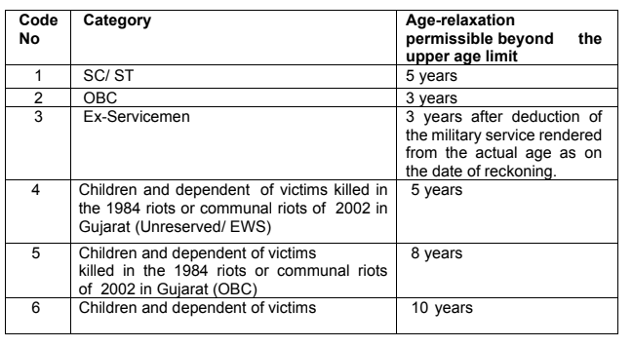
GD constable Age Limits & Age Relaxation
Age :- 18- 23 years
Candidates should not have been born
earlier than 02-01-2001 and later than 01-01-2006 in normal course.
Candidates should not have been born
earlier than 02-01-2001 and later than 01-01-2006 in normal course.

Slide 4
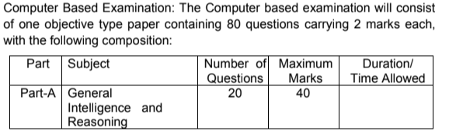
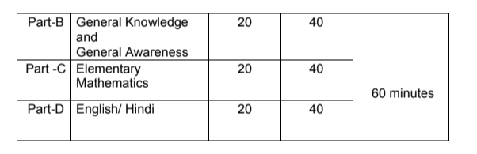
GD constable Exam pattern
GD constable Exam syllabus
The syllabus for the Examination will be as follows:
General Intelligence and Reasoning: Analytical aptitude and ability to observe and distinguish patterns will be tested through
questions principally of non-verbal type. This component may include questions on analogies, similarities and differences,
spatial visualization, spatial orientation, visual memory, discrimination, observation, relationship concepts, arithmetical
reasoning and figural classification, arithmetic number series, non-verbal series, coding and decoding, etc.
General Knowledge and General Awareness:
Questions in this component will be aimed at testing the candidate’s general awareness of the environment around him.
Questions will also be designed to test knowledge of current events and of such matters of every day observations and
experience in their scientific aspect as may be expected of any educated person. The test will also include questions
relating to India and its neighboring countries especially pertaining to sports, History, Culture, Geography,
Economic Scene, General Polity, Indian Constitution, and scientific Research etc. These Questions will
be such that they do not require a special study of any discipline.
Elementary Mathematics:
This paper will include questions on problems relating to Number Systems, Computation of Whole Numbers,
Decimals and Fractions and relationship between Numbers, Fundamental arithmetical operations,
Percentages, Ratio and Proportion, Averages, Interest, Profit and Loss, Discount, Mensuration,
Time and Distance, Ratio and Time, Time and Work, etc.
English/ Hindi: Candidates’ ability to understand basic
English/ Hindi and his basic comprehension would be tested.

