Slide 1

Basic Details of the Team and Problem Statement
Ministry/Organization Name/Student Innovation: AICTE,MIC-Student Innovation
PS Code: SM968
Problem Statement Title: Student Innovation
Team Name: CIVIL UNITED
Team Leader Name: Chotaliya Maulik
Institute Code: 028
Institute Name: L.D. College Of Engineering
Theme Name: Miscellaneous

Slide 2
Idea/Approach Details
Flow Chart :
Plastic Waste
Recycling Process
Decoration
HDPE Plastic Lumber
HDPE Plastic
Wall Panels
Construction of Walls
Furniture
Sunlight
Solar Panel
Energy Supply to the Cafe
First time investment
Break even in 4-5 years
Net profitable
Describe your idea/Solution/Prototype here:
Theme revolving around renewable & sustainable energy concept.
A unique café having business potential, utilizing renewable energy and recycled plastic waste.
Capital oriented market which is a complete profitable business after Break even point is reached.
Incorporation of Solar energy eliminates the excessive dependency on artificial energy generation resources and also promotes the India’s policy for emphasizing on renewable energy resources.
Use of recycled HPDE/LDPE/EPS/PET plastic promotes utilization of generated waste and serves as a solution to conserve environment.
The project converts the defects and ill-effects of plastic into positive role to create an aesthetically pleasant ambience.
Describe your Technology stack here:
Solar Equipments.(i.e. solar ovens, solar cooker, solar stove, solar water heater, Solar coffee machine, solar cookie machine).
Structurally stable and serviceable facility.
HDPE/PET Lumber furniture.
Photovoltaic and other energy storage devices.
Walls made up of renewable waste.
Solar operated Lightings

Slide 3
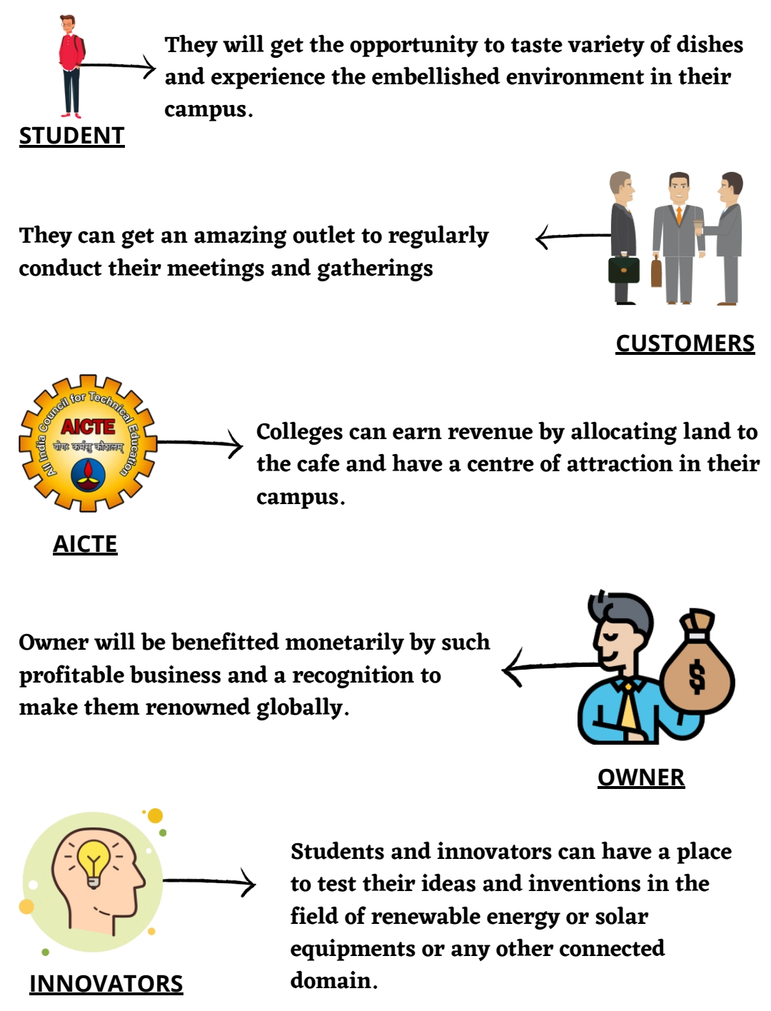
Idea/Approach Details
Describe your Use Cases here
Describe your Dependencies / Show stopper here
The project is depended on the weather conditions as to generate optimum solar energy a sunny day is the most preferable.
As the theme is utilizing renewable waste generated from plastic, dependency on quantity of plastic waste generated increases.
Maintenance of Solar equipments and other devices as well as solar panels will be needed to be catered on regular basis.

Slide 4
Team Member Details
Team Leader Name: Chotaliya Maulik
Branch: B. Tech Stream: Civil Engineering Year: III
Team Member 1 Name: Shaikh Aamirah
Branch: B. Tech Stream : Civil Engineering Year: III
Team Member 2 Name: Pal Aditya
Branch: B. Tech Stream : Civil Engineering Year: IV
Team Member 3 Name: Chariya Rohit
Branch: B. Tech Stream : Civil Engineering Year: III
Team Member 4 Name: Dabhi Sanidhya
Branch: B. Tech Stream : Civil Engineering Year: III
Team Member 5 Name: Odedara Raju
Branch: B. Tech Stream: Civil Engineering Year: III
Team Mentor 1 Name: Prof Chintan D. Patel
Category: Academic Expertise : Design of RCC and Steel Structures,
High Rise Structure. Domain Experience (in years): 13 Year
Team Mentor 2 Name: Prof. Mayur G. Vanza
Category: Academic Expertise :Design of RCC and Steel Structures,
High Rise Structure. Domain Experience (in years): 30 Year

