Slide 1

Senior Design Project
TITLE : Design and Layout of 8-bit Current Steering DAC
NAME | USN
Akash Biradar | 01FE22BEC287
Krishna Sebani | 01FE22BEC302
Raju Barker | 01FE22BEC274
Rohit Mandalollu | 01FE22BEC257

Slide 2
Introduction
Digital-to-analog converters (DACs) are key components in modern mixed-signal and communication systems.
They convert digital data into continuous-time analog signals for applications such as wireless communication, video processing, and instrumentation.
Increasing system speed and scaling of CMOS technology make high-resolution and low-power DAC design challenging.
Current-steering DACs are widely used in high-speed applications due to their fast settling time and good compatibility with CMOS processes.
Different DAC architectures involve trade-offs between speed, linearity, power, and area.
Segmented DAC architectures help balance these trade-offs by improving performance while maintaining efficiency.

Slide 3
Problem Statement
Design and implement an 8-bit segmented current-steering Digital-to-Analog Converter (DAC) using UMC 180 nm CMOS technology to convert digital input codes into accurate and monotonic analog output signals suitable for high-speed mixed-signal applications.

Slide 4
Objectives
Design an 8-bit segmented current-steering DAC with binary-weighted LSBs and thermometer-coded MSBs
Operate the DAC with a 1.8 V supply voltage
Achieve 256 discrete output levels with monotonic behavior
Minimize glitch energy, especially during major code transitions
Improve Differential Non-Linearity (DNL) and Integral Non-Linearity (INL)
Ensure synchronous switching of current sources using clocked registers
Achieve a full-scale output current of approximately 490 µA
Implement layout-aware design techniques to reduce mismatch and parasitics
Verify performance through pre-layout and post-layout simulations, including DRC and LVS

Slide 5
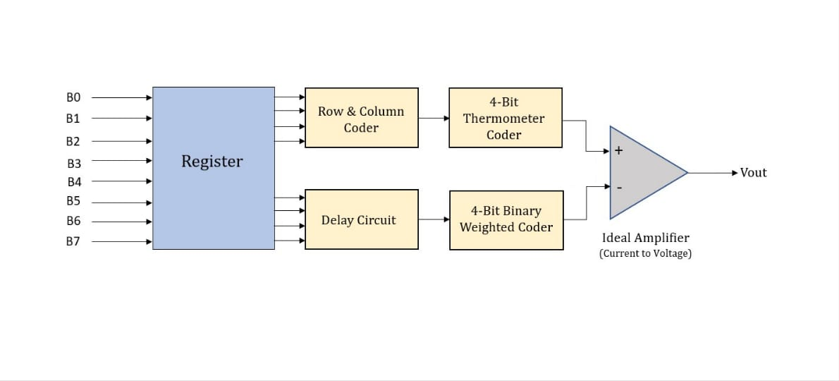
Design Methodology

Slide 6
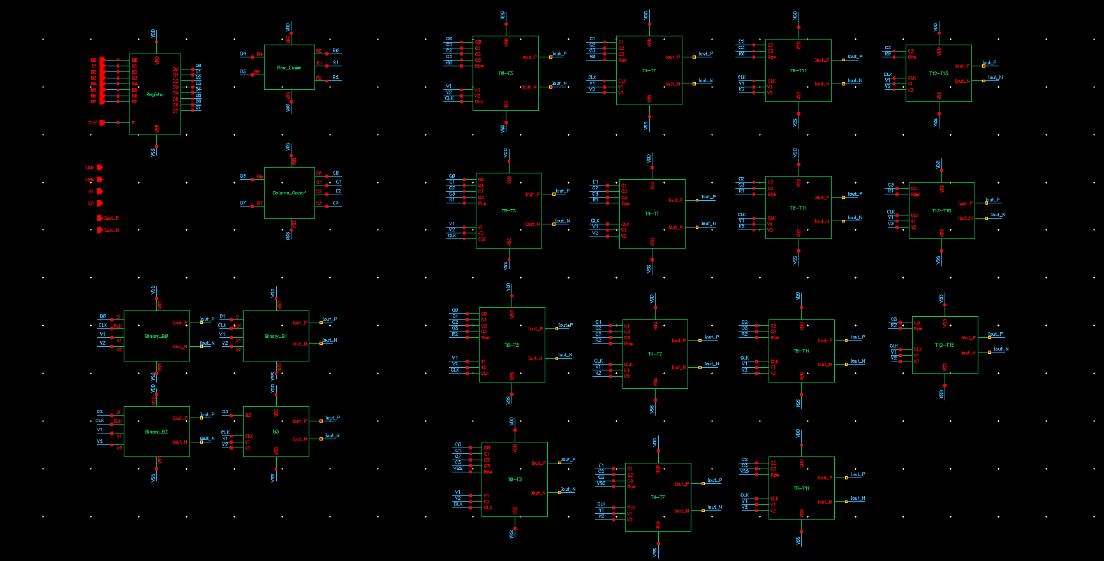
Circuit Schematic

Slide 7
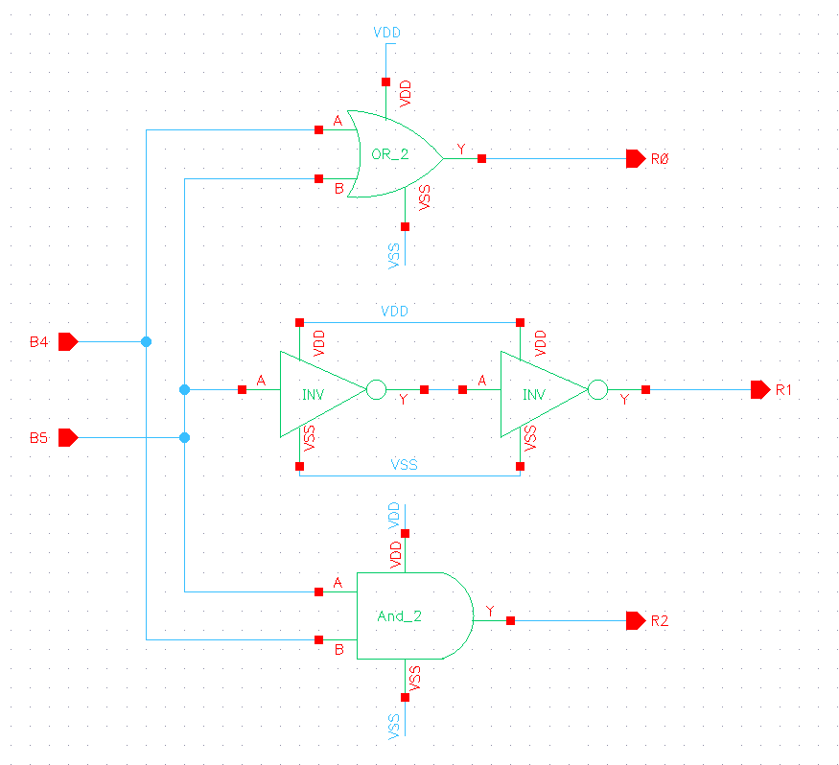
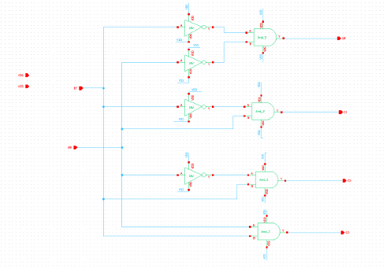
Row and Column Coder

Slide 8
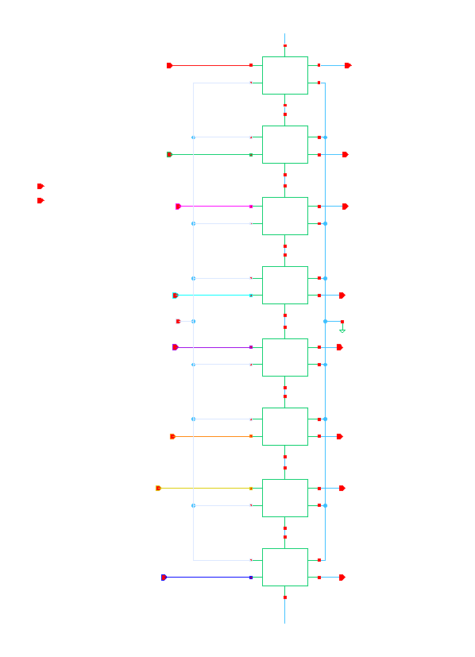
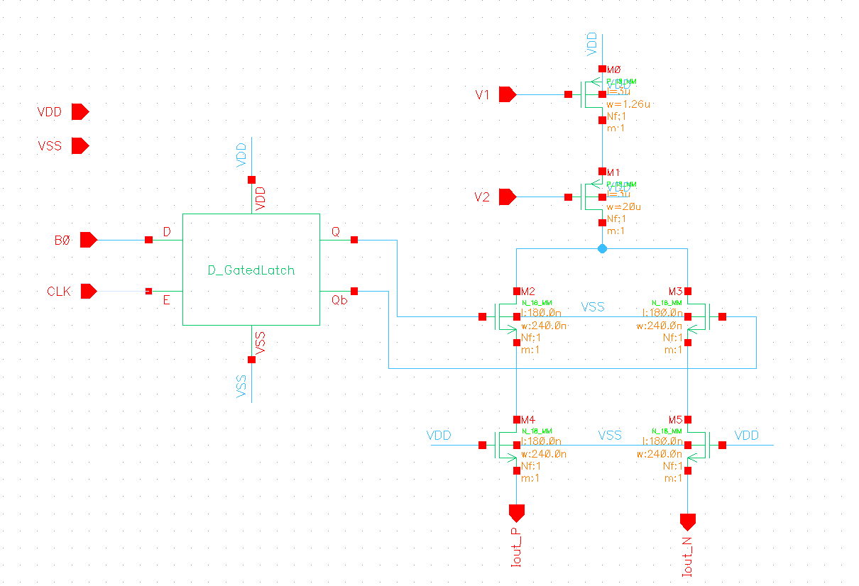
Register and Binary DAC

Slide 9
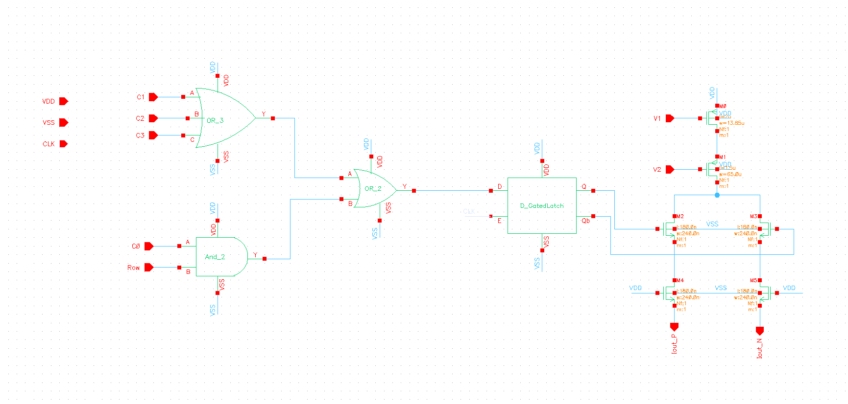
Thermometer DAC

Slide 10
Implementation details
1. Register
Stores the digital input data before conversion
Uses D-latches clocked by a common high-frequency clock
Ensures all DAC control signals switch simultaneously
Reduces timing mismatch and glitch energy
2. Segmented Current-Steering DAC
DAC architecture combining binary and thermometer coding
LSBs use binary-weighted currents for area efficiency
MSBs use thermometer coding for better linearity
Provides a balance between speed, accuracy, and area
3. Row Coder
Part of the thermometer-coded MSB section
Generates horizontal enable signals for current cell rows
Reduces decoder complexity and routing congestion
Helps maintain symmetry and timing matching

Slide 11
Implementation details
4. Column Coder
Works along with the row coder in MSB decoding
Generates vertical enable signals for current cell columns
Activates a unit current cell only when both row and column are enabled
Improves layout regularity and scalability
5. Thermometer Coder
Converts binary MSB input into thermometer code
Ensures only one unit current cell switches per code change
Guarantees monotonic operation
Reduces DNL and glitch energy
6. Binary-Weighted Coder
Used in the LSB section of the DAC
Assigns currents in powers of two (ILSB, 2ILSB, 4ILSB, etc.)
Requires fewer current sources than thermometer coding
Provides fine resolution with low area overhead

Slide 12
Implementation details
Unit Current Cell: Generates a precise reference current and steers it to the output based on digital control.
Current Steering Switch: Directs current to positive or negative output while keeping total current constant.
Differential Outputs (Iout+ / Iout−): Provide better noise immunity and reduce supply and substrate noise effects.
Current-to-Voltage Converter: Converts DAC output current into a proportional voltage for evaluation.
Layout Techniques: Use symmetric routing, common-centroid placement, and guard rings to reduce mismatch and noise.
Power Mesh: Wide metal network ensuring uniform VDD/VSS distribution and low IR drop.
DRC (Design Rule Check): Ensures layout follows fabrication design rules.
LVS (Layout Versus Schematic): Confirms the physical layout matches the schematic design.

Slide 13
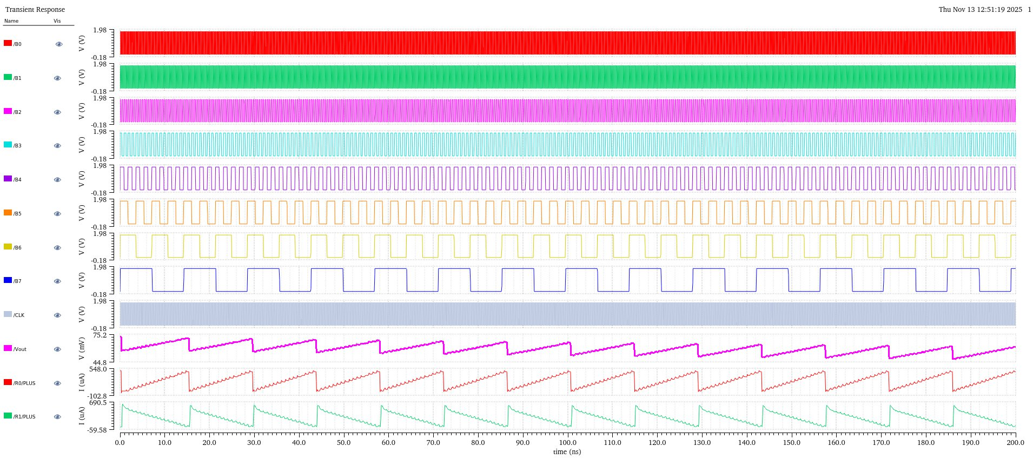
Results

Slide 14
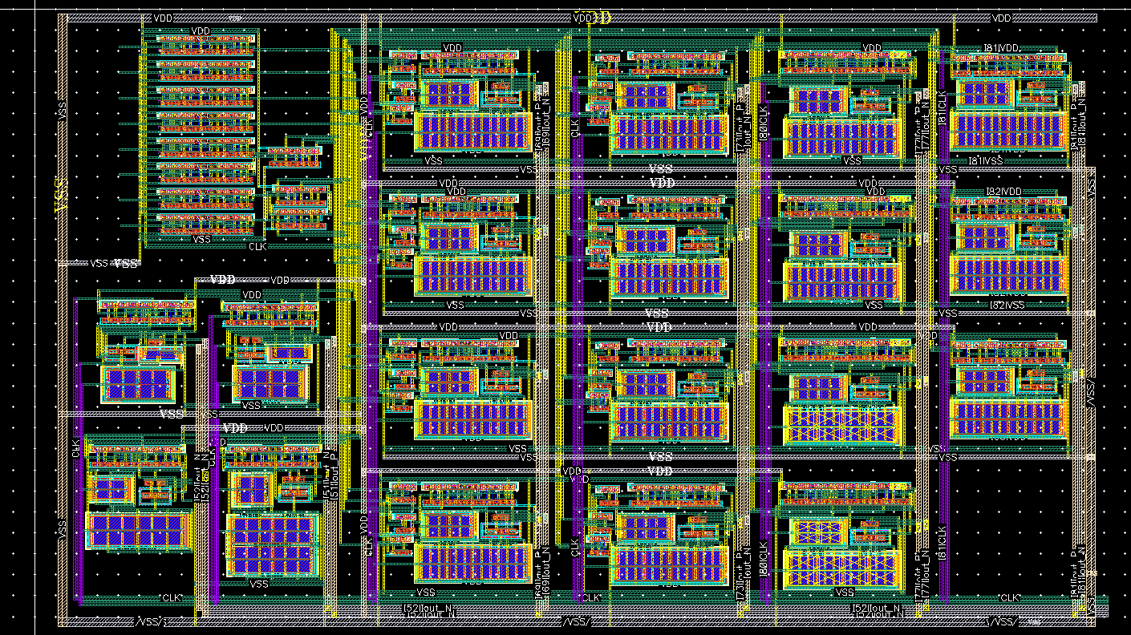
Full Custom Layout

Slide 15
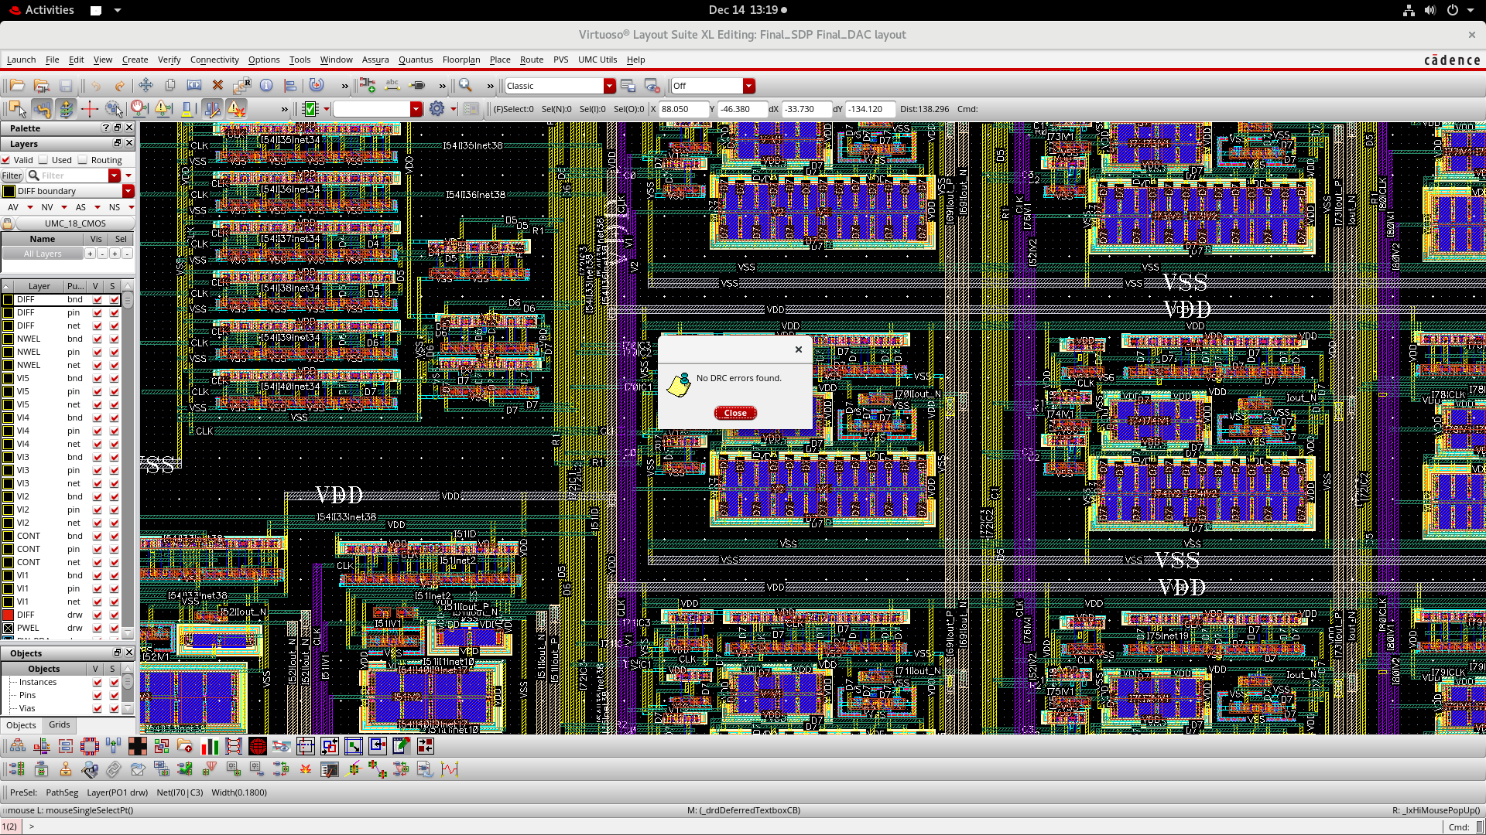
Layout Verification : DRC

Slide 16
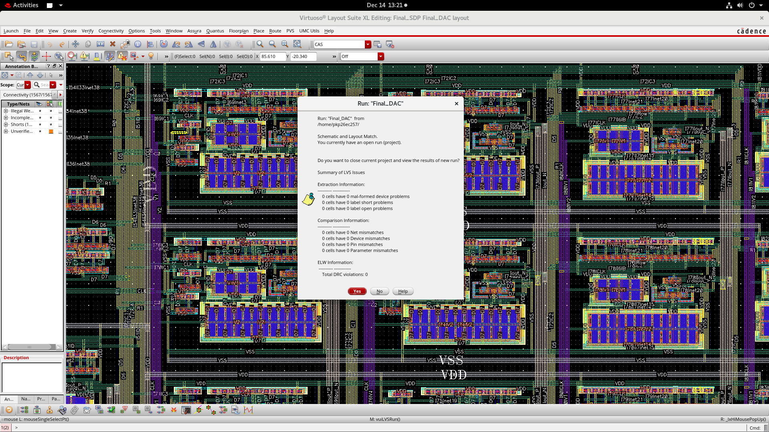
Layout Verification : LVS

Slide 17
Results and conclusions
Successfully designed and implemented an 8-bit segmented current-steering DAC in UMC 180 nm CMOS technology
Achieved 256 monotonic output levels with proper staircase behavior
Glitch energy significantly reduced, especially during major code transitions
DNL maintained within ±1 LSB, ensuring no missing codes
INL remained low, indicating good overall linearity
Differential output currents showed excellent matching and noise immunity
Register-based synchronous switching ensured stable high-speed operation
Post-layout simulations closely matched schematic-level results
DRC and LVS passed, confirming layout correctness and manufacturability

Slide 18
THANK YOU

