Slide 1
Data Science For Business Lecture 1 Gene Leynes September 11, 2014
Intro to Gene
Intro to Data Science
Intro from Class
What and why is Data Science
Topics
Intro to R

Slide 2
About Gene (Me)
Education
University of Chicago MBA
DePaul University Math / Statistics
Experience
Milliman consultant – more than 100 projects over 6 years in a variety of industries, client types, and project sizes
Entrepreneur – Developed fully automated, real time trading systems for hedge funds / broker dealers
Milliman consultant (part 2) – Product development / data mining for large scale multinational projects
Founder of Chicago Data Science
Large scale server performance analysis, sensor analysis, microcontrollers, hedge fund work
Help other start-up companies at 1871
Data Scientist at the City of Chicago (May 2014)
SmartData Platform project; Bloomberg funded
Notes:
Story about Orkin plots

Slide 3
Data science in a nutshell
There are a lot of opinions that are (IMHO) of various quality. The best definitions include:
Using the empirical method to analyze data (empirical method == Question, conjecture, prediction, experiment, analysis).
Results must always be reproducible!
Data science is definitely has these elements
Math
Computer Science
Consulting
Communication / Design
Some other nice ways to describe data science:
Data driven story telling
Turning data into information
Applying the empirical method to business
Data science is not business intelligence, data mining, statistics… Data science also isn't science.
Notes:
What is data
Physical reality. Example of Nile river depth
What is science

Slide 4
What data science is not
Business Intelligence
Data mining
Analytics
Business analysis
Natural sciences
Computer science
Excel

Slide 5
Introductions: You
Background
Expectations
Examples
Short memorable stories?

Slide 6
Applications of data science
I’m sure you know, but data science is / can be should be everywhere:
User interface analysis
Website analysis
Social network analysis (online / offline)
Visualization conception
Science
Baseball
Government
Conservation
You name it… anyone with a lot of data

Slide 7


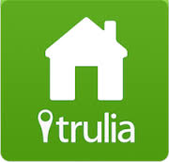




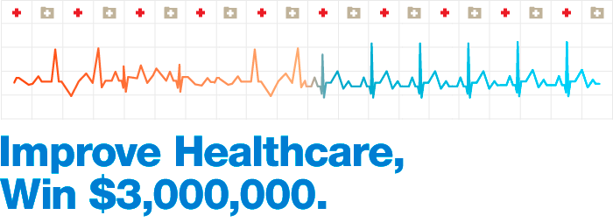
Origins of Data Science
Obviously, some companies come to mind as pioneers: Google, Facebook, Twitter, Netflix, Trulia, Dell
The Gamification of data science expanded the reputation much further: Heritage health prize, Netflix competition, Kaggle

Slide 8
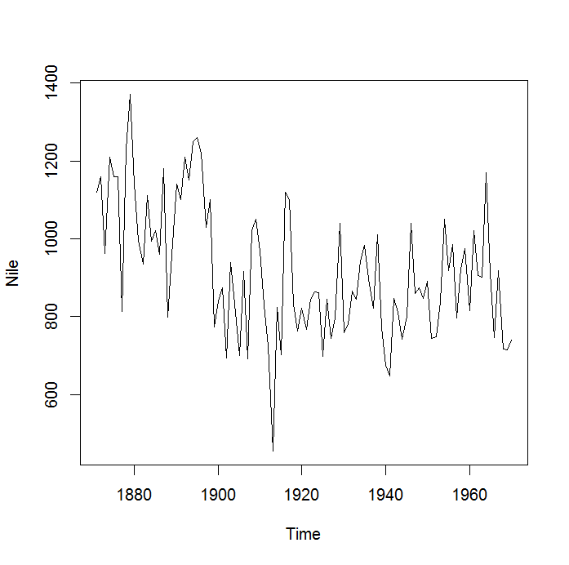

Sources of Data
The nature of “data” has changed
Data storage, data collection, network connectedness
Sensors, links, records of decisions
How would you measure the depth of the Nile river?
http://eoimages.gsfc.nasa.gov/images/imagerecords/54000/54842/Egypt.A2000060.0855.900x1175.jpg

Slide 9
Some Philosophy of Data Science
Everything is details
Data is/are a collection of details
It’s good to focus on how data could possibly connect to the solution
Successful project depend on leadership that cares about details
You always bear the burden to craft effective communication
The best (and most interesting) data science is multidisciplinary

Slide 10
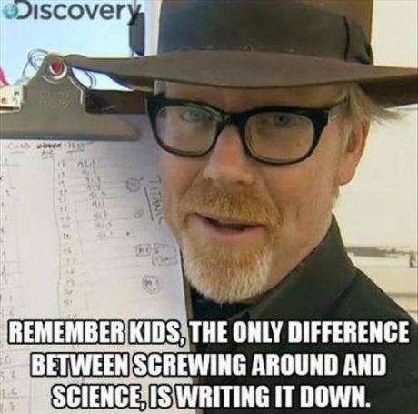
Reproducibility
Work only counts if it’s communicated
Work only counts if it’s reproducible

Slide 11
Keys to Success
Be really good at stealing borrowing / adopting ideas from other people, disciplines, languages
Be really good at finding help
Stack overflow is your BFF (and the stack exchange cousins)
Be really good at balancing confidence and humility
Make sure that everything is reproducible and systematic

Slide 12
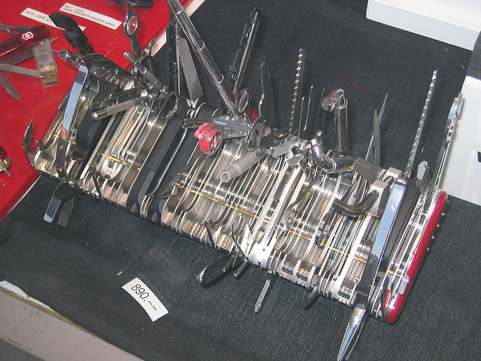

Ways to do data science
Some people embrace using many tools, I prefer to be good at a few

Slide 13
Key Data Science Tools
Excel
Linux
Command line tools: ssh, grep, sed, awk, ls, pipe, less
R / R Studio
One program, many packages: ggplot2, data.table, caret, e107, knitr, shiny
Python
scikit learn, numpy, scipy, pandas, others
Git
Use the command line!
Text Editor
Look into Sublime if you think Notepad is a text editor
Adobe Products
Illustrator / Photoshop
Notes:
Why learn a programming language? Three reasons: scratch your own itch, credibility, and verification

Slide 14
Excel
It’s best to “Outgrow Excel”
Excel is exceptionally powerful
Pivot tables
Links
Dimensional analysis
Ease of formatting
Portability
Excel is fundamentally limited
Impossible to reproduce
Memory constrained
Closed source
Unsophisticated
No analytics community
Still, it’s often the best way to
Get something actually done
Get anything done quickly
Share results quickly (but should you ever do this?)

Slide 15
Linux
Yes, we’re still using an operating system from the 70’s
Many installations easier
Better for server management
Many tools are only available in Linux
Want to use Hadoop, AWS, and all that other stuff? I’m guessing it will start from a Linux command line
Trick (ssh pun omitted): Git bash makes many Linux tools available in Windows. You don’t need Putty

Slide 16
R / R Studio
R
Has a great ecosystem
Developed by statisticians
Becoming ubiquitous
Consistent though time, across platforms
Relatively easy compared to other options
Free
Not a “real” programming language
No object orientation
Not super fast (or easily made super fast)
Other issues
Learning curve
R Studio has made R a much better tool
Syntax highlighting
Knitr and Shiny
Support
Repository
Package / project / application management

Slide 17
Bad Tools
Some general rules for spotting bad tools:
Anything with a marketing budget
Anything closed source
Anything without a StackOverflow category

Slide 18
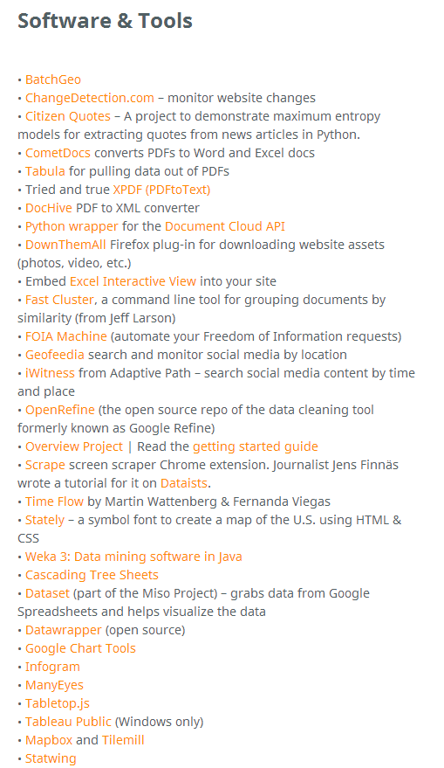
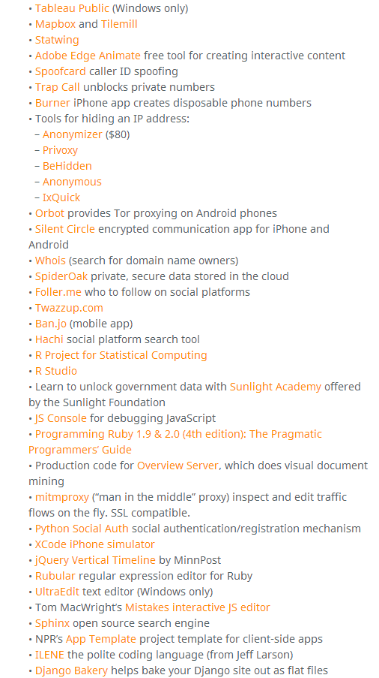
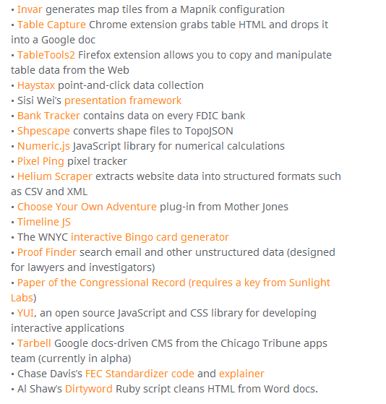
Never ending tools…
The number of tools is constantly exploding. Be an early adopter at your own risk
http://www.chryswu.com/blog/2013/02/27/tools-slides-links-tutorials-nicar13/

Slide 19
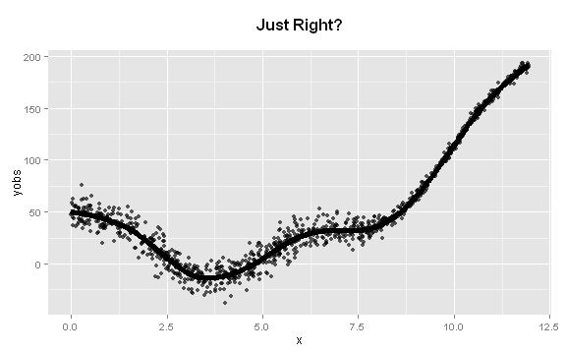
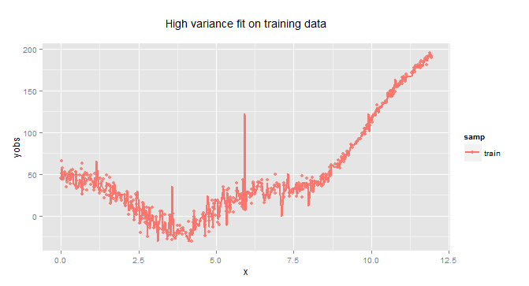
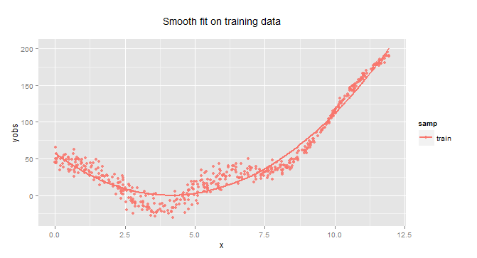
Machine Learning
General main categories
Supervised
Unsupervised
Reinforcement learning?
Main goal: avoid overfitting flexible models

Slide 20
Categories of analysis (also see list starting on page 20 of Data Science for Business)
Regression
Classification
Binary
multiple
Time series
Signal processing
Bayesian
MCMC / MCMV
Network analysis
NLP / Text
Spatial
Rules Learning
Causal analysis
Dimension Reduction
Optimization
annealing
hill climbing
evolutionary

Slide 21
Visualization
What is an effective visualization?
Infographic vs Plot
Network diagrams
Hairball vs Circos vs Hive
Whiteboard, drawing, “line in the sand”

Slide 22
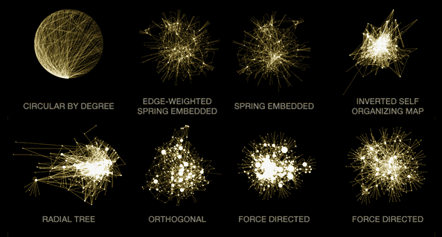
Network Diagrams
Network analysis depends heavily on visualization
Three approaches for visualizing networks
Hairball
Circos
Hive
The “hairball” method is common, has issues:
Image source: http://www.hiveplot.net/

Slide 23
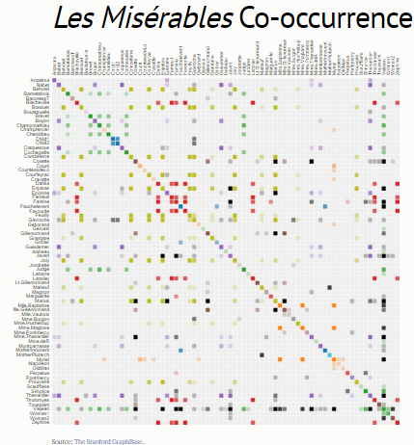
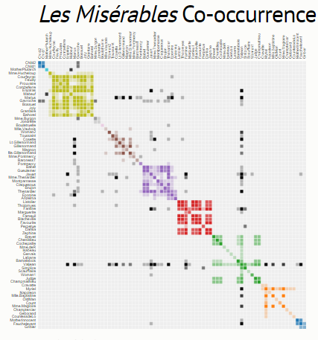
Matrix Network Diagrams
Mike Bostock http://bost.ocks.org/mike/miserables/

Slide 24
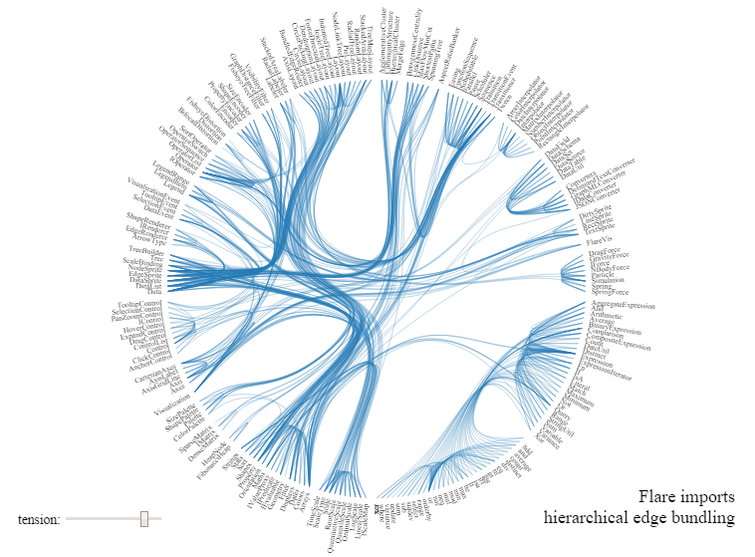
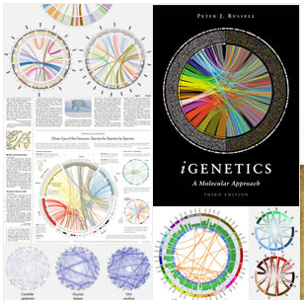
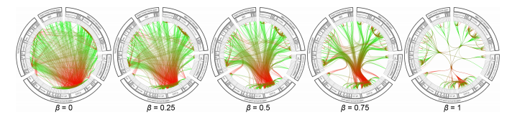
Circos / Hierarchical Edge Bundling
http://mbostock.github.io/d3/talk/20111116/bundle.html
Hierarchical Edge Bundles: Visualization of Adjacency Relations in Hierarchical Data. Danny Holten http://www.win.tue.nl/~dholten/papers/bundles_infovis.pdf
Circos website: http://circos.ca/

Slide 25
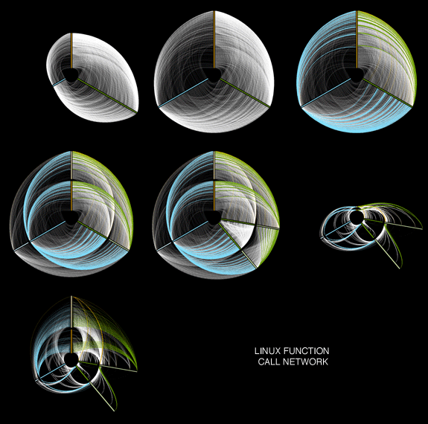
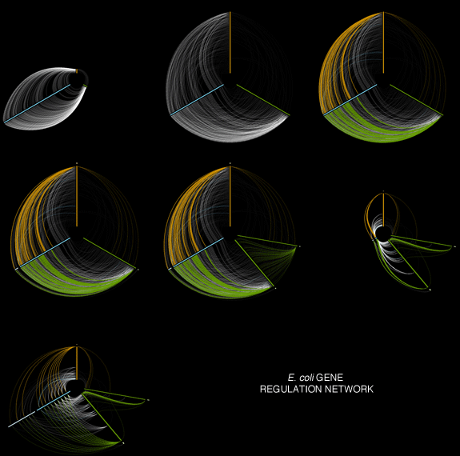
Hive Plots
“These 3D plots were inspired by the ideas of VSEPR theory in chemistry: the axes of these 3D plots are arranged withthe hiver package 3 tetrahedral, trigonal bipyramidal or octahedral geometries for 4-6 axes respectively”
http://cran.r-project.org/web/packages/HiveR/vignettes/HiveR.pdf
http://www.hiveplot.net/ Krzywinski M, Birol I, Jones S, Marra M (2011). Hive Plots — Rational Approach to Visualizing Networks. Briefings in Bioinformatics (early access 9 December 2011, doi: 10.1093/bib/bbr069

Slide 26
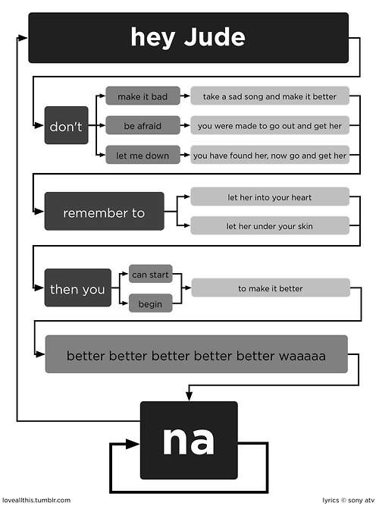
Graph analysis?
Found on one of the best visualization sites of all time:
http://flowingdata.com/

Slide 27
Some good reading
http://flowingdata.com/
http://shiny.rstudio.com/gallery/
http://www.r-bloggers.com/

