Slide 1
Data Science For Business Lecture 2 Gene Leynes January 15, 2014
Intro to Gene
The data science workflow
- Why R
- How to learn R (lots of handouts)
- Doing data science, the real details that nobody tells you
- Text editing
- IDE (R Studio)
- File comparison
- Style guides
- Version control
- Analysis in R

Slide 2
About Gene (Me)
Education
University of Chicago MBA
DePaul University Math / Statistics
Experience
Milliman consultant – more than 100 projects over 6 years in a variety of industries, client types, and project sizes
Entrepreneur – Developed fully automated, real time trading systems for hedge funds / broker dealers
Milliman consultant (part 2) – Product development / data mining for large scale multinational projects
Founder of Chicago Data Science
Large scale server performance analysis, sensor analysis, microcontrollers, hedge fund work
Help other start-up companies at 1871
Data Scientist at the City of Chicago (May 2014)
SmartData Platform project; Bloomberg funded
Notes:
Story about Orkin plots

Slide 3
Today's class
Doing data science
The data science workflow
Why R
How to learn R (lots of handouts)
Doing data science, the real details that nobody tells you
Details of doing data science
Text editing
IDE (R Studio)
File comparison
Style guides
Version control
Analysis in R

Slide 4
Raw Data: collection, storage, retrieval
Reporting: Graphics, reports
Data Processing: merging data, arithmetic calculations, feature generation
Modeling: analysis, machine learning, hypothesis testing
Production: applying analysis, creating systems, testing
R
Javascript
Python
Python
Python
Matlab
“Big Data” Software (e.g. Hadoop)
“Big Data” Software (e.g. Hadoop)
Object Oriented (e.g. Java)
Object Oriented (e.g. Java)
Object Oriented (e.g. Java)

Slide 5
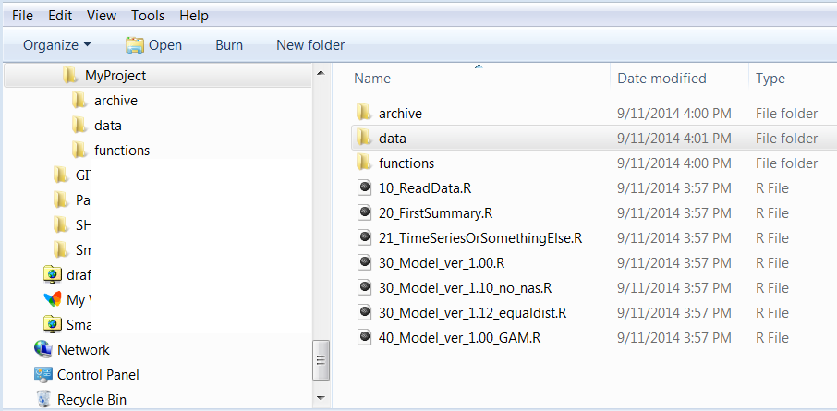
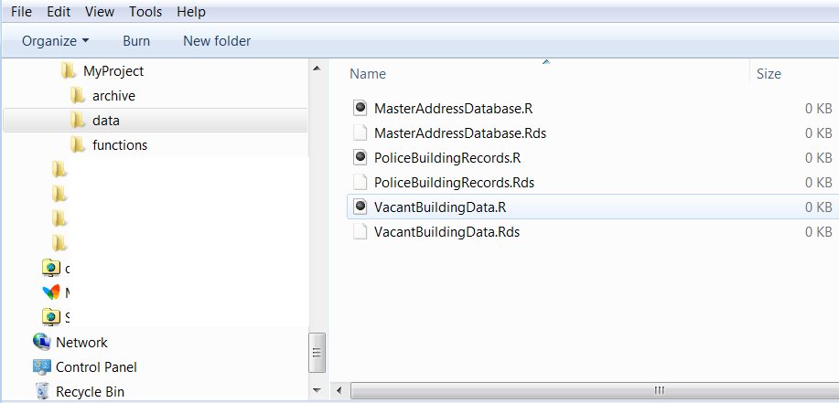
Typical folder structures based on work flow
My system…
Not a gold standard, but it works
Numbers indicate steps in the research process
10s Import data
20s Prepare data
30s Model
40s Prediction step

Slide 6
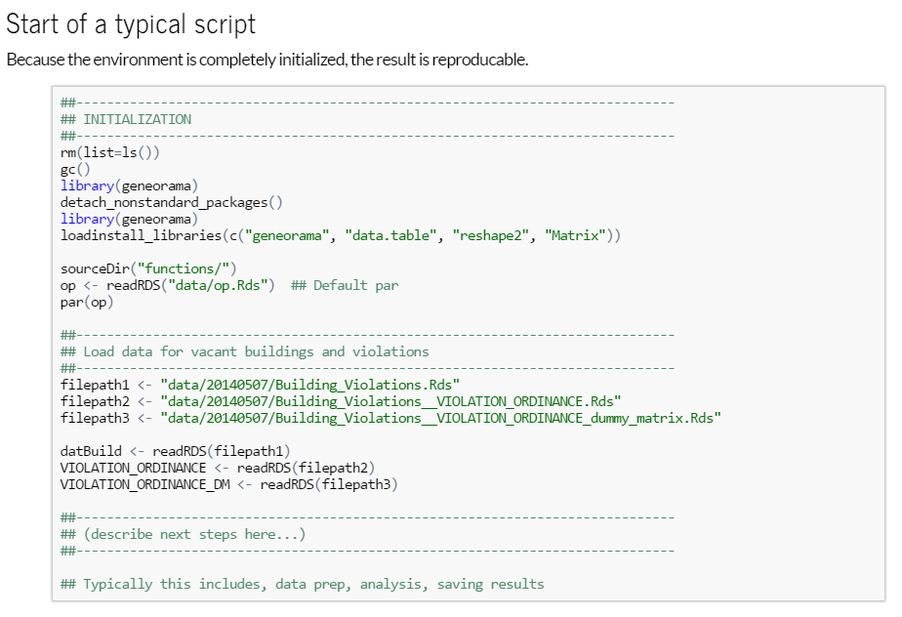

Slide 7
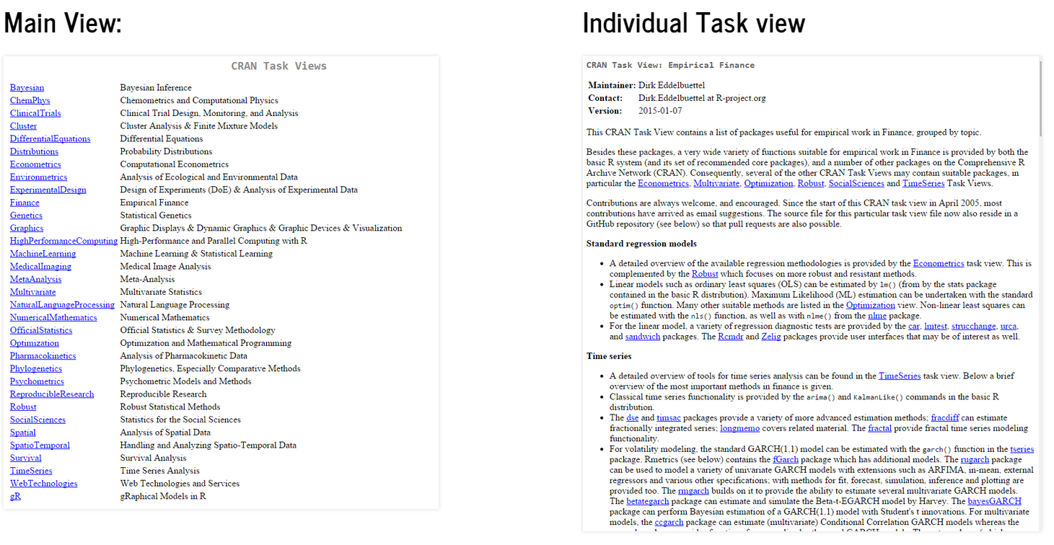
R’s Network CRAN Task Views http://cran.r-project.org/web/views

Slide 8
How to learn R
“There are many like it, but this one is mine.” - from the Rifleman's Creed, Major General William H. Rupertus
There are many great guides, blog posts, and ways to learn R. Some of the best are brand new, but not all of the information is created equally.
CRAN is always the maintainer of the R application and the default source of information: http://cran.r-project.org/
R Studio is the best choice for code editing and project management
http://www.rstudio.com/
R Studio also has lots of related “learning R” resources
CRAN Specific resources:
The R FAQs are invaluable: http://cran.r-project.org/faqs.html
The standard documentation is also invaluable: http://cran.r-project.org/manuals.html
You can access help right from R with “?”. For example, you can learn about the lm funciton by typing ?lm at the console.
CRAN resources and help can be very hard to understand, this is normal. Remember to use many approaches to solve problems.
Download and print this cheat sheet: http://cran.r-project.org/doc/contrib/Short-refcard.pdf
See also http://cran.r-project.org/doc/contrib/Baggott-refcard-v2.pdf (this one is new to me)

Slide 9
Best Guides and References
My favorite R resources for quick help:
http://www.cookbook-r.com/
http://www.r-statistics.com/
If you have experienced a singularity and have near infinite time to think:
http://www.r-bloggers.com/
http://cran.r-project.org/doc/contrib/
http://cran.r-project.org/doc/contrib/usingR.pdf
http://cran.r-project.org/web/views/

Slide 10
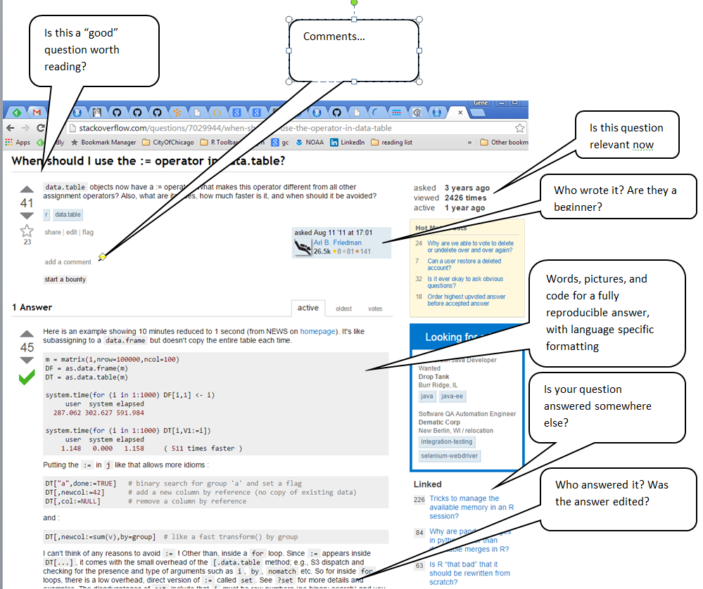
Getting help: Stackoverflow.com

Slide 11
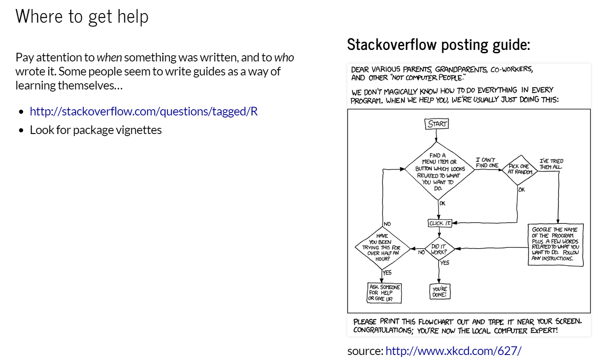

Slide 12
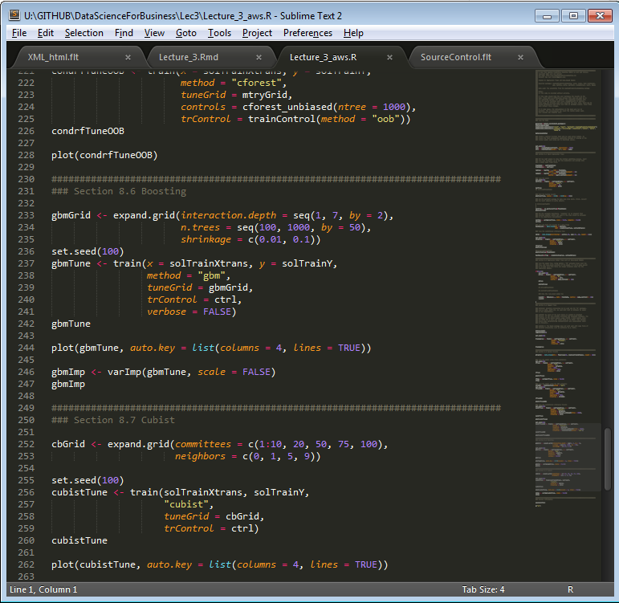
Text Editor
There are different ways to use R, but you're going to want a good text editor to look at code, settings, and anything that's not compiled.

Slide 13
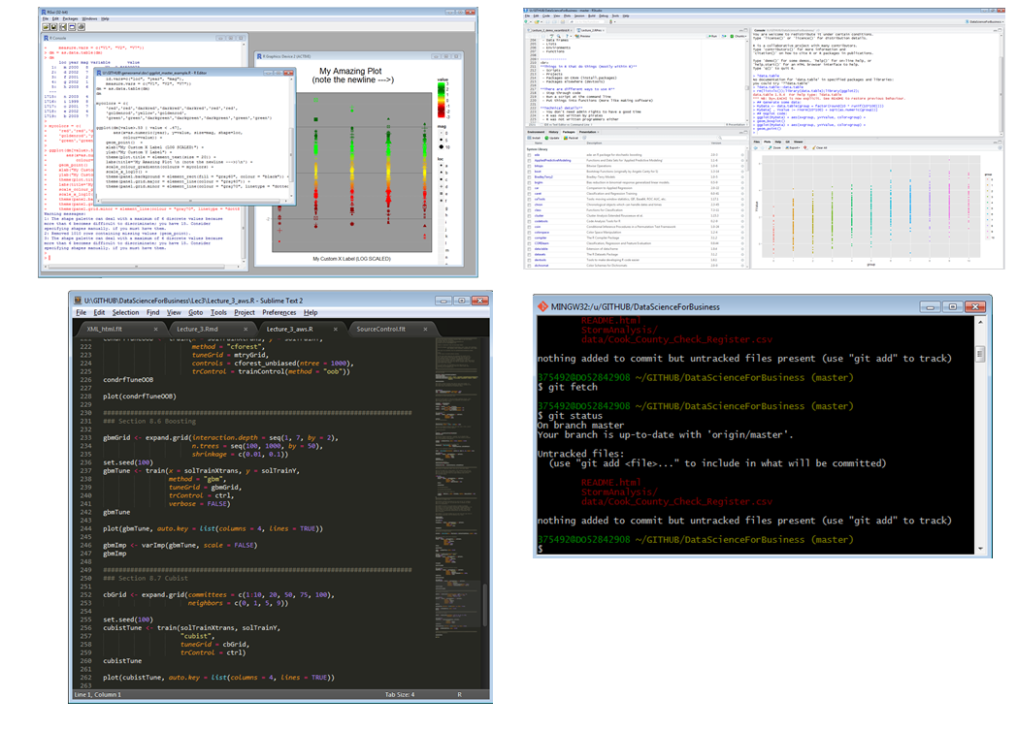
Different ways to use R

Slide 14
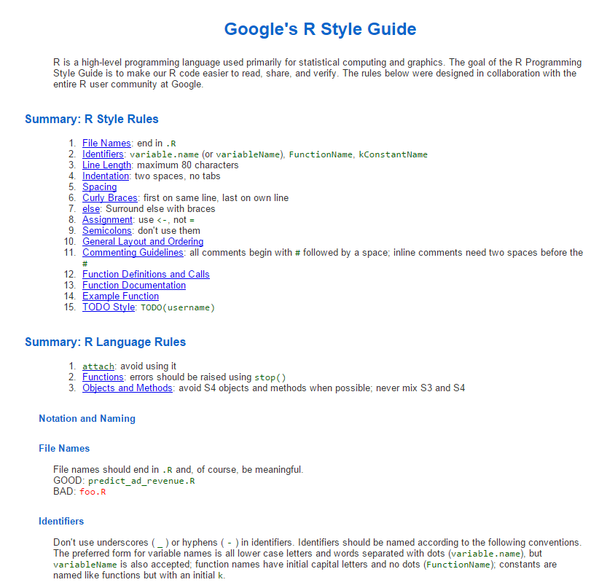
Style Guides

Slide 15
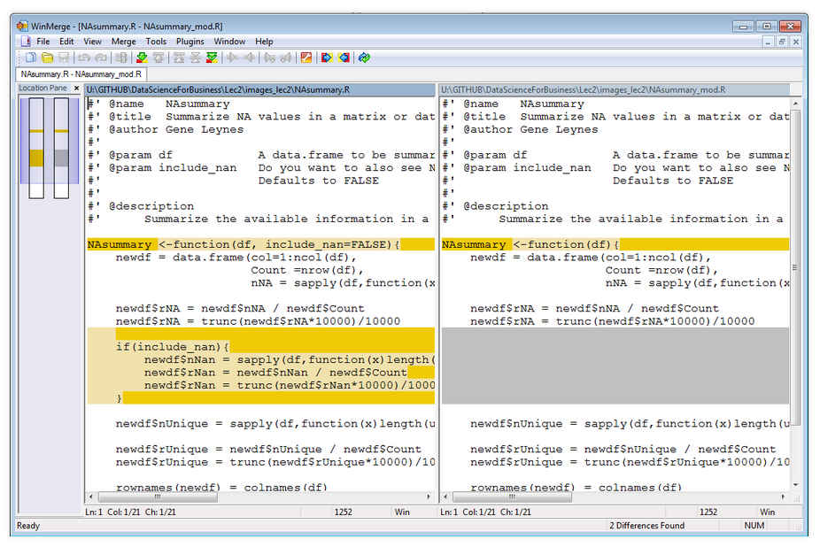
File comparison It's important to have a good way to compare and merge files. My preferred solution is Winmerge, but you can find many other programs online

Slide 16
Github.com
Github is by far the best way to use git, but you should still download git
Download git: http://git-scm.com/
Github supports:
- Branch comparison
- Issues
- Workflow assignments
- Team managment
- Commenting
- Communication
- Markdown

Slide 17
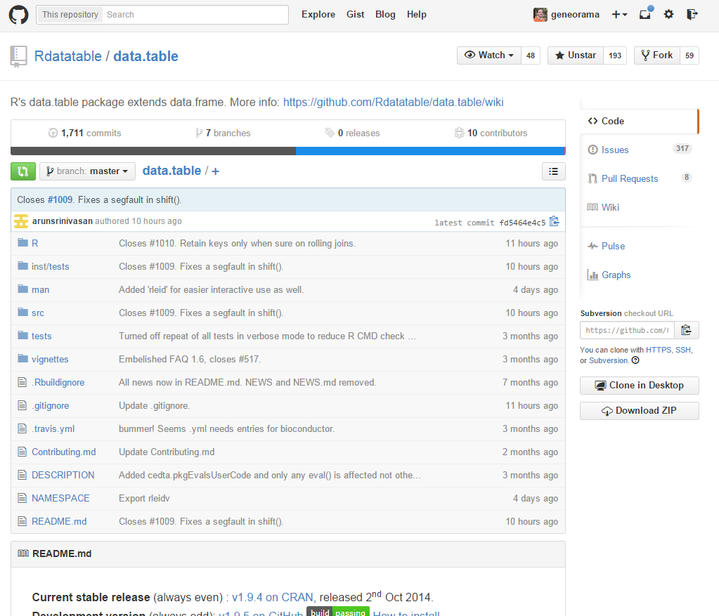
Anatomy of a github page

Slide 18
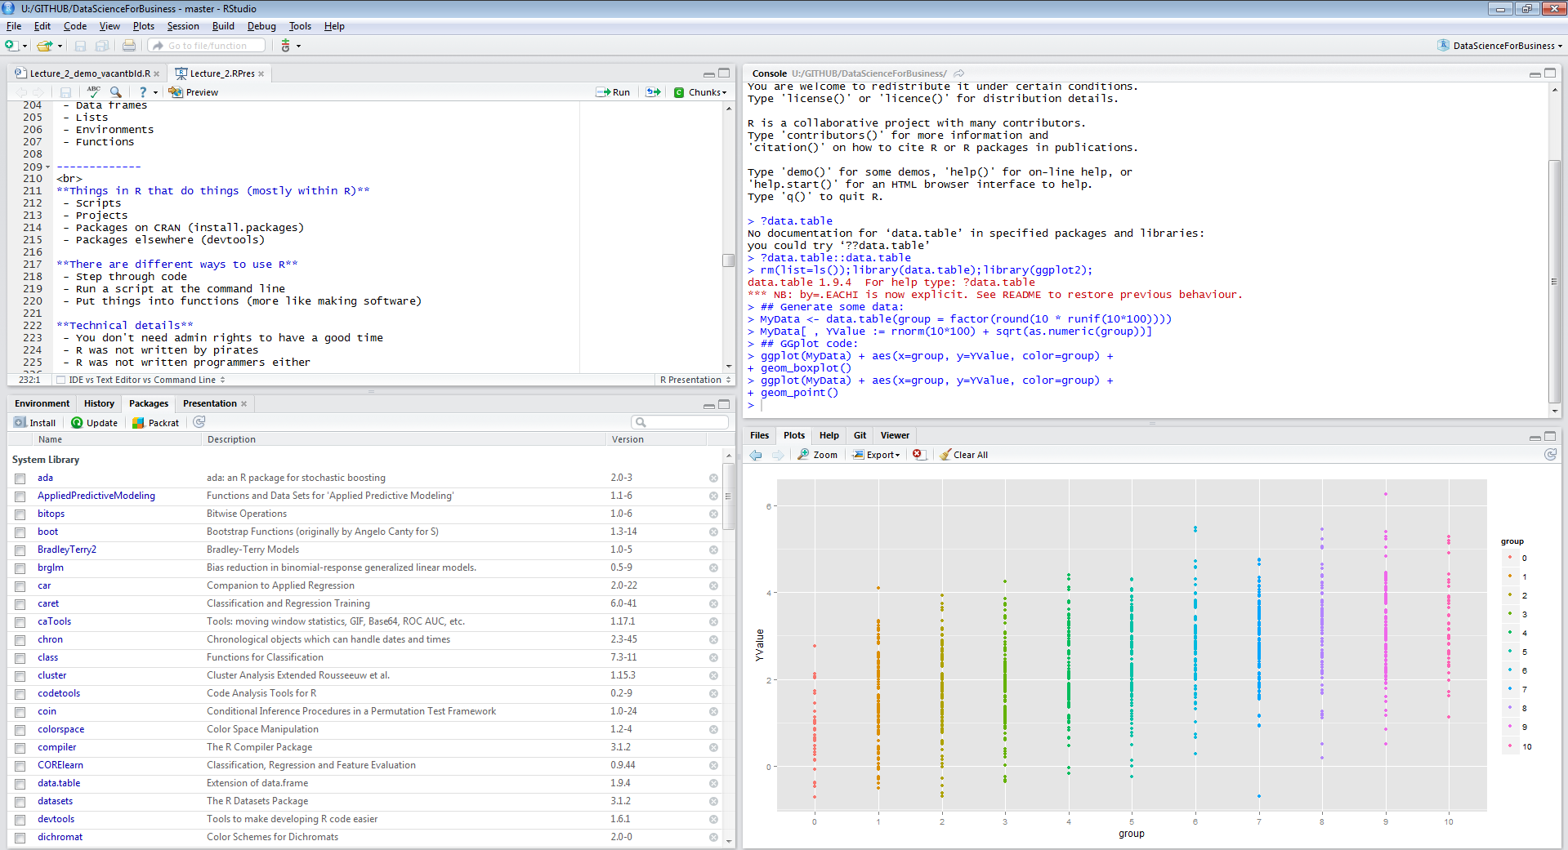
Anatomy of R Studio’s IDE

Slide 19
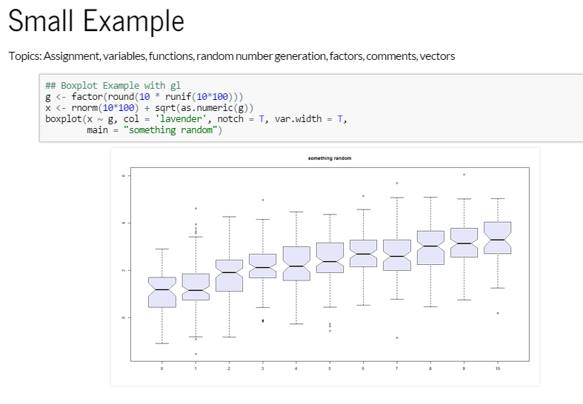

Slide 20
