Slide 1
Data Science For Business Lecture 3 Gene Leynes January 22, 2014
Review
Homework
R Studio
Git
R Language
Packages vs projects
Documentation
Unit testing
Objects
R Programming
The language
The ‘apply’ family
data.table
Getting into R
Importing files
Regular expressions
Database connections
Dates
Using R
Anatomy of a model
Graphics
Lab / Application
Project example
Applying lecture notes to a “real” example
Intro to “getting out of R”

Slide 2
Questions?
Technical problems?
Homework?
Questions from last class?

Slide 3
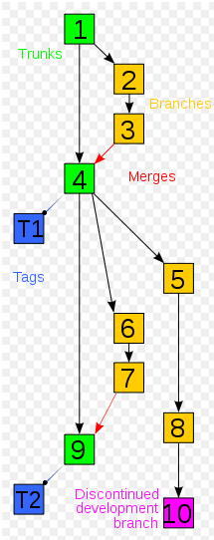
Review: Git
Git is worth reviewing because it’s so important as a tool for version control
This is what an example git workflow looks like:
http://en.wikipedia.org/wiki/File:Revision_controlled_project_visualization-2010-24-02.svg
Notes:
Version control of “what” you might ask? Versions of anything electronic. People keep track of recopies with Git (See taco fancy)

Slide 4
Your IDE – R Studio (Quick reminders)
Project management is upper right corner… make sure whether you’re in a project
Keeps track of your working directory
Allows for relative paths
./data/somefile.Rds
./images/somegraph.Rds
Set global options
Don’t save workspace
Turn on line numbers
Use “margin” guide
You can perform many git functions from within R Studio, including file diffs

Slide 5
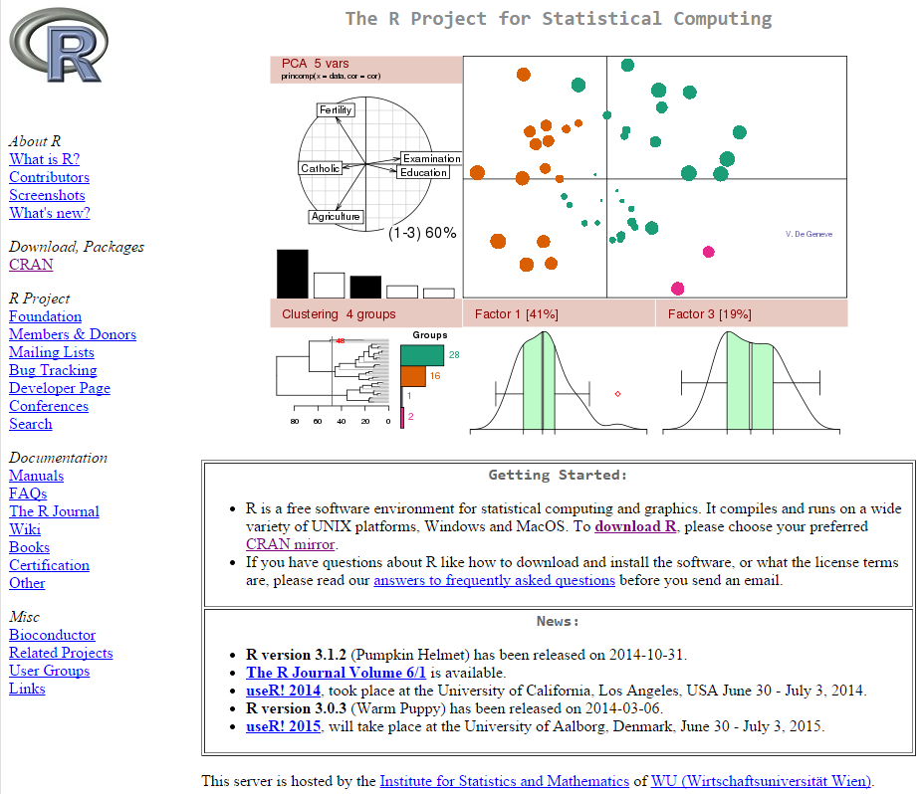
R Fundamentals
CRAN
(actually http://www.r-project.org/)
Many ways to use R functionally
Many industries
Many types of tasks; graphics, data management, big data, sparse data, text analysis
Data scientists may often work in a “project” (a folder of related work)
Packages are like projects, but more general. They help separate functionality
Packages traditionally live on CRAN
Unchanged since ???

Slide 6
Packages vs. Projects
Packages generally have
Example Data
Project Specific Data
Scripts
Functions
Documentation
Help files
Unit tests
Additional help
Contact info
Packages can be created within R with
package.skeleton()
Packages can be compiled with R Studio
Packages are like software
Projects generally have
Example Data
Project Specific Data
Scripts
Functions
Documentation
Help files
Unit tests
Additional help
Contact info
Projects are just text files in folders on a computer
R Studio projects have an .Rproj “project” file
Projects are specific to their intended use

Slide 7
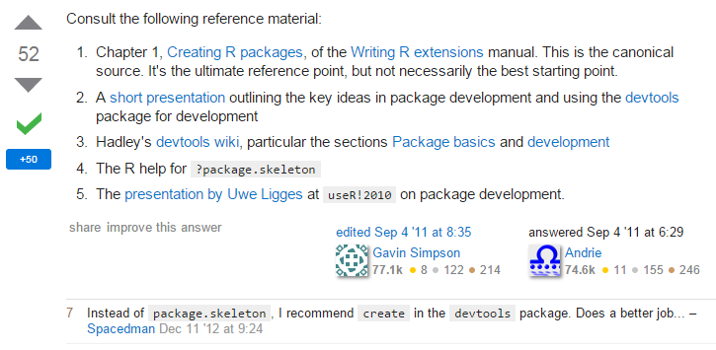
Notes about packages:
As a user of packages
Almost all packages came from CRAN
Now you can get them from other places using the devtools package (available on CRAN!)
CRAN packages are nice to use because they’re very maintained
Install with “install.packages()”, update with “update.packages()”
CRAN packages are a pain to create!
Github has emerged as an alternitive (via devtools)
How to develop an R Package
http://stackoverflow.com/questions/7297458/how-to-develop-a-package-in-r

Slide 8
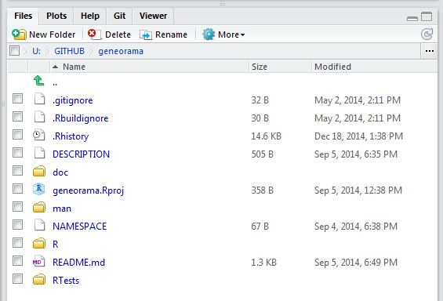
Components of a Package
R has a function to generate the bare essentials: pacakge.skeleton()
Here’s an example of the components for my package:
Git and R studio files
DESCRIPTION and NAMESPACE files are required
Every function is in a separate file in the R folder
This README is for github, not CRAN

Slide 9
Package Documentation
You will want documentation!
Within a package you can make help files using LaTex (this is the hard way)
You can also make documentation using R Oxygen (next slide)
Note: Other types of documentation include reports, readme files, comments… This slide is only about formal package documentation for functions
More info
http://cran.r-project.org/web/packages/roxygen2/vignettes/roxygen2.html
https://support.rstudio.com/hc/en-us/articles/200532317-Writing-Package-Documentation
http://roxygen.org/

Slide 10
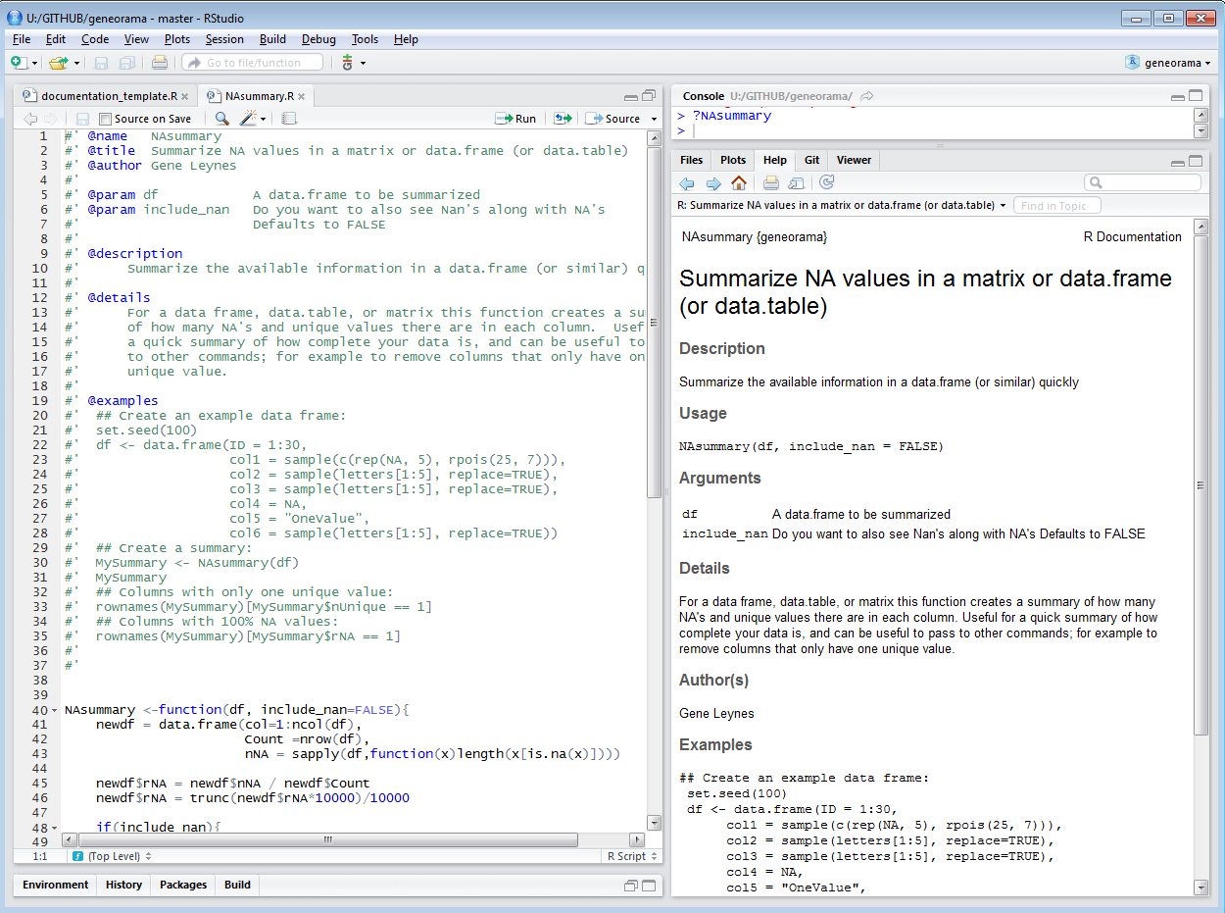

Slide 11
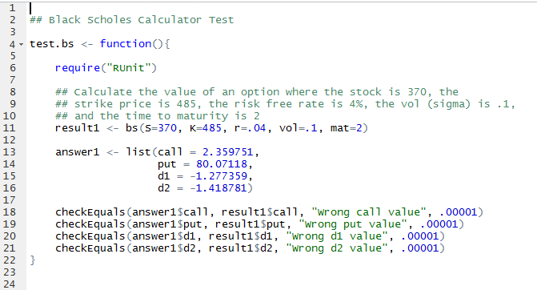
Unit Tests
RUnit is a good package to conduct automated unit testing
Test just make sure that your code is doing what you expect with known inputs and known outputs

Slide 12
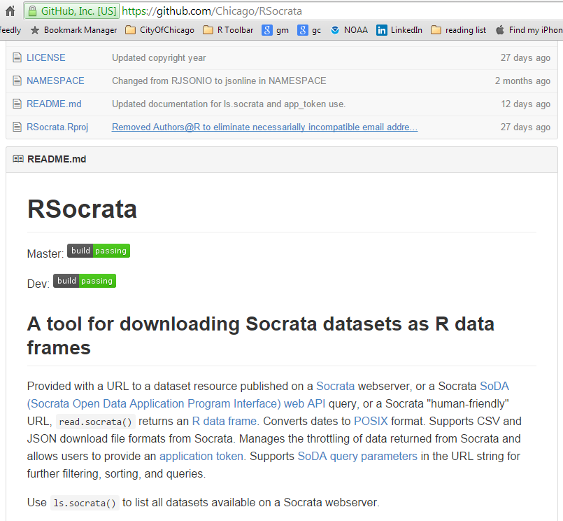
Continuous Integration tests
Github also supports travis-ci, which can tell you if your current “build” passes your tests.
https://travis-ci.org

Slide 13
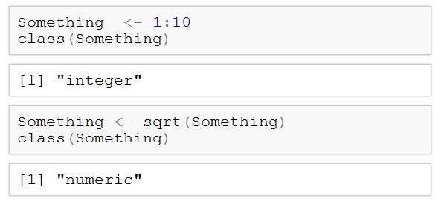
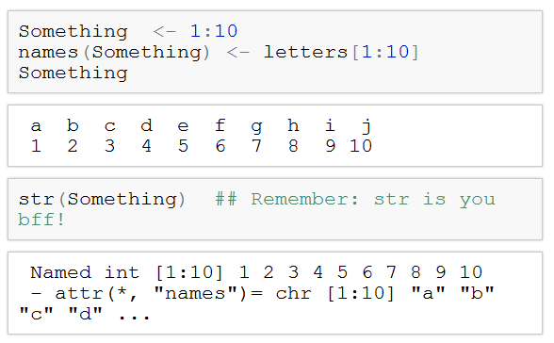
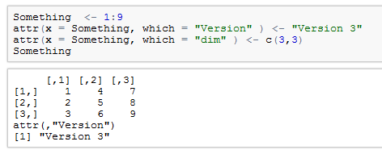
Everything is an “Object”
Objects can be made on the fly, and can change class (on the fly)
Objects can have names, but those names are ultimately just attributes
You can set your own attributes… which may or may not be meaningful

Slide 14
Question: What happens if you use the wrong dimensions?
Try it!
Change c(3,3) to something else
Change Something to be 1:7 (or whatever)
Did you get an error??

Slide 15
Language Review / Resources
Best cheat sheet ever:
http://cran.r-project.org/doc/contrib/Short-refcard.pdf
Google's YouTube guide to R
https://www.youtube.com/playlist?list=PLOU2XLYxmsIK9qQfztXeybpHvru-TrqAP
Review
http://faculty.chicagobooth.edu/matt.taddy/teaching/R_QRC.pdf
Google's YouTube guide to R
http://data.princeton.edu/R/linearModels.html

Slide 16
Importing Text
Use read.table() and write.table()
Other functions like read.csv ultimately call read.table, they’re meant to be convenient, but they’re not.
The function arguments are important, so let’s talk about them:
read.table(
file,
header = FALSE,
sep = "",
quote = "\"'",
na.strings = "NA",
nrows = -1,
skip = 0,
comment.char = "#",
stringsAsFactors = TRUE,
fill = !blank.lines.skip,
strip.white = FALSE,
blank.lines.skip = TRUE,
allowEscapes = FALSE,
flush = FALSE,
fileEncoding = "",
encoding = "unknown",
text,
skipNul = FALSE

Slide 17
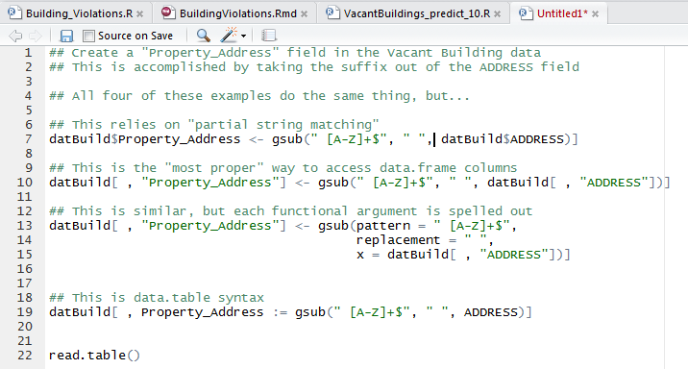
Regular Expressions

Slide 18
Date / Time Conversions
?strptime
The most standard date/time object in R is POSIXct
R also uses POSIXlt, but this format is very convoluted
I suggest only using the data.table functions:
IDate
ITime
At all costs avoid“Date” or “as.Date”
For full info on date time conversions
?strptime

