Slide 1
Data Science For Business Lecture 4 Gene Leynes September 29, 2014
Benefits of R & data.table
Analysis and data manipulation
Remote connections
Using amazon AWS

Slide 2
Summary Points
Why learn R
Community
Top choice among data scientists (along with Python)
Good balance of functionality / ease of use
Why learn data.table
Quick access to variables
Merging
Integer based dates (IDates) will make your life 100% simpler
Version control is essential in all projects
Reproducibility
Notes:
Story about Orkin plots

Slide 3
Data analysis and basic exploration
Data exploration is often the most important and insightful part of the project.
In fact, most projects stop here because just looking at the data is enough to make the right decisions
Update project using git pull
https://github.com/geneorama/DataScienceForBusiness
Open Lecture 3 ggplot example
We’re going to clean this up and extend this report
Remember, knitr uses markdown
http://cran.r-project.org/web/packages/knitr/vignettes/knitr-refcard.pdf

Slide 4
Remote connections
You will often need to remote into other computers to
Check information,
Start a process
Do basic admin (like reboot)
Transfer data
Perform queries
Gain access
Remote in to this computer… and tell me what’s in the file “important_document.txt”
Use these commands: ssh, ls, cat
Username: depaulpeeps
Password: G1thubFOSS4ever

Slide 5
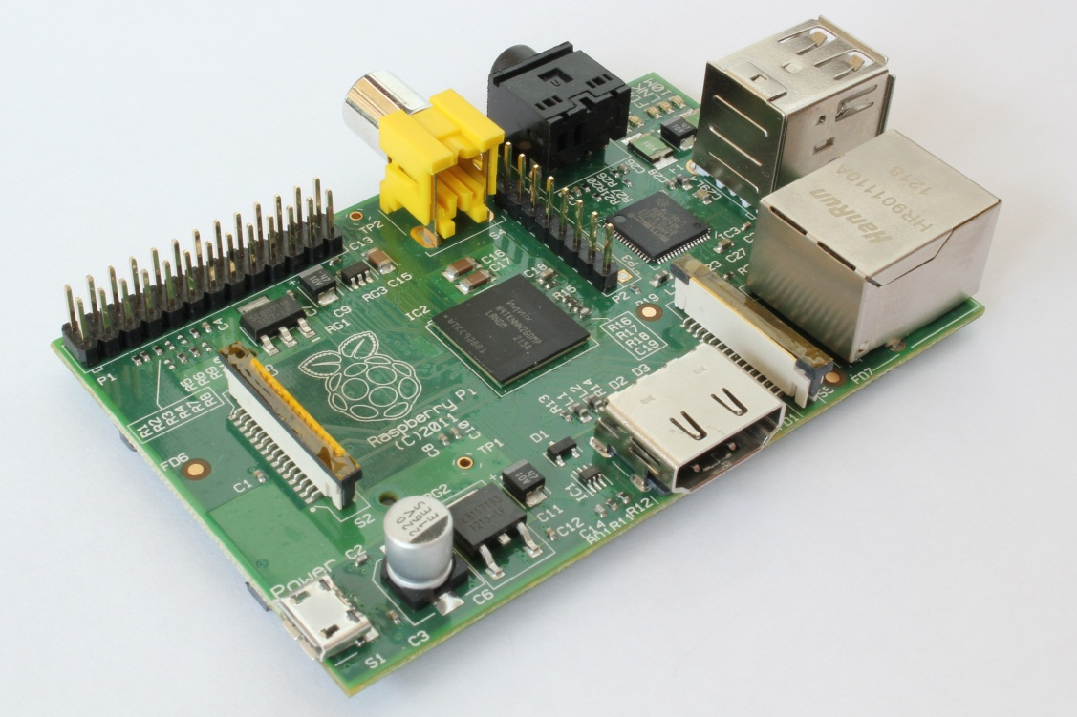
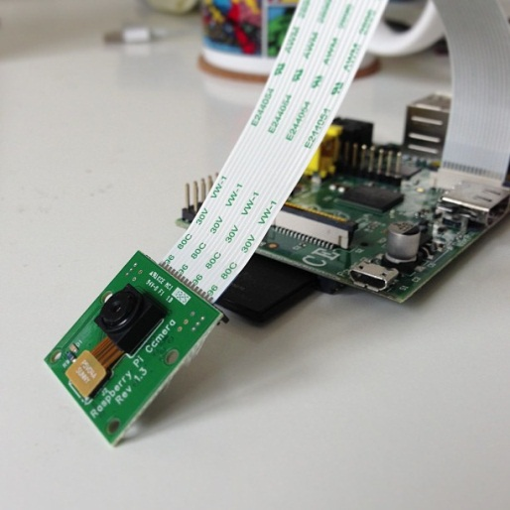
Remote Connections Fun and useful
GPIO Pins
The Raspberry Pi is another great reason to be able to handle / use remote connections
It’s also a great way to learn basic Linux server admin
Camera

Slide 6
Remote Connections - Can also save you!
Open AWS Example

