Slide 1

GLOBAL SYSTEM FOR MOBILE (GSM)
PREPARED BY
Rudra Nepal,15474
Bachelor of Engineering in Information Technology

Slide 2

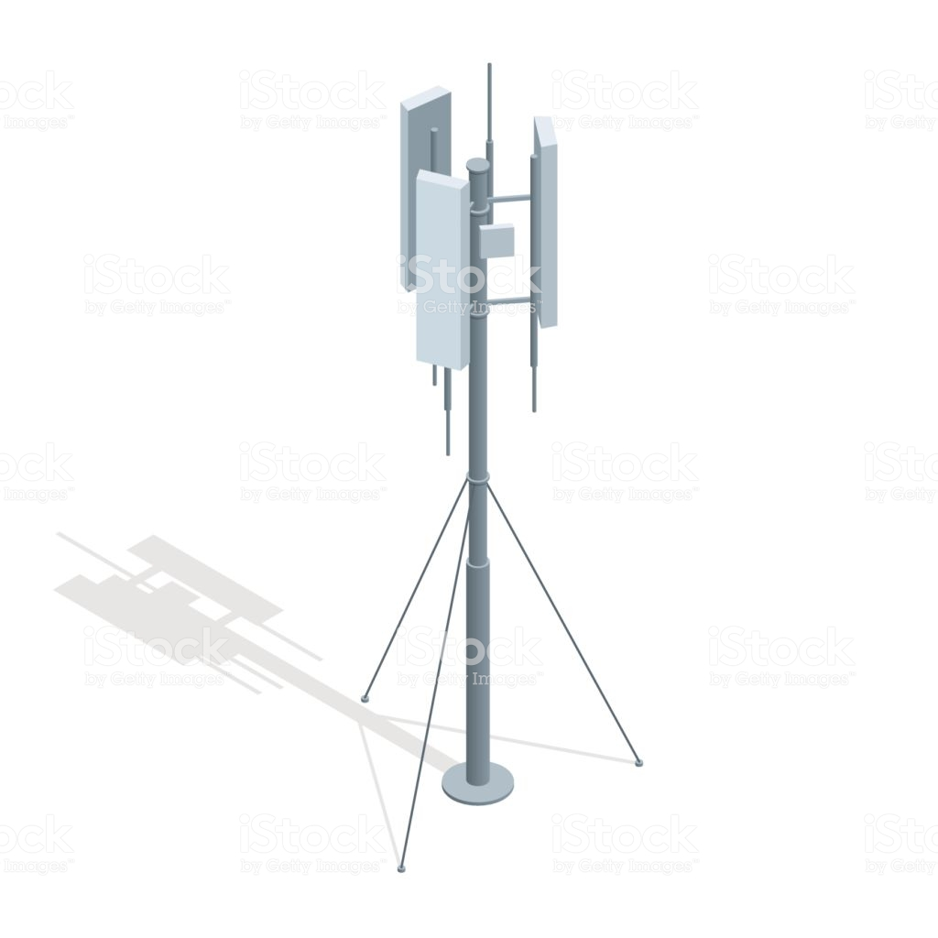
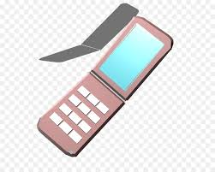
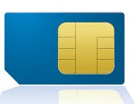
GSM Services and Features
Services
Telephone Service
Data Service
Supplementary Service
Features
Subscriber Identity Module
On the Air Privacy

Slide 3
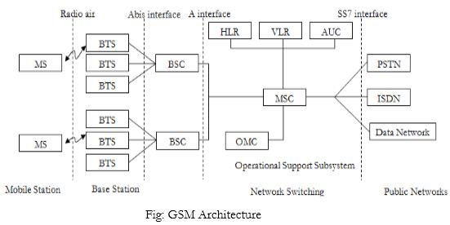
GSM ARCHITECTURE

Slide 4
Mobile Station(MS)
Mobile Equipment(ME)
Subscriber Identity Module(SIM)
Base Station Subsystem(BSS)
Base Transceiver Station(BTS)
- (encoding/decoding and encryption/decryption)
Base station Controller(BSC)
-call maintenance
Network Switching Subsystem(NSS)
Mobile Switching Center(MSC)
-registration,authentication,location updating,handovers and call routing to roaming subscriber
Home Location Register(HLR)
- database
Visitor Location Register(VLR)
Authentication center(AUC)
-protected database holds a copy of secret key stored in each subscribers sim used for authentication and encryption over the radio channel
Equipment Identity Register(EIR)
-database that contains a list all valid mobile station within the network
-white list
-black list
-Grey list

Slide 5
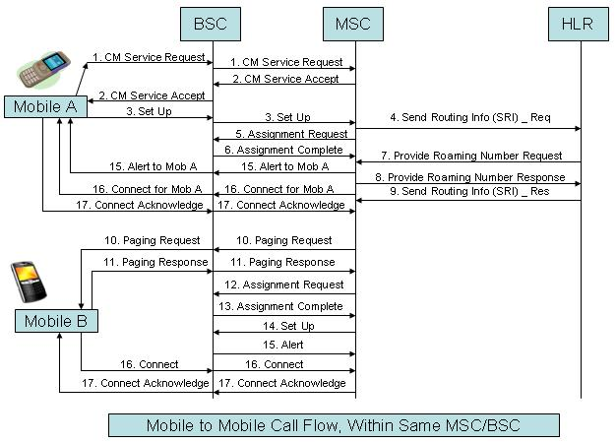
EXAMPLE GSM CALL

