Slide 1
Machine Learning with Privacy Guarantee
Presented By: Raju Deb (3766897)
Sadman Sakib Choudhury (3784838)

Slide 2

Presentations Agenda
Introduction
Impact & Why Machine Learning
Objectives of the Survey
Related Works
Real World Examples
Challenges
Future Directions
Conclusion
References

Slide 3
Introduction
What is Privacy?
Safeguarding sensitive data to ensure access and sharing are limited to authorized entities.
Protecting confidentiality and rights of individuals and organizations.
Why Privacy Matters?
Protects sensitive information
Complies with regulations to maintaining ethical practices

Slide 4

Some Examples of Privacy Concerns
Social Engineering: This happens when attackers trick people into sharing private information by gaining their trust or using fear and urgency.
Privacy Policy Loopholes: Sometimes, users unknowingly agree to give up more data than they realize, and this data can be misused.
IoT Device Exploitation: Devices like smart home gadgets often lack strong security, making them easy targets for hackers to steal private information like location or behavior.
Phishing Attacks: Attackers pretend to be trusted organizations, like banks, to trick people into giving personal information like passwords or bank details.
Data Breaches: Hackers break into poorly protected databases to steal private information, like medical records or company secrets.

Slide 5
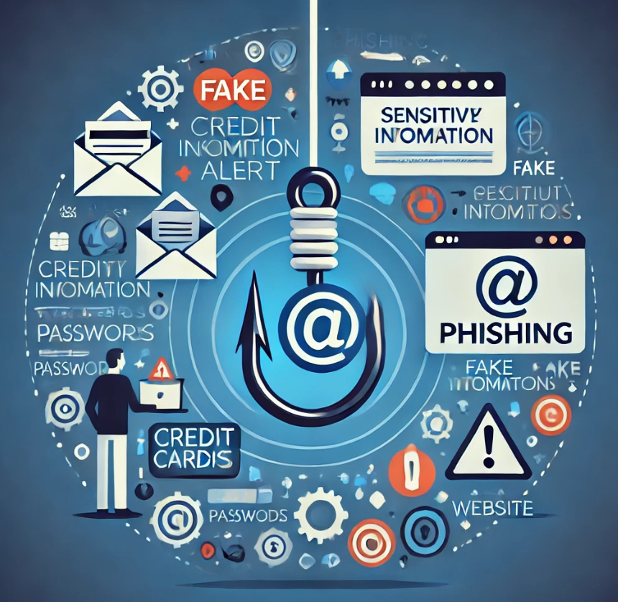
What is Phishing?
Phishing is a cyberattack where attackers deceive individuals into sharing sensitive information (e.g., usernames, passwords, credit card details).
It involves impersonating trustworthy entities through emails, fake websites, or messages to trick victims.

Slide 6
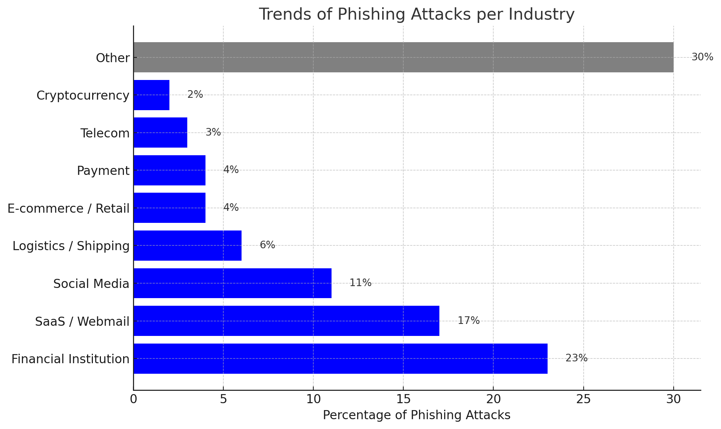
Impact of Phishing

Slide 7
Why Machine Learning in Phishing Detection?
Traditional methods like blacklists and heuristic-based detection are ineffective against evolving tactics.
Machine learning analyzes patterns in URL structures, content, and domain attributes for scalable and accurate detection.

Slide 8
Objectives of the Survey
Review existing machine learning studies for phishing detection.
Compare Current methodologies
Identify gaps & Challenges in current approaches and future Directions.

Slide 9
Related Works

Slide 10
Paper 1: Phishing Detection Using Machine Learning: A Model Development and Integration
Models: K-Nearest Neighbor (KNN), Artificial Neural Networks (ANN). Random Forest (RF)
Dataset: Combined datasets from Ariyadasa et al. (2021) and UNB (2016). Feature selection used mutual information classification.
Key Results: Accuracy= RF 99.78%, KNN 99.67%, ANN 99.11%.
RF and KNN excelled in identifying legitimate websites, while ANN performed well in detecting phishing websites.
Significance: Highlighted the potential of machine learning models for high-accuracy phishing detection.
Developed a Django-based web application for real-time phishing detection using RF as the integrated model.

Slide 11
Limitations
Heavy reliance on hyperparameter tuning and dataset quality for model performance.
The extremely high accuracy reported for all models (e.g., Random Forest: 99.78%, KNN: 99.67%, ANN: 99.11%) suggests potential overfitting, especially if the dataset does not represent diverse, real-world phishing scenarios.
Focused primarily on website phishing attacks, limiting the generalization to other phishing types (e.g., email-based or SMS-based phishing).

Slide 12
Paper 2 : An Ensemble Method for Phishing Websites Detection Based on XGBoost
Models: Random Forest (RF), K-Nearest Neighbors (KNN), and XGBoost (Proposed Ensemble Method).
Dataset: Phishing Website Detector Dataset from Kaggle.
Key Results: Accuracy: XGBoost 96.44%, (RF + ANN + CART) 96.43%, (RF + KNN + Bagging) 96.05%.
Runtime: XGBoost: 0.284 seconds, (RF + ANN + CART) 8.305 seconds, (RF + KNN + Bagging) 6.012 seconds
Significance: Demonstrated that the XGBoost ensemble method combining RF and KNN achieves superior accuracy and efficiency compared to others.
Highlighted the runtime efficiency of XGBoost, making it suitable for real-time phishing detection applications.

Slide 13
Limitations
Limited to URL datasets, which may not generalize well to other phishing vectors like emails, SMS, or social engineering attacks.
High accuracy on a relatively small dataset suggests a potential risk of overfitting, which may impact real-world performance.
The study focuses on ensemble methods and does not compare the proposed XGBoost model with advanced deep learning approaches, which could provide further insights.

Slide 14
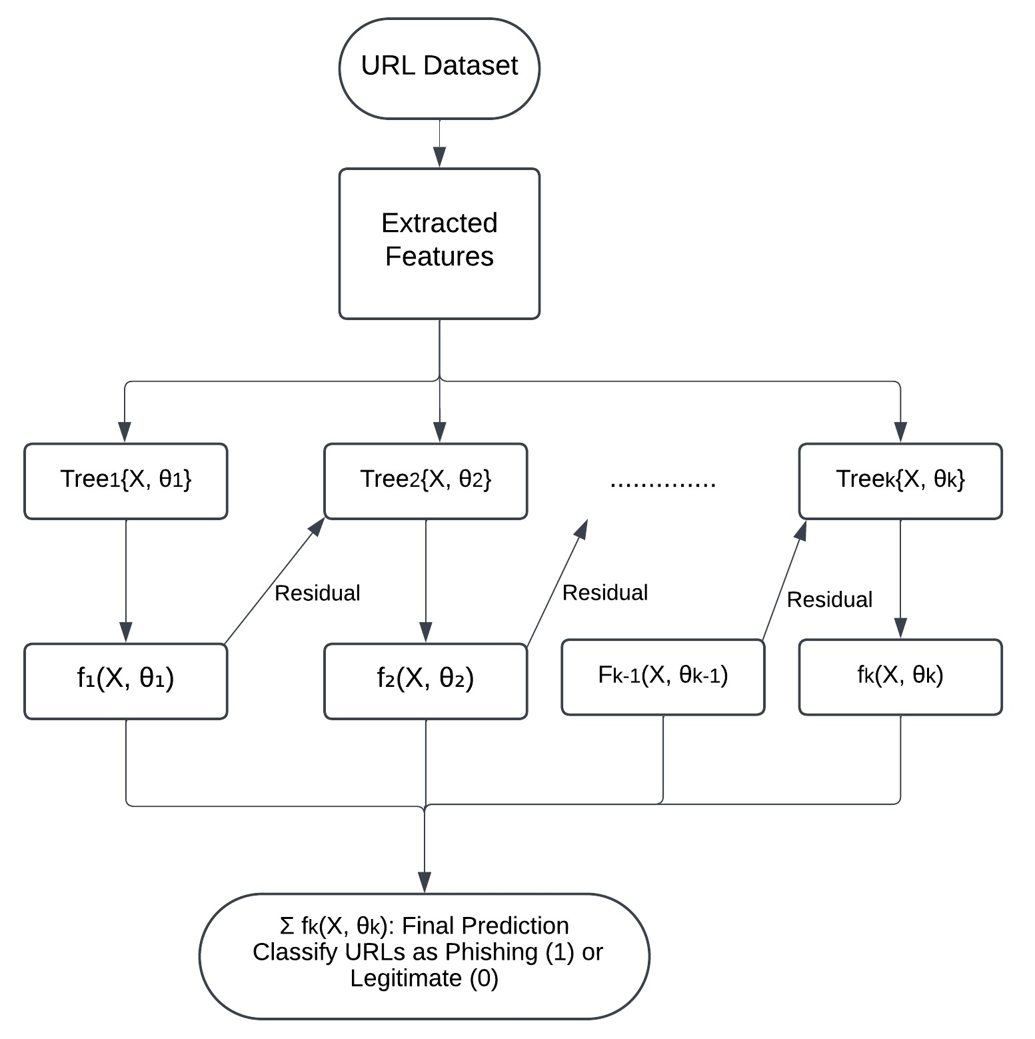
Flowchart of XGBoost in Phishing Detection

Slide 15
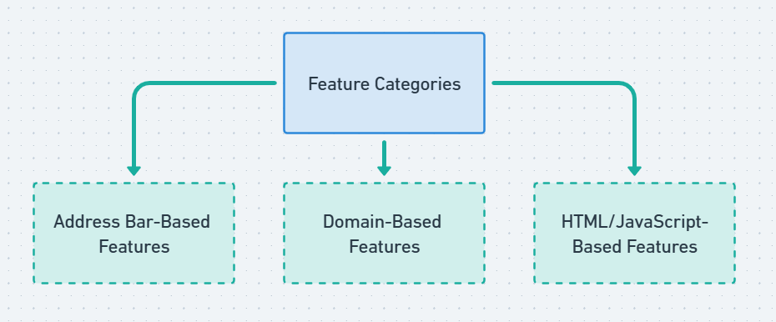
Features Extraction
Address Bar-Based: Domain of URL, IP Address in URL, Length of URL, http/https in Domain Name etc. Domain-Based : DNS Record, Website Traffic, Age of Domain, End Period of Domain etc. HTML/JavaScript-Based: IFrame Redirection, Website Forwarding etc.

Slide 16

Challenges in Phishing Detection
Imbalanced Datasets
Lack of Labeled Data
Difficulty in Detecting Zero-Day Phishing Attacks
Overfitting to Training Data
Adversarial Attacks on Machine Learning Models
Privacy Concerns in Feature Collection and Model Deployment

Slide 17

Real World Examples
PayPal's Fraud Detection System
PayPal has developed an in-house machine learning system to detect fraudulent activities, including phishing attempts targeting its users.
Processes over 35,000 transactions per minute and over $1 trillion annually
Leverages graph technologies to analyze relationships in a 2-Sided Network
98% success rate in preventing phishing and fraud attempts
Key Achievements: Reduced losses for merchants and buyers, Decreased false positives, Lower fraud and phishing prevention costs.

Slide 18

Real World Examples
Gmail’s
integration machine learning models ensures that evolving phishing techniques are effectively countered.
With over 99.9% blocking success, Google sets a benchmark in phishing prevention, combining real-time learning, privacy-preserving technologies, and large-scale data analysis.
Microsoft’s
Machine learning models are strengthened with real-time data from billions of daily email interactions across Office 365.
Combines proactive (heuristics) and reactive (detonation) methods with machine learning for multi-layered phishing detection.

Slide 19
Future Directions
Integration of Contextual Analysis
AI-Driven Personalization
Adoption of Lightweight Models for Edge Devices
Real-Time Adversarial Phishing Detection
Expanded Multimodal Learning

Slide 20
Conclusion
Key Insights:
Machine learning is pivotal for accurate and scalable phishing detection.
Privacy-preserving techniques ensure compliance and user trust.
Challenges:
Adapting to evolving phishing tactics.
Balancing accuracy, privacy, and transparency.
Outlook:
Collaboration and advanced ML techniques will drive safer digital ecosystems.
Continuous innovation is key to staying ahead of threats.
Final Thought:
ML-powered phishing detection, paired with privacy, is essential for securing the digital future.

Slide 21
References
Onih, V. A. (2024). Phishing Detection Using Machine Learning: A Model Development and Integration. International Journal of Scientific and Management Research. DOI: http://doi.org/10.37502/IJSMR.2024.7403
Mandadi, A., Ravella, V., Boppana, S., & Kavitha, R. (2022). Phishing Website Detection Using Machine Learning. IEEE 7th International Conference for Convergence in Technology (I2CT). DOI: 10.1109/I2CT54291.2022.9824801
Gu, J., & Xu, H. (2022):An Ensemble Method for Phishing Websites Detection Based on XGBoost.2022 IEEE 14th International Conference on Computer Research and Development (ICCRD). DOI: https://ieeexplore.ieee.org/stamp/stamp.jsp?tp=&arnumber=9730579.
Google Security Blog. (2022). Building a More Helpful Browser with Machine Learning. Retrieved from https://blog.google.
Microsoft Security. (2022). Microsoft 365 Advanced Threat Protection. Retrieved from https://www.microsoft.com/security.
Zscaler ThreatLabz. (2023). Phishing Insights Report. Retrieved from https://www.zscaler.com.
Proofpoint. (2023). State of the Phish Report. Retrieved from https://www.proofpoint.com.
PayPal. (2023). Payment Fraud Detection with Machine Learning. Retrieved from https://www.paypal.com/us/brc/article/payment-fraud-detection-machine-learning
Alkawaz, M. H., et al. (2020). Detecting Phishing Websites Using Machine Learning. IEEE International Colloquium on Signal Processing and Applications (CSPA 2020). DOI: 10.1109/CSPA48992.2020.9068689
Jain, A. K., & Gupta, B. B. (2018). A Machine Learning-Based Approach for Phishing Detection Using Hyperlink Information. Springer Nature. DOI: 10.1007/s10207-018-0421-1

Slide 22

Any Questions?

Slide 23
Thank you

