Slide 1
Exploratory Data Analysis
What ?
Why ?
How ?

Slide 2
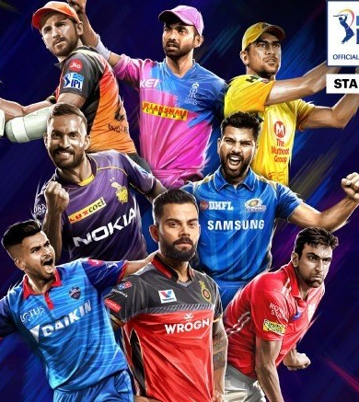
Indian Premier League
Exploratory Data Analysis

Slide 3
Introduction
We are doing Exploratory Data Analysis on IPL data to
analyze teams are performing over the years.
What are their positives and negatives so far ?
What went well ?
What should they focus on?

Slide 4

GOAL

Slide 5
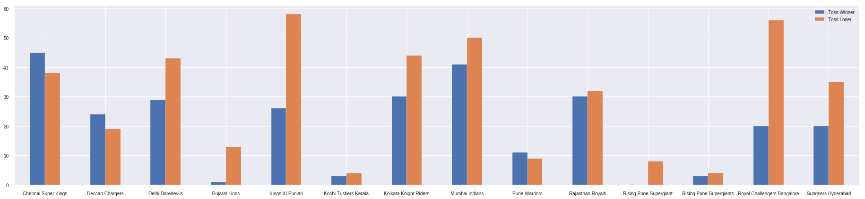
How teams are performing at toss?
Chennai Super Kings it the only team(in current playing teams) which has upper hand at toss.

Slide 6
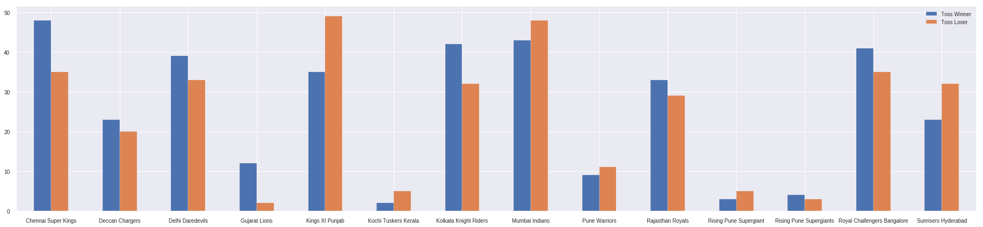
How teams winning toss performing?
8 out of 14 teams won more matches, if they win toss i.e, 57% more chance.

Slide 7
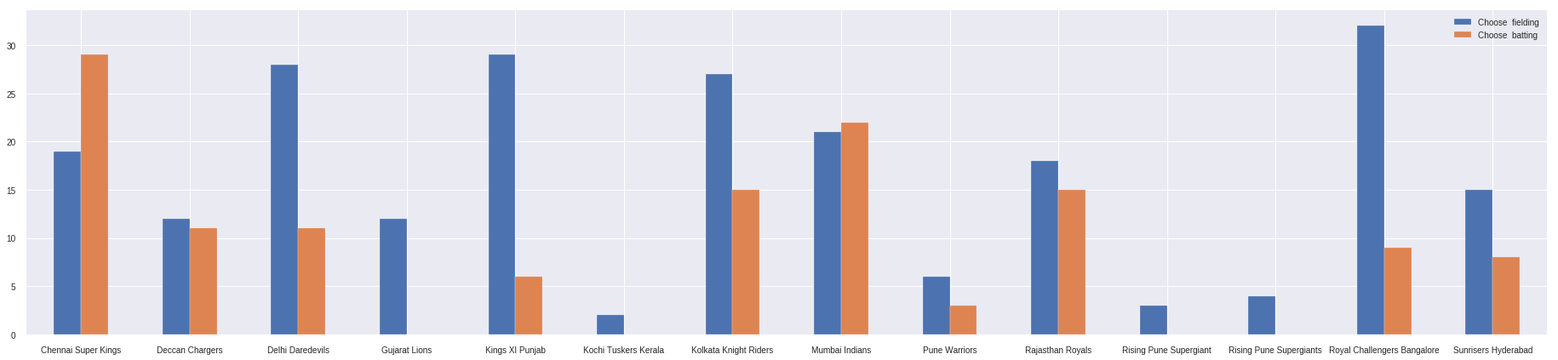
Should a team bat or bowl after winning toss?
10 out of 14 teams won by choosing fielding after winning toss i.e, 71.4%.

Slide 8
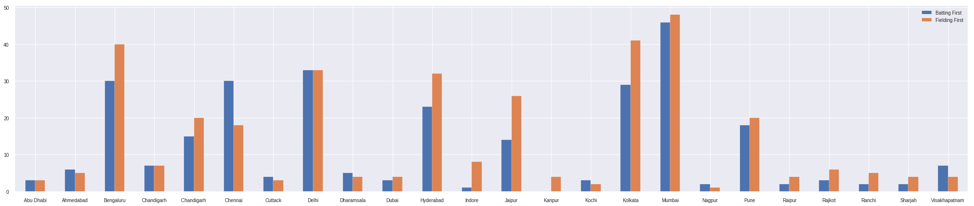
Should we bat or field at particular venue?
Only 7 out of 19 cities favours batting first i.e 36.8%

Slide 9
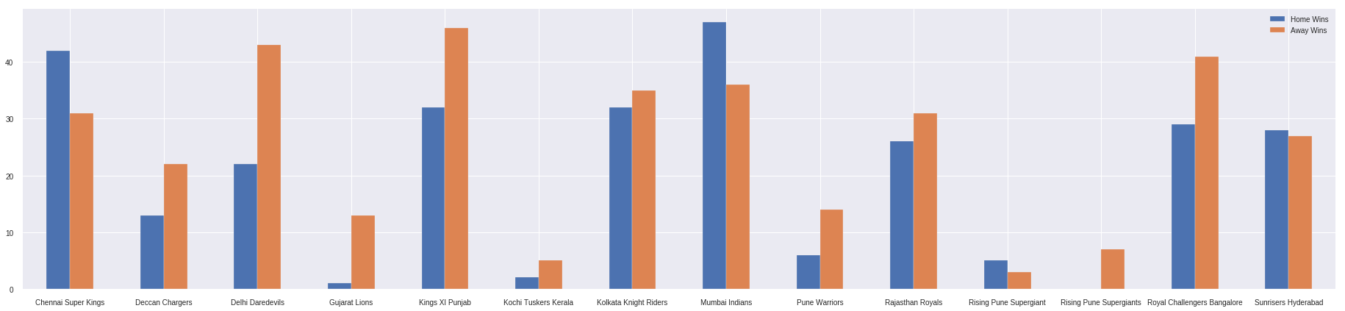
Do teams take home advantage?
Only Chennai Super Kings, Mumbai Indians and Sunrisers Hyderabad are using home
Conditions to their advantage.

Slide 10
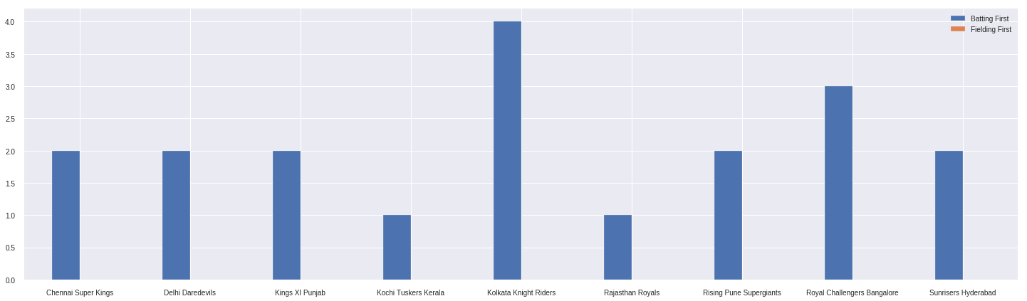
How DLS is affecting teams?
Teams batting first always won when DLS is applied.

Slide 11
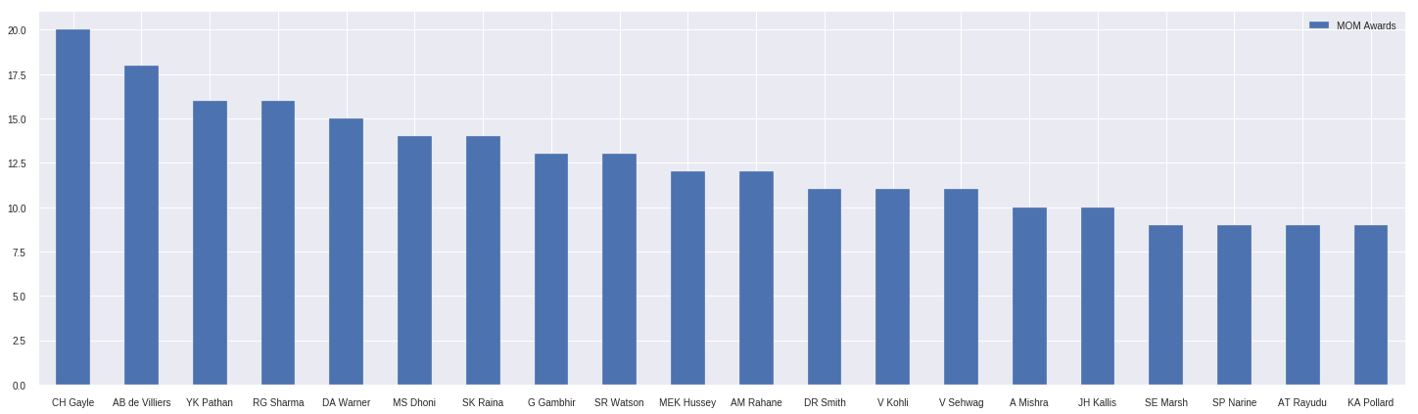
Top 20 players with most MOM awards?

Slide 12
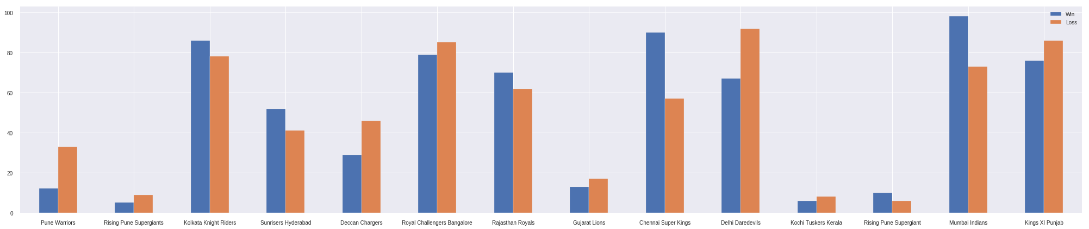
WIN VS LOSS
Only 5 out of 14 teams has more wins than losses i.e; 35.7%. As expected, these also
the teams which won IPL titles.

Slide 13
Table topper == Title winner ?
Season | Table Topper | Title Winner
2008 | Rajasthan Royals | Rajasthan Royals
2009 | Delhi Daredevils | Deccan Chargers
2010 | Mumbai Indians | Chennai Super Kings
2011 | Chennai Super Kings | Chennai Super Kings
2012 | Kolkata Knight Riders | Kolkata Knight Riders
2013 | Mumbai Indians | Mumbai Indians
2014 | Kings XI Punjab | Kolkata Knight Riders
2015 | Royal Challengers Bangalore | Mumbai Indians
2016 | Sunrisers Hyderabad | Sunrisers Hyderabad
2017 | Mumbai Indians | Mumbai Indians
2018 | Chennai Super Kings | Chennai Super Kings
In 7 out of 11 seasons, team that topped points table won
IPL Title i.e 63.6%.

Slide 14
Actionable Insights
It is always recommended to choose fielding.
Teams should work on using home conditions to their advantage.
If a team thinks DLS will come in to place during course of match, they should choose batting.
Teams should work on winning toss as there is 51 % of winning match after winning toss.
Try to be in top of Points-table.

Slide 15

Thank you Raju MLN narasimha4789@gmail.com

