Slide 1
Hadoop Distributed File System
What is DFS
What is HDFS
What is Hadoop?
Hadoop is an open source, Java-based programming framework that supports the processing and storage of extremely large data sets in a distributed computing environment
Components of Hadoop.
Hadoop Distributed File System (HDFS) – It is the storage layer of Hadoop.
Map-Reduce – It is the data processing layer of Hadoop.
YARN – It is the resource management layer of Hadoop.

Slide 2
Features of HDFS
Distributed Storage
Blocks
Why is default configured to 128MB?
Replication
High Availability
Data Reliability
Fault Tolerant
Scalability – Vertical and Horizontal
High throughput access to Application Data
HDFS Assumptions and Goals
Hardware Failure
Streaming Data access
Large Datasets
Simple Coherency Model
Moving Computation is cheaper than moving data
Portability across heterogeneous hardware and software platforms

Slide 3

HDFS Architecture
Master/Slave Architecture
Name Node – Data Node

Slide 4
Task of NameNode
Manage file system namespace.
Regulates client’s access to files.
It also executes file system execution such as naming, closing, opening files/directories.
All DataNodes sends a Heartbeat and block report to the NameNode in the Hadoop cluster. It ensures that the DataNodes are alive. A block report contains a list of all blocks on a datanode.
NameNode is also responsible for taking care of the Replication Factor of all the blocks.
Name Node metadata Components
FsImage
Edit Logs
Task of DataNode
Block replica creation, deletion, and replication according to the instruction of Namenode.
DataNode manages data storage of the system.
DataNodes send heartbeat to the NameNode to report the health of HDFS. By default, this frequency is set to 3 seconds.

Slide 5
Installation of HDFS
Configuration directories in Hadoop – etc, bin, sbin folders
etc/hadoop – contains configuration files for configuring various Hadoop daemons
Bin/sbin – contains executable binaries used to start and stop Hadoop daemons and perform file system commands like listing, copying, deleting etc.
Edit hosts file on Master node(/etc/hosts) and add below entries
MASTER-IP master
SLAVE01-IP slave01
SLAVE02-IP slave02
Note: In place of MASTER-IP, SLAVE01-IP, SLAVE02-IP put the value of the corresponding server IP. In current setup 172.16.40.69 is master node and 172.16.40.53 is slave
Install JDK
Configure SSH and passwordless SSH
Change to Hadoop user directory. In our case its /home/rrduser directory
Generate ssh Key pairs
ssh-keygen -t rsa -P ""
Copy the content of .ssh/id_rsa.pub (of master) to .ssh/authorized_keys on all the slaves as well as master

Slide 6
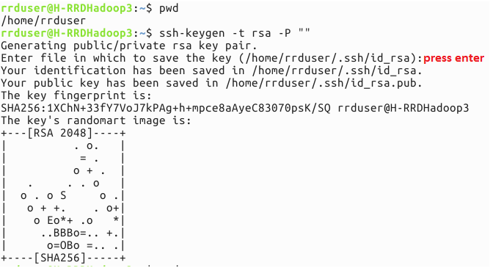
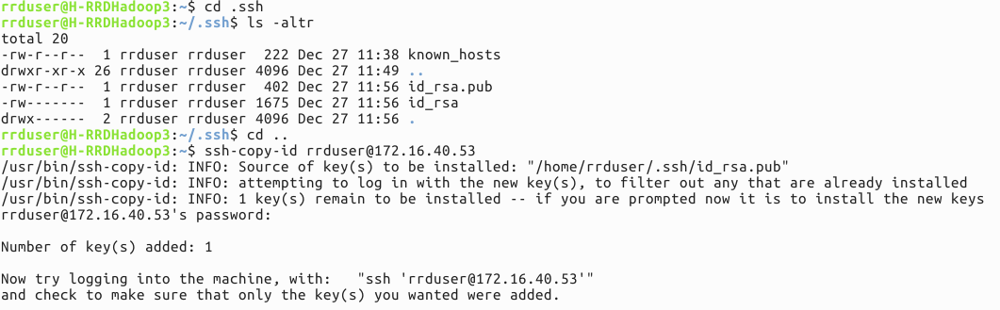

Slide 7
Download Hadoop and untar Hadoop
For current installation, I downloaded Hadoop 2.8.2 version
Configure Hadoop multi node cluster
Edit bash file - .bashrc and add following entries
export HADOOP_PREFIX="/home/rrduser/hadoop/hadoop-2.8.2"
export PATH=$PATH:$HADOOP_PREFIX/bin
export PATH=$PATH:$HADOOP_PREFIX/sbin
export HADOOP_MAPRED_HOME=${HADOOP_PREFIX}
export HADOOP_COMMON_HOME=${HADOOP_PREFIX}
export HADOOP_HDFS_HOME=${HADOOP_PREFIX}
export YARN_HOME=${HADOOP_PREFIX}
In case you want to check if the environment variables are properly set – Restart terminal and issue command HDFS. It should not give any error like command not found
Edit hadoop-env.sh at path HADOOP_HOME/etc/hadoop) and set JAVA_HOME Note: Note: This file specifies the environment variables
export JAVA_HOME=<path-to-the-root-of-your-Java-installation> (in our current installation it is /usr/lib/jvm/java-8-oracle/)

Slide 8
Edit configuration file core-site.xml at path HADOOP_HOME/etc/hadoop and add below entries
Note: The core-site.xml file informs Hadoop daemon where NameNode runs in the cluster
<property>
<name>fs.defaultFS</name> - deprecated - fs.default.name. both are same
<value>hdfs://172.16.40.69:9000</value> - master node ip
</property>
<property>
<name>hadoop.tmp.dir</name>
<value>/home/rrduser/hadoop/hdata</value>
</property>
URI scheme - hdfs determines the filesystem implementation class and the authority determines the host name and port number of the file system.

Slide 9
Edit configuration file hdfs-site.xml at path HADOOP_HOME/etc/hadoop and add following entries –
Note: The hdfs-site.xml file contains the configuration settings for HDFS daemons; the NameNode, the Secondary NameNode, and the DataNodes
<property>
<name>dfs.replication</name>
<value>2</value> - in case we have two slaves. 3 in case we have 3 slaves
<description>Block Replication<description>
</property>
<property>
<name>dfs.namenode.name.dir</name> - default file://${hadoop.tmp.dir}/dfs/name
<value> /home/rrduser/hadoop/data/dfs/namenode</value>
</property>
<property>
<name>dfs.datanode.data.dir</name> - default file://${hadoop.tmp.dir}/dfs/data
<value>/home/rrduser/hadoop/data/dfs/datanode</value>
</property>
<property>
<name>dfs.blocksize<name> - default size 128MB
<value>134217728<value>
<description>Block size<description>
<property>

Slide 10
Edit configuration file mapred-site.xml at path HADOOP_HOME/etc/hadoop and add following entries
Note: This file contains configuration settings for MapReduce
<property>
<name>mapreduce.framework.name</name>
<value>yarn</value>
</property>

Slide 11
Edit configuration file yarn-site.xml at path HADOOP_HOME/etc/hadoop and add following entries - it contains settings for Node Manager, Resource Manager, Containers, and Application Master
<property>
<name>yarn.nodemanager.aux-services</name>
<value>mapreduce_shuffle</value>
</property>
<property>
<name>yarn.nodemanager.aux-services.mapreduce.shuffle.class</name>
<value>org.apache.hadoop.mapred.ShuffleHandler</value>
</property>
<property>
<name>yarn.resourcemanager.resource-tracker.address</name>
<value>master:8025</value>
</property>
<property>
<name>yarn.resourcemanager.scheduler.address</name>
<value>master:8030</value>
</property>
<property>
<name>yarn.resourcemanager.address</name>
<value>master:8040</value>
</property>

Slide 12
Edit configuration file “slaves” at path HADOOP_HOME/etc/hadoop and add following entries:
172.16.40.53 – This file mentions the slave data nodes in Hadoop cluster
<<slave02ip>> if we have one more data node
With above steps Hadoop is now installed on Master
Install Hadoop on Slaves
Edit hosts file on slave nodes(/etc/hosts) and add below entries
MASTER-IP master
SLAVE01-IP slave01
SLAVE02-IP slave02
Note: In place of MASTER-IP, SLAVE01-IP, SLAVE02-IP put the value of the corresponding server IP. In current setup 172.16.40.69 is master node and 172.16.40.53 is slave
Install Java
Copy Hadoop setup from master to all slaves
Tar Hadoop home directory on master
Copy it to Slave
Untar the tar on slaves

Slide 13
Start the Hadoop Cluster
Run the following commands on Master
Format the name node - bin/hdfs namenode –format
Note: This activity should be done once when you install Hadoop, else it will delete all the data from HDFS
Start HDFS Services - sbin/start-dfs.sh
Start YARN services - sbin/start-yarn.sh
http://172.16.40.69:50070/
Check daemons on Master
Executing jps command should display following services running
Master server
10866 SecondaryNameNode
11097 ResourceManager
10654 NameNode
Slave Server
32708 DataNode
413 NodeManager

Slide 14
Stop The Hadoop Cluster
Run the following commands on Master
Stop YARN service sbin/stop-yarn.sh
Stop HDFS service sbin/stop-dfs.sh
Scaling in Hadoop cluster
Vertical Scaling
Horizontal Scaling
Add new node to Hadoop cluster
Add new node entry to configuration file “slaves” at path HADOOP_HOME/etc/Hadoop
Copy the entire Hadoop installation to new node
Start datanode and task tracker on new node using below commands
$ cd path/to/hadoop
$ bin/hadoop-daemon.sh start datanode
$ bin/hadoop-daemon.sh start tasktracker
Note: This also applies to nodes that crash and want to re-join the cluster

Slide 15
HDFS Basic Command Reference
FS Shell user Commands
hdfs dfs –ls /
hdfs dfs –mkdir /test2
hdfs dfs –put hello.txt /test
hdfs dfs –get /test/hello.txt
hdfs dfs –cat /test/hello.txt
hdfs dfs –du –s –h /test
Admin Commands
hdfs dfsadmin –report – Reports basic filesystem information and statistics
hdfs dfsadmin –refreshNodes - Re-read the hosts and exclude files to update the set of Datanodes that are allowed to connect to the Namenode and those that should be decommissioned or recommissioned.

Slide 16
Name nodes – different types
Checkpoint Name Node
A Checkpoint Node was introduced to solve the drawbacks of the NameNode. The changes are just written to edits and not merged to fsimage during the runtime. If the NameNode runs for a while edits gets huge and the next startup will take even longer because more changes have to be applied to the state to determine the last state of the metadata. The Checkpoint Node fetches periodically fsimage and edits from the NameNode and merges them. The resulting state is called checkpoint. After this is uploads the result to the NameNode.
Secondary Name Node
Same as checkpoint node but it doesn’t have the “upload to NameNode” feature. So the NameNode need to fetch the state from the Secondary NameNode. The name is a little confusing because the name suggests that the Secondary NameNode takes the request if the NameNode fails which isn’t the case
Backup Name Node
The Backup Node provides the same functionality as the Checkpoint Node, but is synchronized with the NameNode. It doesn’t need to fetch the changes periodically because it receives a stream of file system edits. from the NameNode. It holds the current state in-memory and just need to save this to an image file to create a new checkpoint.

Slide 17
HDFS Write Operation

Slide 18
HDFS Read Operation

Slide 19
Storage types
The first phase of Heterogeneous Storage with Hadoop version 2.3.0 changed datanode storage model from a single storage - which may correspond to multiple physical storage medias, to a collection of storages with each storage corresponding to a physical storage media. It also added the notion of storage types, DISK and SSD, where DISK is the default storage type.
A new storage type ARCHIVE, which has high storage density (petabyte of storage) but little compute power, is added for supporting archival storage.
Another new storage type RAM_DISK is added for supporting writing single replica files in memory

Slide 20
Storage policies
Hot - for both storage and compute. The data that is popular and still being used for processing will stay in this policy. When a block is hot, all replicas are stored in DISK.
Cold - only for storage with limited compute. The data that is no longer being used, or data that needs to be archived is moved from hot storage to cold storage. When a block is cold, all replicas are stored in ARCHIVE.
Warm - partially hot and partially cold. When a block is warm, some of its replicas are stored in DISK and the remaining replicas are stored in ARCHIVE.
All_SSD - for storing all replicas in SSD.
One_SSD - for storing one of the replicas in SSD. The remaining replicas are stored in DISK.
Lazy_Persist - for writing blocks with single replica in memory. The replica is first written in RAM_DISK and then it is lazily persisted in DISK

Slide 21
Storage policies
A storage policy consists of the following fields:
Policy ID, Policy name, A list of storage types for block placement and Replicas
A list of fallback storage types for file creation and A list of fallback storage types for replication
When there is enough space, block replicas are stored according to the storage type list specified in #3. When some of the storage types in list #3 are running out of space, the fallback storage type lists specified in #4 and #5 are used to replace the out-of-space storage types for file creation and replication, respectively.
The following is a typical storage policy table.
Policy ID | Policy Name | Block Placement (n replicas) | Fallback storages for creation | Fallback storages for replication
15 | Lasy_Persist | RAM_DISK: 1, DISK: n-1 | DISK | DISK
12 | All_SSD | SSD: n | DISK | DISK
10 | One_SSD | SSD: 1, DISK: n-1 | SSD, DISK | SSD, DISK
7 | Hot (default) | DISK: n | <none> | ARCHIVE
5 | Warm | DISK: 1, ARCHIVE: n-1 | ARCHIVE, DISK | ARCHIVE, DISK
2 | Cold | ARCHIVE: n | <none> | <none>

Slide 22
Storage policy and types configuration
Configuration
dfs.storage.policy.enabled - for enabling/disabling the storage policy feature. The default value is true.
dfs.datanode.data.dir - on each data node, the comma-separated storage locations should be tagged with their storage types. This allows storage policies to place the blocks on different storage types according to policy. For example:
A datanode storage location /grid/dn/disk0 on DISK should be configured with [DISK]file:///grid/dn/disk0
A datanode storage location /grid/dn/ssd0 on SSD can should configured with [SSD]file:///grid/dn/ssd0
A datanode storage location /grid/dn/archive0 on ARCHIVE should be configured with [ARCHIVE]file:///grid/dn/archive0
A datanode storage location /grid/dn/ram0 on RAM_DISK should be configured with [RAM_DISK]file:///grid/dn/ram0
The default storage type of a datanode storage location will be DISK if it does not have a storage type tagged explicitly.

Slide 23
Simple storage policy commands
List out all the storage policies.
hdfs storagepolicies –listPolicies
Set a storage policy to a file or a directory.
hdfs storagepolicies -setStoragePolicy -path <path> -policy <policy>
-path <path> The path referring to either a directory or a file.
-policy <policy> The name of the storage policy.
Get the storage policy of a file or a directory.
hdfs storagepolicies -getStoragePolicy -path <path>
-path <path> The path referring to either a directory or a file.
Mover - A New Data Migration Tool
A new data migration tool is added for archiving data. The tool is similar to Balancer. It periodically scans the files in HDFS to check if the block placement satisfies the storage policy. For the blocks violating the storage policy, it moves the replicas to a different storage type in order to fulfill the storage policy requirement.
hdfs mover [-p <files/dirs> | -f <local file name>]
-p <files/dirs> Specify a space separated list of HDFS files/dirs to migrate.
-f <local file> Specify a local file containing a list of HDFS files/dirs to migrate.
Note that, when both -p and -f options are omitted, the default path is the root directory.

Slide 24
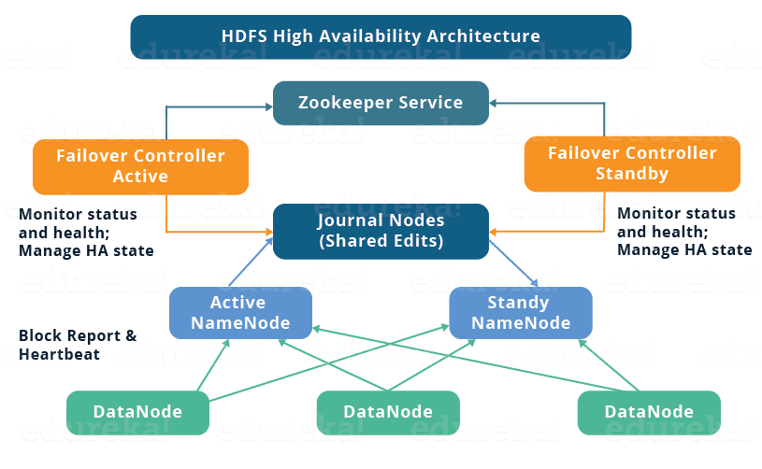
Manual Failover - hdfs haadmin -failover -forceactive namenode1(active) namenode1(standby)
HA cluster – automatic and manual failover

Slide 25
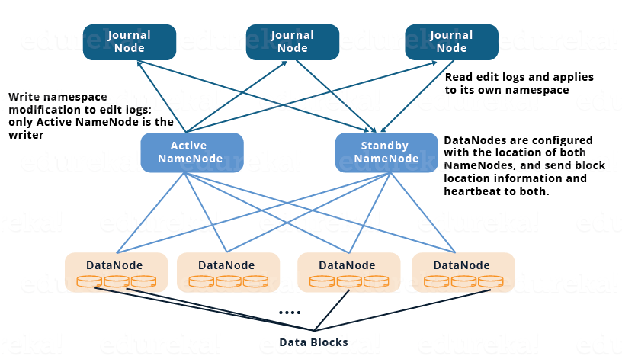
HA cluster using quorum journal nodes

Slide 26
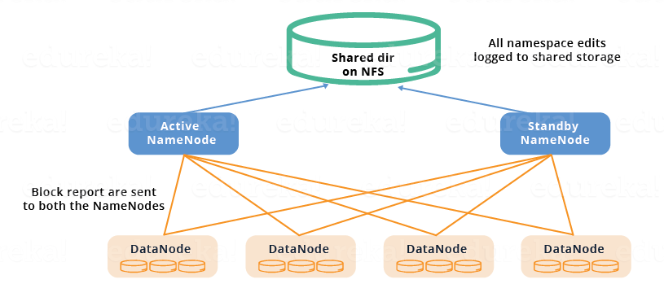
HA cluster shared storage using nfs

Slide 27
Rack awareness
Erasure Coding
HDFS Federation
HTTP access to hdfs – httpfs and webhdfs

