Slide 1
EDA
Exploratory Data Analysis

Slide 2
What is EDA?
In statistics, exploratory data analysis (EDA) is an approach to analysing data sets to summarize their main characteristics, often with visual methods.
A statistical model can be used or not, but primarily EDA is for seeing what the data can tell us beyond the formal modelling or hypothesis testing task.

Slide 3
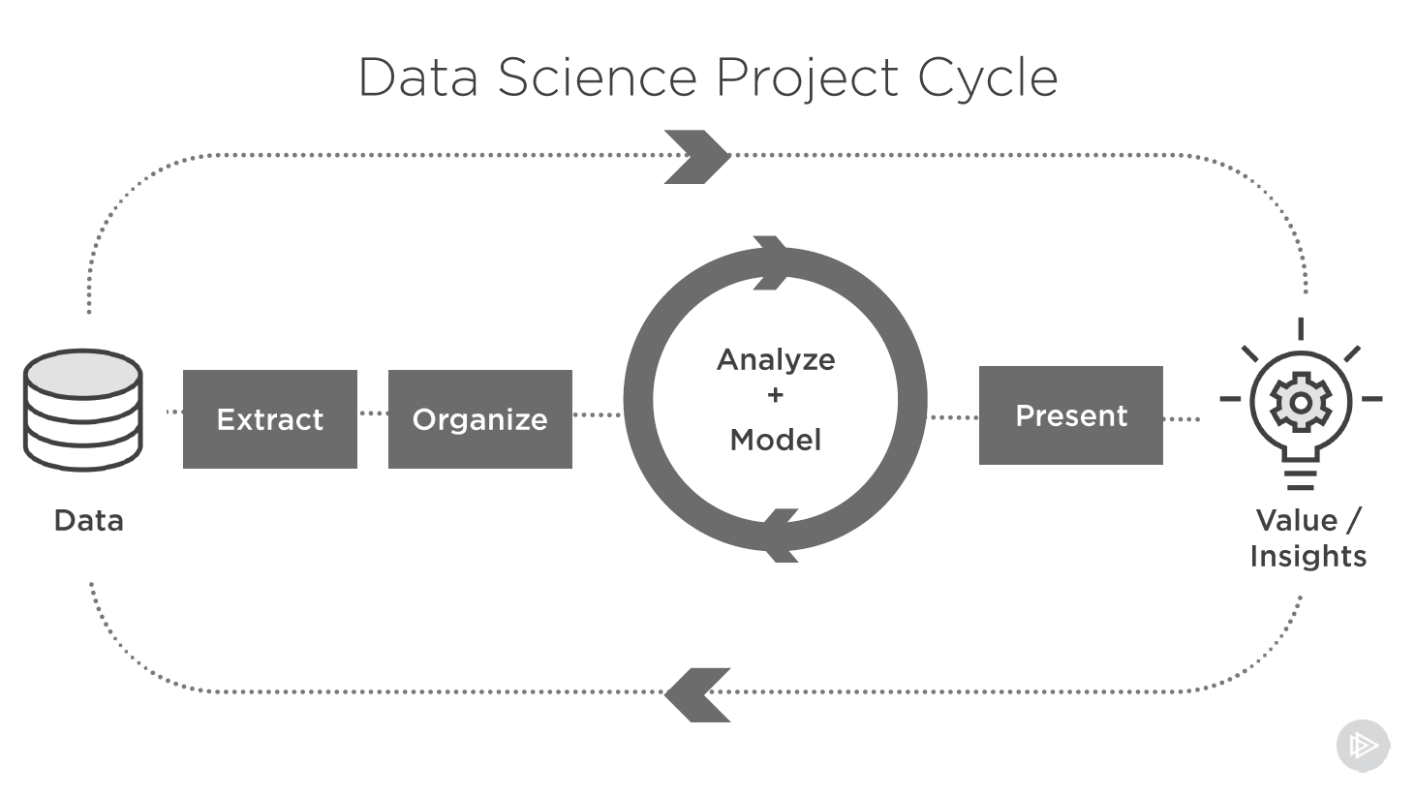

Slide 4
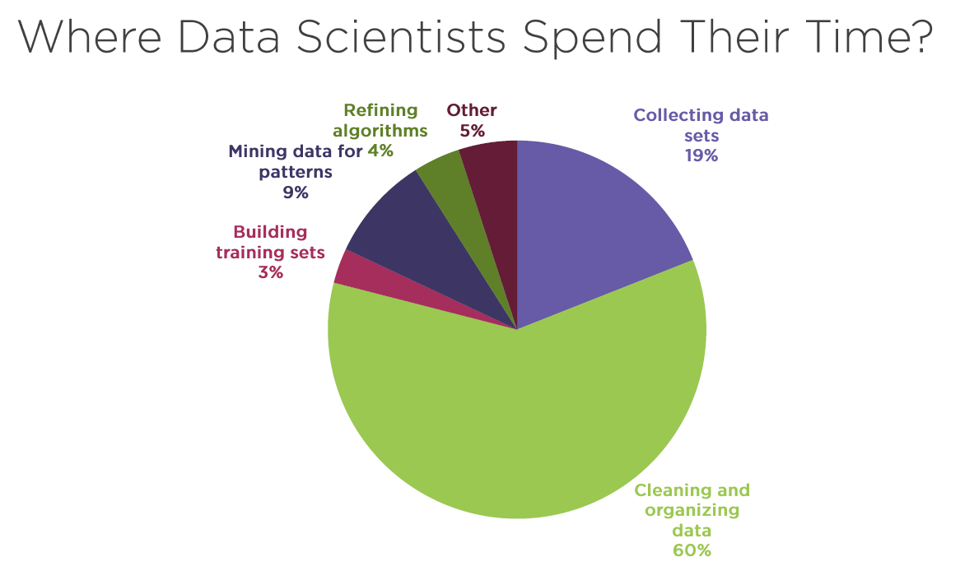

Slide 5
Why do we need EDA?
Detection of mistakes
Checking of assumptions
Preliminary selection of appropriate models
Determining relationships among the explanatory features, and
Assessing the direction and rough size of relationships between explanatory and outcome features.

Slide 6
Improvisation of EDA
Quality of your inputs decide the quality of your output.
To improve the model accuracy, EDA may be repeated after the model tuning.

Slide 7
What EDA Does?
EDA visualizes the important aspect in the data while hiding the unnecessary.
EDA explores the data, and possibly formulate hypotheses that could lead to new data collection and experiments.
EDA focuses more narrowly on checking assumptions required for model fitting and hypothesis testing, and handling missing values and making transformations of variables as needed.

Slide 8
How EDA Works?
EDA is generally cross-classified in two ways:
Each method is either non-graphical or graphical.
Each method is either univariate or multivariate (usually just bivariate).
Beyond the categories created by the above cross-classification, each of the categories of EDA have further divisions based on:
The role (outcome or explanatory)
The type (categorical or continuous)
The techniques involved to understand, clean and prepare your data for building your predictive model:
Identify Predictor
Identify Target Features
Identify the data type and the category of the feature

Slide 9
Types of EDA
There are 4 different types of EDA.
Univariate non-graphical
Univariate graphical
Multivariate non-graphical
Multivariate graphical

Slide 10
Univariate non-graphical
This method is to look into the “sample distribution” of a single feature to make some tentative conclusions about how the target column is compatible with that feature.
To find missing data.
To find outlier (noise data) values.
Based on the type of feature, categorical or continuous, there are different approaches.

Slide 11
Univariate non-graphical – Categorical Data
Range of values and the frequency (or relative frequency) of occurrence for each value are to be found.
The technique used is some form of tabulation of the frequencies, along with calculation of the percent of data that falls in each category.
Statistic | Maths | Physics | Chemistry | Social | Total
Count | 5 | 6 | 4 | 5 | 20
Proportion | 0.25 | 0.3 | 0.2 | 0.25 | 1
percent | 25% | 30% | 20% | 25% | 100%

Slide 12


Univariate non-graphical – Continuous Data
Central tendency and spread of the feature are to be identified.
It uses 3 different arithmetic statistical methods:
Mean
Median The middle value of the values placed as an ordered list.
Mode The most frequently occurring value.
Several statistics are commonly used as a measure of the spread of a distribution:
Variance
Standard Deviation Square root of Variance
Interquartile range IQR = Q3 - Q1

Slide 13
Univariate graphical
Graphical techniques, are graphics in the field of statistics used to visualize quantitative data.
Non-graphical techniques yield their output in numeric or tabular form, where as graphical techniques allow such results to be displayed in some sort of pictorial form.
The different types of graphical methods are,
Histogram
Stem-and-Leaf plot
Boxplot

Slide 14
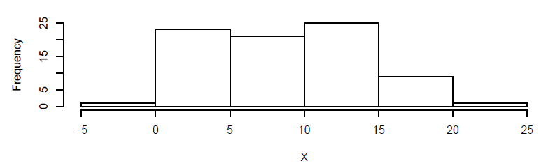
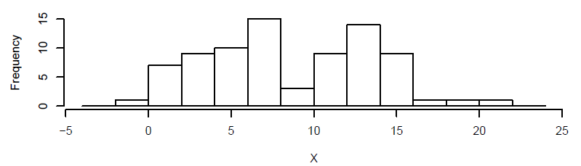
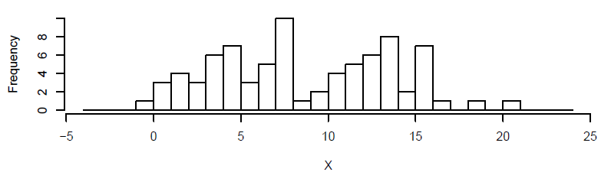
Histogram
The most basic graph is the histogram, which is a bar plot in which each bar represents the frequency (count) or proportion (count/total count) of cases for a range of values.

Slide 15
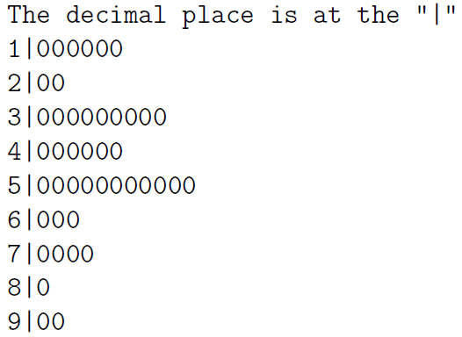
Stem-and-Leaf plot
A simple substitute for a histogram is a stem and leaf plot. A stem and leaf plot is sometimes easier to make by hand than a histogram, and it tends not to hide any information.

Slide 16
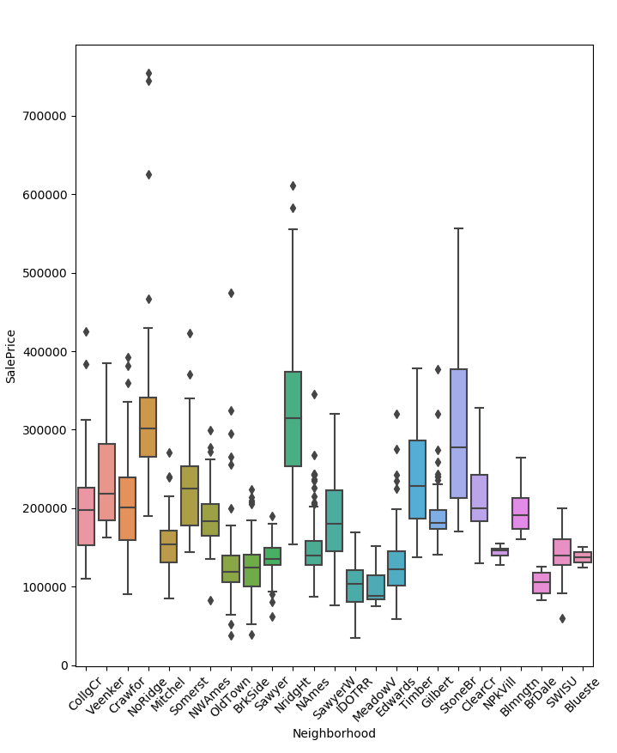
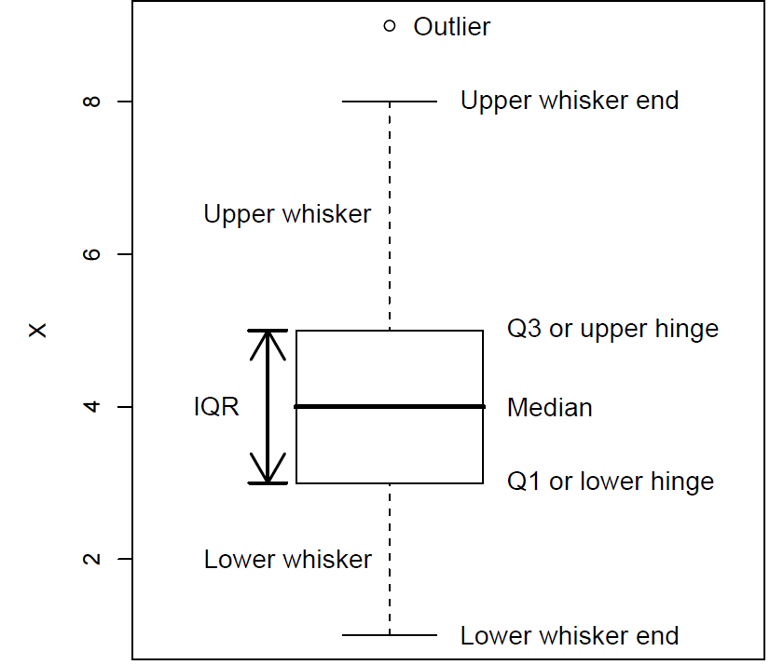
Boxplot
The boxplot consists of a rectangular box bounded above and below by hinges that represent the quartiles Q3 and Q1 respectively, and with a horizontal median line through it.

Slide 17
Multivariate non-graphical
Multivariate non-graphical EDA techniques generally show the relationship between two or more features in the form of either cross-tabulation or statistics.
There are three approaches:
Categorical and Categorical
Continuous and Continuous
Categorical and Continuous

Slide 18

Multivariate non-graphical – Categorical Data
Cross Tabulation
Ex: For each subject we observe sex and age as categorical variables.
Subject ID | Age Group | Sex
GW | young | F
JA | middle | F
TJ | young | M
JMA | young | M
JMO | middle | F
JQA | old | F
AJ | old | F
MVB | young | M
WHH | old | F
JT | young | F
JKP | middle | M
Age Group/Sex | Female | Male | Total
young | 2 | 3 | 5
middle | 2 | 1 | 3
old | 3 | 0 | 3
Total | 7 | 4 | 11
Chi-Square Test is for testing null hypothesis.
Significance level: We can choose significance levels from 0.01 to 0.10; but any value between 0 and 1 can be used.
Probability of 0: It indicates that both categorical variables are dependent
Probability of 1: It shows that both categorical variables are independent.

Slide 19

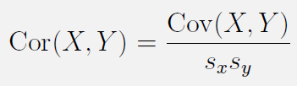
Multivariate non-graphical – Continuous Data
For two continuous features, the basic statistics of interest are the sample covariance and/or sample correlation.
Positive covariance values suggest that when one measurement is above the mean the other will probably also be above the mean, and vice versa.
Negative covariance suggest that when one variable is above its mean, the other is below its mean.
And covariance near zero suggest that the two variables vary independently of each other.
Covariance tend to be hard to interpret, so we often use correlation instead. The correlation has the nice property that it is always between -1 and +1, with -1 being a perfect negative linear correlation, +1 being a perfect positive linear correlation and 0 indicating that X and Y are uncorrelated.
Where Sx is the standard deviation of X and Sy is the standard deviation of Y.

Slide 20
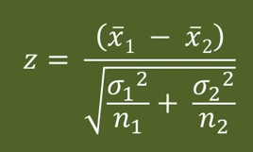
Multivariate non-graphical – Categorical and Continuous data
Z-Test: This test tells whether mean of two groups are statistically different from each other or not.

Slide 21
Multivariate graphical
Multivariate graphical EDA techniques generally show the relationship between two or more features in the form of graphics.
There are three approaches:
Categorical and Continuous
Continuous and Continuous
Categorical and Categorical

Slide 22
Multivariate graphical – Categorical and Continuous data
When we have one categorical (usually explanatory) and one continuous (usually outcome) feature, graphical EDA usually takes the form of conditioning on the categorical random feature.
This simply indicates that we focus on all of the subjects with a particular level of the categorical random feature, then make plots of the continuous feature for those subjects.
The most commonly used of these are side-by-side boxplots, Facet Grids and Factor Plot.
Facet Grid is used to draw plots with multiple Axes where each Axes shows the same relationship conditioned on different levels of features.
Factor Plot, we have to see how features get mapped to the plot structure so that comparisons can be made easy. As a general rule, it is easier to compare positions that are closer together, so the hue variable should be used for the most important comparisons.

Slide 23
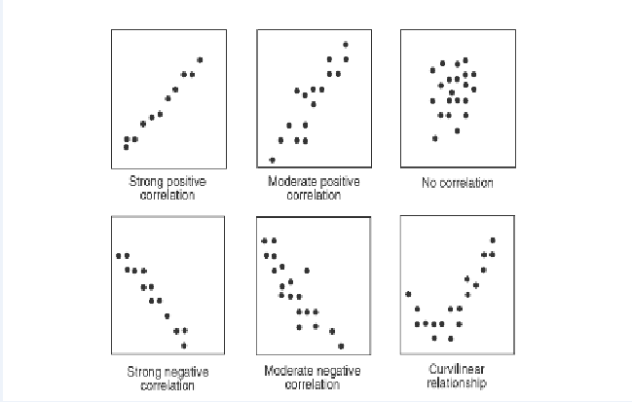
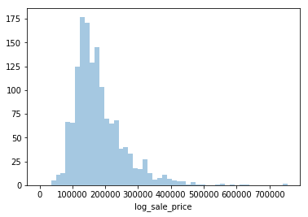
Multivariate graphical – Continuous Data
Scatter plot is a way to find out the relationship between two continuous features.
The relationship can be linear or non-linear.
This is good plot for data visualization as we can see data points as dots.
Dist. plot: Visualization of continuous columns with log values

Slide 24
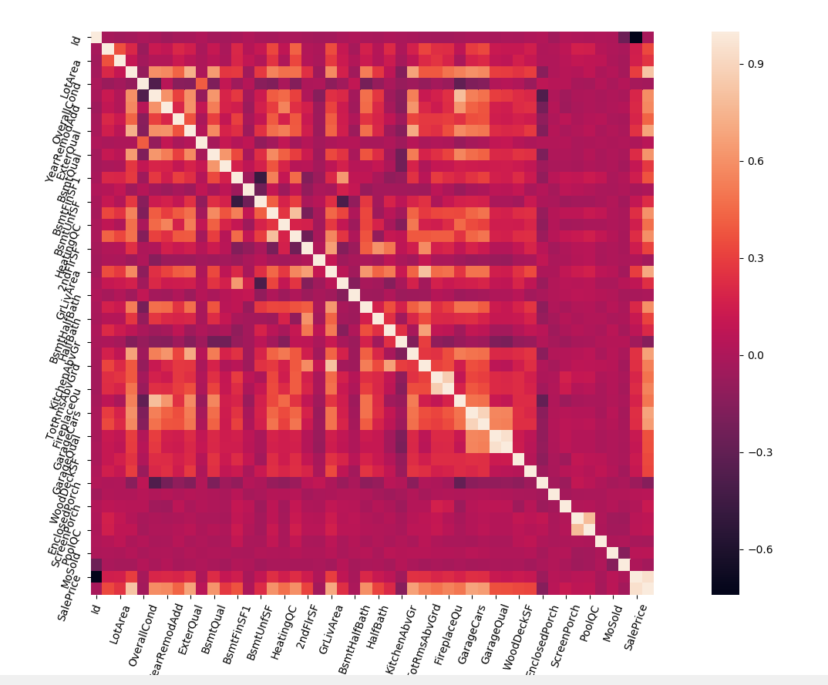
Multivariate graphical – Continuous Data(Cont.)
Heat map is used to understand the correlation between features
Correlation boundary is from -1 to +1
-0.5 to +0.5 correlation columns are considered
Boundary: -1 to 0 to +1
We consider features with the range from – 0.5 to + 0.5

Slide 25
Multivariate graphical – Categorical Data
Stacked Column Chart is used to visualise graphically.
MSSubClass | LotFrontage | SalePrice
60 | 65 | 208500
20 | 80 | 181500
60 | 68 | 223500
70 | 60 | 140000
60 | 84 | 250000
50 | 85 | 143000
MSSubClass/Lot Frontage | 60 | 65 | 68 | 80 | 84 | 85
20 |  |  |  | 181500
50 |  |  |  |  |  | 143000
60 |  | 208500 | 223500 |  | 250000
70 | 140000

Slide 26
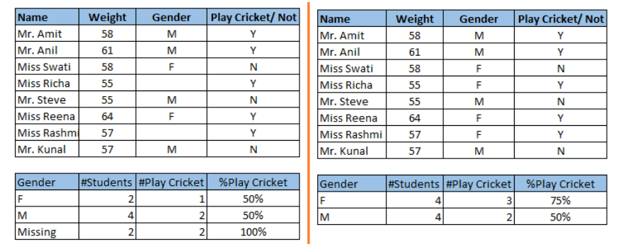
Few other EDA Techniques
Missing value treatment
Missing data can reduce the accuracy of model and can also lead to a biased model
Mean/Mode/Median Imputation
We can also use Mean/Median/Mode to fill the missing data.
Deletion: There are two types
List wise Deletion: In list wise deletion, we delete rows where any of the variable is missing.
Pair Wise Deletion: In Pair wise deletion, we ignore missing values.

Slide 27
Feature Engineering
Feature engineering is the science of extracting more information from raw data. We are not adding any new data here but we are making the actual data more useful.
Feature engineering also take good part of project time.
It is an iterative process that interplays with data selection and model evaluation, again and again, until we run out of time on our problem ☺.

Slide 28
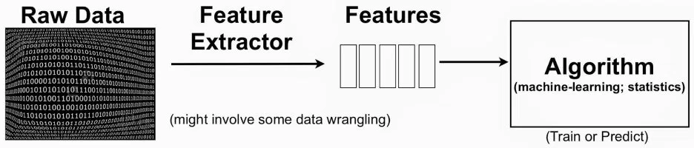
Life Cycle of FE

Slide 29
Importance of Feature Engineering
The features in our data will directly influence the predictive models we use and the results we can achieve.
We can say that: the better the features that we prepare and choose, the better the results we will achieve.
Better features means flexibility.
Better features means simpler models.
Better features means better results.

Slide 30
Sub-Problems of Feature Engineering
Feature: An attribute useful for our modelling task
Feature Importance: An estimate of the usefulness of a feature
Feature Extraction: The construction of new features from raw data
Feature Selection: From many features to a few that are useful

