Slide 1
Tableau

Slide 2
Introduction
Tableau is a Business Intelligence tool for visually analyzing the data.
Users can create and distribute an interactive and shareable dashboard, which depict the trends, variations, and density of the data in the form of graphs and charts.
Tableau can connect to files, relational and Big Data sources to acquire and process data. The software allows data blending and real-time collaboration, which makes it very unique.
It is used by businesses, academic researchers, and many government organizations for visual data analysis.

Slide 3
VizQL
VizQL is a visual query language that translates drag-and-drop actions into data queries and then expresses that data visually.
VizQL delivers dramatic gains in people’s ability to see and understand data by abstracting the underlying complexities of query and analysis.
The result is an intuitive user experience that lets people answer questions as fast as they can think of them.We believe that VizQL represents a foundational advancement in the area of data analysis andvisualization.

Slide 4
Different Tableau Products
There are different tableau products available:
  Tableau Desktop
  Tableau Server
  Tableau Online
  Tableau Public

Slide 5
Tableau Desktop
Tableau Desktop is a data visualization application to facilitate you to examine virtually any kind of structured data and generate highly interactive, beautiful graphs, dashboards, and reports within minutes.
Once a quick installation, you can tie to virtually any data source from spreadsheets to data warehouses and display information in several graphic perspectives.

Slide 6
Tableau Server
Tableau Server is a business intelligence application which offers browser-based analytics anyone can utilize.
It is a rapid-fire alternative to the slow pace of traditional BI software.
It is an online solution meant for sharing, distributing, and collaborating on content created in Tableau.

Slide 7
Tableau Online
Tableau Online is a secure, cloud-based solution used for sharing, distributing, and collaborating on Tableau views and dashboards.
Tableau Online set the flexibility and ease of a powerful cloud-based data visualization solution to work intended for you—without servers, server software, or IT support. It builds rapid-fire business analytics easier than ever.
Share dashboards among your whole company and with customers and partners— in minutes.

Slide 8
Tableau Public
Tableau Public is free software to facilitate anyone to connect to a spreadsheet or file and create interactive data visualizations for the web.
It is delivered as a service which permits user to be up and running overnight. With Tableau Public user can construct amazing interactive visuals and publish them quickly, without the help of programmers or IT.

Slide 9
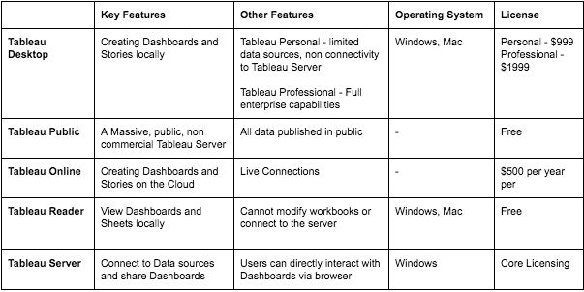
Different Tableau Products and the Cost

Slide 10
Advantages
Speed
Ease of use
Enhanced user-experience using Tableau
Handle large amount of data
Multiple Data Source Connections

Slide 11
Disadvantages
High Cost
Security Issues
IT Assistance for proper use
Poor BI Capabilities

Slide 12
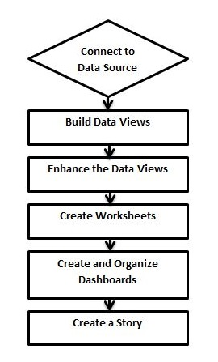
Design Flow

Slide 13
Step 1:Connect to Data Source
Tableau connects to all popular data sources. It has inbuilt connectors which take care of establishing the connection, once the connection parameters are supplied.
Be it simple text files, relational sources, SQL sources or cloud data bases, Tableau connects to nearly every data source.

Slide 14
Step 2:Build Data Views
After connecting to a data source, you get all the column and data available in the Tableau environment.
Tableau classify them as dimensions and measures, and create any hierarchy required. Using these you build views, which are traditionally known as Reports.
Tableau provides easy drag and drop feature to build views.

Slide 15
Step 3:Enhance the Views
The views created above needs to be enhanced further by the use of filters, aggregations, labeling of axes, formatting of colors and borders, etc.
Step 4:Create Worksheets
Create different worksheets to create different views on the same or different data.

Slide 16
Step 5:Create and Organize Dashboards
Dashboards contain multiple worksheets which are linked. Hence, the action in any of the worksheet can change the result in the dashboard accordingly.
Step 6:Create Story
A story is a sheet that contains a sequence of worksheets or dashboards that work together to convey information. You can create stories to show how facts are connected, provide context, demonstrate how decisions relate to outcomes, or simply make a compelling case.

Slide 17
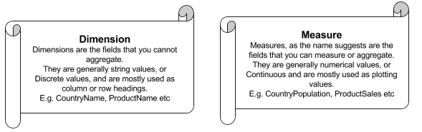
Dimensions And Measures

Slide 18
File Types
Tableau Workbook (.twb): It contains information on each sheet and dashboard that is present in a workbook. It has the details of the fields, which are used in each view and the formula applied to the aggregation of the measures. It also has the formatting and styles applied. It contains the data source connection information and any metadata information created for that connection.
Tableau Packaged Workbook (.twbx):This file format contains the details of a workbook as well as the local data that is used in the analysis. Its purpose is to share with other Tableau desktop or Tableau reader users, assuming it does not need data from the server.

Slide 19
File Types(Cont...)
Tableau Data Source (.tds):The details of the connection used to create the tableau report are stored in this file. In the connection details, it stores the source type (excel/relational/sap, etc.) as well as the data types of the columns.
Tableau Packaged Data source (.tdsx):This file is similar to the .tds file with the addition of data along with the connection details.

Slide 20
File Types(Cont...)
Tableau Data Extract (.tde):This file contains the data used in a .twb file in a highly compressed columnar data format. This helps in storage optimization. It also saves the aggregated calculations that are applied in the analysis. This file should be refreshed to get the updated data from the source.
Tableau Bookmark (.tbm):These files contain a single worksheet that is shared easily to be pasted into other workbooks.
Tableau Preferences (.tps):This file stores the color preference used across all the workbooks. It is mainly used for consistent look and feel across the users.

Slide 21
Data Types
STRING: Any sequence of zero or more characters. They are enclosed within single quotes. The quote itself can be included in a string by writing it twice.
Eg:'Hello' 'Quoted' 'quote'
NUMBER:These are either integers or floating points. It is advised to round the floating point numbers while using them in calculations.
Eg:3,142.58

Slide 22
Data Types(Cont...)
BOOLEAN:They are logical values.
Eg:TRUE,FALSE
DATE & DATETIME :Tableau recognizes dates in almost all formats. But in case we need to force Tableau to recognize a string as date, then we put a # sign before the data.
Eg:"02/01/2015","#3 March 1982"

Slide 23
Data Sources
Tableau’s native connectors can connect to the following types of data sources:
File Systems such as CSV, Excel, etc.
Relational Systems such as Oracle, Sql Server, DB2, etc.
Cloud Systems such as Windows Azure, Google BigQuery, etc.
Other Sources using ODBC.

Slide 24
Custom Data View
A custom data view is used to extend the normal data views with some additional features so that the view can give different types of charts for the same underlying data. For example, you can drill down a dimension field which is part of a pre-defined hierarchy so that additional values of the measures are obtained at a different granularity.
There are two types in the custom data view
Drill Down View
Swapping Dimensions

Slide 25
Extracting Data
Step 1:Creating an Extract
Extraction of data is done by following the menu - Data → Extract Data. It creates many options such as applying limits to how many rows to be extracted and whether to aggregate data for dimensions.
Step 2:Applying Extract Filters
To extract a subset of data from the data source, you can create filters which will return only the relevant rows. Let’s consider the Sample Superstore data set and create an extract. In the filter option, choose Select from list and tick mark the checkbox value for which you need to pull the data from the source.

Slide 26
Extracting Data(Cont...)
Step 3:Adding New Data to Extract
To add more data for an already created extract, you can choose the option Data → Extract → Append Data from File. In this case, browse the file containing the data and click OK to finish. Of course, the number and datatype of columns in the file should be in sync with the existing data.
Step 4:Extract History
You can verify the history of data extracts to be sure about how many times the extract has happened and at what times.For this, you can use the menu - Data → Extract History.

Slide 27
Feild Operations
Step 1:Adding Fields to Worksheet
You can add any field to the worksheet by right-clicking and choosing the option Add to Sheet.
You can also drag and drop the fields into different shelves present in the worksheet, like Columns shelf, Rows shelf, Filters shelf, and many other shelves under the Marks card. The following diagram shows the right-click option.
Step 2:Combining Two Fields
You can combine two dimension fields to create one field. This combined field has a name which is a combination of the individual fields.
The values in the dimension get combined to a single value by joining the two strings into one string separated by a comma.

Slide 28
Feild Operations
Step 3:Searching Fields
You can search for names of fields by using the search box option. Writing first three or more letters of the field name brings out the result showing only the fields whose name contains these letters.
Step 4:Reordering Fields
You can change the position of fields by simply dragging them up and down. This is usually done to bring similar fields together which are frequently used for analysis.

Slide 29
Editing the metadata
Step 1:Checking the Metadata
After connecting to a data source, Tableau presents all possible tables and columns present in the source.
Consider the source ‘Sample Coffee shop’ for checking the metadata. Click the Data menu and choose to connect to a data source. Browse for the MS access file named ‘Sample - Coffee shop’.
Drag the table named Product to the data canvas. On choosing the file, you get the following screen which shows the column names, their data types.
The string data types are shown as Abc and Numeric data types are shown as #.

Slide 30
Editing the metadata(Cont...)
Step 2:Changing the Data Type
You can change the datatype of some of the fields if required. Depending on the nature of source data, sometimes Tableau may fail to recognize the data type from the source. In such scenarios, we can manually edit the data type.
Step 3:Renaming and Hiding
The column names can be changed by using the renaming option. You can also hide a column so that it does not appear in the data view that you create.
Step 4:Column Alias
Each column of the data source can be assigned an alias which helps better understand the nature of the column.

Slide 31
Data Joining
Step 1:Creating a Join
Consider the data source ‘Sample superstore’ to create a join between Orders and Returns table. For this, go to the Data menu and choose the option Edit Data Source. Next, drag the two tables, Orders and Returns to the data pane.
Step 2:Editing a Join Type
The type of join which the table creates automatically can be changed manually. For this, click the middle of the two circles showing the join. A popup window appears below which shows the four types of joins available.

Slide 32
Data Joining
Step 3:Editing Join Fields
You can also change the fields forming the join condition by clicking the Data Source option available in the join popup window. While selecting the field, you can also search for the field you are looking for using a search text box.

Slide 33
Data Blending
Data Blending is a very powerful feature in Tableau. It is used when there is related data in multiple data sources, which you want to analyze together in a single view.
Step 1:Preparing Data for Blending
First load the sample coffee chain to Tableau and look at its metadata. Go to the menu - Data → New Data Source and browse for the sample coffee chain file, which is a MS Access database file.

Slide 34
Data Blending
Step 2:Adding Secondary Data Source
Next, add the secondary data source named Sample-superstore by again following the steps - Data → New Data Source and choosing this data source.
Step 3:Blending the Data
Now you can integrate the data from both the above sources based on a common dimension. Note that a small chain image appears next to the dimension named State. This indicates the common dimension between the two data sources

Slide 35
Tableau Operators
General Operators: Addition (+),Subtraction(-)
Arithmetic Operators: Multiplication(*),Division(/),Modulo(%),Power(^)
Relational Operators:Equal to(== or =),Not equal to(!= or <>),Greater than(>),Less than(<).
Logical Operators: AND,OR,NOT.

Slide 36
Tableau Functions
Number Functions:CEILING,POWER,ROUND
String Functions:LEN,LTRIM,REPLACE,UPPER
Date Functions:DATE ADD,DATE NAME,DAY,NOW
Logical Functions:IF NULL(EXP1,EXP2),IS DATE(STRING),MIN
Aggregate Functions:AVG,COUNT,MEDIAN,STDEV

Slide 37
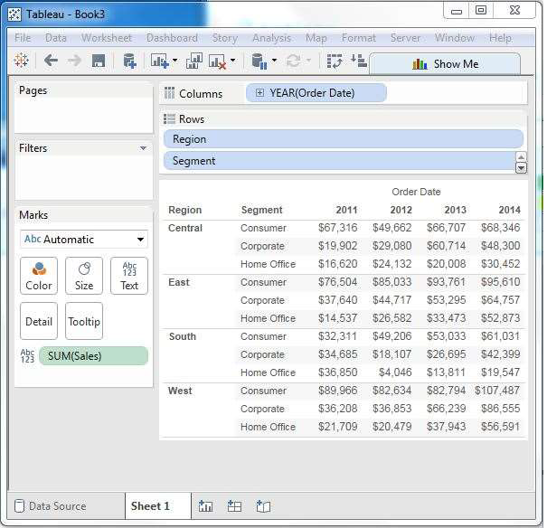
Tableau Charts
Cross Tab (or) Text tables:Select one or more dimensions and one or more measures.

Slide 38
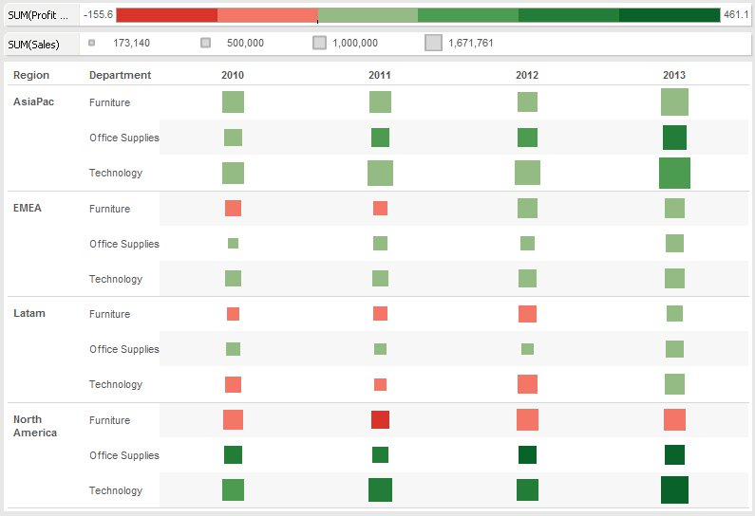
Tableau Charts(Cont...)
Heat Map:Select one or more dimensions and maximum of two measures.

Slide 39
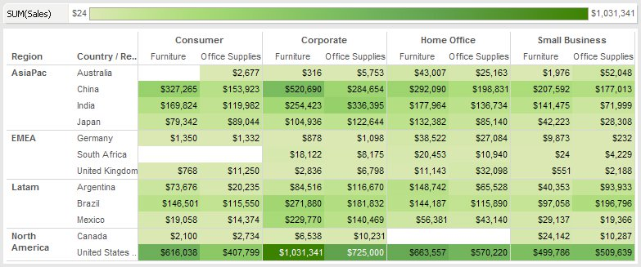
Tableau Charts(Cont...)
Highlight Tables:Select one or more dimensions and only one measure.

Slide 40
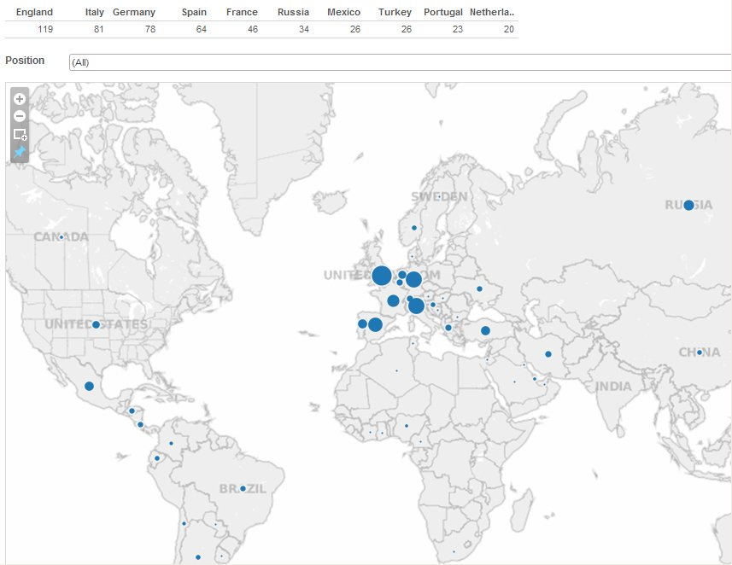
Tableau Charts(Cont...)
Symbol Maps:Select one geo dimensions,0 or more dimensions and,0 or more measures.

Slide 41
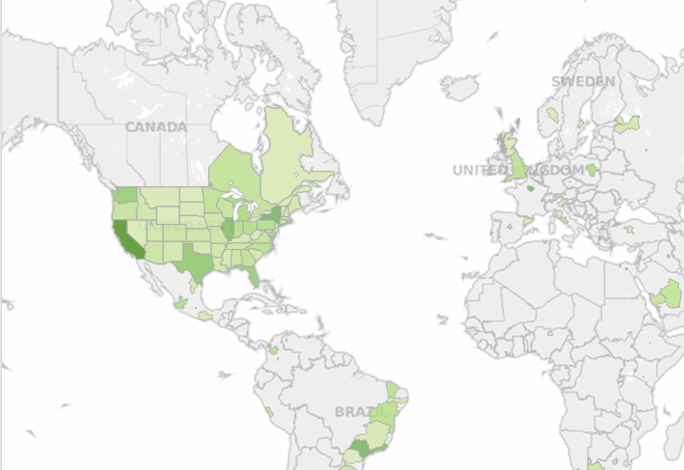
Tableau Charts(Cont...)
Filled Maps: Select one geo dimensions,0 or more dimensions and 0 or more measures.

Slide 42
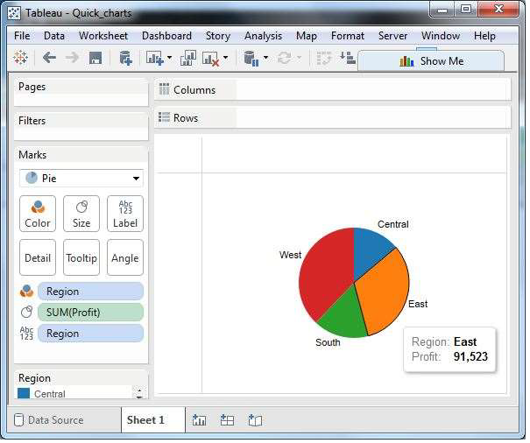
Tableau Charts(Cont...)
Pie Chart:Select one or more dimensions and maximum of two measures.

Slide 43
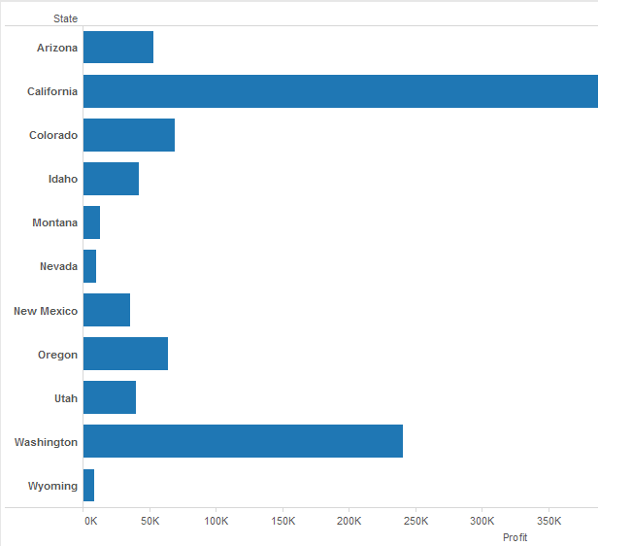
Tableau Charts(Cont...)
Horizontal Bar Charts:Select 0 or more dimensions and one or more measures.

Slide 44
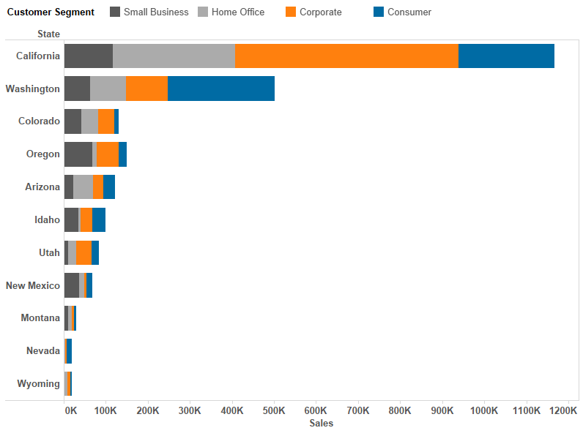
Tableau Charts(Cont...)
Stacked Bar Chart:Select one or more dimensions and one or more measures.

Slide 45
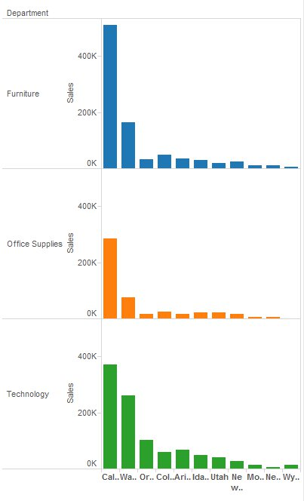
Tableau Charts(Cont...)
Side by Side Bar Charts:Select one or more dimensions and one or more dimensions.But requires atleast three.

Slide 46
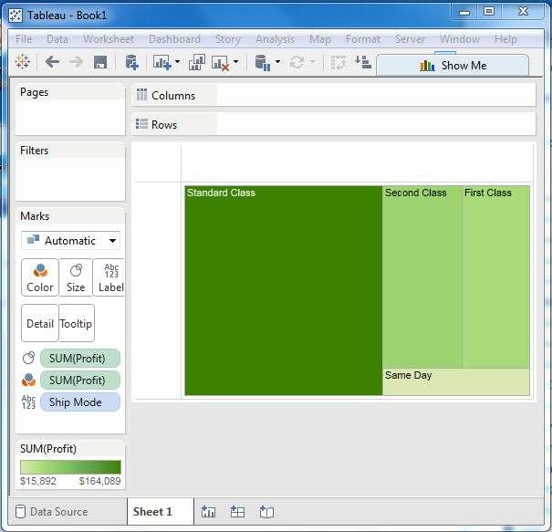
Tableau Charts(Cont...)
Tree Maps:Select one or more dimensions and maximum of two measures.

Slide 47
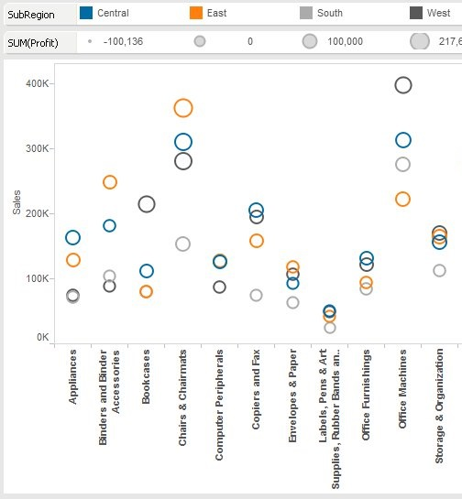
Tableau Charts(Cont...)
Circles View:Select one or more dimensions and one or more measures.

Slide 48
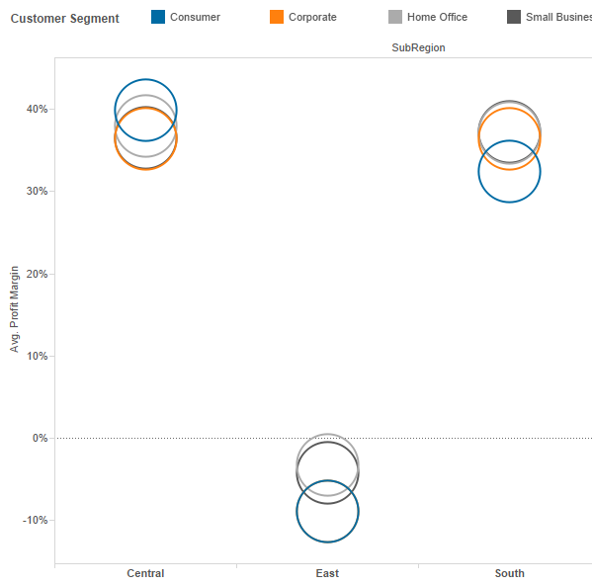
Tableau Charts(Cont...)
Side by Side Circles View:Select one or more dimensions and one or more measures.But requires atleast three.

Slide 49
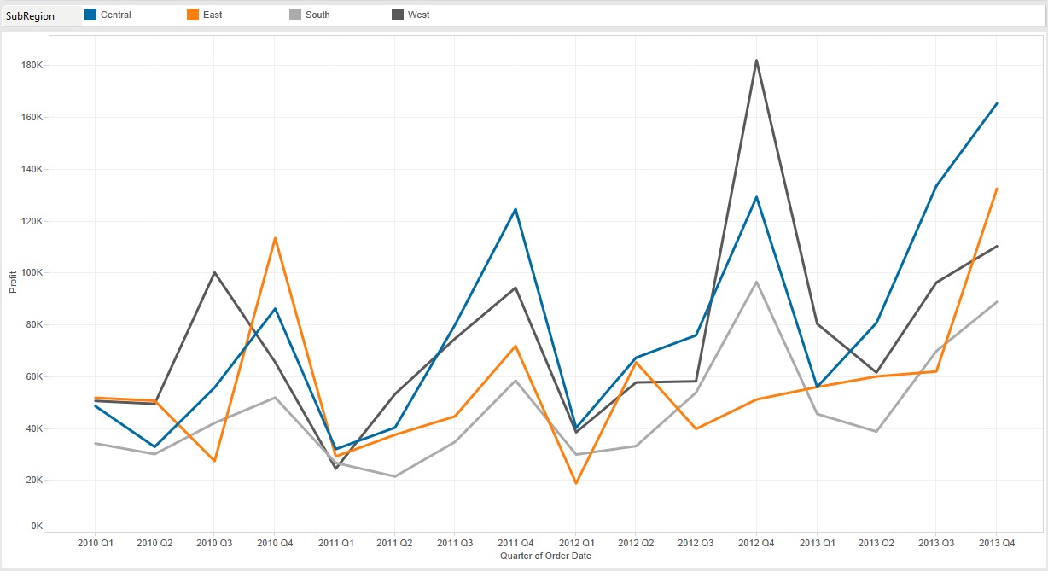
Tableau Charts(Cont...)
Line(Continuous):This is for Date.Select 0 or more dimensions and 1 or more measures.

Slide 50
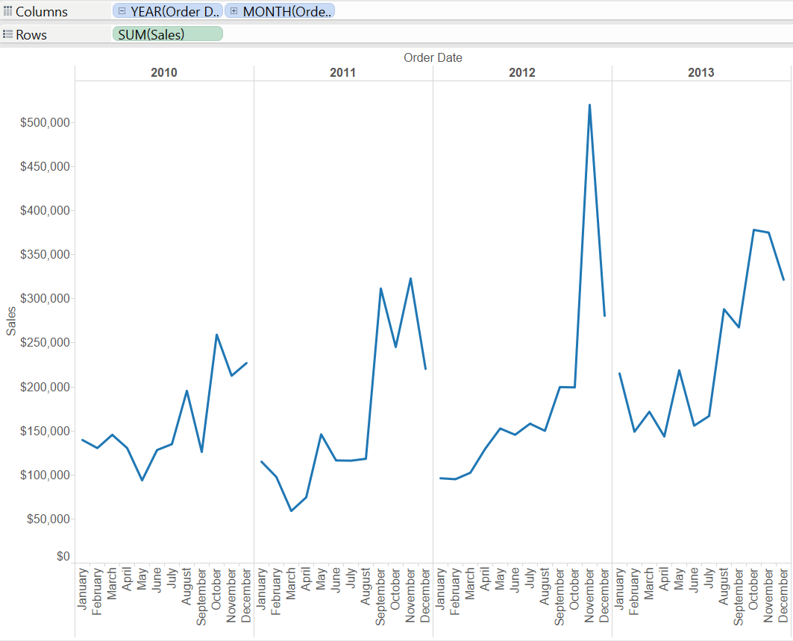
Tableau Charts(Cont...)
Line(Discrete):This is for Date.Select 0 or more dimensions and 1 or more measures.

Slide 51
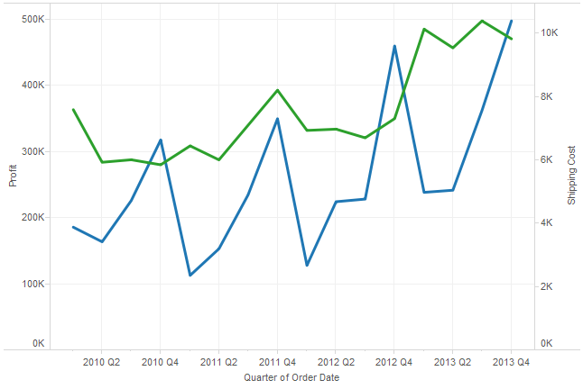
Tableau Charts(Cont...)
Dual Lines:This is for Date.Select one or more dimensions and two measures.

Slide 52
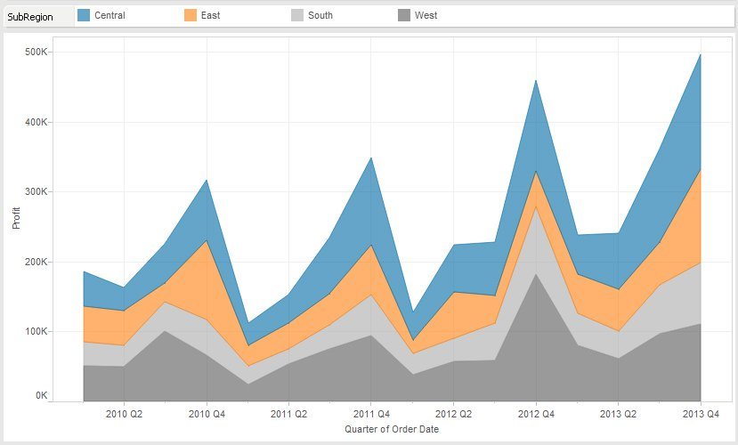
Tableau Charts(Cont...)
Area Chart(Continuous):This is for Date.Select 0 or more dimensions and 1 or more measures.

Slide 53
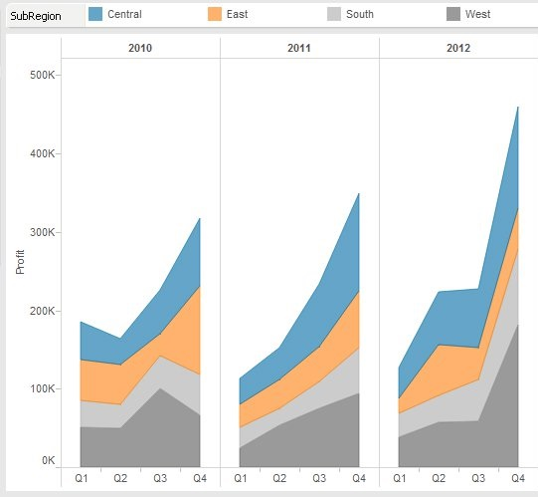
Tableau Charts(Cont...)
Area Chart(Discrete):This is for Date.Select 0 or more dimensions and 1 or more measures.

Slide 54
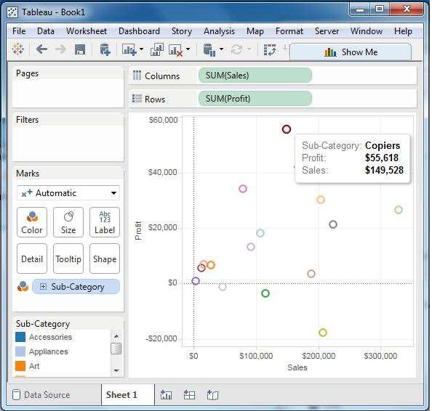
Tableau Charts(Cont...)
Scatter Plot:Select 0 or more dimensions and two to four measures.

Slide 55
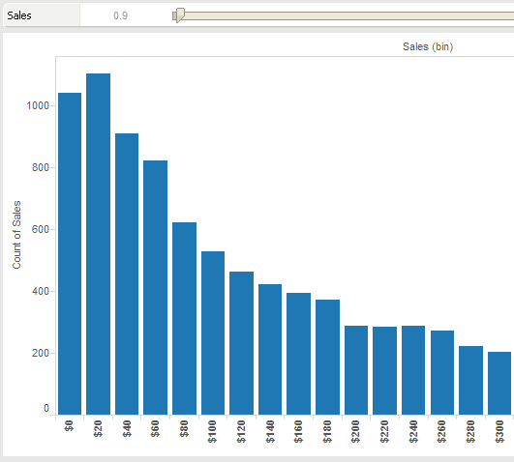
Tableau Charts(Cont...)
Histrogram:Creates a bin feild it is not applicable for all the measures.Select one measures.

Slide 56
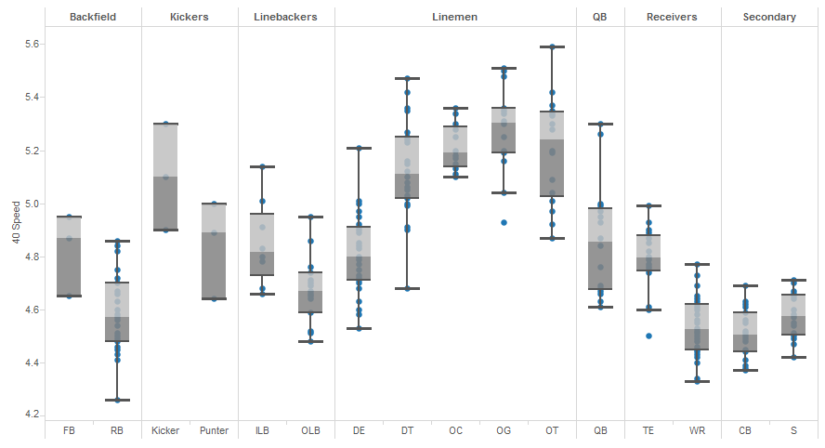
Tableau Charts(Cont...)
Box or whisker plot:Select 0 or more dimensions and one or more measures.

Slide 57
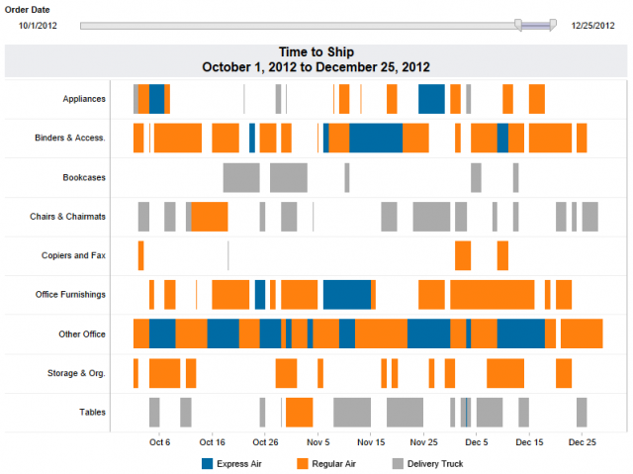
Tableau Charts(Cont...)
Gantt Chart:This is for Date.Select one or more dimensions and maximum two measures.

Slide 58
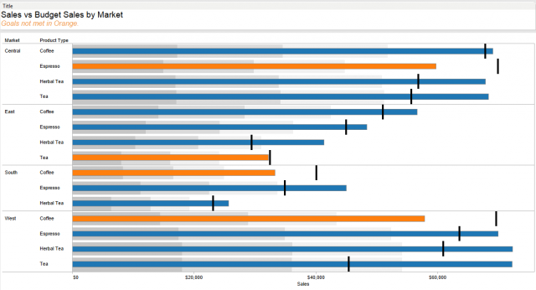
Tableau Charts(Cont...)
Bullet Graph:Select 0 or more dimensions and maximum two measures.

Slide 59
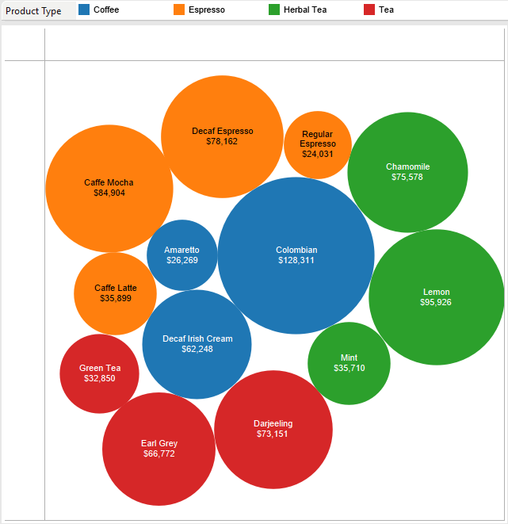
Tableau Charts(Cont...)
Packed Bubbles:Select one or more dimensions and maximum two measures.

Slide 60
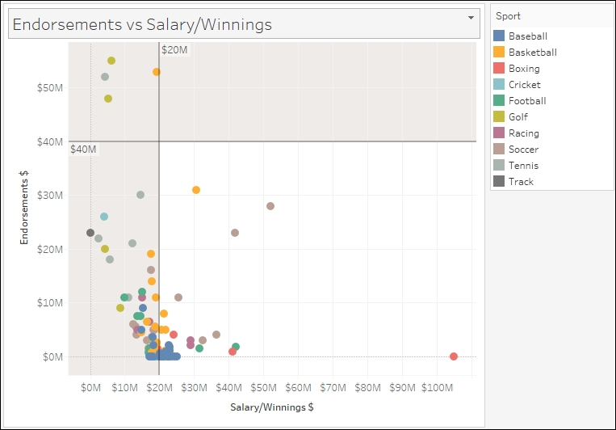
Analytics Pane
Summarize:
Constant Line:A line with the value that is input.

Slide 61
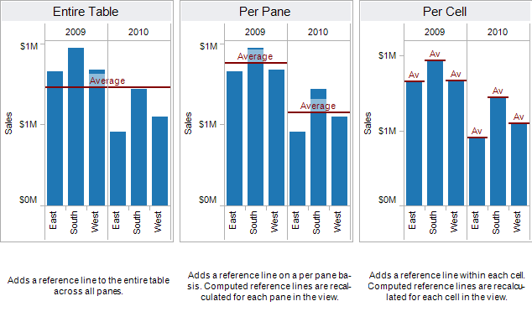
Analytics Pane(Cont...)
Average Line:A line showing the average summed up to the level specified.

Slide 62
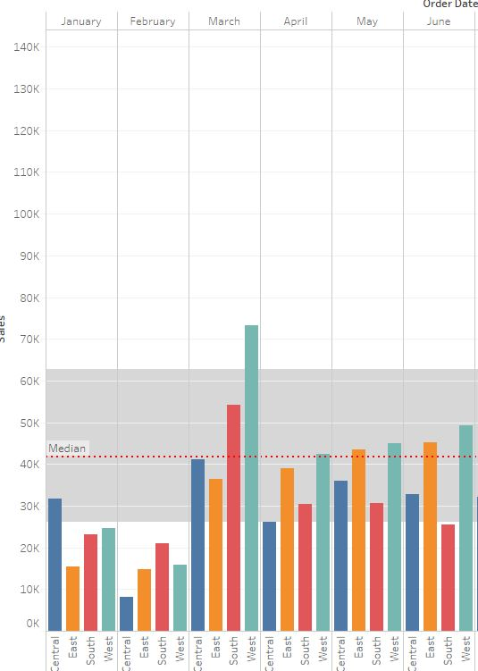
Analytics Pane(Cont...)
Median with Quartiles:The middle number and the lines which contain 25% and 75% of the values.

Slide 63
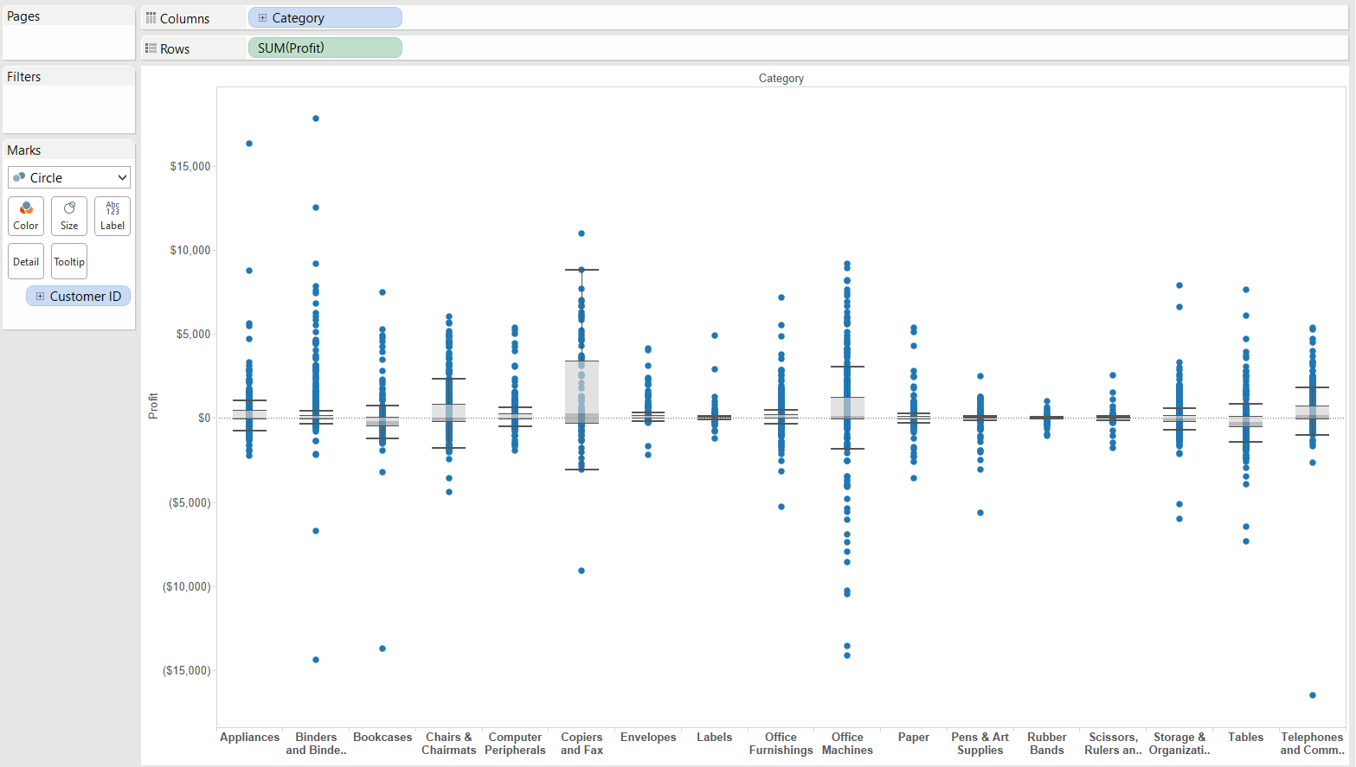
Analytics Pane(Cont...)
Box Plot:The same as above but with more lines and at different values.

Slide 64
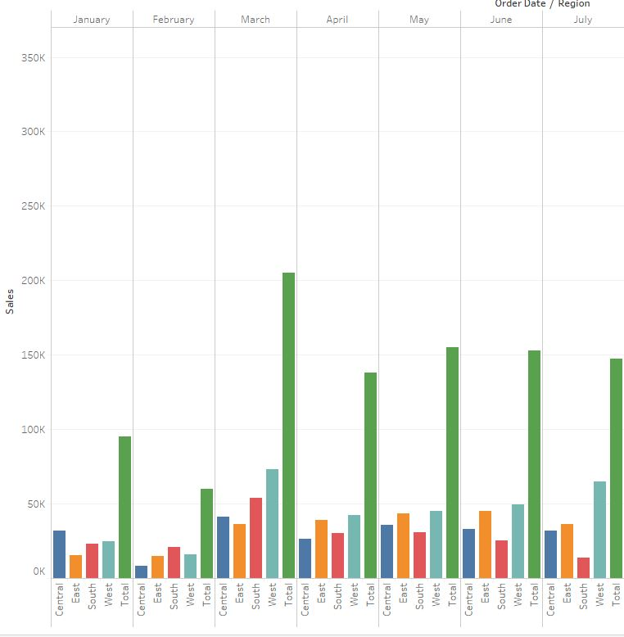
Analytics Pane(Cont...)
Totals:Gives the totals.

Slide 65
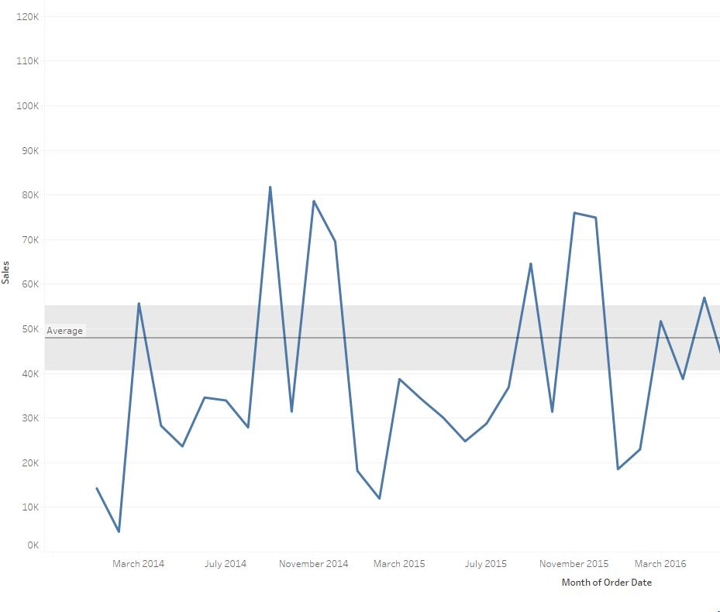
Analytics Pane(Cont...)
Model:
Average with 95%CI(Confidence Interval): Gives the average and a customisable confidence level line.The confidence interval distribution bands shade the region in which the population average will fall 95% of the time.

Slide 66
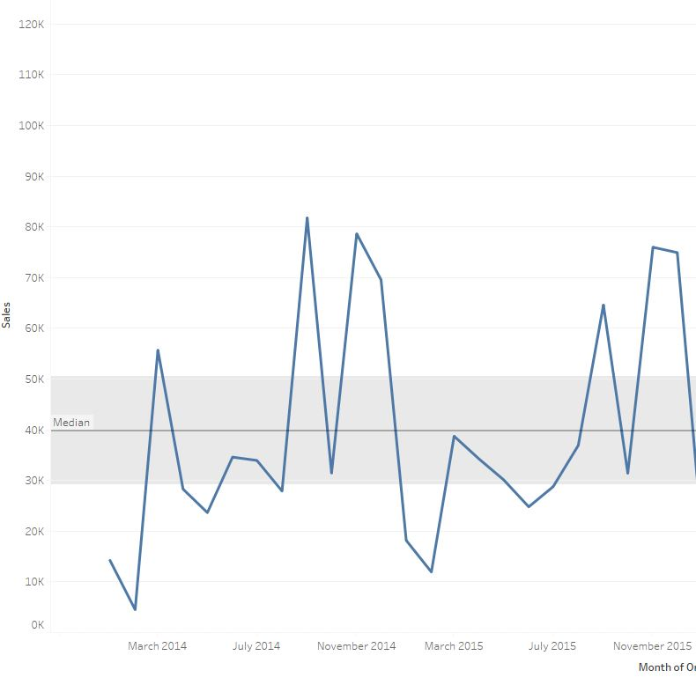
Analytics Pane(Cont...)
Median with 95% CI(Confidence Interval):Gives the median and a customisable confidence level line.The confidence interval distribution bands shade the region in which the population median will fall 95% of the time.

Slide 67
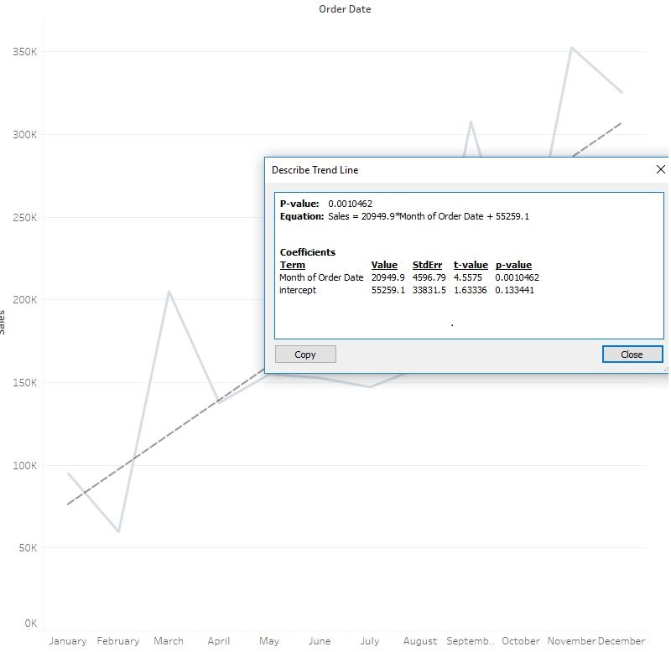
Analytics Pane(Cont...)
Trend Line:Finds the trend of your points (the line closest to the most points).

Slide 68
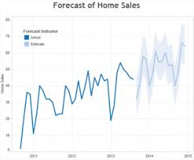
Analytics Pane(Cont...)
Forecast:Forecasts your data for the future.Forecasting in Tableau uses a technique known as exponential smoothing. Forecast algorithms try to find a regular pattern in measures that can be continued into the future.

Slide 69
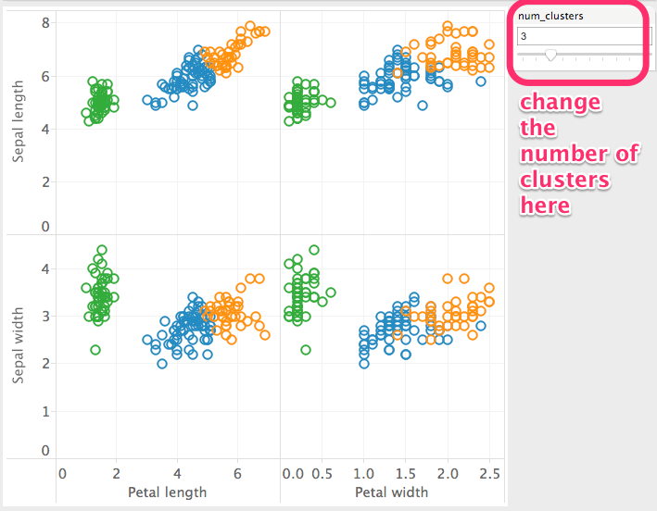
Analytics Pane(Cont...)
Cluster:Cluster analysis partitions the marks in the view into clusters, where the marks within each cluster are more similar to one another than they are to marks in other clusters. Tableau distinguishes clusters using color.

Slide 70
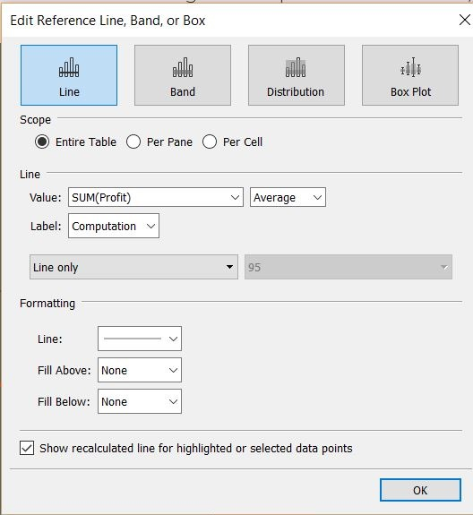
Analytics Pane
Dragging on the ‘Custom’ line/band allows you to decide what kind of analysis you want to do with the line/band.

Slide 71
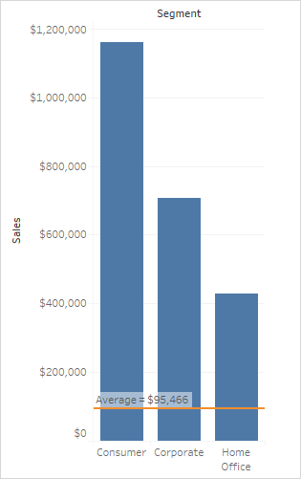
Analytics Pane(Cont...)
Custom:
Reference Line:Plots a line based on any measure in the visualisation.

Slide 72
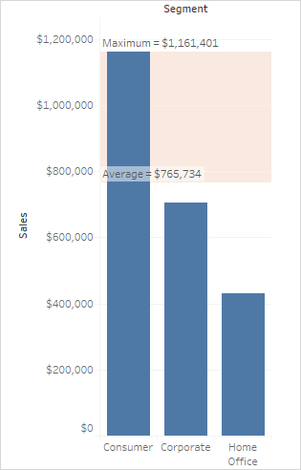
Analytics Pane(Cont...)
Reference Band: Maps a box between two customisable lines.

Slide 73
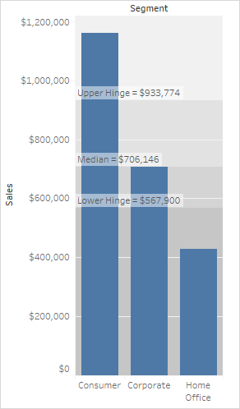
Analytics Pane(Cont...)
Distribution Band:Same as above but with percentages of values.

Slide 74
Analytics Pane(Cont...)
Box Plot:The same as a box plot but with the custom menu open by default.

Slide 75


