Slide 1
RAGAS Evaluation
A No-Code Way to Evaluate RAG System Quality
June-26
AIWeavers

Slide 2
Who This Is For
One tool, three different audiences
Non-Coders
Anyone — QA, product, leadership — can evaluate a RAG system's answers themselves, with zero code.
Developers
Self-check your own RAG system's output in the UI, without waiting on a tester first — removing one full dependency.
Testers
Still own the important part: creating the test data from the golden test cases that everything else runs against.

Slide 3
What Does the API Extract from the RAG Pipeline?
Architecture flow
Query
from Tester / User
RAG System Under Test
Vector DB
retrieves Context chunks
Query
from Tester / User
RAG API Response
fetches the Context from the Vector DB + the Answer from the LLM
Our Evaluation Tool
scores the Answer using RAGAS metrics
In-Built LLM
generates the Answer
Ground Truth
golden test case, provided by Testers

Slide 4
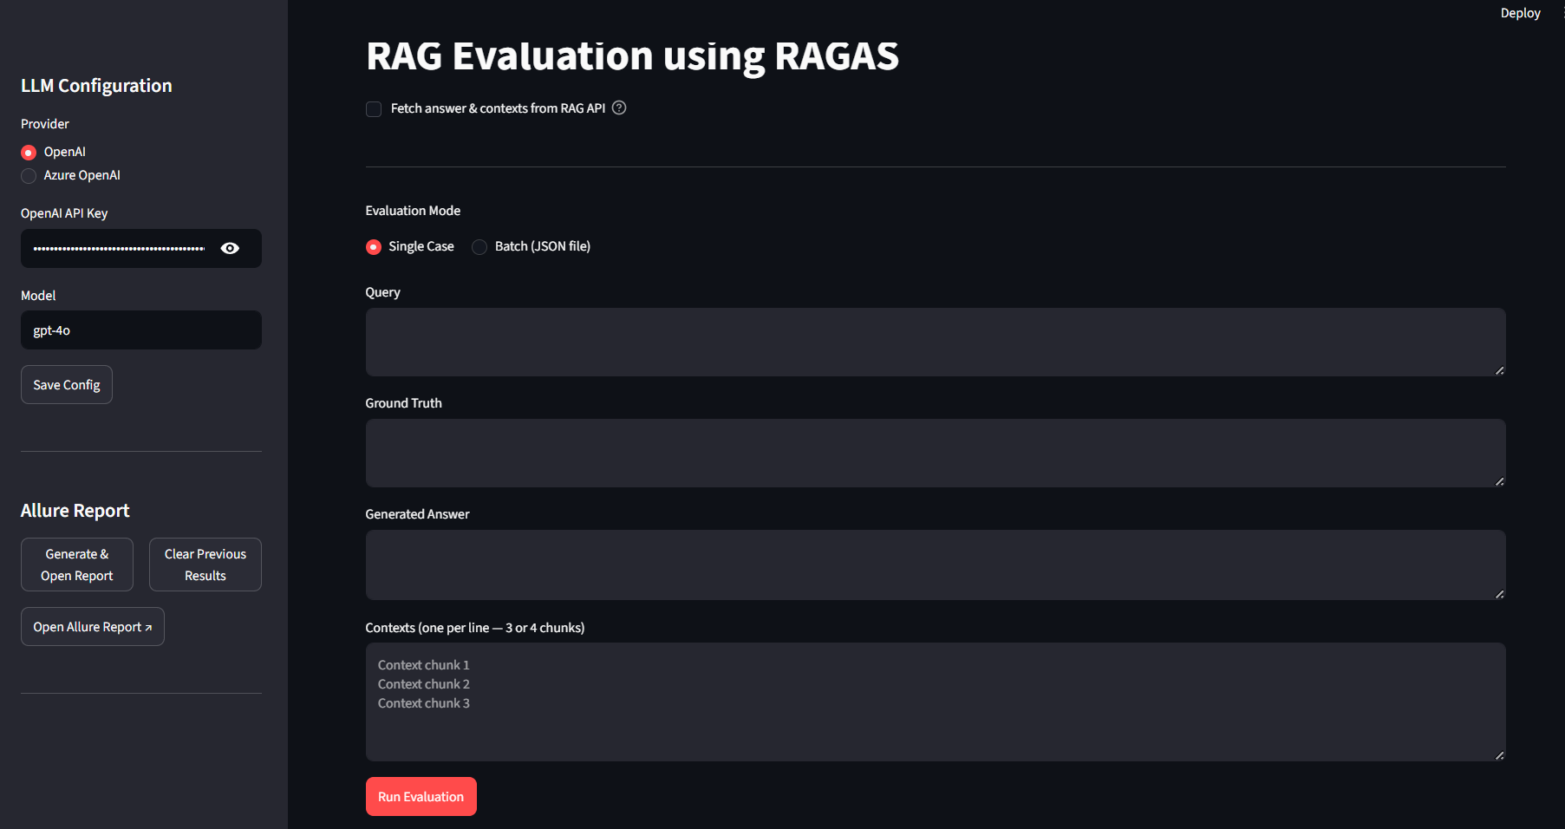
Getting Started
From dashboard to evaluation form
• Open the app — you land on a simple Dashboard, not a wall of settings.
• Click the "RAG Evaluation using RAGAS" box to open the evaluation form.
• No installation steps, no command line, no code — just point and click.
[ Dashboard screenshot ]

Slide 5
Single Case Evaluation
One question at a time
With the RAG API
Provide only: Query Ground Truth Answer + Contexts are fetched automatically.
Without the RAG API
Provide all manually: Query Ground Truth Generated Answer Contexts

Slide 6
Batch Evaluation
Many test cases, one run
With the RAG API
Each row in the JSON file needs only: query ground_truth Answer + Contexts are fetched per row.
Without the RAG API
Each row in the JSON file needs all four: query ground_truth generated_answer contexts
The app shows the exact expected JSON schema on screen — no guesswork.

Slide 7
Reading the Results
Every test case is fully traceable
• Single case: four metric scorecards appear instantly at the top of the page.
• Batch: a summary of averages, a per-case results table, and an expandable detail view for every case — including the retrieved contexts.
• Nothing is a black box: query, ground truth, generated answer, and contexts are all visible for every test case.

Slide 8
Making Scores Easy to Read
Plain-English quality bands
Excellent
0.85+
Good
0.70 – 0.84
Moderate
0.50 – 0.69
Poor
< 0.50
These thresholds aren't arbitrary — they're based on benchmarking data shared by Ashwani from the Pontoon project, reflecting real, validated quality bands.

Slide 9
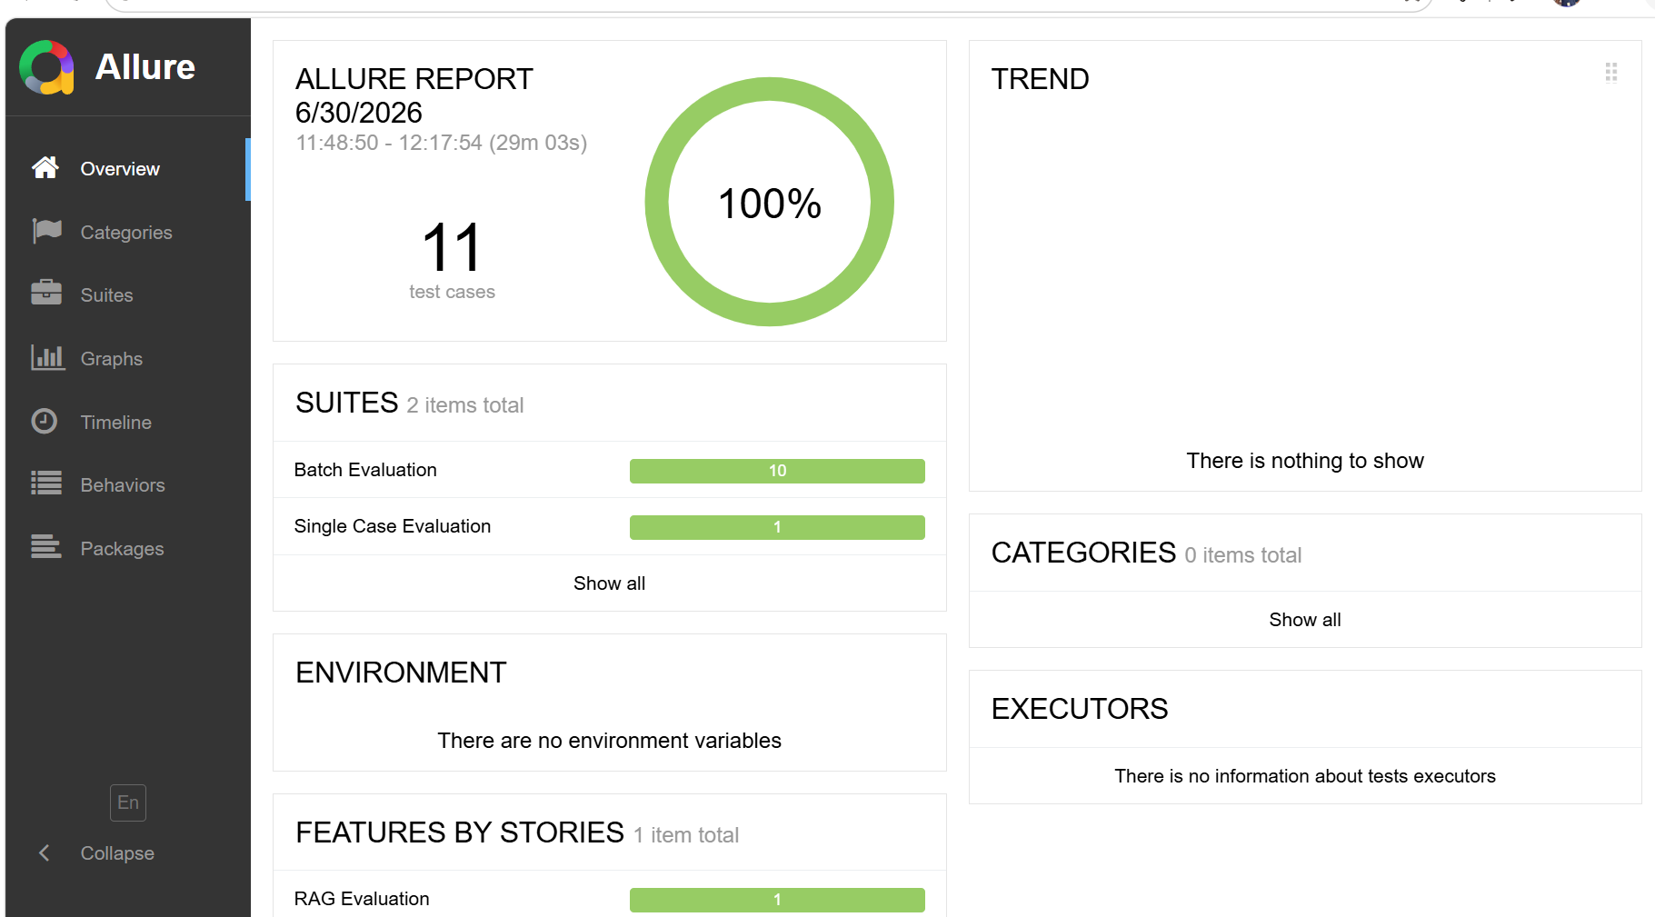
The Shareable Allure Report
One click, fully visual
• Every evaluation run is saved automatically — nothing extra to do.
• Click "Generate & Open Allure Report" in the sidebar, any time.
• The report opens in a new tab of the same browser — ready to share with anyone.

Slide 10
Bringing It Together
• Testers create the golden test data.
• Anyone — coder or not — can run a full RAGAS evaluation from there: single case or batch, with or without a live API.
• Every run produces a clear, shareable report — no engineer required to interpret it.
• Net result: one less dependency, one less bottleneck, a faster feedback loop for the whole team.

Slide 11
Thank You
Questions & Discussion

