Slide 1
Applied Data Science Capstone Project - The Battle of Neighbourhoods

Slide 2
Introduction
The City of New York is famous for its excellent cuisine. It's food culture includes an array of international cuisines influenced by the city's immigrant history.
Sushi restaurants have become so popular in the United States now it seems that there is one on every corner, not only in major cities but also in smaller cities. Starting a sushi restaurant can be a great business opportunity, but you need to distinguish yourself from others to enjoy long-term success

Slide 3
Introduction
The insights derived from analysis will give good understanding of the business environment which helps in strategically targeting the market. This will help in reduction of risk. And the Return on Investment will be reasonable.

Slide 4
Business Problem
Sushi restaurants have become so popular in the United States now it seems that there is one on every corner, not only in major cities but also in smaller cities. Starting a sushi restaurant can be a great business opportunity, but you need to distinguish yourself from others to enjoy long-term success

Slide 5
Data Selection
To identify the characteristics of our competitors' venues in Manhattan, we would first need to find out the number of sushi bars in Manhattan currently and their location.
We then used Google Map API to find their geographic coordinates based on their postal code addresses.

Slide 6
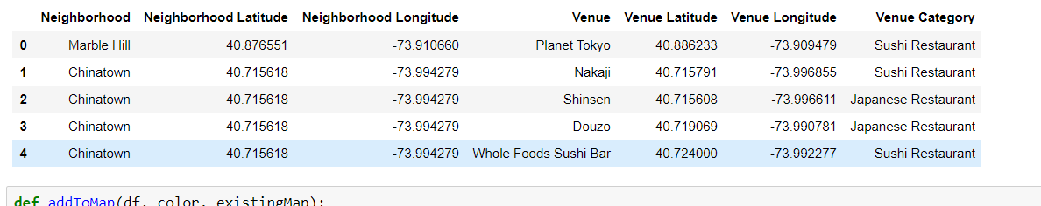
Data Selection
The downloaded dataset link here: https://geo.nyu.edu/catalog/nyu_2451_34572. It contains 306 rows × 4 columns of details like ID, Borough, Neighbourhood, Latitude, and Longitude.

Slide 7
Methodology
Address are converted into their equivalent latitude and longitude values.
Foursquare API is used to explore neighborhoods in Manhattan, New York.
After that, explore function to get sushi restaurant categories in each neighborhood.

Slide 8
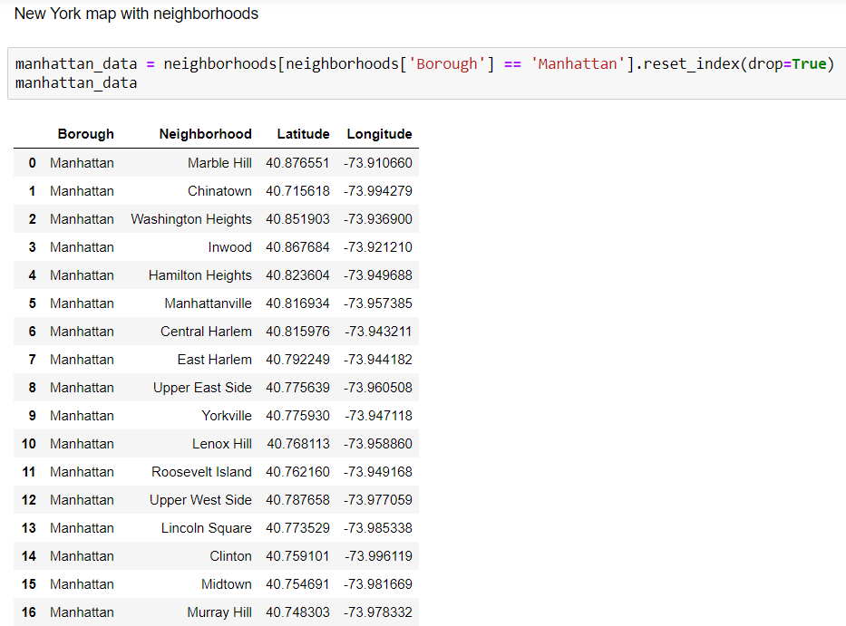
Methodology

Slide 9
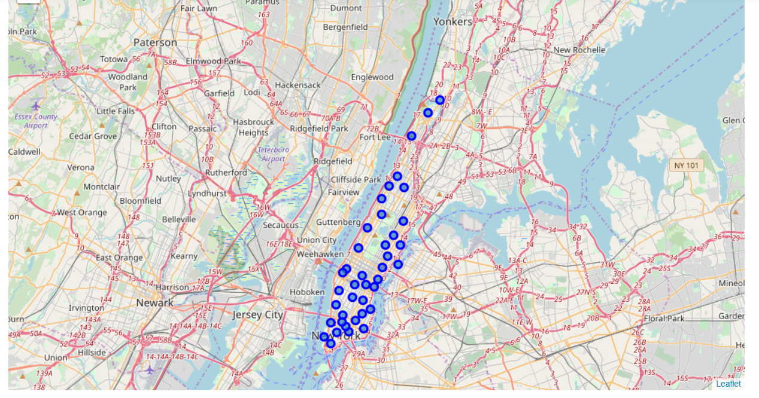
Methodology

Slide 10
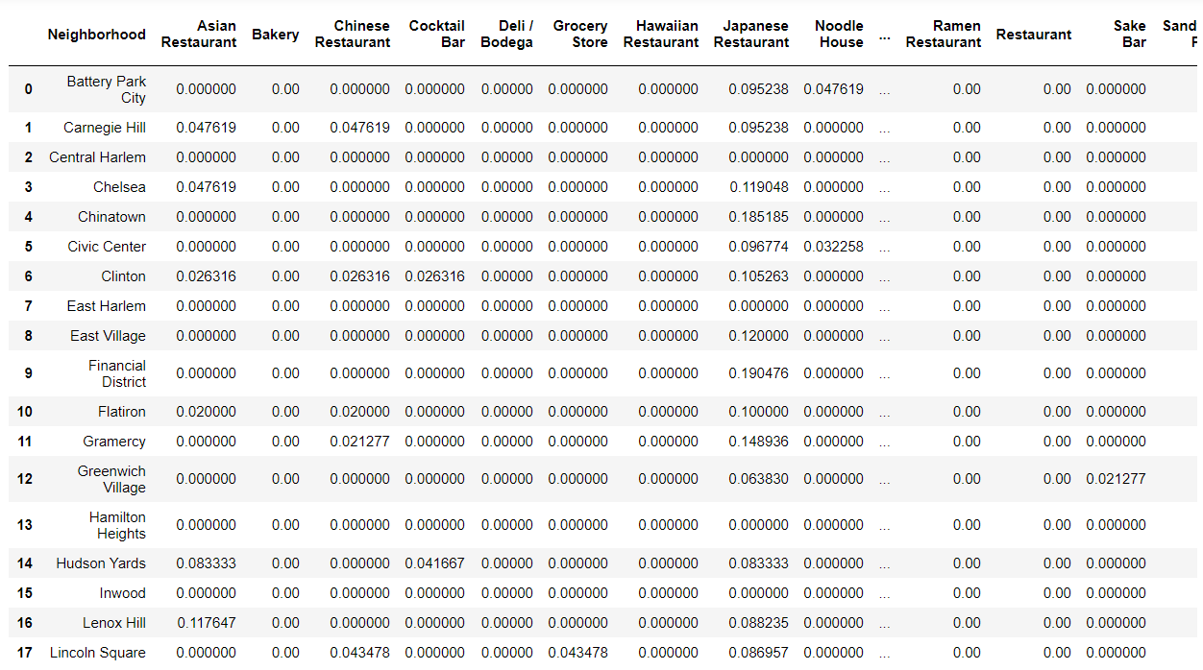
Methodology

Slide 11
Results
Then using this feature to group the neighborhoods into clusters K-means clustering algorithm will be use to complete this task. And also, the Folium library to visualize the neighborhoods in Manhattan and its emerging clusters.
Using K-mean to clustering data area with less number of sushi bars

Slide 12
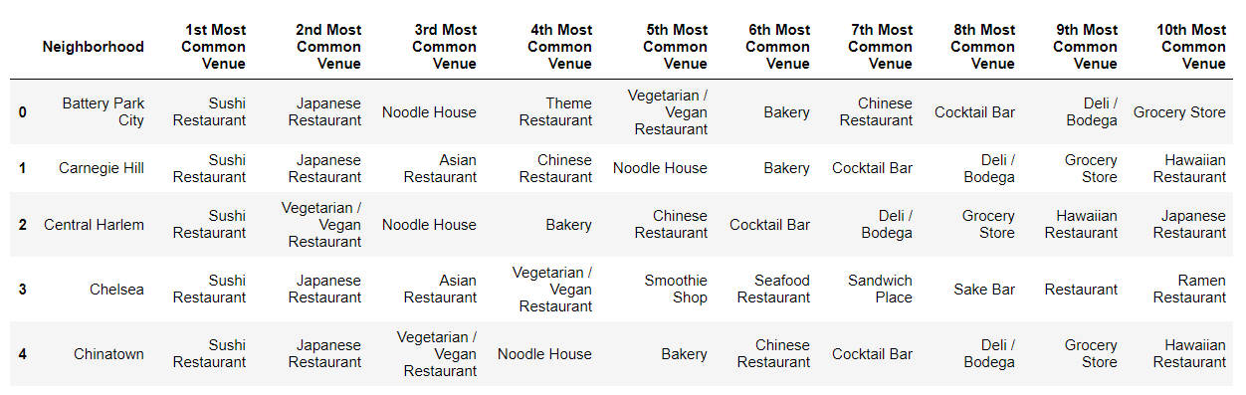
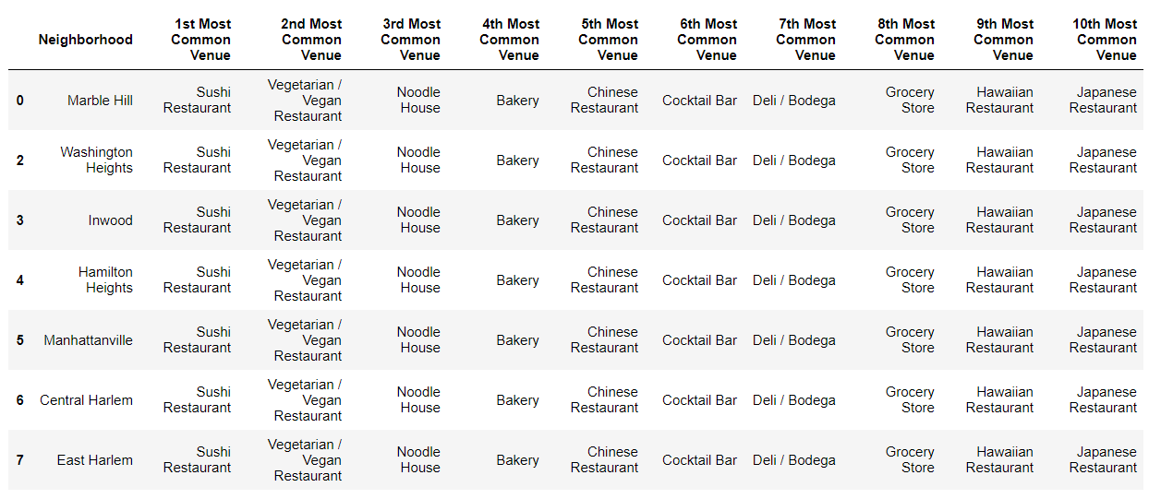
Results
Cluster 0
Cluster 1

Slide 13
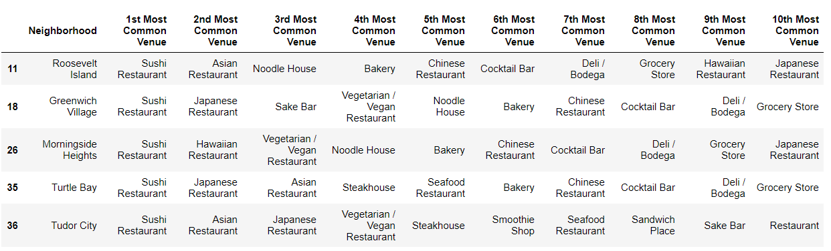
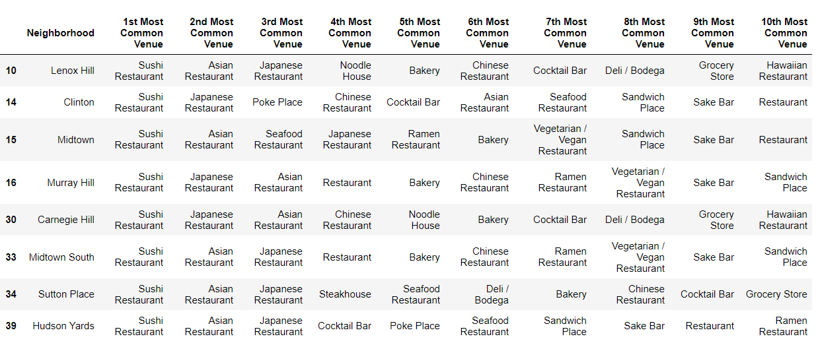
Results
Cluster 3
Cluster 4

Slide 14
Discussion
This analysis is performed on limited data. This may be right or may be wrong. But if good amount of data is available there is scope to come up with better results.
There is high competition in Midtown and Soho so it is very risky to open business in these areas.
Central Harlem has also potential where closes to Morningside Heights area.
It can be done more detailed analysis by adding other factors such as transportation, demographics of inhabitants.

Slide 15
Conclusion
Although all of the goals of this project were met there is definitely room for further improvement and development as noted below. However, the goals of the project were met and, with some more work, could easily be developed into a fully pledged application that could support the opening a business idea in an unknown location.

