Slide 1
Smart Recruitment Prediction System
Presented by: Venkata Appala Narsimha Raju Pakala Pati
Date: May 13, 2025

Slide 2
Problem Statement
Traditional recruitment methods are often manual, time-consuming, and prone to human bias, resulting in inefficient hiring decisions and high offer rejection rates. HR teams struggle to anticipate whether shortlisted candidates will accept job offers, leading to delays, increased recruitment costs, and lost talent. In a competitive job market driven by data, there is an urgent need for intelligent tools that can forecast candidate behaviour and streamline hiring.
the main goal of this project Develop a system to predict hiring decisions using historical candidate data.
feature importance to show which factors (e.g., Interview Score, Skill Score) drive hiring decisions

Slide 3
Why its is important
This Smart Recruitment Predictor acts as a bridge between people and machines, helping:
HR teams make faster, fairer, and more informed decisions
Candidates better prepare and position themselves for roles they're most likely to succeed in
it’s a decision-support tool that can transform how recruitment works at scale.
Increases the chance of landing in a role where their profile is most appreciated.
Better Role Fit

Slide 4
Introduction
Recruitment is one of the most critical functions in human resource management, yet traditional hiring methods often rely heavily on manual screening, subjective judgments, and limited evaluation metrics
Smart Recruitment Analysis, leverages a structured recruitment dataset sourced from Kaggle to develop a machine learning model that predicts whether a candidate is likely to be hired. By analyzing features such as experience, education level, skill score, interview performance, and recruitment strategy, the system delivers real-time hiring predictions through an interactive Gradio interface.

Slide 5
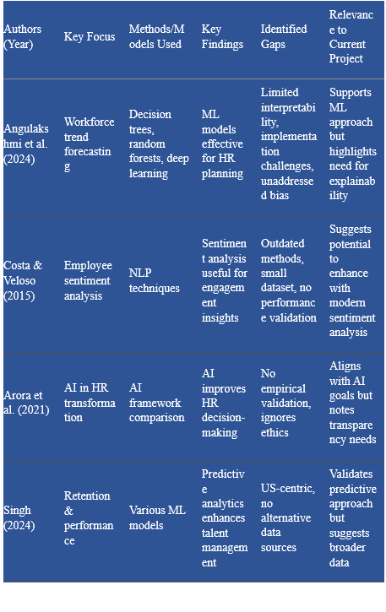
Literature Survey

Slide 6
Methodology
1. Data Preprocessing: Handled missing values and encoded categorical features.
2. Feature Engineering: Created Salary_Gap and Experience_Salary_Ratio.
3. Model Building: Trained five models (Logistic Regression, Decision Tree, Random Forest, SVM, XGBoost).
4. Evaluation: Measured accuracy, precision, recall, and F1-score.

Slide 7
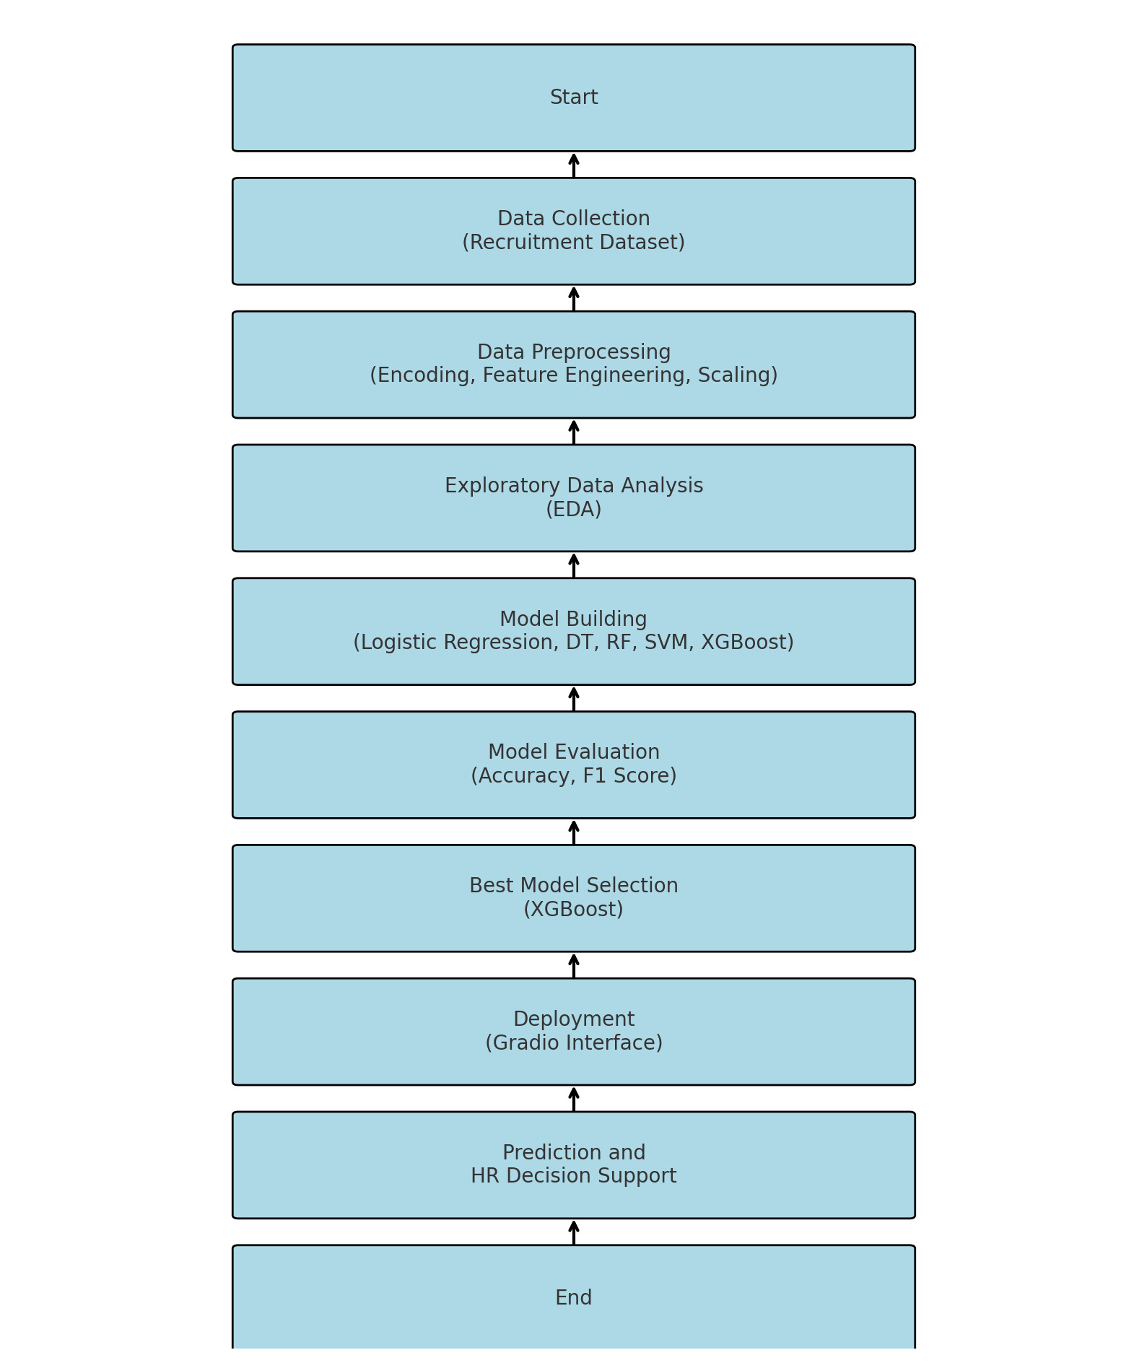
Work flow

Slide 8
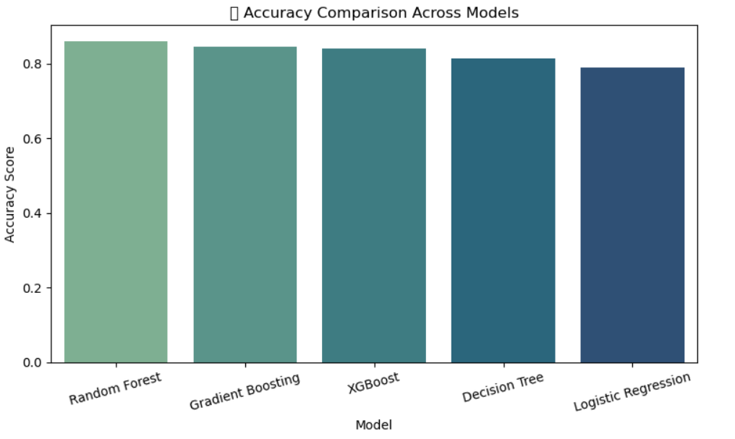

Slide 9
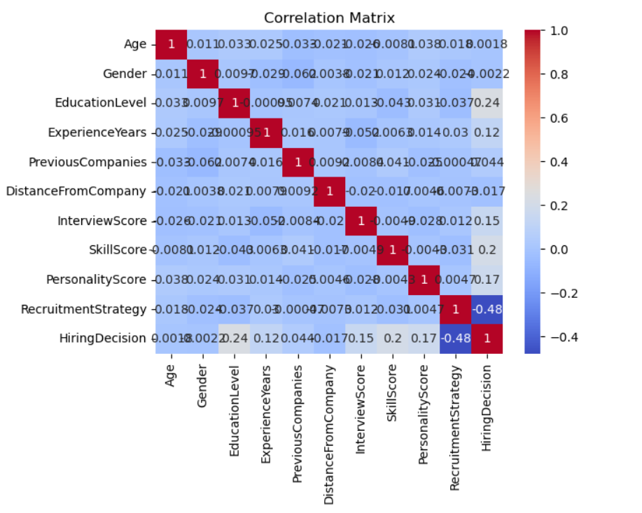
Corelation matrix

Slide 10
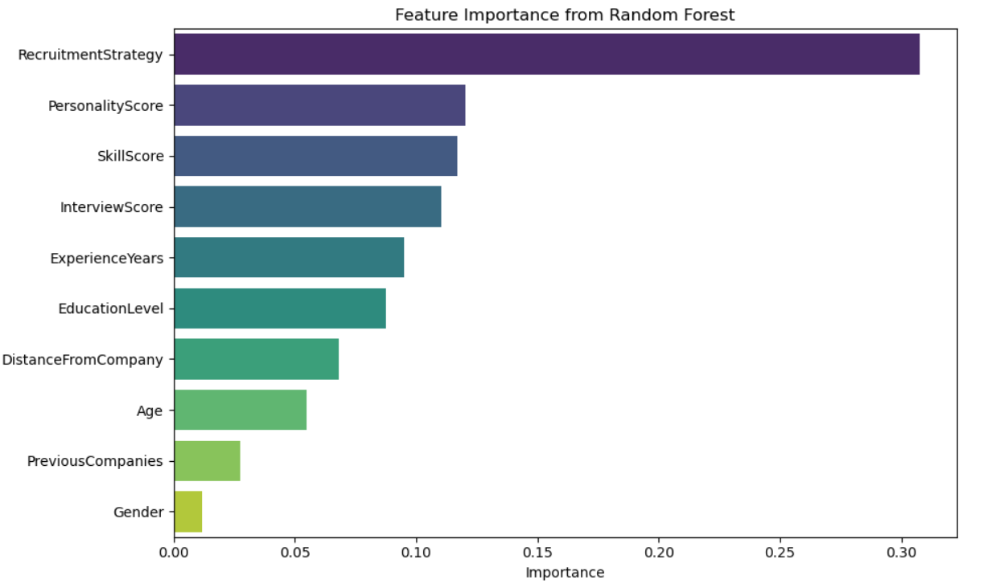
Feature importance

Slide 11
Conclusion
Conclusion
Built a machine learning model to predict hiring decisions using structured recruitment data (Kaggle-sourced).
Used key features like Skill Score, Interview Score, and Experience Years to train models.
Random Forest delivered the best accuracy 86% with strong interpretability.
Implemented a Gradio interface for real-time prediction, making it HR-friendly and interactive.
The model enhances recruitment by enabling faster, fairer, and data-driven hiring decisions.

Slide 12
Future work
Resume Parsing (NLP): Extract skills and experience from unstructured resumes automatically.
Best-Fit Role Suggestion: Recommend ideal job roles for candidates based on profile.
Bias & Fairness Checks: Audit the model for gender, education, or strategy-based bias.
ATS Integration: Deploy in real-world hiring systems for live candidate evaluation.
Batch Prediction: Support bulk resume screening through CSV upload.

