Slide 1
RAINFALL PREDICTION USING MACHINE LEARNING MODELS Predicting Whether It Will Rain TOMORROW Using Historical Weather Data from Australia
Name: RAJU KUMAR REDDY SAREDDY
Student Id: 24084499
Github Link: https://github.com/Rajusareddy1203/final_project.git

Slide 2
.
Introduction & Motivation
Precise rainfall forecasting is crucial for agriculture, water resource management, disaster mitigation, and daily planning. Conventional weather forecasting techniques depend on meteorological models that are often intricate and resource-intensive. The accessibility of extensive historical weather datasets enables machine learning algorithms to analyze weather trends and enhance the precision of rainfall predictions. Meteorological variables including temperature, humidity, pressure, wind velocity, and cloud cover are instrumental in influencing precipitation.
This study investigates the capability of machine learning models to forecast the likelihood of rain the following day based on historical weather data.

Slide 3
Research question: How accurately can machine learning models predict whether it will rain tomorrow using historical weather data from the weather.AUS dataset? Objectives: 1. Examine the weather.AUS dataset to comprehend its structure and principal meteorological factors. 2. Execute data preprocessing, encompassing the management of missing values and the encoding of category variables. 3. Perform exploratory data analysis (EDA) to ascertain correlations between meteorological variables and precipitation. 4. Develop several machine learning models to forecast the incidence of precipitation. 5. Utilize SMOTE to address class imbalance within the dataset. 6. Assess model efficacy with classification metrics including accuracy, precision, recall, and f1-score. 7. Determine the most effective model for precipitation forecasting.

Slide 4
Literature review recent studies indicate that machine learning techniques enhance rainfall forecasting by effectively capturing intricate and nonlinear interactions within meteorological data, surpassing standard statistical methods. Nithya et al. (2025) examined rainfall forecasting with the random forest algorithm and contrasted it with decision tree and multi-layer perceptron methodologies. Their research indicated that random forest yielded more accurate forecasts by modeling interactions among variables including temperature, pressure, humidity, cloud cover, and wind direction. Vaidya et al. (2025) created rainfall prediction models employing xgboost, catboost, random forest, and support vector machines based on historical rainfall data. Their research contends that machine learning models can surpass conventional approaches and facilitate effective decision-making in agriculture, water management, and disaster planning. Mohan et al. (2024) examined rainfall utilizing SVM, KNN, naïve bayes, and logistic regression, subsequently enhancing performance by ensemble techniques including voting, stacking, and bagging. Their findings indicated that bagging attained the best accuracy of 99.5%, underscoring the efficacy of ensemble learning in rainfall analysis. These studies indicate that ensemble models and tree-based methods are very proficient in rainfall prediction, whereas meticulous preprocessing, feature selection, and model comparison are crucial for enhancing forecasting precision.

Slide 5
This research utilizes the weather.Aus dataset, sourced from Kaggle. The collection comprises 145,460 daily weather observations and 23 meteorological variables gathered from various weather stations throughout Australia. It encompasses significant meteorological parameters including temperature, precipitation, humidity, wind velocity, air pressure, cloud cover, and solar radiation. The goal variable is rain tomorrow, signifying the occurrence of rainfall the following day (yes = 1, no = 0). The collection has almost a decade of historical meteorological data, rendering it appropriate for machine learning-driven precipitation forecasting. Source: kaggle https://www.Kaggle.Com/datasets/jsphyg/weather-dataset-rattle-package
DATASET

Slide 6
Ethical Considerations
This study utilizes a dataset from Kaggle that is open to the public. It just has weather observations and no personal or sensitive information.
The data was only utilized for research and academic purposes, as the dataset usage instructions said it should be.
We used anonymized weather data for all of our analysis, so no one person or group is harmed.
The models that were created are meant to help in weather prediction and decision-making, not to take the place of official weather forecasting systems.
During data preprocessing, analysis, and model construction, ethical ways of handling data were used.

Slide 7
Data preparation The dataset was initially analyzed to comprehend its structure, data kinds, and absent values. Numerous meteorological variables exhibited absent values, especially in attributes such as sunshine, evaporation, cloud9am, and cloud3pm. Missing values in numerical data were imputed using the median, whilst categorical variables were imputed with the mode. The date column was transformed into datetime format, and supplementary features including year, month, and dayofweek were generated to identify temporal patterns. Categorical variables such as location, windgustdir, winddir9am, and winddir3pm were transformed into numerical values by label encoding. The goal variable rain tomorrow was transformed into a binary format (yes = 1, no = 0) for classification purposes. The dataset was subsequently standardized using standardscaler, and the data was partitioned into training and testing sets for model building. The SMOTE approach was utilized on the training data to rectify class imbalance between rain and no-rain observations.

Slide 8
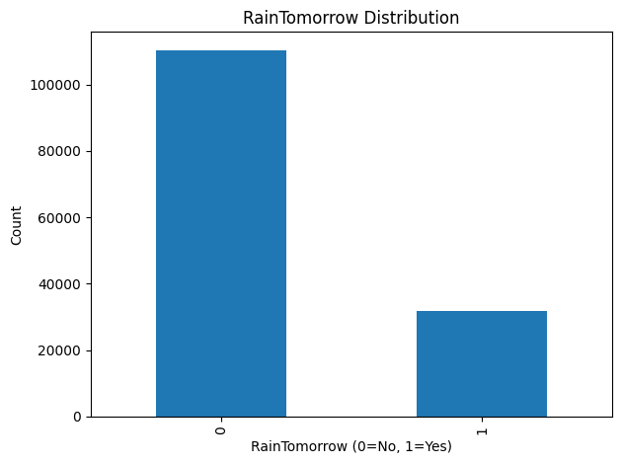
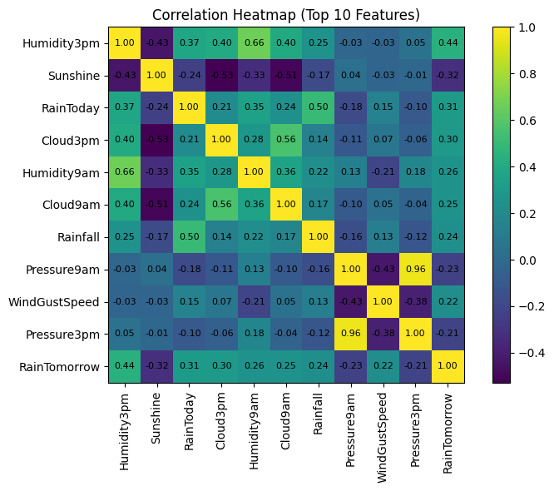
Exploratory Data Analysis (EDA) The RainTomorrow distribution map indicates an imbalanced dataset, featuring a markedly higher frequency of No-rain occurrences (0) compared to Rain cases (1). This signifies the necessity for strategies like SMOTE to equilibrate the classes during model training. The correlation heatmap emphasizes the most significant meteorological variables associated with rainfall forecasting. Variables including Humidity3pm, RainToday, Cloud3pm, Humidity9am, and Rainfall have more robust positive correlations with RainTomorrow. The humidity distribution at 3 PM indicates that the majority of humidity values fall between 40% and 70%, implying that elevated humidity levels may enhance the likelihood of precipitation. The log-scaled rainfall boxplot indicates the existence of outliers, signifying extreme rainfall occurrences within the dataset. Logarithmic transformation enhances the clarity of these variations. The exploratory study indicates that humidity, cloud cover, prior precipitation, and air pressure are significant factors for rainfall forecasting.

Slide 9
Models used: After preprocessing and exploratory analysis, various machine learning models were trained to forecast rain for the following day. Random forest is an ensemble learning system that combines numerous decision trees to increase prediction accuracy while minimizing overfitting. XGBoost is a gradient boosting technique that generates sequential decision trees and is commonly used for high-performance classification problems. The Artificial Neural Network (ANN) is a deep learning model that can capture complex nonlinear correlations between meteorological variables. These models were trained on the processed weather dataset, and their performance was measured using classification metrics such as accuracy, precision, recall, and f1-score to determine the best model for rainfall prediction.

Slide 10
1. How to evaluate: I used accuracy, f1-score, and confusion matrix to check how well the machine learning models worked. These are all good ways to check how well a model does at classification. 2. Comparing different machine learning models: we used three models: random forest, XGBoost and artificial neural networks(ANN). To make sure that the evaluation was fair, each model was trained on the same set of preprocessing steps and a balanced dataset. 3. The best model performance: XGBoost had the best overall performance of the algorithms that were tested. This suggests that ensemble-based methods work well for analyzing complex behavioral datasets.
Model Results and Performance
Model | Accuracy | Precision | Recall | F1-Score
Random Forest | 0.812 | 0.9 | 0.85 | 0.88
XGBoost | 0.849 | 0.88 | 0.93 | 0.91
ANN | 0.729 | 0.94 | 0.70 | 0.80

Slide 11
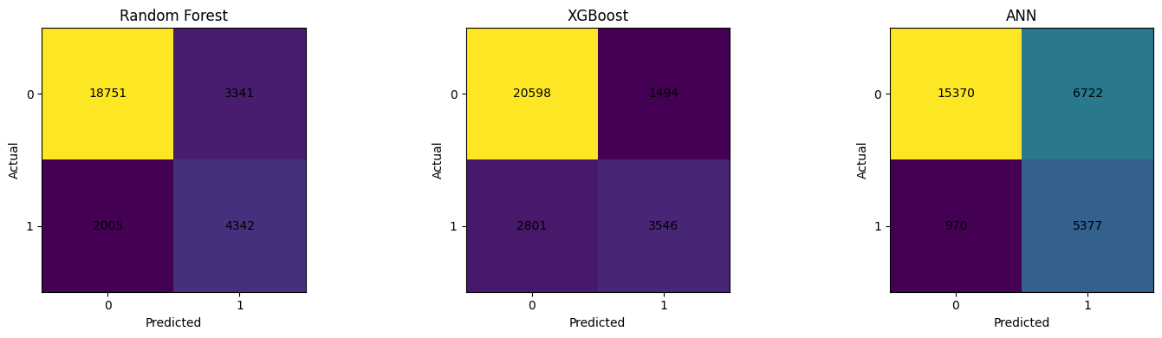
Model evaluation (confusion matrix) The confusion matrices demonstrate how each model classified rain and no-rain cases. Random forest accurately forecasted majority of no-rain situations (18,751) and identified 4,342 rainfall events. XGBoost had the most correct no-rain forecasts (20,598) and 3,546 correct rain predictions. ANN identified the most rain cases (5,377) but also produced more false positives.
Model | Rainfall tomorrow(yes) | Rainfall tomorrow(no)
Random Forest | 4342 | 18751
XGBoost | 3546 | 20598
ANN | 5377 | 15370

Slide 12
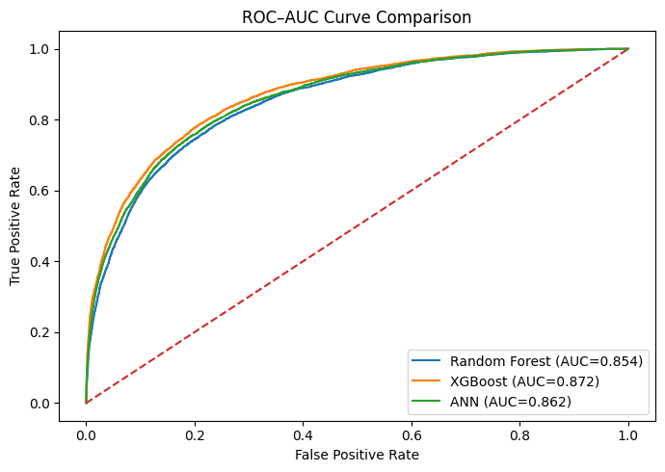
ROC Curve
The ROC curve for Random Forest shows that it can tell the difference between no rain and correct rain, which means it can classify things well.(AUC = 0.854)
The ROC curve for XGBoost shows the best ability to tell the difference between no rain and correct rain because it has the strongest class separation.(AUC = 0.872)
The ROC curve for ANN shows that it can tell that difference between no rain and correct rain, which means it can classify things well.(AUC = 0.862)
XGBoost got the highest AUC score (0.872), which means it was the best at telling the difference between no rain and correct rain.

Slide 13
Hyperparameter Optimization Results
Method for tuning hyperparameters: We used RandomizedSearchCV with cross-validation to find the best parameter combinations for the Random Forest, XGBoost and ANN models.
How well the model works after being optimized: The models got the following accuracies after tuning:
Random Forest: 0.841
XGBoost: 0.80
ANN: 0.799
The Random Forest and ANN models improved with hyperparameter modification, whereas the XGBoost model exhibited only a minor loss in performance.

Slide 14
CONCLUSION
The findings demonstrate that XGBoost had the highest baseline accuracy (0.849) and the best ROC-AUC score (0.872), indicating outstanding overall predictive performance. Random Forest produced balanced predictions, properly detecting both rain and no-rain scenarios, and performed best after hyperparameter adjustment (accuracy = 0.841). ANN had a high recall for rain events, which means it detected more rainfall incidents but produced more false positives than tree-based models. The dataset was imbalanced, with more no-rain observations, which hampered model performance and necessitated the use of techniques like SMOTE to balance the training data. Weather variables such as humidity, cloud cover, rainfall, and pressure were discovered to be strong predictors of rainfall. Overall, the findings indicate that ensemble tree-based models, such as Random Forest and XGBoost, are particularly effective at predicting rainfall from meteorological data.

Slide 15
References
Nithya, P. Mahesh, B. R. Reddy and P. Ramakrishna, "Forecasting Rainfall Patterns With Random Forest Algorithm," 2025 IEEE 6th India Council International Subsections Conference (INDISCON), Rourkela, India, 2025, pp. 1-6, doi: 10.1109/INDISCON66021.2025.11252303.
URL: https://ieeexplore.ieee.org/stamp/stamp.jsp?tp=&arnumber=11252303&isnumber=11251524
P. Vaidya, V. Varshini, K. A. Bhavitha, K. Nandhini, C. Madhavi and M. Sarayu, "Innovative Approaches to Rainfall Prediction: Empowering Farmers with ML Models," 2025 Fifth International Conference on Advances in Electrical, Computing, Communication and Sustainable Technologies (ICAECT), Bhilai, India, 2025, pp. 1-4, doi: 10.1109/ICAECT63952.2025.10958919.
URL: https://ieeexplore.ieee.org/stamp/stamp.jsp?tp=&arnumber=10958919&isnumber=10958195
Mohan, K. P. S and R. N. T, "Monthly Rainfall Analysis in Southern Parts of India Using Machine Learning and Ensemble Methods," 2024 Third International Conference on Smart Technologies and Systems for Next Generation Computing (ICSTSN), Villupuram, India, 2024, pp. 1-5, doi: 10.1109/ICSTSN61422.2024.10671145.
URL: https://ieeexplore.ieee.org/stamp/stamp.jsp?tp=&arnumber=10671145&isnumber=10670715

Slide 16
THANK YOU

