Slide 1
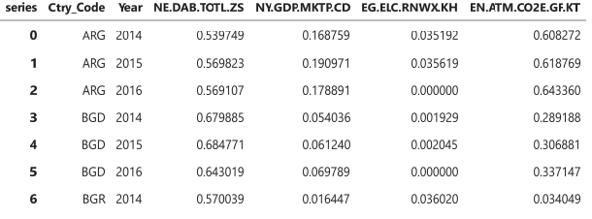
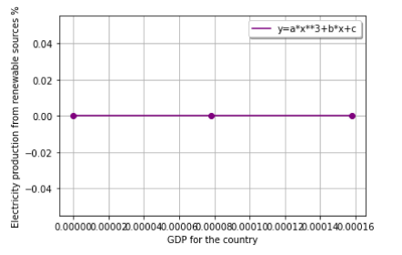
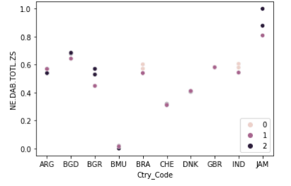
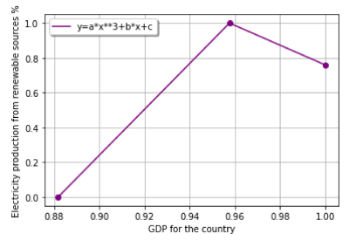
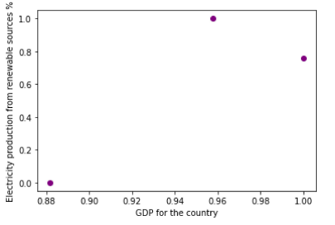
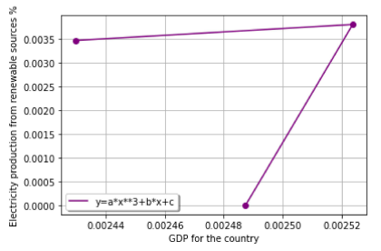
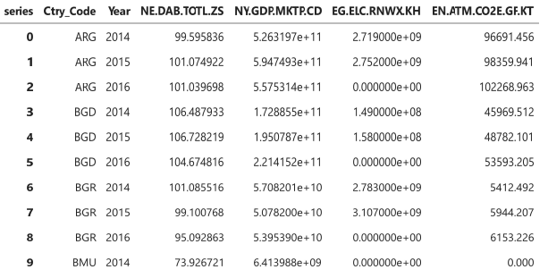
APPLIED DATA SCIENCE ASSIGNMNT - 3
Introduction
Clustering plays a strategic role in data science and algorithms as it aims to group the objects based on their similarity. This categorization of the data is done based on the density of the data, or based on graphs, or any such statistical observations or distributions. (Nvidia, 2022).
Fitting in simple words can be understood as the adjustment made in the parameters with an aim to improve the accuracy of the data or the results. (Edpresso, 2022).
The above image depicts the values that has been achieved after normalization of the data frame values.
The above image is of Bermuda country and represents the indicators electricity production from renewable sources and GDP of the country. In order to achieve the above result, curve fit has been used in order to fit the data of Bermuda which has a low total expenditure.
Method
Panda has been used in order to analyze the data through algorithm and clustering and fitting methods
The figure above presents the information about total expenditure of all the nations that has been selected in this research with an aim to undertake comparative analysis. From the image it can be clearly seen that the total expenditure of Jamaican country is higher as compared to other selected countries in the study
Countries selected Bermuda, Denmark, Bulgaria, Argentina, Great Britain, India, Brazil and Jamaica. Different data like
NE.DAB.TOTL.ZS: total expenditure,
NY.GDP.MKTP.CD: USD GDP of the country,
EG.ELC.RNWX.KH: electricity generation from renewable sources (%) and
EN.ATM.CO2E.GF.KT: emissions of carbon dioxide from fuel;
These indicators have been used in this research in order to compare with the help of clustering and fitting methods.
The above data shows the relationship between electricity production from renewable sources and GDP of Great Britain. To achieve this result, curve fit is used as it can be seen that the country has medium total expenditure.
Results
The above image depicts the information for Jamaican country and the association between its electricity production from the renewable sources and the GDP of the country..
The above image depicts the association between the two indicators for country Great Britain, and that is electricity production from the renewable sources (%) and the GDP of the country.
Conclusion
Countries with high total expenditure have direct relationship with the GDP of the country and the electricity production. Countries with medium total expenditure, the relationship is direct between GDP and the electricity till the point a certain GDP is reached, after that the relationship becomes indirect. Countries with low total expenditure, the relationship between GDP and electricity production from renewable sources is parallel to the axis.
References
The above image depicts the gathering of all the four indicators that has been selected in this research for all the countries with an aim to undertake the comparative analysis by clustering and fitting method.
Edpresso, 2022. Definition: Model fitting. [Online] Available at: https://www.educative.io/edpresso/definition-model-fitting [Accessed 14 May 2022].
Nvidia, 2022. CLUSTER ANALYSIS. [Online] Available at: https://www.nvidia.com/en-us/glossary/data-science/clustering/ [Accessed 14 May 2022].

