Slide 1

Customer Churn Analysis — SQL + Python
A technical deep-dive into identifying, understanding, and reducing customer churn using SQL, Python, and data engineering best practices.

Slide 2

Business Problem
Who
Identify who is churning
Why
Understand why they're churning
Impact
Quantify the revenue impact of churn
Actions
Recommend actions to improve retention

Slide 3



Tech Stack
Database
Language
SQLite (.db)
Python 3 (Jupyter Notebook)
Libraries
Export
sqlite3, pandas, numpy, matplotlib, seaborn
CSV, HTML → PDF

Slide 4



Dataset
customers
subscriptions
support
Demographics — name, age, gender, country, state
Plan type, contract type, subscription channel, monthly charges, start/cancellation dates, churn score
Complaint records, escalation status, CSAT score

Slide 5

Data Cleaning & Validation
1
Renamed ambiguous columns; dropped irrelevant fields
Rename & Drop
2
Converted date columns to datetime; standardized categorical values
Type Conversion
Deduplication
3
Fixed duplicate support records by aggregating latest complaint per customer
Join Validation
4
Validated join integrity before merging tables

Slide 6

Feature Engineering
1
2
churn_flag
tenure_days
Created churn_flag (1/0) from cancellation date presence
Created tenure_days — subscription duration
3
4
churn_risk
Ordinal Encoding
Created churn_risk (Low/Medium/High) by bucketing churn_score
Ordinal-encoded categorical fields by business priority

Slide 7
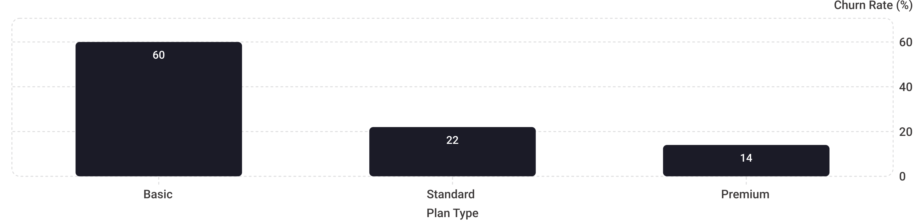
Key Metrics & Correlations
28.57%
71.43%
0.77
19.05%
~1,452
Churn Rate
Retention Rate
Escalation ↔ Churn Correlation
Escalation Rate
Avg Tenure (days)
Strong positive

Slide 8
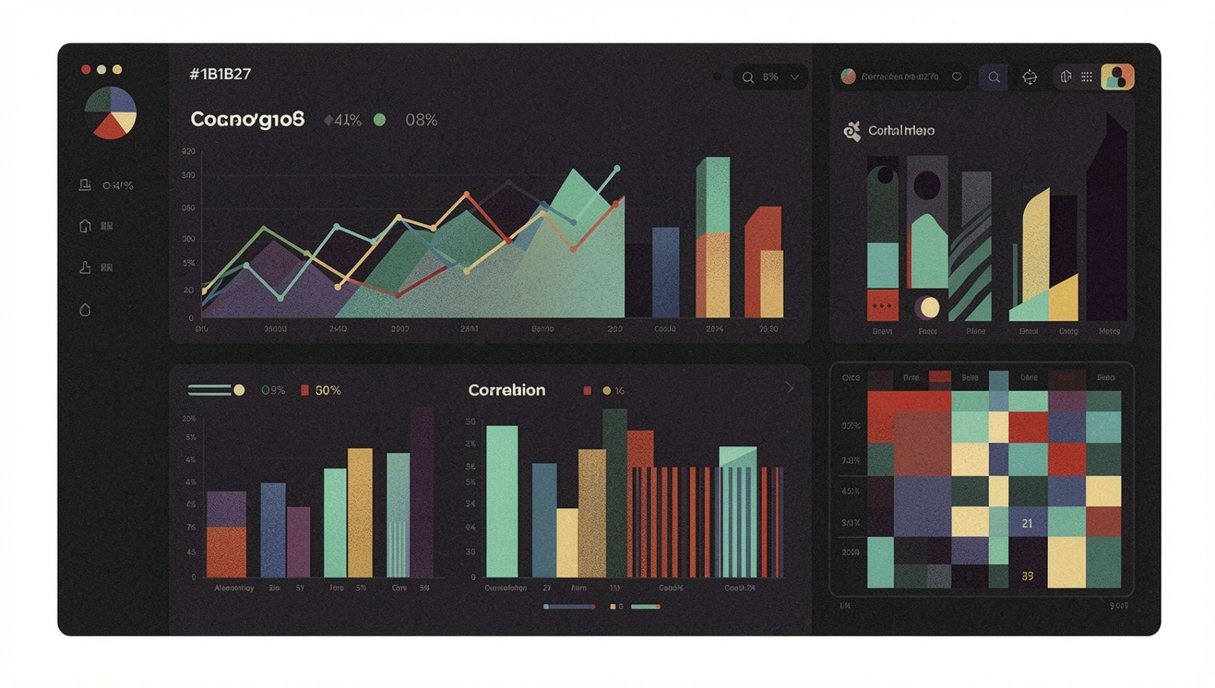

Visualizations
Line chart
Bar charts
Monthly churn trend over time
Churn by plan type, churn by state
Heatmap
Pair plot & cat plot
Correlation matrix across encoded features
Multi-variable relationships

Slide 9



Key Insights
Basic plan subscribers churn at 60%
Far higher than Standard (22%) or Premium (14%)
Escalation ↔ Churn: 0.77 Correlation
Customers who escalated complaints show strong correlation (0.77) with churning
Regional & Temporal Spikes
Karnataka had highest state-level churn; September showed a churn spike

Slide 10




Recommended Actions
Investigate Basic-Plan Churn
Tiered Retention Outreach
Investigate root causes of Basic-plan churn (pricing, feature gaps, service quality)
Prioritize retention outreach by churn_risk tier, starting with high-value Premium customers
Audit Support Resolution
Cross-Reference Churn Spikes
Audit customer support resolution — reduce escalations by fixing recurring complaint themes
Cross-reference churn spikes with product/pricing change timelines

Slide 11

Skills Demonstrated
Languages & Databases
SQL · SQLite · Python · Pandas ·

