Slide 1
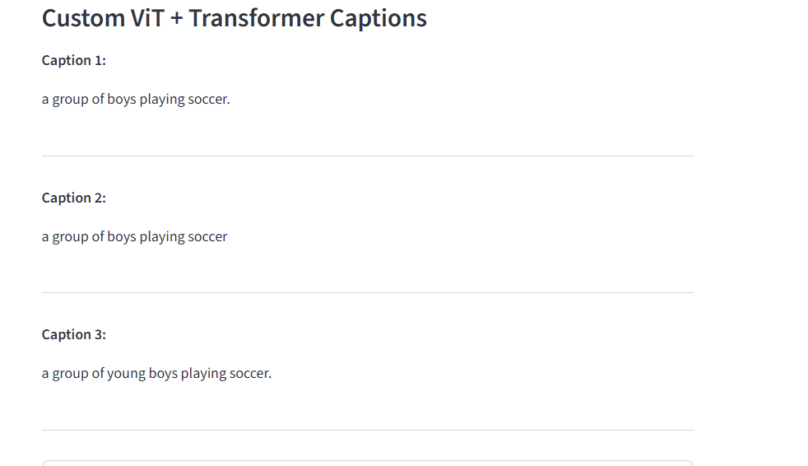
M.TECH PROJECT • FINAL PRESENTATION
IMAGE CAPTIONING USING VISION TRANSFORMER + TRANSFORMER DECODER
From image patches to natural-language captions
Rajvardhan Salunkhe\nM.Tech. – Data Science | COEP Technological University
Academic Year 2026–2027

Slide 2
1. Problem objectives
THE PROBLEM
THE APPROACH
PROJECT GOALS
An image contains objects, actions and scene context. A computer must convert these visual signals into a readable sentence.
Encode the image into visual features, then generate a caption one token at a time with a decoder.
Build a ResNet-50 + LSTM baseline, a ViT + Transformer model, evaluate outputs and deploy a simple app.
• Compare reference-based caption metrics across the baseline and custom model.
• Inspect common errors and compare the custom model with pretrained BLIP on external images.
• Provide an upload-and-caption interface using Streamlit.
M.Tech. Data Science | Image Captioning Project | COEP Technological University
2

Slide 3
Research foundation & project hypothesis
How the project builds on established image-captioning research
Key literature
Research hypothesis
• Vinyals et al. (2015): CNN–RNN encoder–decoder captioning.
• Xu et al. (2015): visual attention for caption generation.
• Vaswani et al. (2017): Transformer self-attention.
• Dosovitskiy et al. (2021): ViT patch-based image representations.
• Li et al. (2022): BLIP pretrained vision-language model.
A patch-based visual representation combined with a Transformer decoder can improve reference-caption similarity compared with a ResNet-50 + LSTM baseline.
Important: attention can help use context, but it does not guarantee factual correctness.
What this project tests
• Build both baseline and custom systems using the same project dataset workflow.
• Compare BLEU-1 to BLEU-4, METEOR and ROUGE-L.
• Inspect qualitative errors and compare the custom model with pretrained BLIP on 10 external images.
• Deploy the models in a Streamlit interface for practical testing.
M.Tech. Data Science | Image Captioning Project | COEP Technological University 14

Slide 4
2. Dataset & preprocessing
Flickr8k-style image-caption data used in the project
8,092 images
40,460 captions
12,076 words
38 tokens
Image collection
Raw caption records
Vocabulary size
Maximum sequence length
Data split (caption records)
Train: 30,000
Validation: 5,000
Test: 5,000
• Text is cleaned and tokenized; special tokens mark sequence start, end, padding and unknown words.
• Token IDs: PAD = 0, START = 1, END = 2, UNK = 3.
M.Tech. Data Science | Image Captioning Project | COEP Technological University
3

Slide 5
3. End-to-end methodology
The complete path from input image to generated sentence
1
→
2
→
3
→
4
→
5
Input image
ViT encoder
Transformer decoder
Caption text
Evaluation / app
Resize / normalize
Patch features
Stop at END token
Metrics + Streamlit
Predict next token
The encoder describes the image as a sequence of visual features. The decoder uses those features and the words generated so far to predict the next word.
Core idea
M.Tech. Data Science | Image Captioning Project | COEP Technological University
4

Slide 6
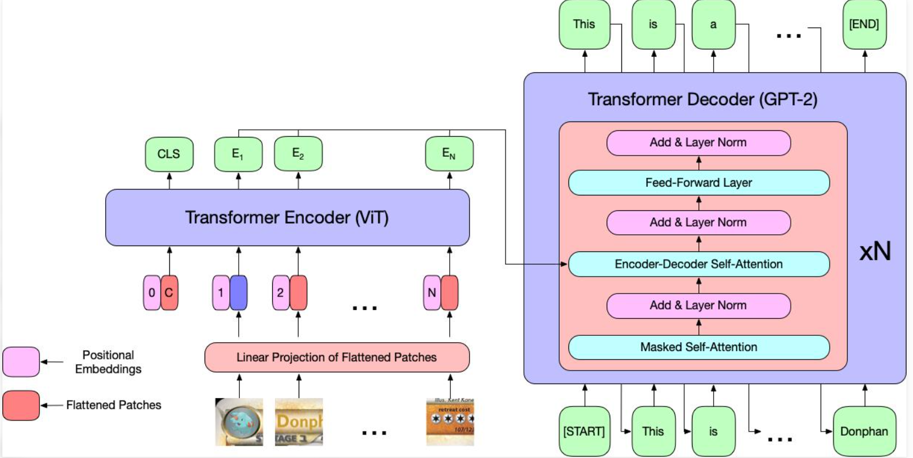
4. Custom model architecture: ViT + Transformer
Architecture illustration used to explain the encoder–decoder workflow
VISION TRANSFORMER (ViT)
Splits a 224 × 224 image into 16 × 16 patches and encodes relationships among patches.
VISUAL FEATURES
196 patch tokens, each with 768 features in the recorded ViT-B/16 setup.
TRANSFORMER DECODER
Uses attention and previous caption tokens to predict the next token.
Encoder frozen during this experiment
M.Tech. Data Science | Image Captioning Project | COEP Technological University
5

Slide 7
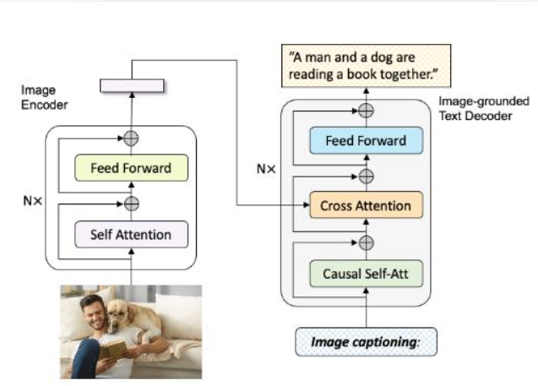
5. How attention helps captioning
Encoder–decoder attention flow
• Encoder self-attention relates image patches to one another.
• Causal self-attention reads only earlier caption tokens, preventing future-word leakage.
• Cross-attention lets the text decoder use image features while generating each word.
• Feed-forward layers transform the attended representations.
• Add & Layer Norm helps stabilize and refine layer outputs.
The caption is generated : one token at a time.
M.Tech. Data Science | Image Captioning Project | COEP Technological University
6

Slide 8
6. Main model parameters and their functions
Values recorded for the custom ViT + Transformer experiment
Parameter | Recorded value | Function
Image size | 224 × 224 | Standardized input resolution
Patch size | 16 × 16 | Creates 196 image patches
Visual feature size | 768 | Representation size for each patch
Decoder layers | 3 | Number of stacked decoder blocks
Attention heads | 8 | Learns different attention relationships
Embedding size | 256 | Represents caption tokens as vectors
Feed-forward size | 1,024 | Intermediate dimension inside each decoder block
Maximum caption length | 38 | Caps sequence length including special tokens
Decoder parameters | ≈ 9.56 million | Trainable decoder parameter count recorded
Baseline reference: ResNet-50 feature size 2,048; LSTM embedding 256; hidden size 512.
M.Tech. Data Science | Image Captioning Project | COEP Technological University
7

Slide 9
7. Training, decoding & evaluation
What happens after the architecture is defined?
TRAINING
DECODING
EVALUATION
The decoder learns to predict caption tokens from image features and preceding words. Best recorded epoch: 4.
Greedy decoding picks the highest-probability next token. Beam search keeps multiple candidates; width = 5, up to 3 shown.
BLEU measures n-gram overlap; METEOR accounts for flexible word matching; ROUGE-L uses longest common subsequence.
Recorded test metrics
Metric | ViT + Transformer
BLEU-1 | 0.5241
BLEU-2 | 0.3615
BLEU-3 | 0.2409
BLEU-4 | 0.1583
METEOR | 0.4055
ROUGE-L | 0.4149
• Custom model outperformed ResNet-50 + LSTM on the recorded reference metrics.
• Metrics measure agreement with reference captions; they do not guarantee every detail is visually correct.
• Do not claim optimizer, learning rate or batch size unless confirmed from the notebook.
M.Tech. Data Science | Image Captioning Project | COEP Technological University
8

Slide 10
Results in context: baseline vs custom model
Recorded test-set metrics and validation checkpoint observations
Metric | ResNet-50 + LSTM | ViT + Transformer | Observed change
BLEU-1 | 0.4704 | 0.5241 | +0.0537
BLEU-2 | 0.3090 | 0.3615 | +0.0525
BLEU-3 | 0.1942 | 0.2409 | +0.0467
BLEU-4 | 0.1247 | 0.1583 | +0.0336
METEOR | 0.3483 | 0.4055 | +0.0572
ROUGE-L | 0.3821 | 0.4149 | +0.0328
Validation loss
Baseline: ≈ 3.2404
Custom model: ≈ 3.2314
Both best checkpoints were recorded at epoch 4.
Interpretation
The custom model scored higher on all six reference-based metrics in the recorded evaluation.
These scores measure similarity to reference captions—not guaranteed factual correctness.
Validation loss is token-prediction cross-entropy on held-out validation captions; lower is better only when preprocessing and loss aggregation are comparable.
M.Tech. Data Science | Image Captioning Project | COEP Technological University 15

Slide 11
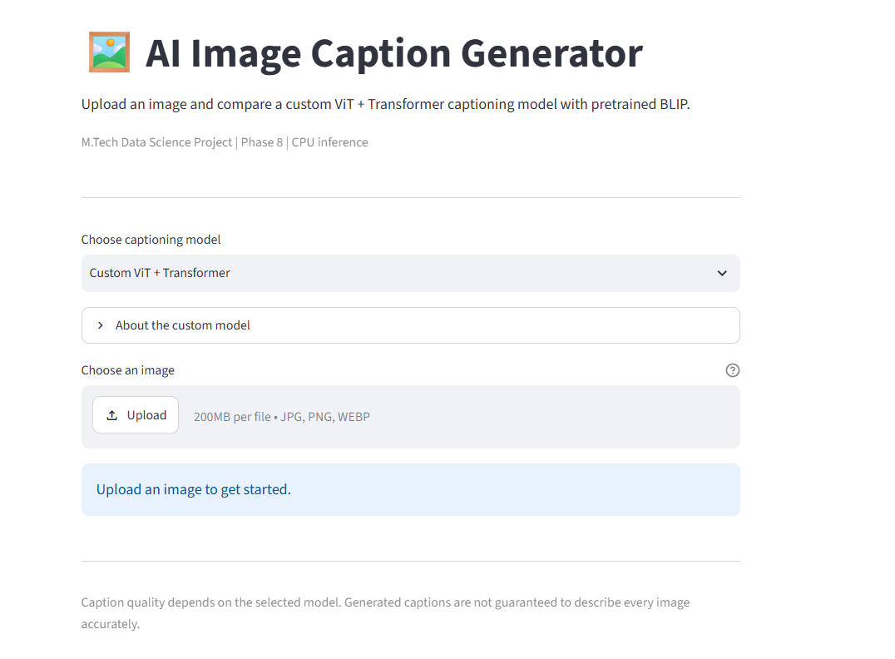
8. Working application: image upload
Streamlit interface for choosing a captioning model and uploading an image
• User chooses the custom ViT + Transformer or pretrained BLIP.
• User uploads an image in JPG, PNG or WEBP format.
• The app loads the saved model and vocabulary to generate captions.
• Inference uses the existing checkpoint; model retraining is not needed for each upload.
APPLICATION PURPOSE
Makes the research model testable through a simple interface.
M.Tech. Data Science | Image Captioning Project | COEP Technological University
9

Slide 12
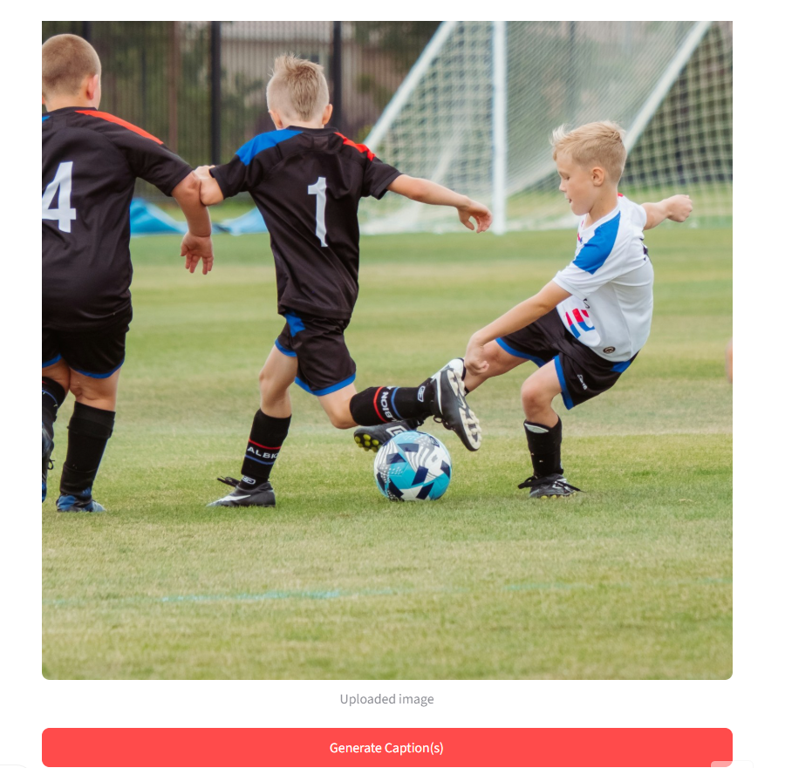
9. Example run: input image → generated captions
Output captured from the working application
CUSTOM ViT + TRANSFORMER OUTPUT
Caption 1
a group of boys playing soccer.
Caption 2
a group of boys playing soccer
Caption 3
a group of young boys playing soccer.
Interpretation: all three candidates capture the main activity; wording varies slightly.
M.Tech. Data Science | Image Captioning Project | COEP Technological University
10

Slide 13
10. Model comparison & observations
Keep the dataset metrics and small external comparison distinct
Model | BLEU-1 | BLEU-2 | BLEU-3 | BLEU-4 | METEOR | ROUGE-L
ResNet-50 + LSTM | 0.4704 | 0.3090 | 0.1942 | 0.1247 | 0.3483 | 0.3821
ViT + Transformer | 0.5241 | 0.3615 | 0.2409 | 0.1583 | 0.4055 | 0.4149
WHAT THE TEST METRICS SHOW
WHAT THE EXTERNAL CHECK SHOWED
The custom model improved across all six recorded reference-based metrics compared with the baseline.
In the recorded 10-image comparison, BLIP received higher human ratings, while the custom model ran faster on CPU. This is a small sample, not a universal ranking.
M.Tech. Data Science | Image Captioning Project | COEP Technological University
11

Slide 14
BLIP external comparison: quality vs speed
A separate 10-image exploratory test—not the Flickr8k test-set metric evaluation
Measure | Pretrained BLIP | Custom ViT + Transformer
Images reviewed | 10 | 10
Manual rating total | 18 / 20 | 10 / 20
Normalized human-rating score | 90% | 50%
Average CPU inference time | ≈ 2.73 s/image | ≈ 0.97 s/image
What the results mean
• BLIP received higher manual ratings on this small image sample.
• The custom model was faster in the recorded CPU run (about 64% less time per image).
• BLIP uses large-scale pretraining; the two systems do not have equivalent training data.
Do not claim
Fairer future evaluation
90% / 50% are normalized human-rating scores, not formal model accuracy.
This small sample cannot establish a universal model ranking.
Use more images, a fixed scoring rubric, multiple raters, and consistent timing rules. Keep loading time separate from per-image inference.
M.Tech. Data Science | Image Captioning Project | COEP Technological University 16

Slide 15
11. Error analysis, limitations & next steps
Honest interpretation matters as much as the score
OBSERVED ERRORS
DIAGNOSTICS
LIMITATIONS
Object or action substitutions, generic captions, scene confusion and repeated wording.
Mean vocabulary coverage ≈ 0.5521; 359/1,000 cases had coverage below 0.5. Mean recorded confidence ≈ 0.4129.
Small caption dataset, frozen encoder, CPU-only training/inference setup and a 10-image external comparison.
Next improvements
• Increase data diversity and verify image-disjoint data splits.
• Fine-tune selected ViT layers; tune decoder settings and rare-word handling.
• Evaluate on a larger external benchmark and use multiple human raters.
M.Tech. Data Science | Image Captioning Project | COEP Technological University
12

Slide 16
12. Conclusion & references
Summary of implementation and foundational reading
• Built an image-captioning pipeline using ViT visual features and a Transformer decoder.
• Compared it with a ResNet-50 + LSTM baseline and integrated caption generation into Streamlit.
• The custom model improved the recorded reference metrics; BLIP was stronger in the small external human-rated sample.
• Caption quality still depends on visual grounding, data coverage and careful evaluation.
Selected references
• Vaswani et al. (2017). Attention Is All You Need. NeurIPS.
• Dosovitskiy et al. (2021). An Image is Worth 16×16 Words: Transformers for Image Recognition at Scale. ICLR.
• Vinyals et al. (2015). Show and Tell: A Neural Image Caption Generator. CVPR.
• Li et al. (2022). BLIP: Bootstrapping Language-Image Pre-training for Unified Vision-Language Understanding and Generation. ICML.
Thank you • Questions & discussion
M.Tech. Data Science | Image Captioning Project | COEP Technological University
13

