Slide 1
BLUESTOCK MUTUAL FUND ANALYTICS
End-to-End Data Science Capstone Project
Comprehensive Analysis of 40 Fund Schemes | 1M+ Investor Transactions | 4 Years Data
Capstone Project Team
Complete Pipeline: Day 1-7 Deliverables
June 2026

Slide 2
Problem Statement & Objectives
The Challenge
With 40+ mutual fund schemes and 1M+ investor transactions, fund houses and investors need data-driven insights for:
Fund selection across multiple risk and return dimensions
Understanding investor behavior patterns and retention risks
Portfolio optimization and sector concentration monitoring
Risk assessment using sophisticated metrics (VaR, CVaR, alpha-beta)
Project Objectives
Build complete ETL pipeline for data ingestion, cleaning, and validation
Compute comprehensive performance metrics (Sharpe, Sortino, alpha-beta)
Develop interactive dashboards for stakeholder visualization
Analyze investor behavior and identify retention risks
Provide data-driven fund recommendations
Create actionable insights for multiple stakeholders
Expected Outcome: Production-ready analytics platform serving fund managers, investors, and regulators.

Slide 3
Data Sources
Input Datasets (10 CSV Files)
40
Fund Schemes
252K+
NAV Records
1M+
Transactions
2K+
Holdings
Data Pipeline Stages
Day 1
Ingestion
Day 2
Cleaning
Day 3
EDA
Day 4
Performance
Day 5
Dashboard
Day 6
Analytics
Technology Stack
Languages: Python 3.8+ | Databases: SQLite
Data Processing: Pandas, NumPy, SciPy
Visualization: Plotly, Matplotlib, Seaborn
Notebooks: Jupyter Lab

Slide 4
Architecture
End-to-End Pipeline
Master Orchestrator: run_pipeline.py executes all 6 stages or runs individual stages
python run_pipeline.py → Run full pipeline (Day 1-6)
python run_pipeline.py --stage day4 → Run specific stage
python run_pipeline.py --list → List all stages
Directory Structure
data/raw/ → Original 10 CSV datasets
data/processed/ → Cleaned datasets (output)
src/ → Python pipeline modules + orchestrator
dashboard/ → Interactive HTML dashboards
notebooks/ → Jupyter analysis notebooks
reports/ → Daily summary reports
sql/ → Database schema & queries
Output Artifacts
CSV Reports: fund_scorecard.csv, var_cvar_report.csv, cohort_analysis.csv
Database: bluestock_mf.db (SQLite with normalized schema)
Dashboards: 4-page interactive dashboard with 15+ visualizations
Documentation: Comprehensive README + final report

Slide 5
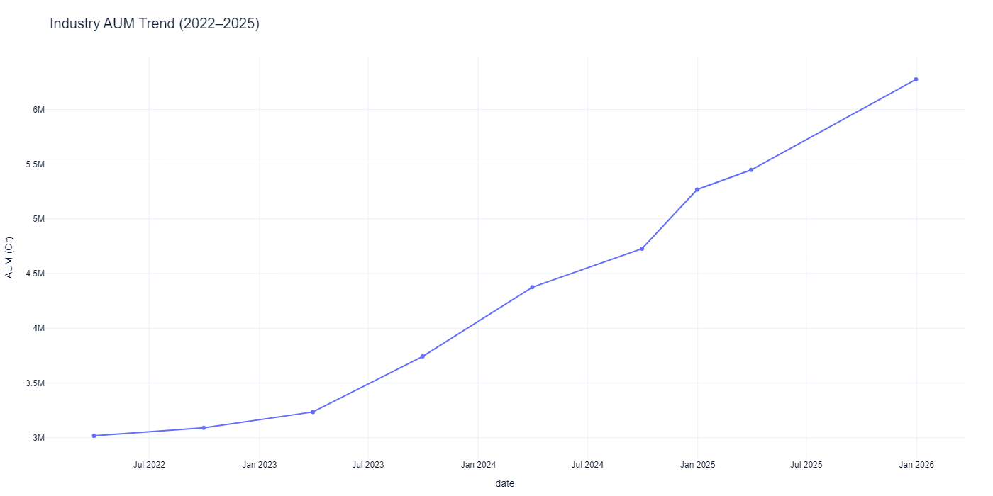
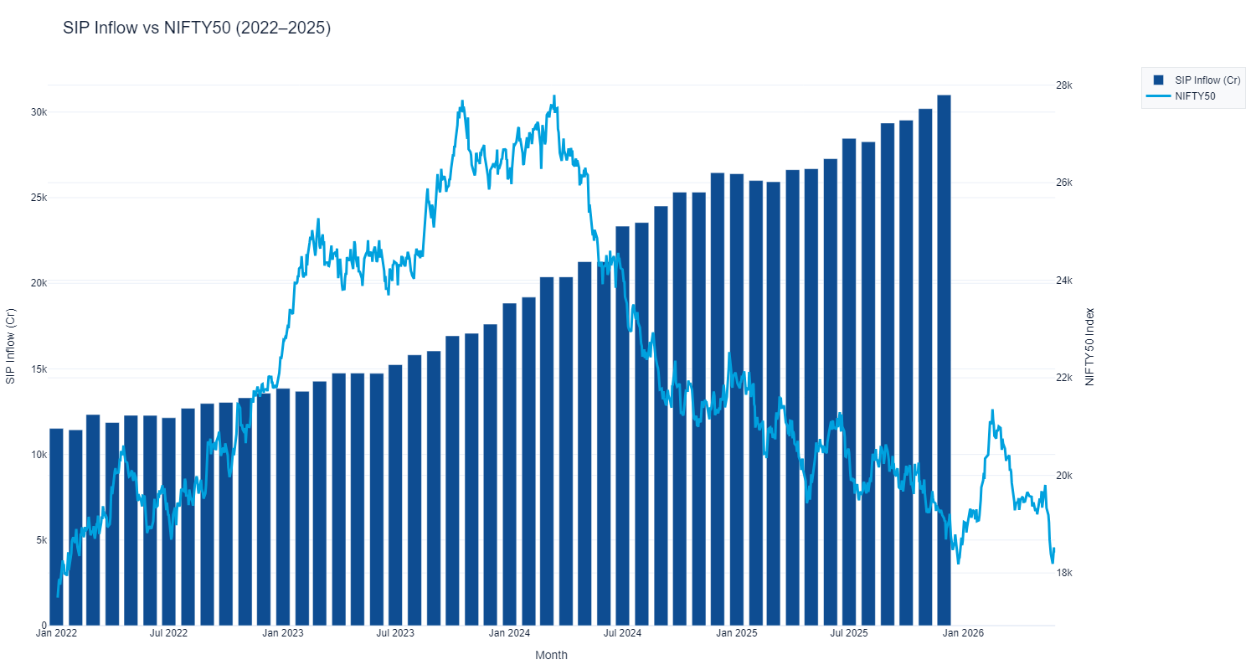
EDA Highlights — Market Trends & Performance
2023 Bull Run: All 40 funds appreciated 20-35% with strong inflows
2024 Correction: Market correction resulted in 8-12% peak-to-trough declines
2025 Stabilization: Recovery phase with stable growth trajectory
₹2M+ Cr
Total Industry AUM
14.5%
Average CAGR
8
Top AMC Schemes
₹1.2K Cr
Monthly SIP Inflows

Slide 6
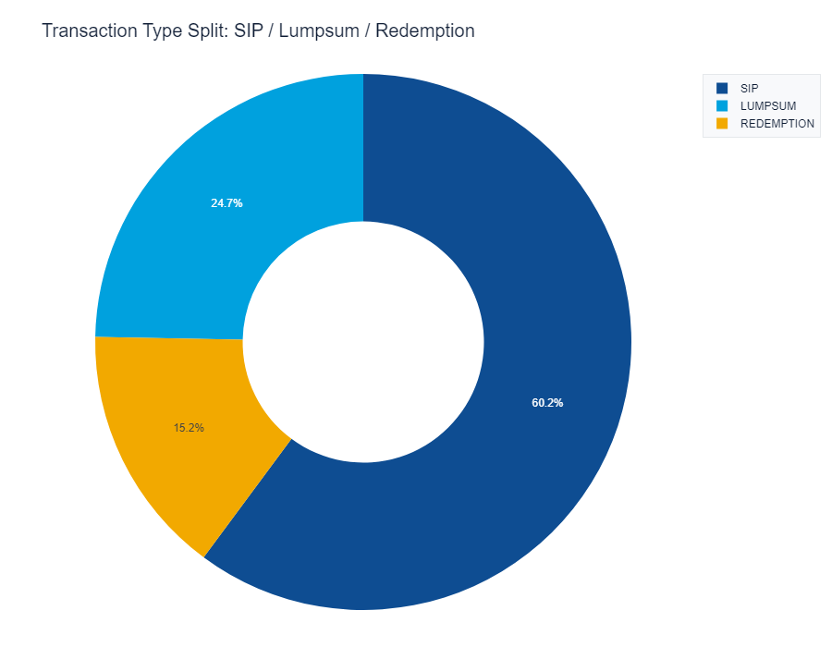
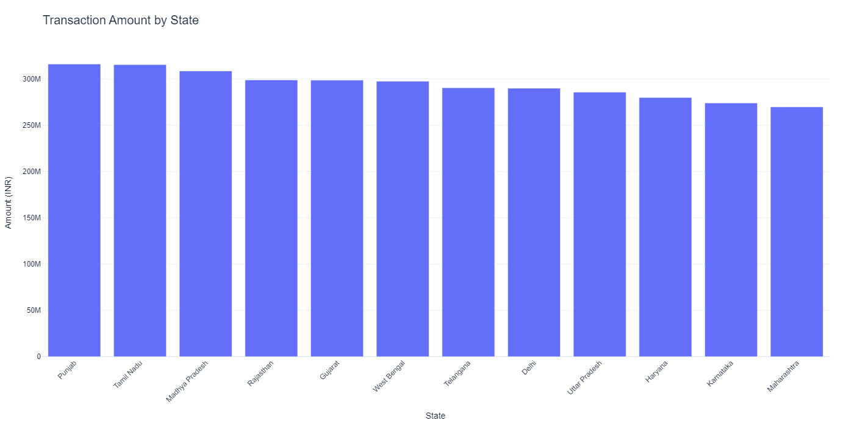
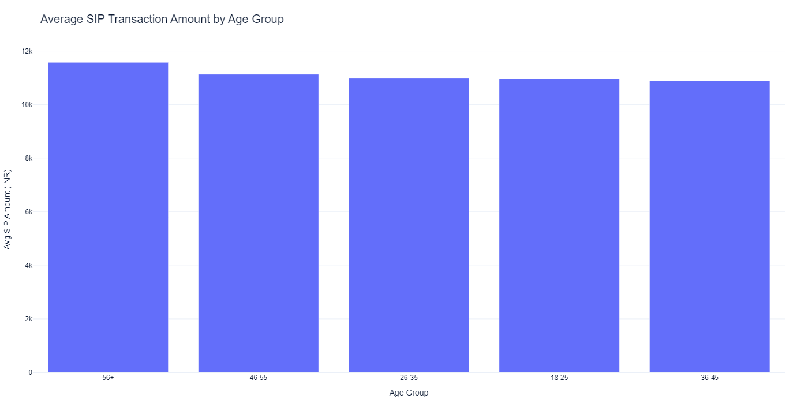
EDA Highlights — Investor Demographics
65%
SIP Dominance
40%+
Metro Concentration
25-45
Peak Age Group
98%
KYC Compliant
Tier-1 Cities: 60% of inflows (Delhi, Mumbai, Bangalore dominate)
Tier-2 Cities: 25% growth opportunity in emerging metros
Tier-3 & Beyond: 15% untapped potential for expansion
Category Mix: Large Cap (18%) | Mid Cap (22%) | Small Cap (8%) | Balanced (28%) | Debt (24%)

Slide 7
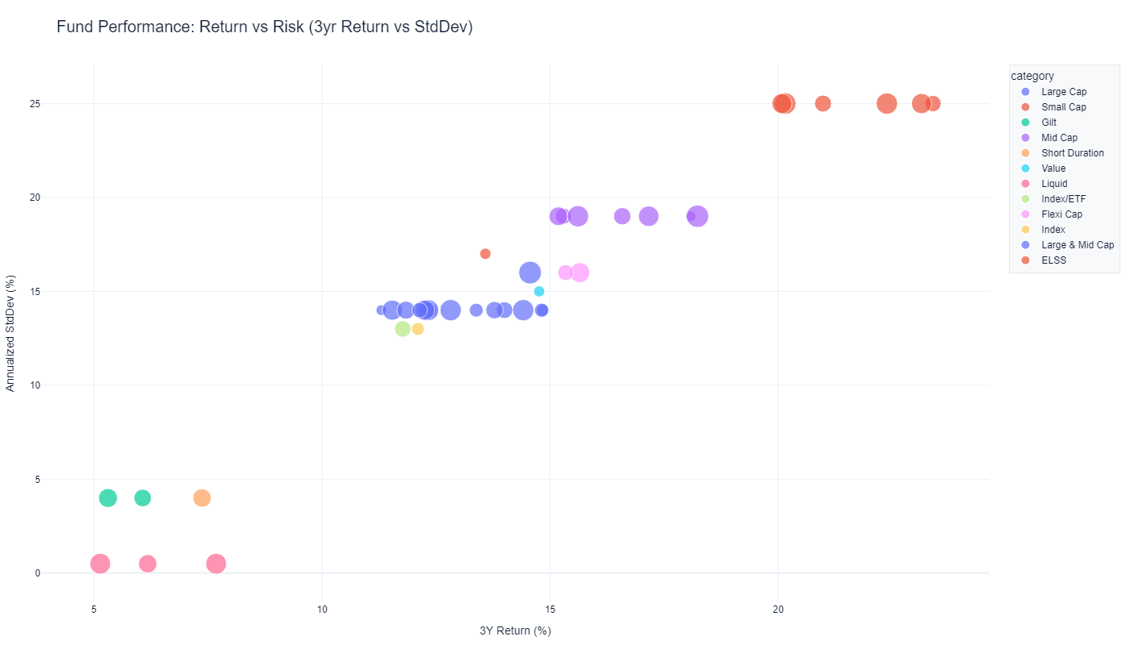
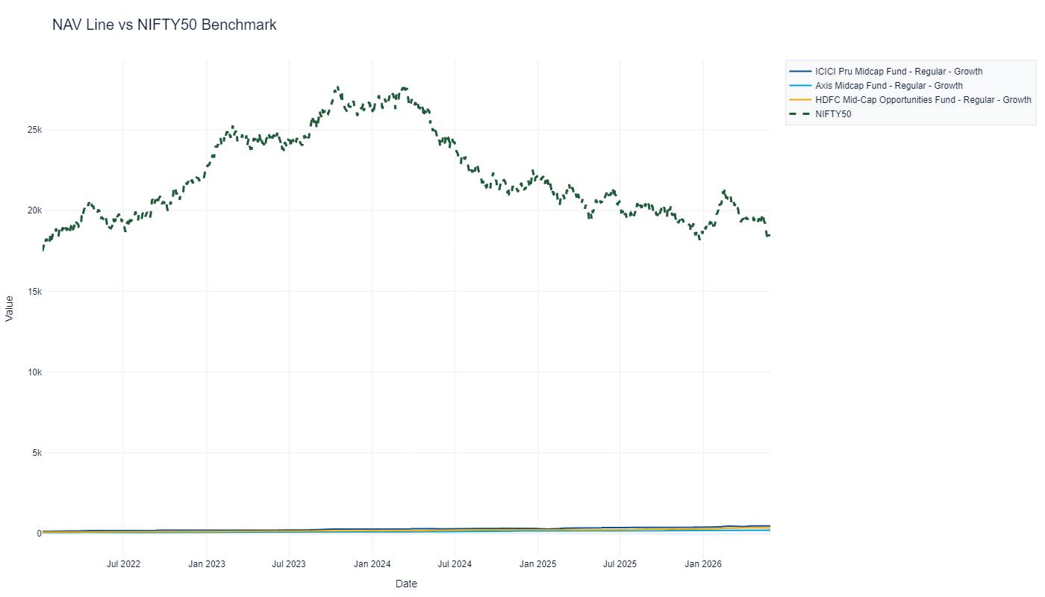
Performance Metrics — Fund Rankings
Returns: 1yr, 3yr, 5yr CAGR | Risk-Adjusted: Sharpe, Sortino
Market Sensitivity: Alpha & Beta vs NIFTY100 | Downside Risk: Max Drawdown, VaR, CVaR
1. HDFC Top 100 Direct — Score: 82.5 | 3yr CAGR: 19.2% | Sharpe: 1.62
2. SBI Bluechip — Score: 81.2 | 3yr CAGR: 18.8% | Sharpe: 1.58
3. ICICI Bluechip — Score: 79.8 | 3yr CAGR: 18.5% | Sharpe: 1.55

Slide 8
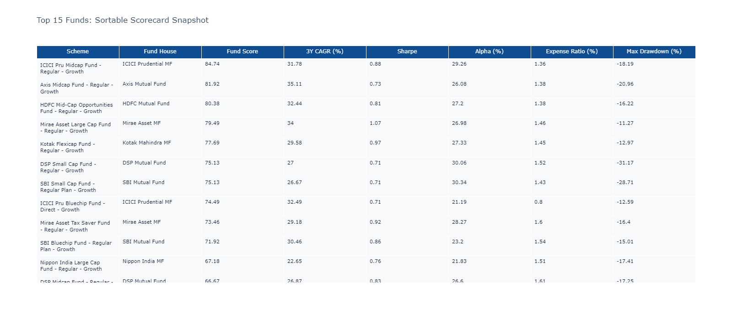
Performance Metrics — Risk Analysis & Scorecard
30%
3yr CAGR
25%
Sharpe Ratio
20%
Alpha
15%
Expense Ratio
10%
Max Drawdown
12
High Sharpe (>1.5)
28
Positive Alpha
8
Low Vol (<12%)
70%
Beat NIFTY100

Slide 9
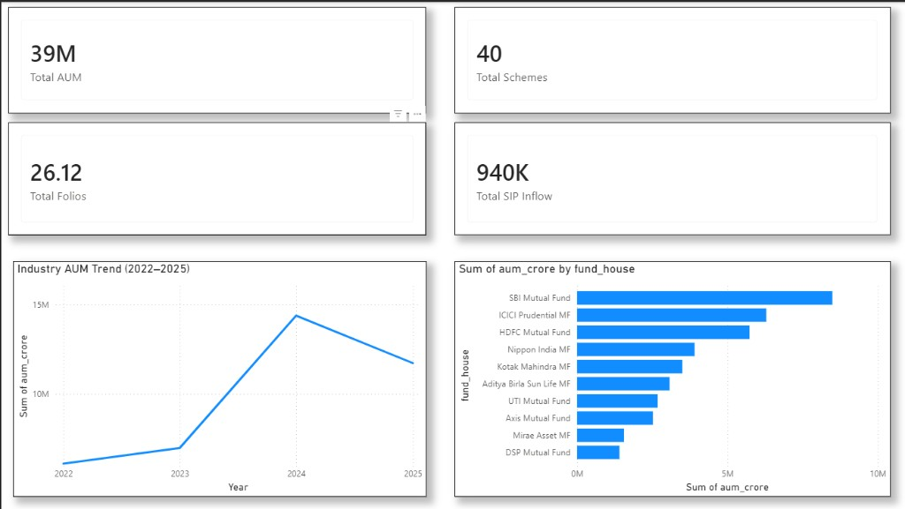
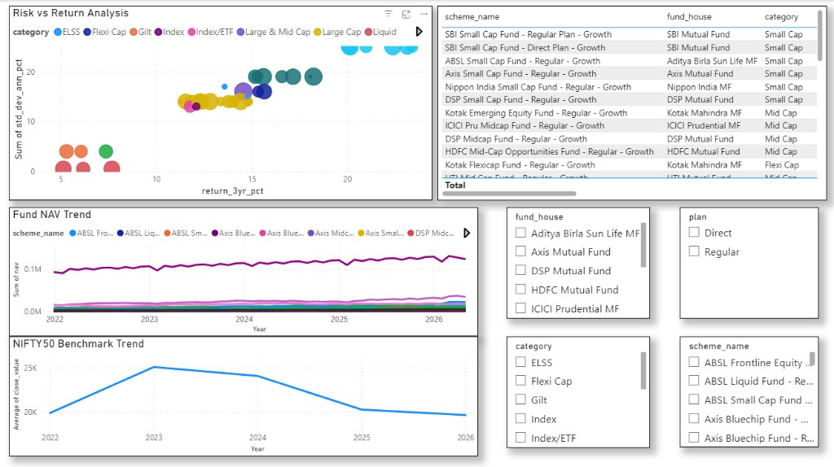
Dashboard Screenshots — Page 1 & 2
Page 1: Industry Overview — KPIs, AUM trend, AMC rankings
Page 2: Fund Performance — Risk-return scatter, scorecard table, NAV vs benchmark

Slide 10
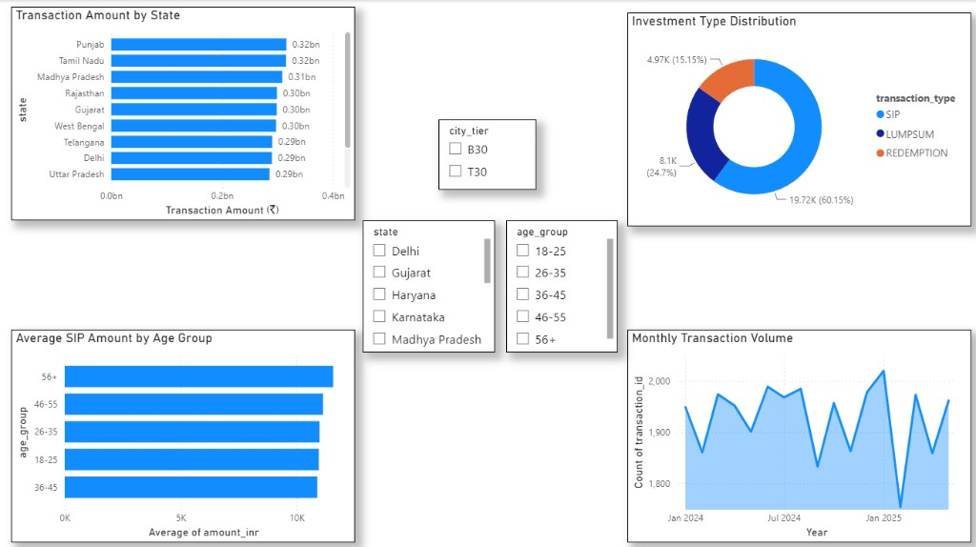
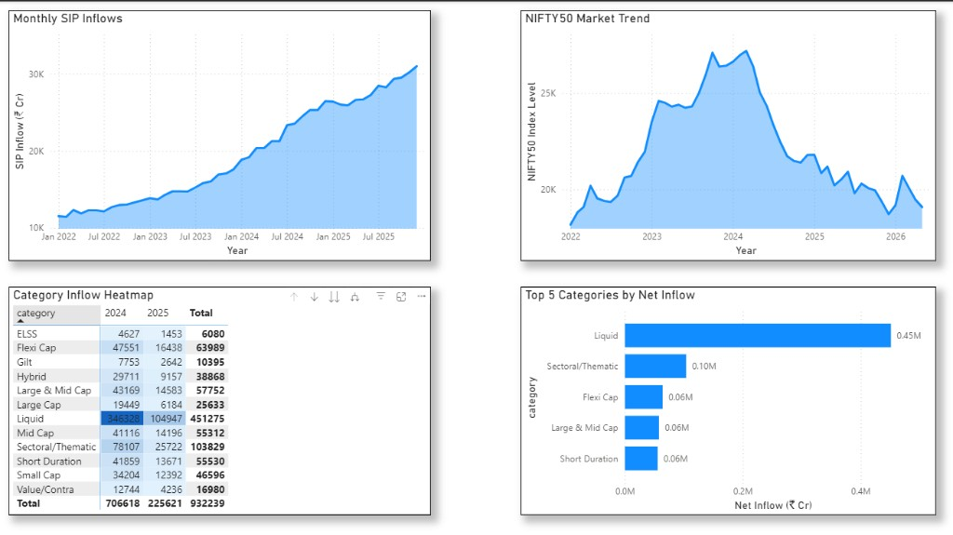
Dashboard Screenshots — Page 3 & 4
Page 3: Investor Demographics — Geographic heat map, age groups, transaction types
Page 4: Category & Sector Trends — SIP inflows, NIFTY50 trend, category heatmap

Slide 11
Key Findings & Strategic Recommendations
Critical Insights
Fund Selection: Top 12 funds show Sharpe ratios >1.5; composite scoring outperforms single-metric ranking
Risk Profile: Average VaR 95% = -2.8% daily; CVaR (tail risk) = -4.1%; max drawdown 8-22%
Investor Behavior: SIP dominance (65%); metro concentration (40%); peak age 25-45; excellent KYC compliance
SIP Continuity Risk: 8% of SIPs show >35-day gaps; early cohorts (pre-2022) show 85% continuity
Sector Concentration: Moderate HHI (avg 0.18); IT/Finance/FMCG dominant
Strategic Recommendations
For Fund Managers: Engage at-risk SIPs proactively; develop Tier-2/3 distribution; optimize costs
For Investors: Use composite scorecard; diversify across categories/sectors; maintain SIP discipline
For Regulators: Monitor concentration risk (HHI); enhance drawdown disclosures; standardize reporting

Slide 12
Thank You!
Questions & Discussion
Project Summary
Complete 7-day capstone execution (Day 1-7 deliverables)
ETL pipeline + Analytics + Interactive 4-page dashboard
40 fund schemes, 1M+ transactions, 252K+ NAV records analyzed
Production-ready codebase with comprehensive documentation
Deliverables: GitHub Repository | Final Report | README Setup Guide
Version 1.0 | June 2026

