Slide 1

Logisticsnow Pvt Ltd
Data Visualization Dashboard

Slide 2
Dataset Summary
Parameter | Value
Total Spend (in INR Lakhs) | 6040.92
Total Volume (in Truckload) | 24212.06
No. of Lanes | 246
No. of Origins | 21
No. of Destinations | 39
No. of Truck Types | 9
No. of Transporters | 0
LogisticsNow Confidential

Slide 3
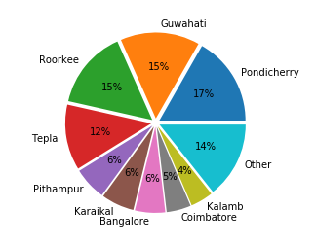
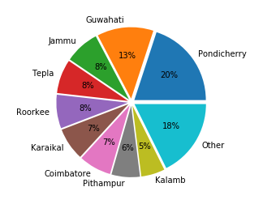
Origin/Plant: Snapshot
By Spend
By Volume
LogisticsNow Confidential

Slide 4
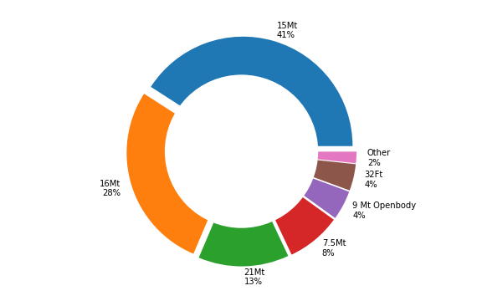
Trucktype By Spend
LogisticsNow Confidential

Slide 5
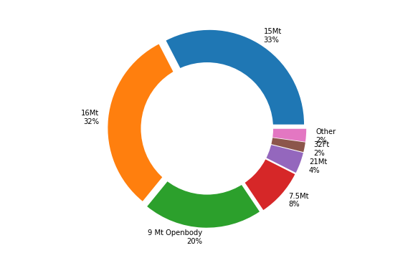
Trucktype By Volume
LogisticsNow Confidential

Slide 6
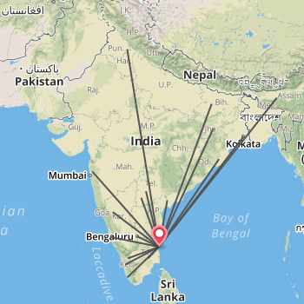
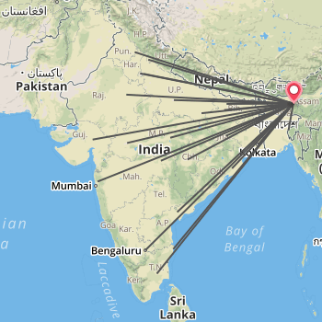
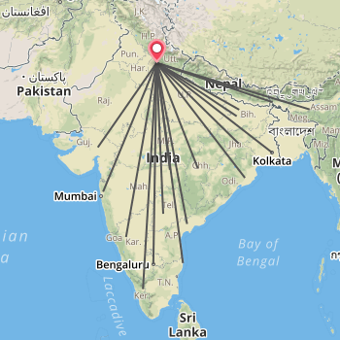
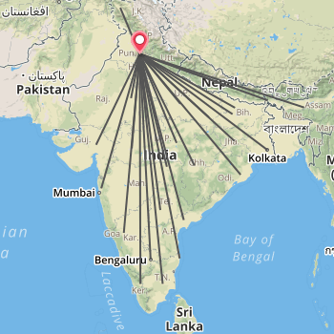
Top Plant Lanes Network: By spend
Pondicherry
Guwahati
Roorkee
Tepla
LogisticsNow Confidential

Slide 7
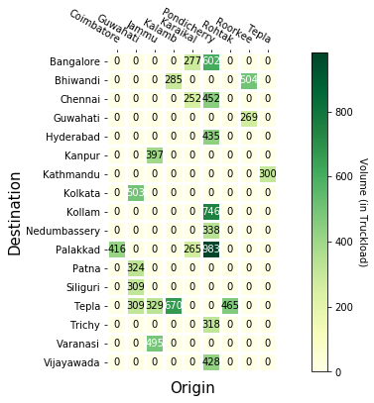
Top 25 Lanes By volume
LogisticsNow Confidential

Slide 8
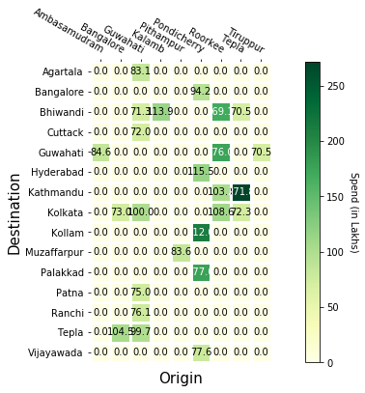
Top 25 Lanes By spend
LogisticsNow Confidential

Slide 9
Top 10 Lanes by Volume
LogisticsNow Confidential

Slide 10
Top 10 Lanes by Spend
LogisticsNow Confidential

Slide 11
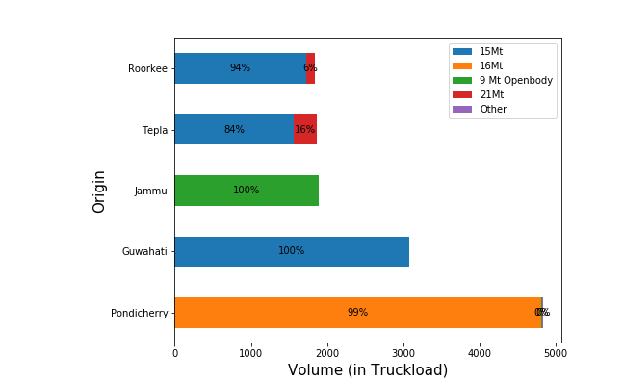
Origin Distribution by Trucktype (volume)
LogisticsNow Confidential

Slide 12
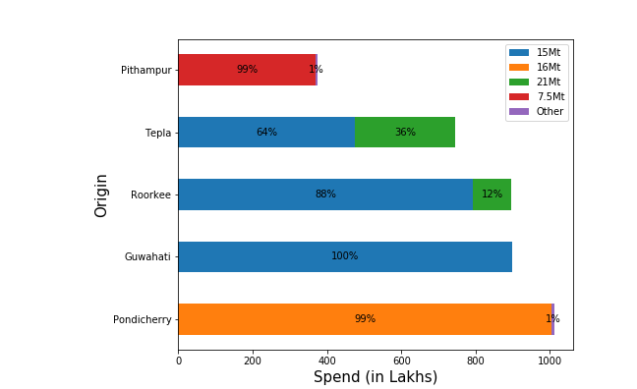
Origin Distribution by Trucktype (spend)
LogisticsNow Confidential

Slide 13
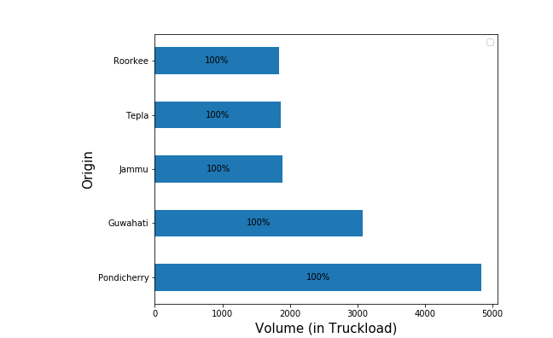
Origin Distribution by Transporter (volume)
LogisticsNow Confidential

Slide 14
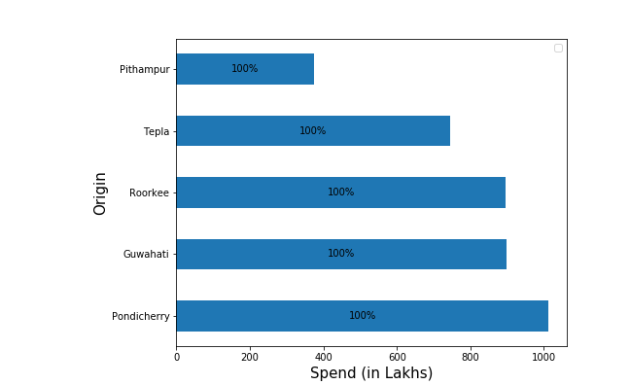
Origin Distribution by Transporter (spend)
LogisticsNow Confidential

Slide 15

Questions / Feedback
Thank You!

