Slide 1

Logisticsnow Pvt Ltd
Data Visualization Dashboard

Slide 2
Dataset Summary
Parameter | Value
Total Spend (in INR Lakhs) | 5516.23
Total Volume (in Truckload) | 17760.0
No. of Lanes | 229
No. of Origins | 20
No. of Destinations | 38
No. of Truck Types | 7
No. of Transporters | 31
LogisticsNow Confidential

Slide 3
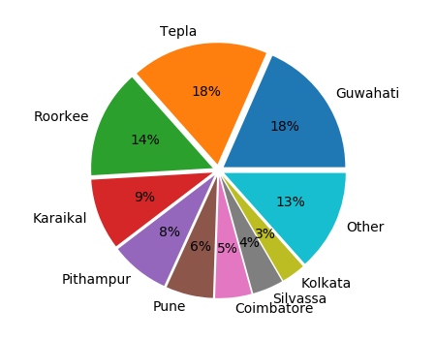
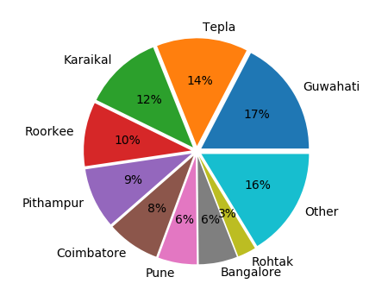
Origin/Plant: Snapshot
By Spend
By Volume
LogisticsNow Confidential

Slide 4
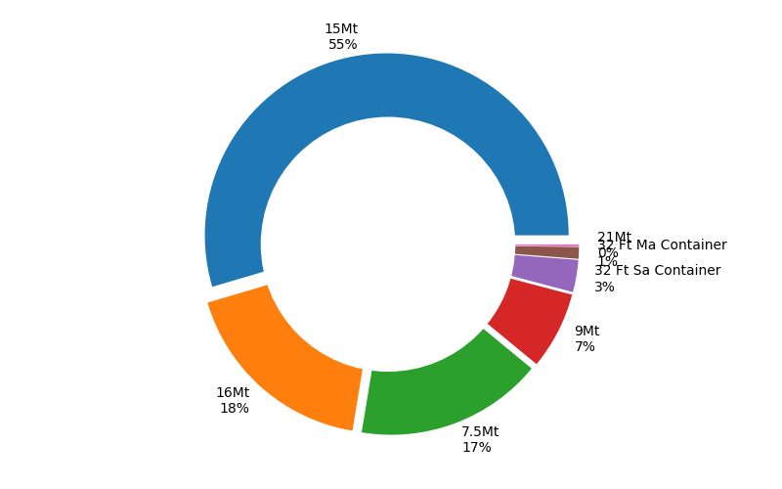
Trucktype By Spend
LogisticsNow Confidential

Slide 5
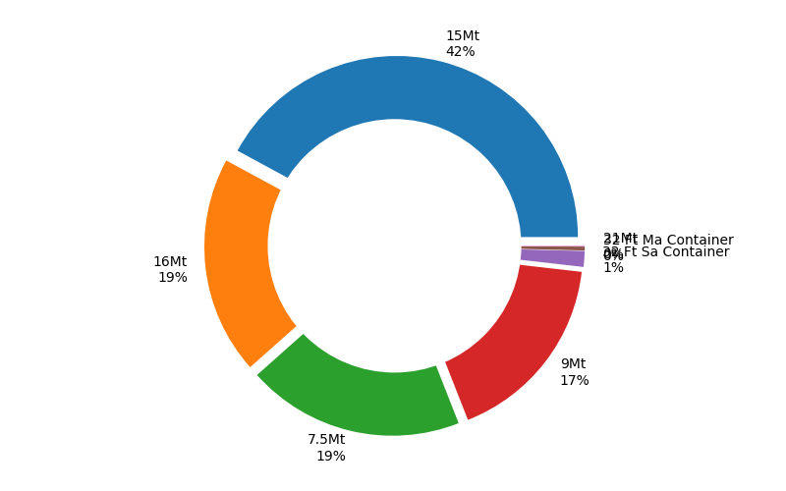
Trucktype By Volume
LogisticsNow Confidential

Slide 6
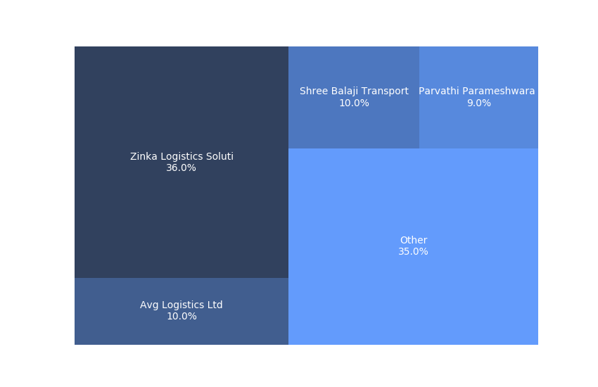
Transporter Snapshot: By Spend
LogisticsNow Confidential

Slide 7
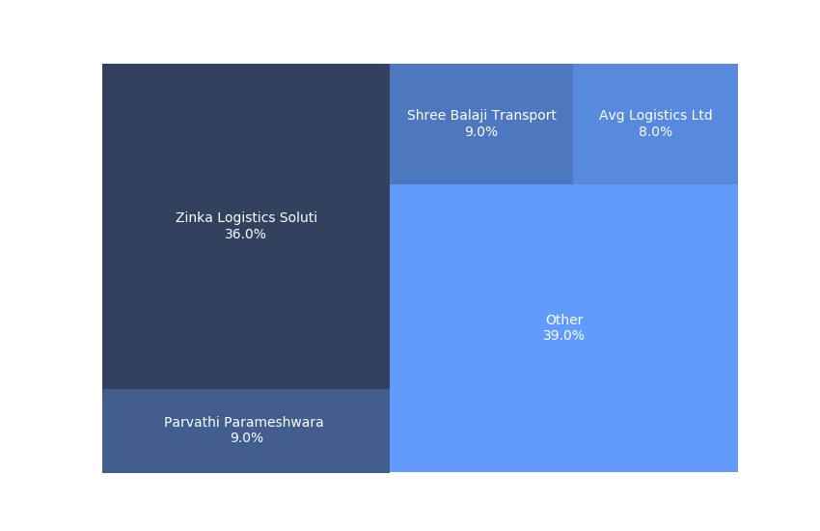
Transporter Snapshot: By Volume
LogisticsNow Confidential

Slide 8
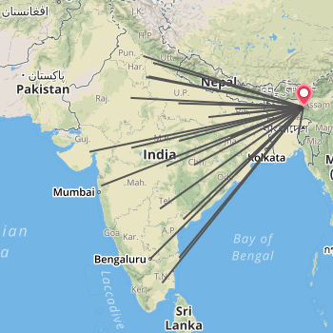
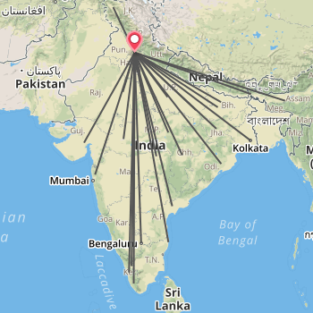
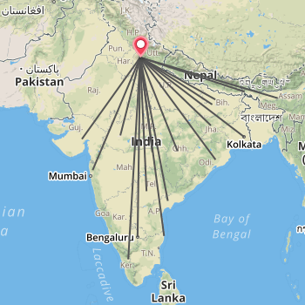
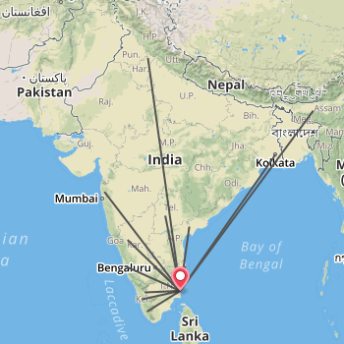
Top Plant Lanes Network: By spend
Guwahati
Tepla
Roorkee
Karaikal
LogisticsNow Confidential

Slide 9
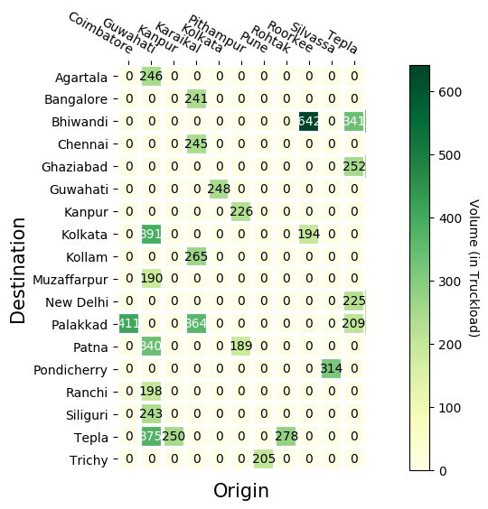
Top 25 Lanes By volume
LogisticsNow Confidential

Slide 10
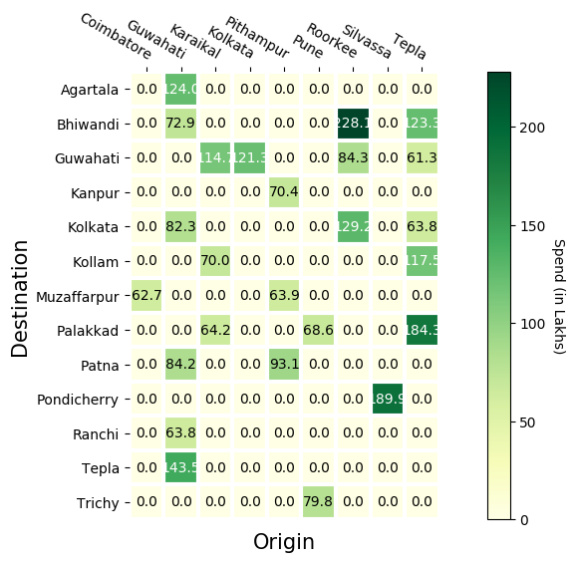
Top 25 Lanes By spend
LogisticsNow Confidential

Slide 11
Top 10 Lanes by Volume
LogisticsNow Confidential

Slide 12
Top 10 Lanes by Spend
LogisticsNow Confidential

Slide 13
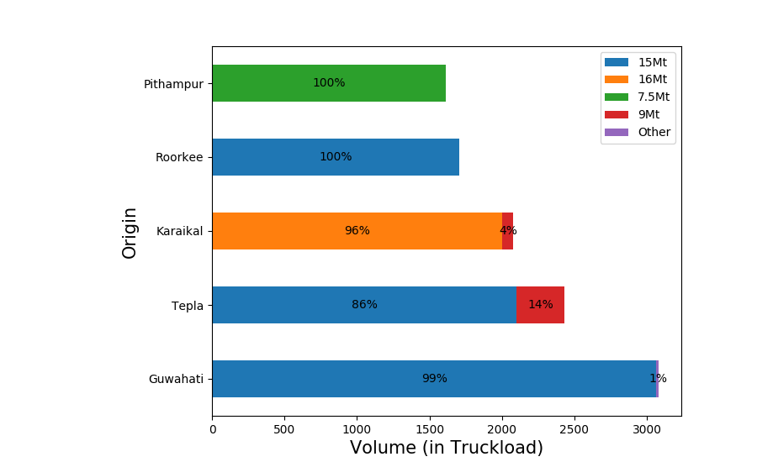
Origin Distribution by Trucktype (volume)
LogisticsNow Confidential

Slide 14
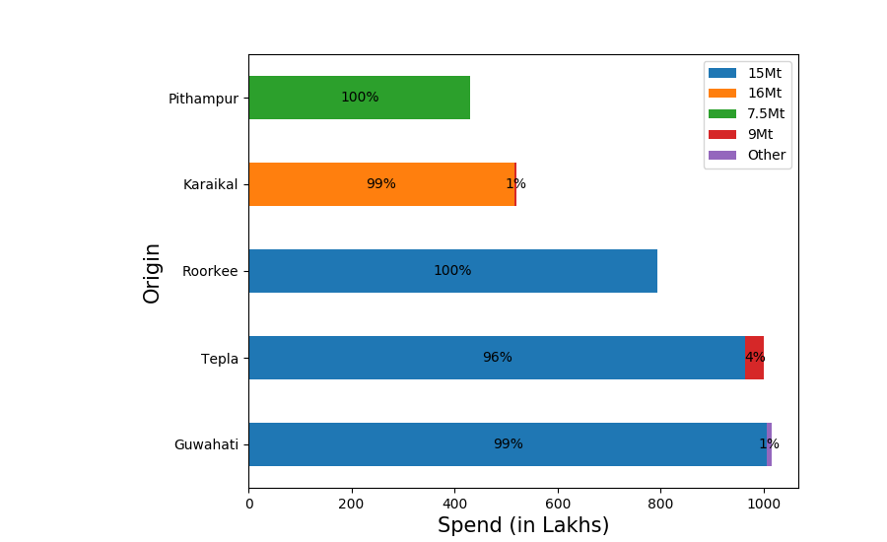
Origin Distribution by Trucktype (spend)
LogisticsNow Confidential

Slide 15
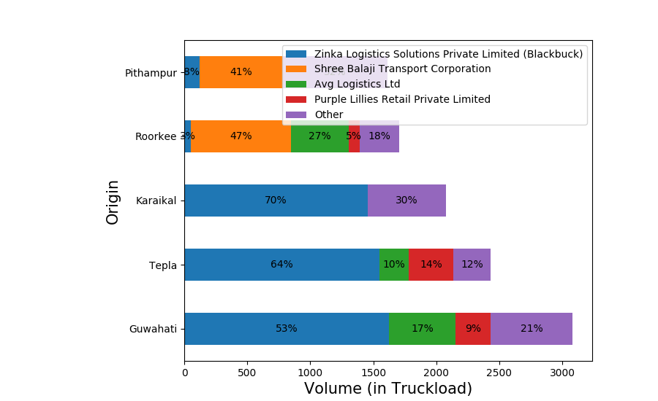
Origin Distribution by Transporter (volume)
LogisticsNow Confidential

Slide 16
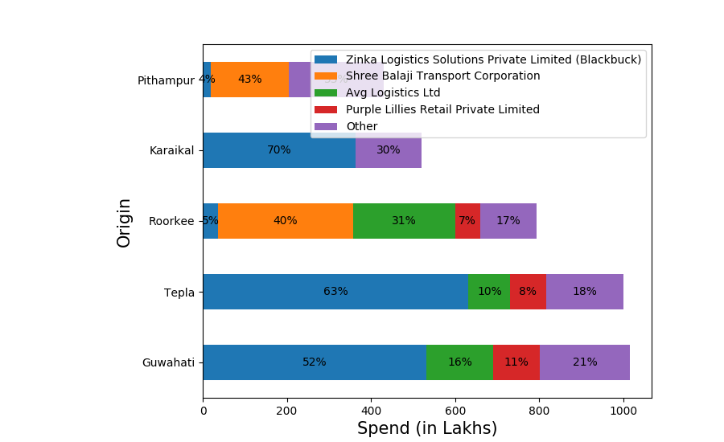
Origin Distribution by Transporter (spend)
LogisticsNow Confidential

Slide 17
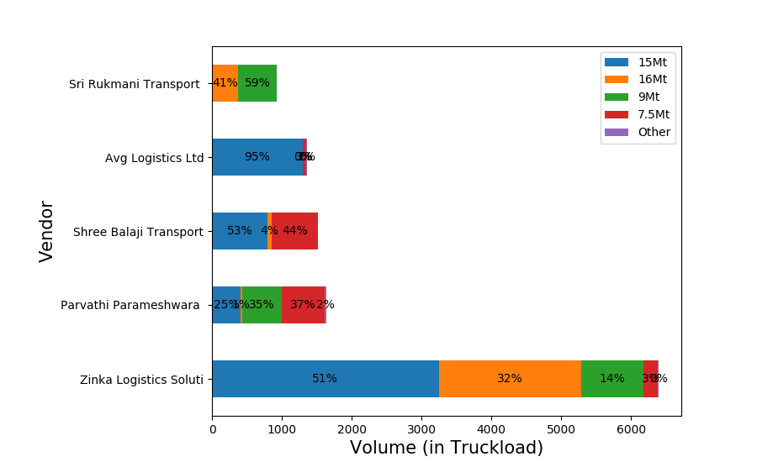
Transporter Distribution by Trucktype (volume)
LogisticsNow Confidential

Slide 18
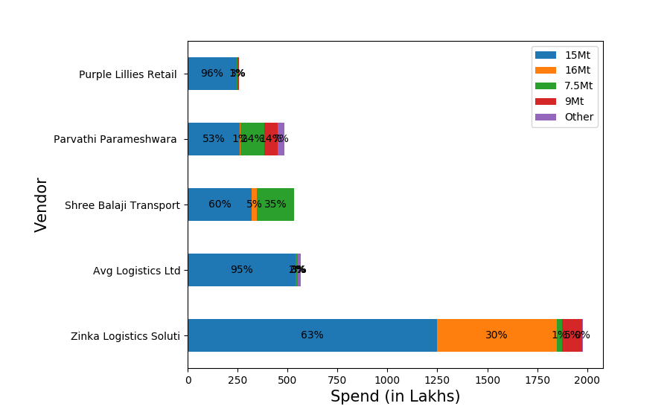
Transporter Distribution by Trucktype (spend)
LogisticsNow Confidential

Slide 19

Questions / Feedback
Thank You!

