Slide 1
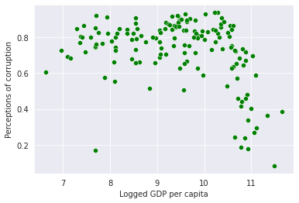
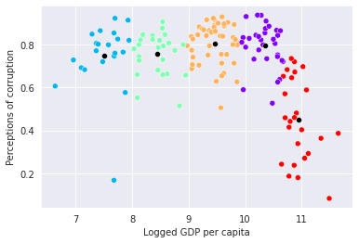
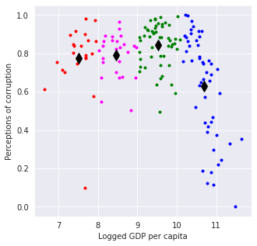
Happiness and population
INTRODUCTION
the aim is to segregate groups with similar traits and assign them into clusters, secondly, the process of finding a mathematical function in an analytic form that best fits set of data, Lastly, initiate arrays for lower and
upper limits.
fig1
Fig 2
Fig 1:produce a scatter plot of Logged GDP per Capita and Perceptions of corruption
Fig 2: shows Kmeans clustering as there are five clusters of Logged GDP per Capita and Perception of corruption
Fig 3:kmeans set up the clusters, 4 expected clusters and show clusters in a center marker size=10 with Xlable as of Logged GDP per Capita and Ylable as Perceptions of corruption
Fig 3

Slide 2
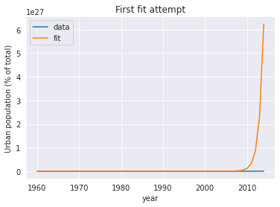
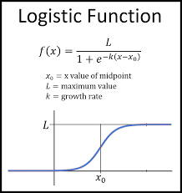
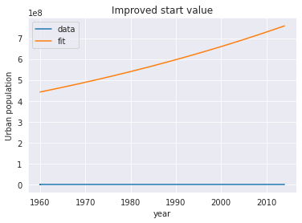
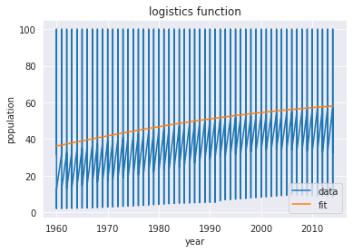
Fig 1
Fig 2
Fig 1 shows fit exponential growth of urban population from the year 1069 to 2010 with Year with title First show attempt
Computes exponential function with
scale and growth as free parameters
find a feasible start value the
Pedestrian way
the scale factor is way too small. The exponential factor too large.
Try scaling with the 1960 urban population and a smaller exponential factor
decrease or increase exponential factor until rough agreement is reached
growth of 0.02 gives a reasonable start value
Fig 2 scaling with the 1960 urban population and a smaller exponential factor.
Fig3:Computes logistics function with scale, growth rate
and time of the turning point as free parameters from the years 1960 and unban population
Fig 3

Slide 3
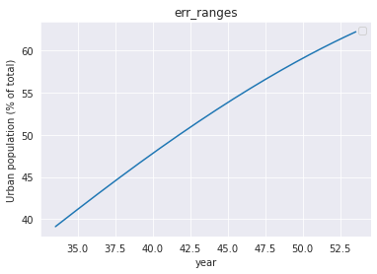
Calculates the upper and lower limits for
the function, parameters and
sigma for single value or array x. Functions values are calculated for all combinations of +/sigma and the minimum and maximum is determined. Can be used for all number of parameters and
sigma >=1

