Slide 1
Transportation Analysis
Rajvinder Kaur

Slide 2

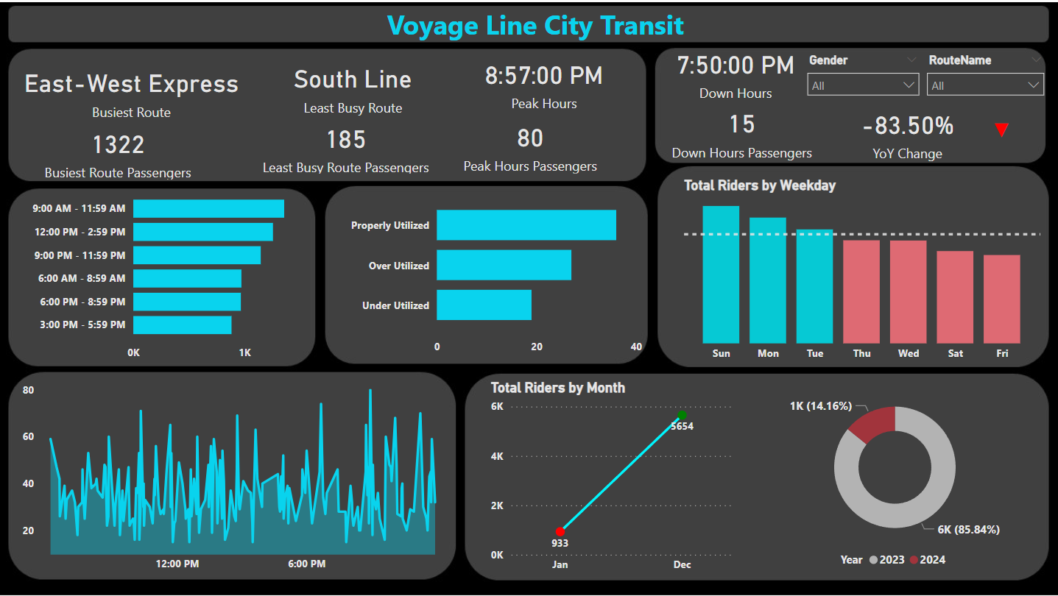
Rajvinder Kaur

Slide 3
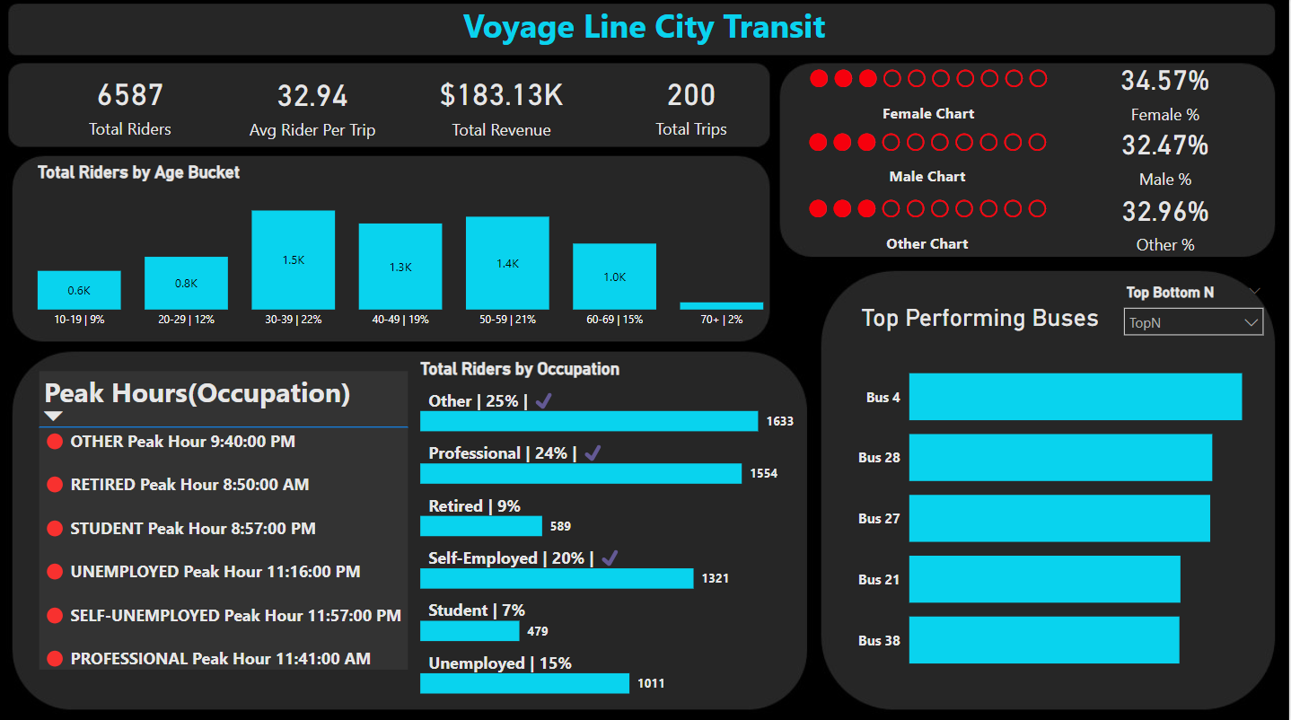
Rajvinder Kaur

Slide 4
Thank you!
Rajvinder Kaur

