Slide 2
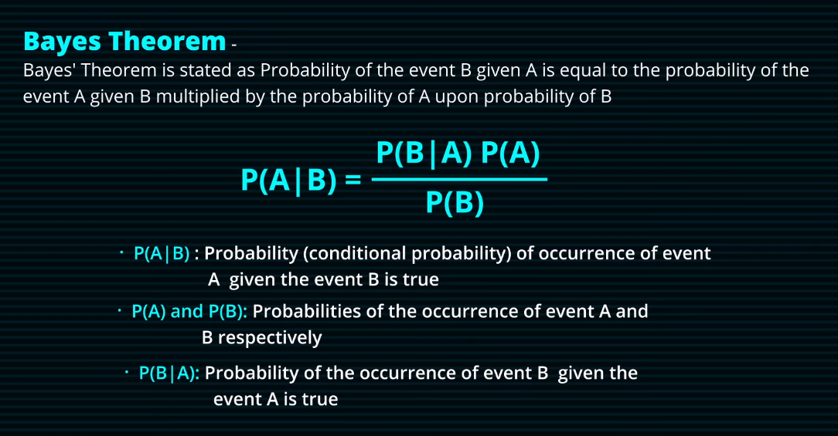

Slide 3
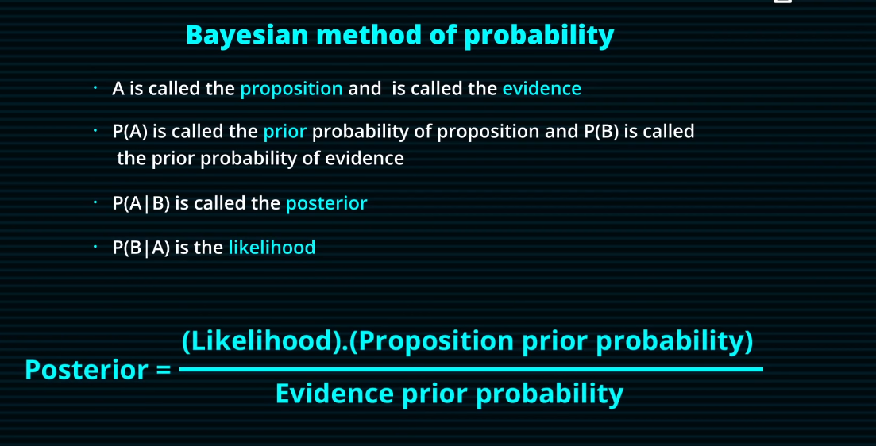

Slide 4
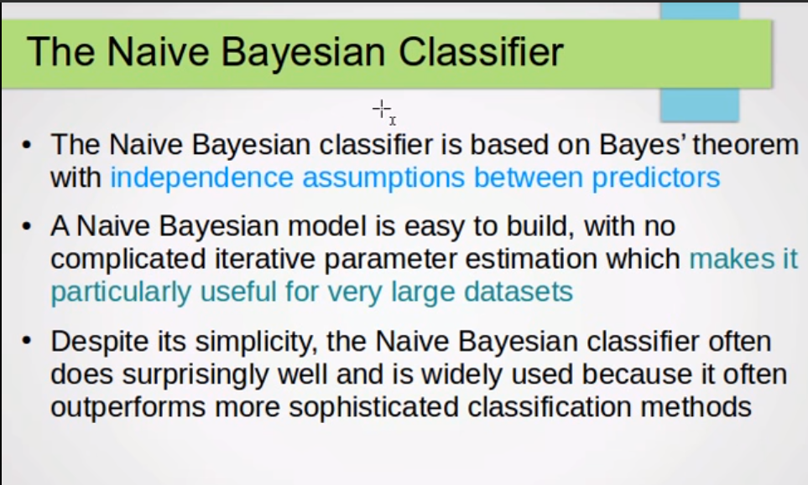
Naïve Bayes classifier is based on Bayes Theorem.
It assumes there is no dependency between the predictors.
It makes it one of the useful techniques while working with large dataset.

Slide 5
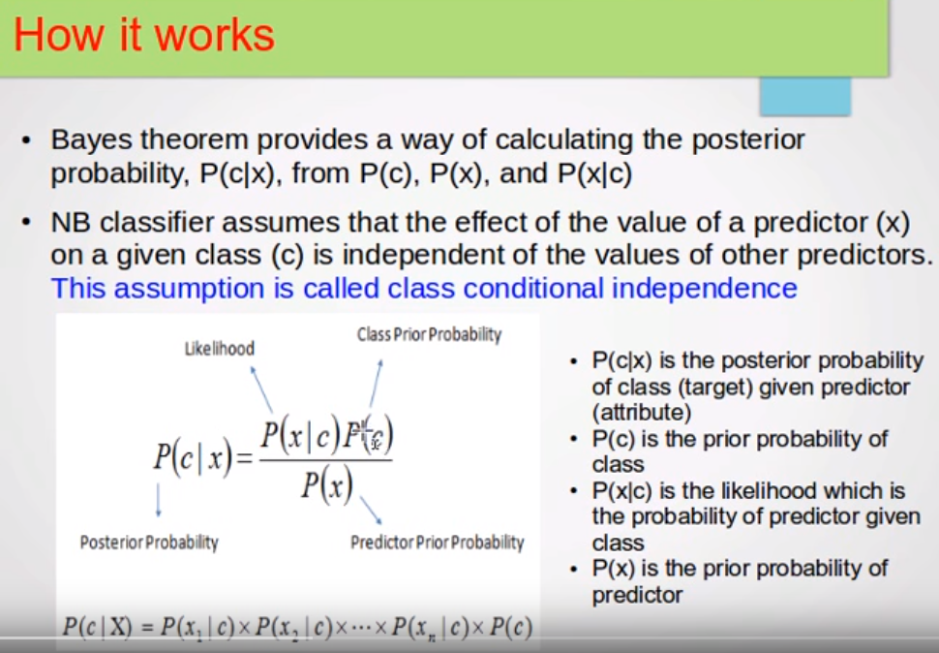
Naïve Bayes theorem
Likelihood
Class Prior Probability
Probability Condition
Probability of Drug
Probability of Drug
Given Drug
Given Condition
Posterior Probability
Probability Condition
Predictor’s Prior Probability
Probability of Drug
Probability Condition1
Probability Condition2
Probability of Drug
……
Given Condition
Given Drug
Given Drug

Slide 6
Type of Problem
Natural Binary
Spam Classification
Segmentation (Same or Different )
Multi Class
Topic Classification
Part of speech tagging
Document Classifying
Binary
Multi -Class
UI

Slide 7
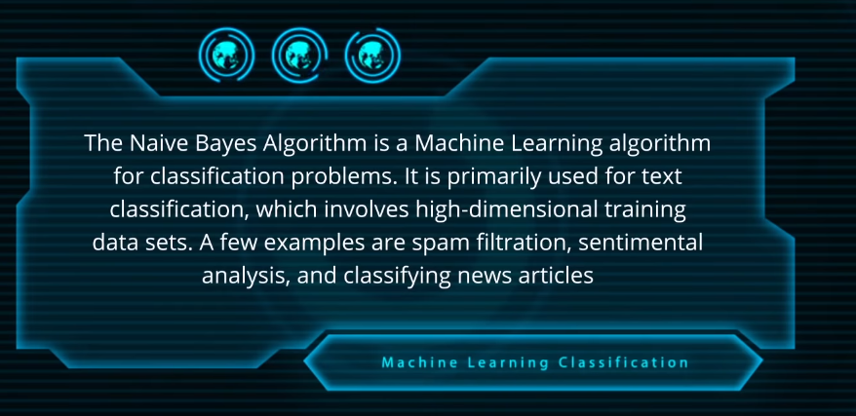

Slide 8








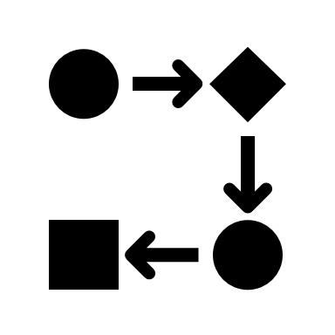




Analysis and Design
Medical Data
Symptoms & Problem
Frequent Terms
Mongo
Human Body
Naive Bayes Model
Data Wrangling
Term Frequency
Prepare Model
Condition Record

Slide 9



Working With Model
Mongo
Download
Apply
Result
I have sinus infection.
Mongo
Frequent Terms
Conditions
Server
Naive Bayes Model

Slide 10







I have sinus infection.

Slide 11
https://www.youtube.com/watch?v=sjUDlJfdnKM
https://www.youtube.com/watch?v=CPqOCI0ahss

