Slide 1

PYTHON PROJECT
WHALE
OPTIMISATION
ALGORITHM
1

Slide 2
Team Members
TUSHAR SAMPLA( 24CSB1A70 )
TERLI SOAN SAGAR( 24CSB1A65 )
RAJWARDHAN SINGH ( 24CSB1A52 )
K.AKHIL YADAV ( 24CSB1A26 )
2

Slide 3
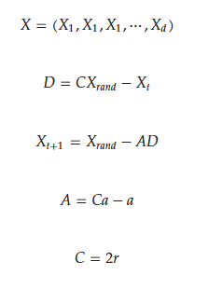
Random Walk Search
In the random search stage of the Whale Optimization Algorithm (WOA), when A>1 and p<=0.5 whales perform global exploration by randomly updating their positions based on other whales’ locations to search broadly for the prey’s optimal position.
3

Slide 4
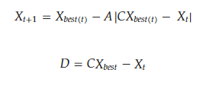
Surrounding Prey Stage
In the prey-surrounding stage of the Whale Optimization Algorithm (WOA), when A<1 and p<0.5 whales stop random exploration and update their positions toward the current best solution, forming a spiral movement around the prey to gradually converge to the optimal position.
4

Slide 5
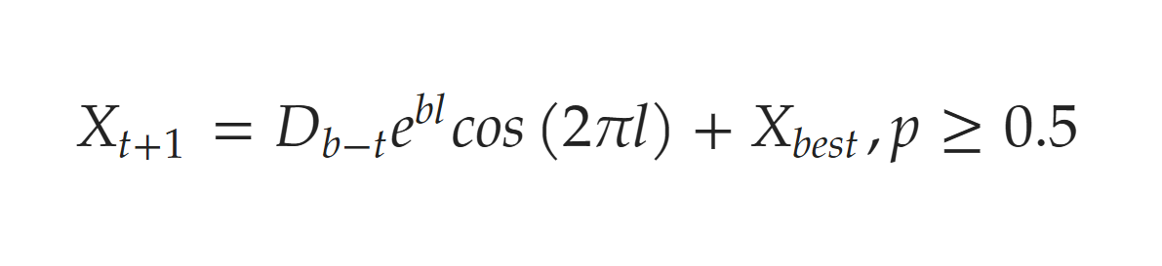
Bubble Net Predation
In the hunting stage of the Whale Optimization Algorithm (WOA), when A<1 and p>=0.5, the whales employ a bubble-net attack strategy, using spiral movements around the best solution to simulate encircling and capturing the prey, thus finalizing the optimization process.
5

Slide 6
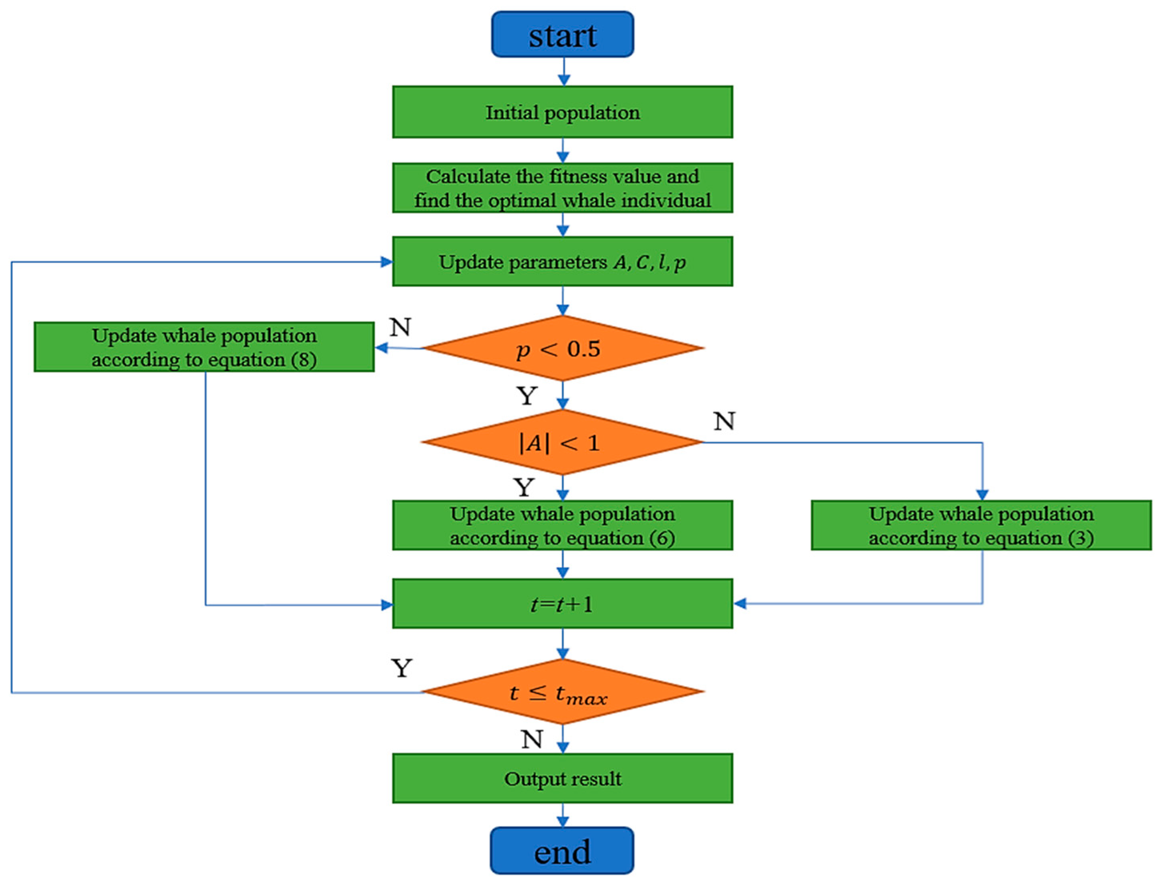
Block
Diagram
6

Slide 7
Approach Used
Feature Extraction
Train Test Split and Normalization
Baseline SVM Model Training
WOA Hyperparameter Tuning(C, gamma)
Hyperparameter Tuned Model Training
Comparing Tuned Model with Baseline model
7

Slide 8
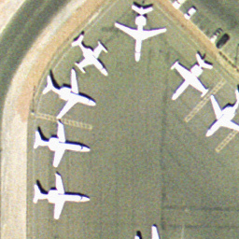
UC Merced Land Use Dataset
The UC Merced Land Use Dataset is a benchmark aerial image dataset containing 21 land-use classes with 100 images each, commonly used for scene classification and remote sensing research.
URL:https://www.kaggle.com/datasets/abdulhasibuddin/uc-merced-land-use-dataset
8

Slide 9
UC Merced Land Use Dataset
Baseline Accuracy: 0.9048
Tuned Accuracy: 0.9238
Improvement: +0.0190
URL:https://www.kaggle.com/datasets/abdulhasibuddin/uc-merced-land-use-dataset
9

Slide 10
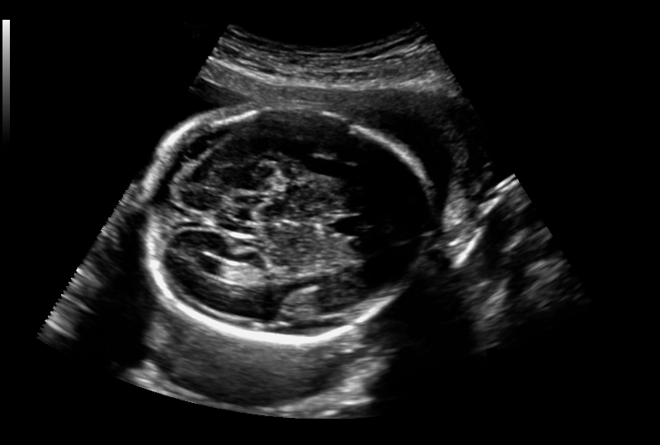
Ultrasound Fetus Dataset
The Ultrasound Fetus Dataset consists of fetal ultrasound images categorized by gestational age or anatomical features, used for medical imaging analysis and classification tasks.
URL:https://www.kaggle.com/datasets/abdulhasibuddin/uc-merced-land-use-dataset
10

Slide 11
Ultrasound Fetus Dataset
Baseline Accuracy: 0.7481 Tuned Accuracy: 0.7481 Improvement: +0.0000
11

Slide 12
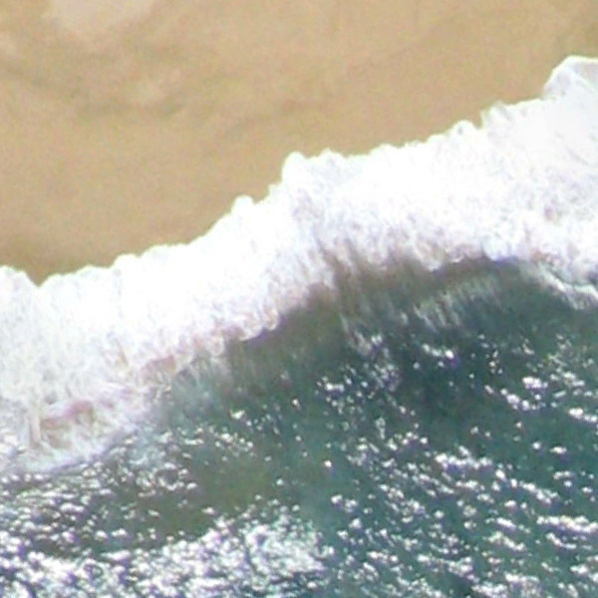
AID: A scene classification dataset
AID is a large-scale aerial scene classification dataset containing diverse high-resolution images across multiple land-use categories for remote sensing research.
URL:https://www.kaggle.com/datasets/jiayuanchengala/aid-scene-classification-datasets
12

Slide 13
AID: A scene classification dataset
Baseline Accuracy: 0.8815
Tuned Accuracy: 0.8910
Improvement: +0.0095
URL:https://www.kaggle.com/datasets/jiayuanchengala/aid-scene-classification-datasets
13

Slide 14
Contribution of Members
TERLI SOAN SAGAR( 24CSB1A65 )
Baseline SVM Model
Built baseline SVM model using RBF kernel.
Trained model on extracted VGG16 feature embeddings.
Used default parameters to assess initial performance.
Evaluated model accuracy on unseen test data.
Compared results to identify improvement scope.
Recorded baseline metrics for future optimization.
14

Slide 15
Contribution of Members
TUSHAR SAMPLA( 24CSB1A70 )
Train Test Split and Normalisation
Organized dataset into predefined train and test directories.
Loaded images efficiently using PyTorch ImageFolder.
Ensured balanced class distribution across splits.
Extracted features separately for training and testing data.
Applied StandardScaler for consistent feature normalization.
Verified scaled data readiness for SVM training.
15

Slide 16
Contribution of Members
RAJWARDHAN SINGH (24CSB1A52)
Conceptualisation, Feature Extraction, and WOA
Designed complete workflow integrating CNN features, SVM, and WOA.
Planned pipeline for preprocessing, training, and evaluation.
Utilized pre-trained VGG16 for extracting deep visual features.
Applied global average pooling to reduce feature dimensions.
Implemented Whale Optimization Algorithm for SVM hyperparameter tuning.
Evaluated fitness using cross-validation to refine parameters.
16

Slide 17
Contribution of Members
K.AKHIL YADAV ( 24CSB1A26 )
Evaluation of Final Model
Loaded best SVM model with optimized hyperparameters.
Tested model on unseen test dataset for accuracy.
Predicted labels using final trained SVM.
Calculated accuracy score for performance assessment.
Compared tuned model accuracy against baseline results.
Documented evaluation metrics for reporting and analysis.
17

Slide 18
Novelty
Implementing the model after feature extraction on extracted features saved a lot of computational power.
Used a baseline model to get good parameters and used those baseline parameters to tune the model further.
The baseline parameters help the WOA to be near the optimal result beforehand which helps a lot in further optimization.
18

Slide 19
Thank You

