Slide 1

Workplace Productivity
&
Time Management
Strategies to Improve Efficiency in Corporate Workplaces
Rakesh Gupta

Slide 2
Introduction
What is Productivity?
Productivity is the measure of how efficiently tasks are completed in a given time.
It’s about achieving more with fewer resources while maintaining quality.
Why is Time Management Important in the Workplace?
Improves work efficiency & reduces stress.
Helps in prioritizing important tasks.
Leads to better work-life balance & job satisfaction.
Statistics on Productivity (Use Infographic)
55% of employees say distractions at work lower their productivity.
Workers spend an average of 2.5 hours daily on non-work-related tasks.
Effective time management can boost productivity by 40%

Slide 3
Key Challenges Affecting Productivity
1. Common Workplace Distractions
Social media & smartphone usage
Unnecessary meetings
Office noise & interruptions
2. Multitasking vs. Focused Work
Myth: Multitasking increases productivity.
Reality: It reduces efficiency by 40% due to task-switching.
3. Time Wasters (Graph/Visual Representation)
Emails: Employees check emails 36 times per hour.
Meetings: 67% of meetings are considered unproductive.
Procrastination: 20% of workers admit to delaying tasks daily.

Slide 4
Effective Time Management Techniques
1. Eisenhower Matrix (Urgent vs. Important)
Quadrants:
Urgent & Important → Do it now
Important but Not Urgent → Schedule it
Urgent but Not Important → Delegate it
Neither Urgent nor Important → Eliminate it
Use an Eisenhower Matrix diagram.
2. Pomodoro Technique (Work in Intervals)
Work for 25 minutes, then take a 5-minute break.
Helps maintain focus & avoid burnout.
3. 80/20 Rule (Pareto Principle)
80% of results come from 20% of efforts.
Focus on high-impact tasks first.
Add icons or visuals for each technique.

Slide 5
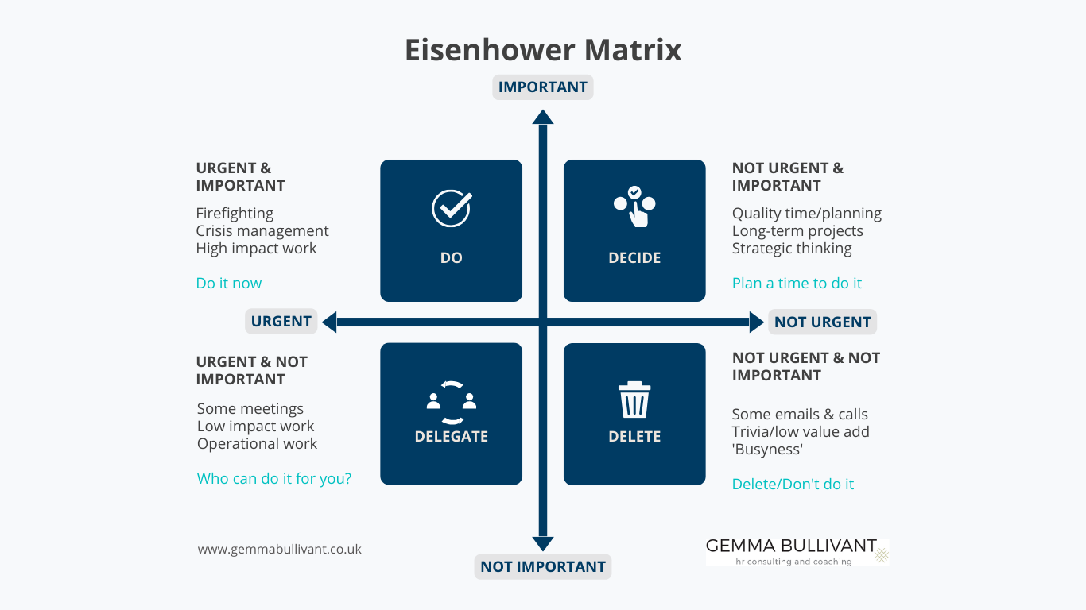
Effective Time Management Techniques
1.Eisenhower Matrix diagram

Slide 6
Tools & Technologies for Productivity
Top Productivity Tools (Use a Table for Comparison)
Tool | Purpose | Key Features
Trello / Asana | Task Management | Organizes tasks into boards & lists
Google Calendar / Outlook | Scheduling | Set reminders & automate meetings
Forest / Freedom | Focus Apps | Blocks distractions, improves deep work

Slide 7
Conclusion & Takeaways
Key Takeaways:
Manage time wisely to boost productivity.
Use effective strategies & tools.
Maintain work-life balance to avoid burnout.
Final Thought: “Time isn’t the main thing. It’s the only thing.” — Miles Davis
Company Contact Info (if applicable).
Rakesh Gupta​

