Slide 1
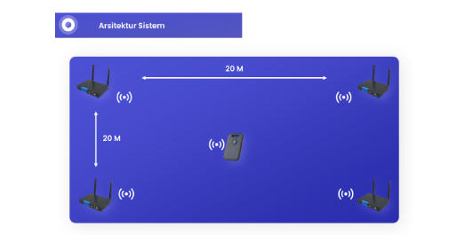

Slide 2
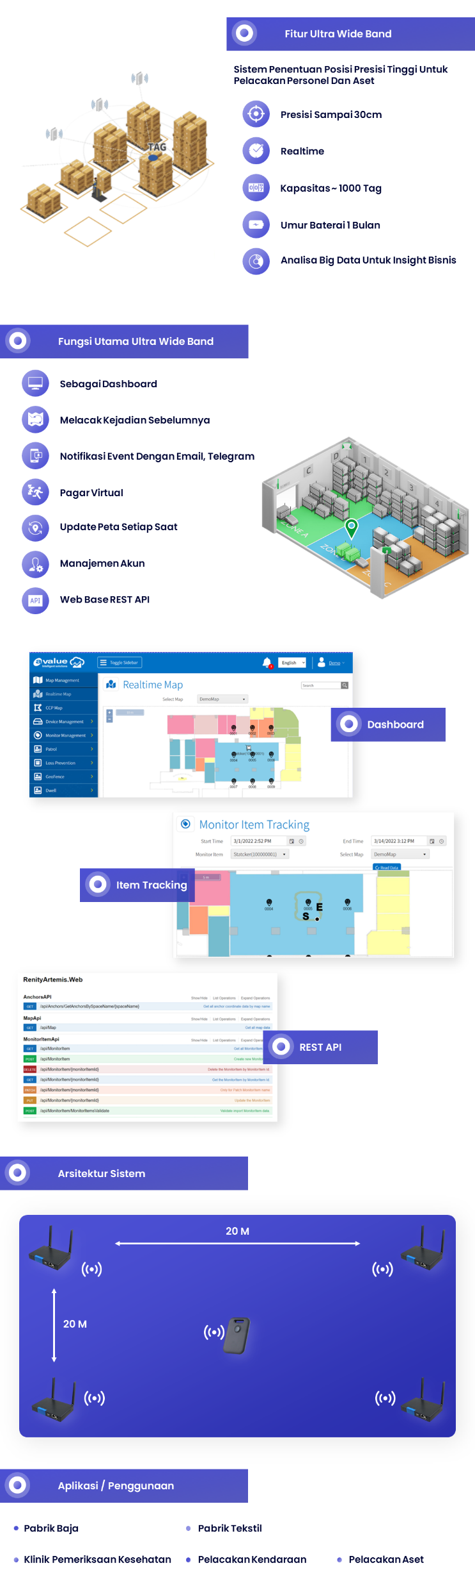

Slide 3
C.A.T
Computer Assisted Test

