Slide 1

Rakan Alharbi
UK Incidents Data Analysis

Slide 2
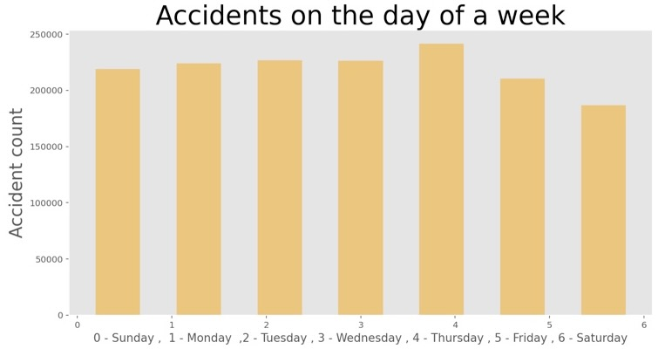
find out the number of accidents on the days of a week.

Slide 3
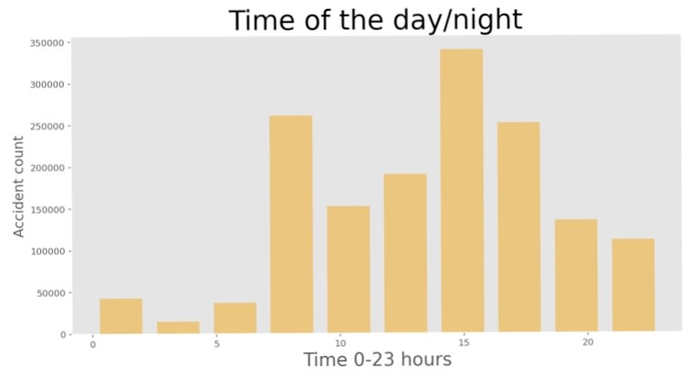
find out about the accidents number using hours of the day.

Slide 4
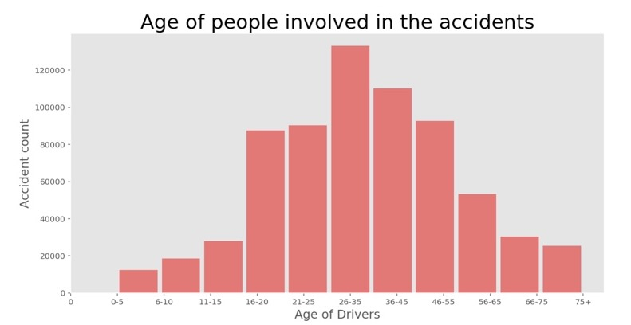
Finding out about the age of driver can tell us more about the accidents

Slide 5
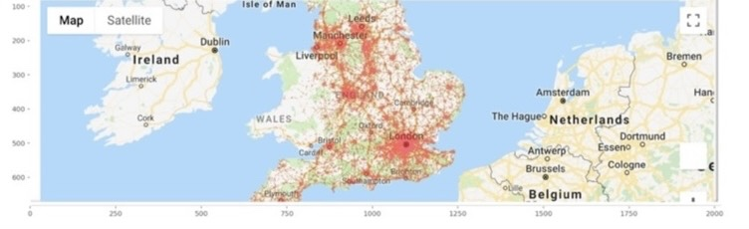
Plotting accidents Location on Google Maps:

Slide 6

Machine learning: tuning the balance in data:

Slide 7
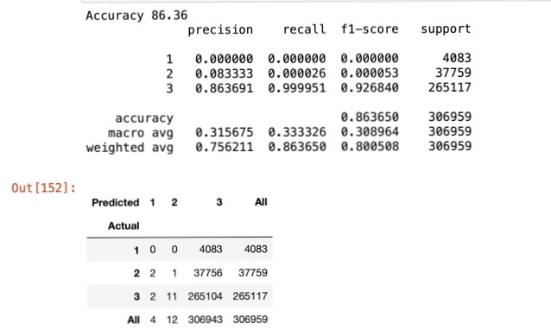
logistic regression algorithm:

Slide 8
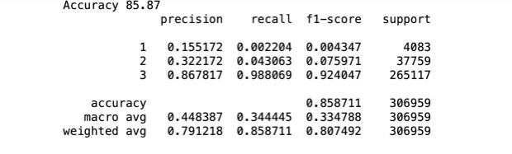
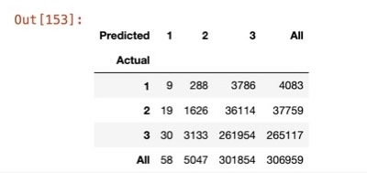
decision tree algorithm:

Slide 9
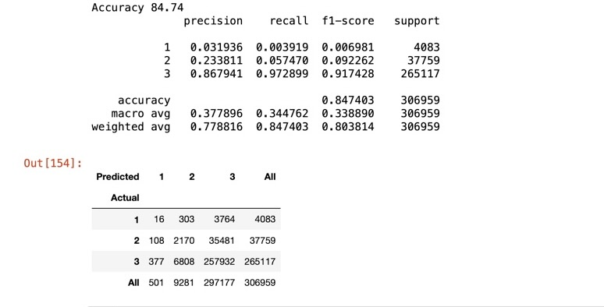
Random forest classifier algorithm:

Slide 10
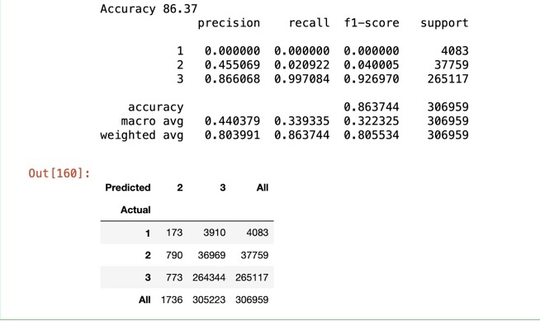
Grid search CV:

