Slide 1

DATA ANALYSIS

Slide 2
Objective
To provide analysis of IPL cricket data for better game planning and strategy.
Dataset
Open-source data
Matches
Deliveries

Slide 3





Structure we followed
DATA
ANALYSIS
RESULTS

Slide 4
ANALYSIS

Slide 5
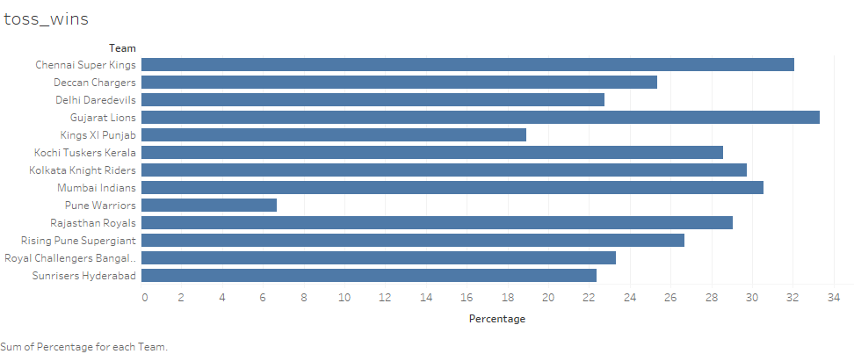
Impact of toss on the outcome of the match

Slide 6
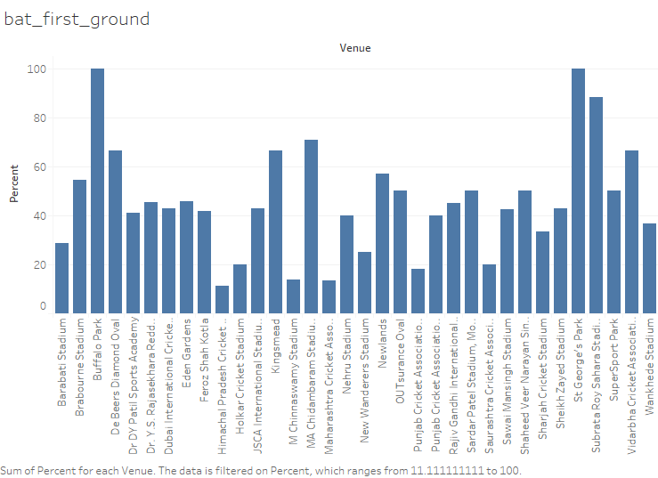
Analyzing which stadium is most suitable for batting first

Slide 7
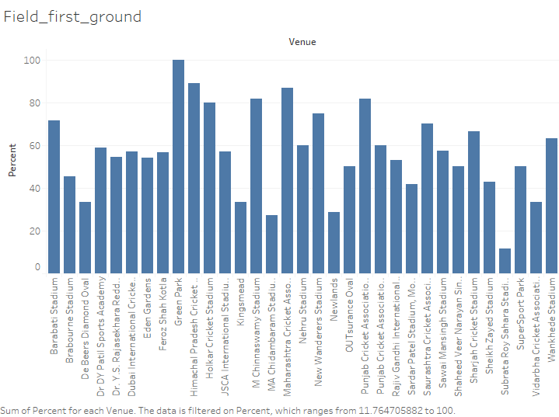
Analyzing which stadium is most suitable for fielding first

Slide 8
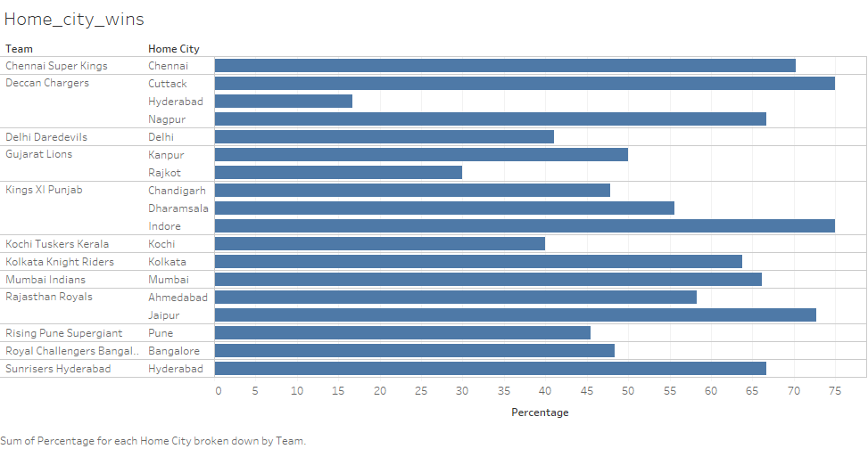
Home Ground Wins Percentage

Slide 9
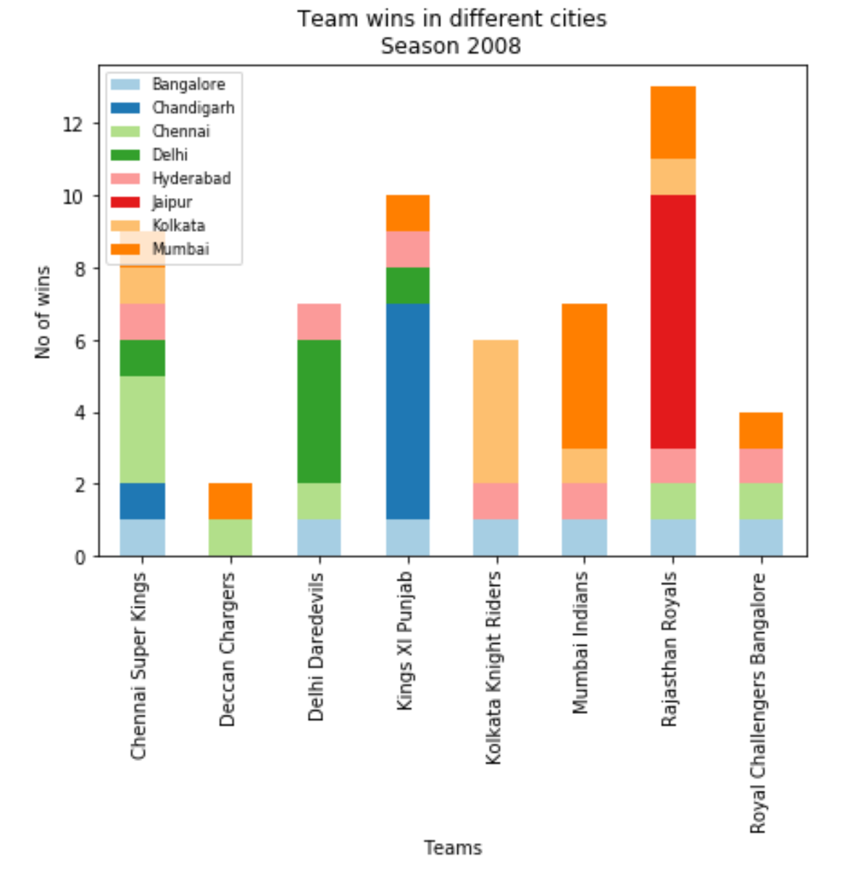
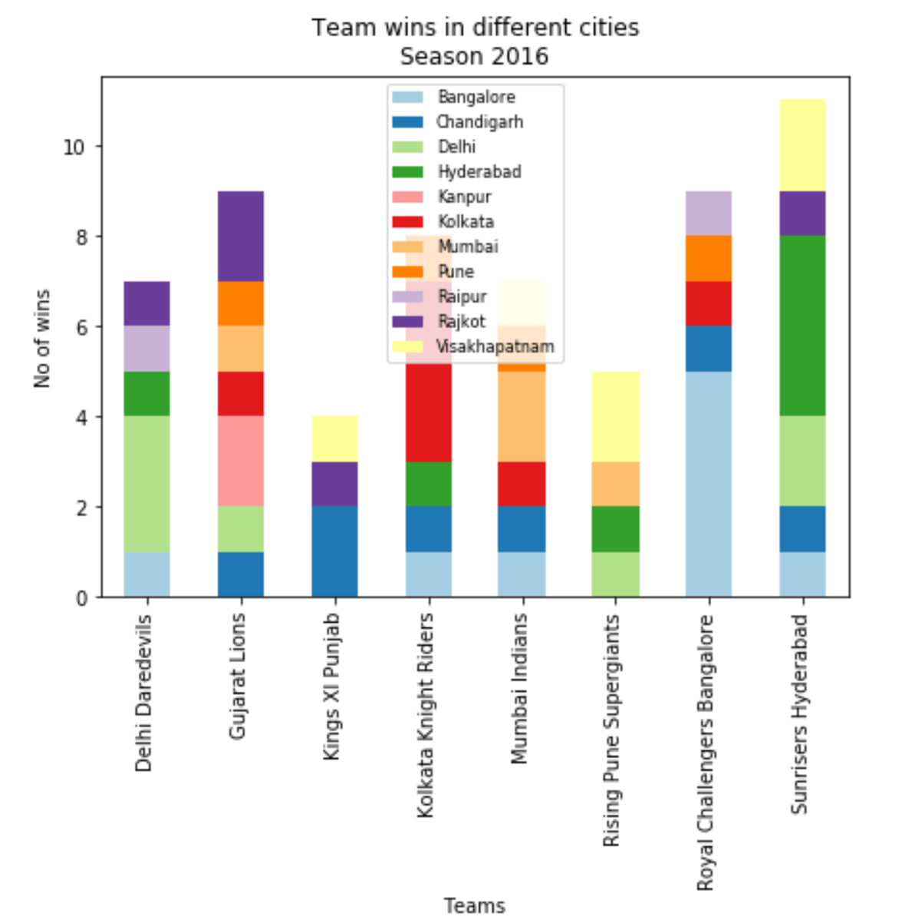
No. of wins by team and season in each city

Slide 10
FURTHERANALYSIS

Slide 11
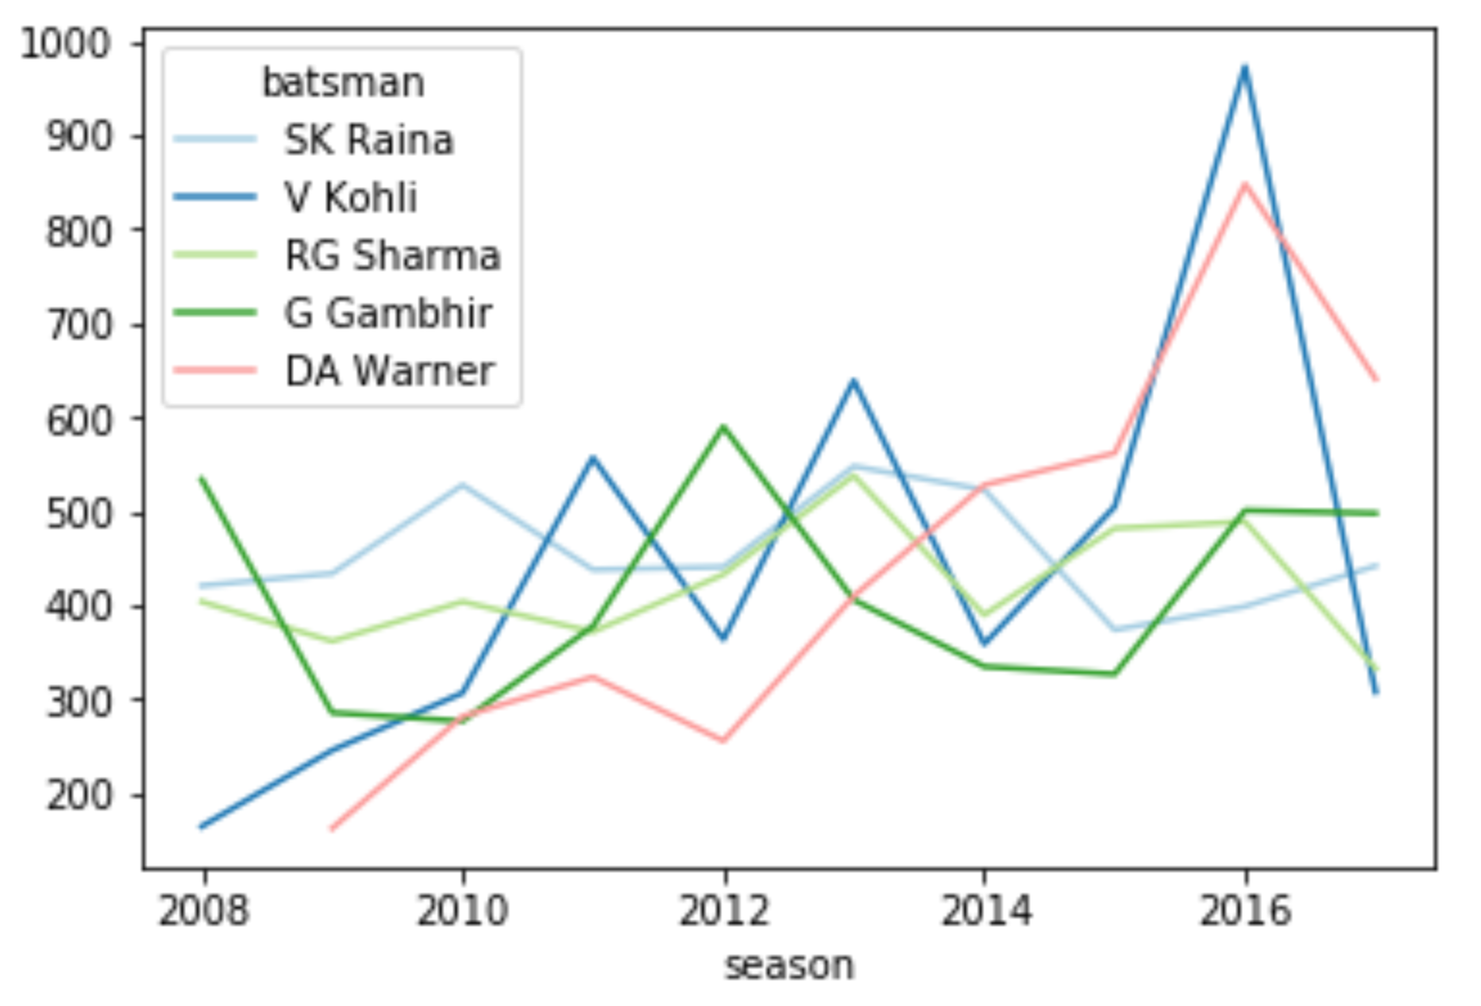
Top 5 batsmen over the seasons

Slide 12
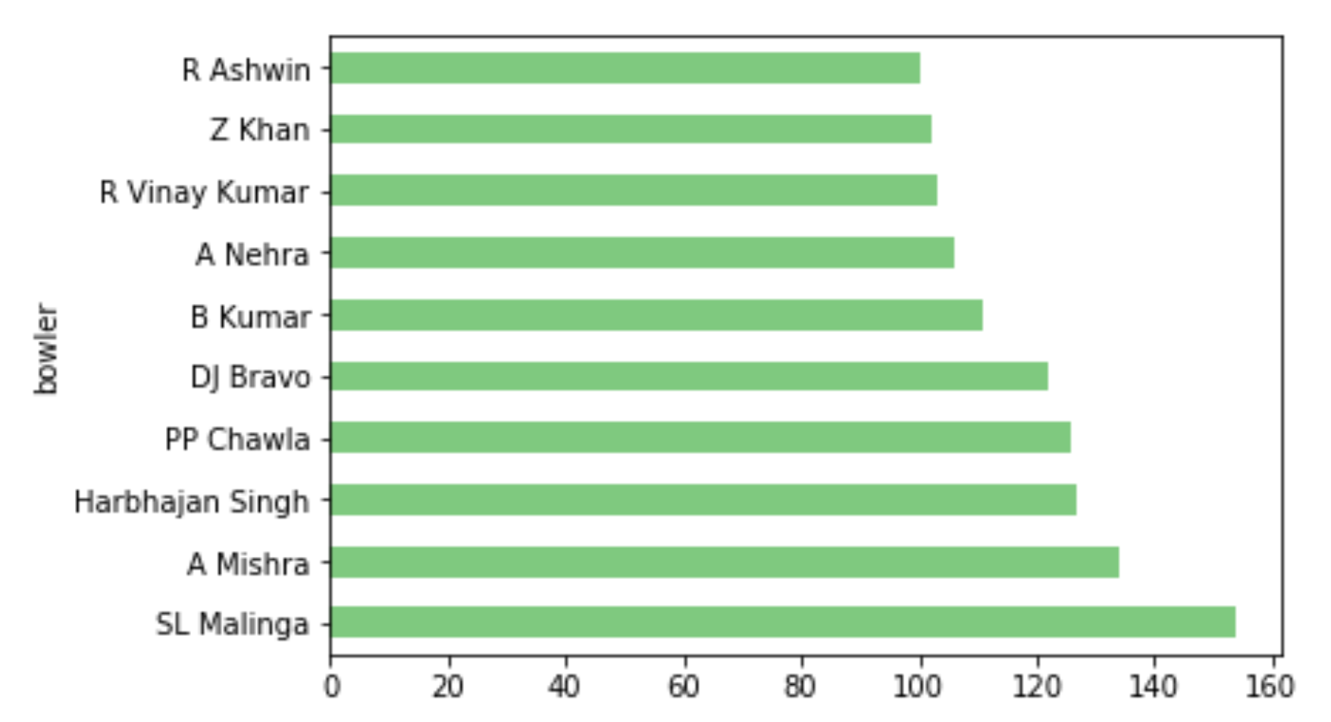
Top Bowlers over the seasons

Slide 13
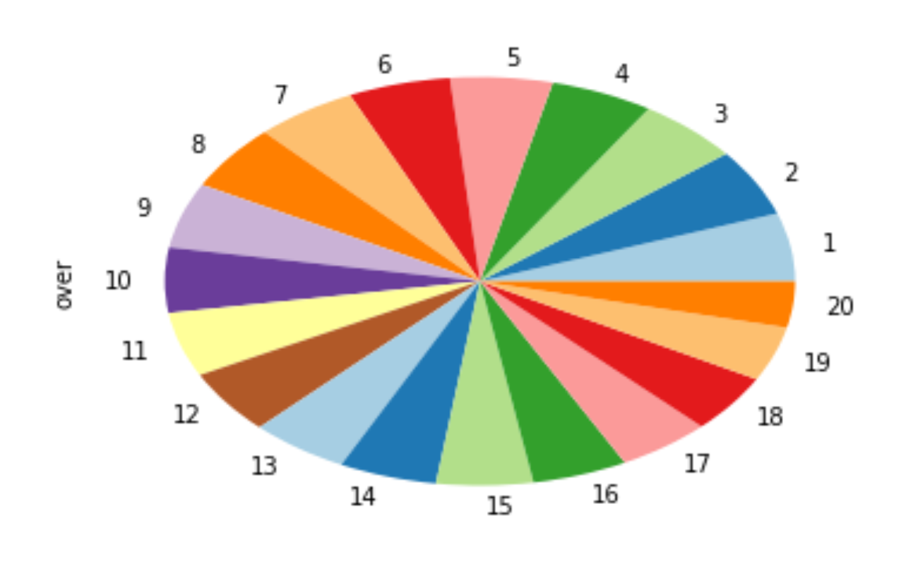
Wicket Distribution in different overs

Slide 14
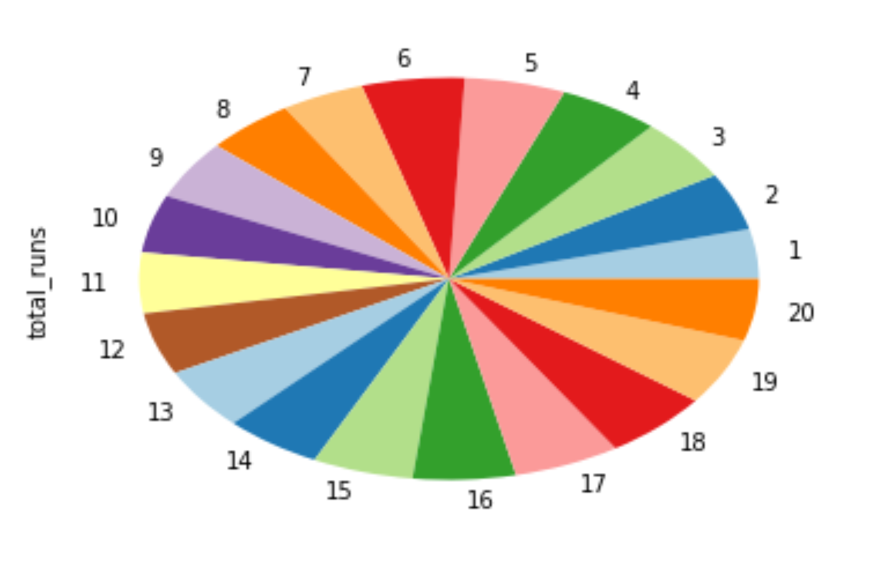
Runs Distribution in different overs

Slide 15
Other Analysis
Total Number of Matches Played by a team
Total Number of Matches won by a team
Total Number of Matches lost by a team
Bowler Aggregate
Batsmen Aggregate
Man of the Match
Centuries scored
Top Batsmen over the seasons
Top Bowlers in terms of Economy

Slide 16
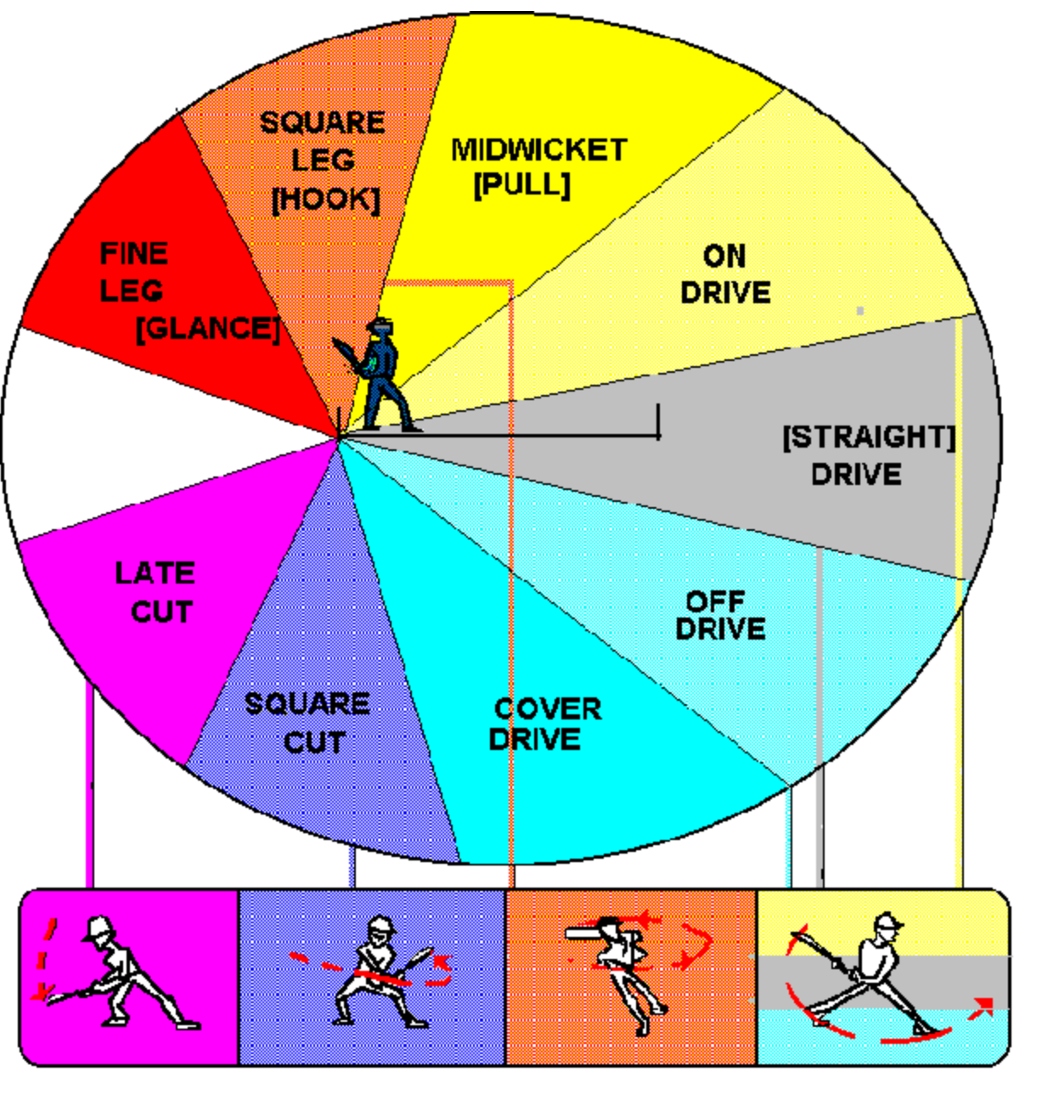
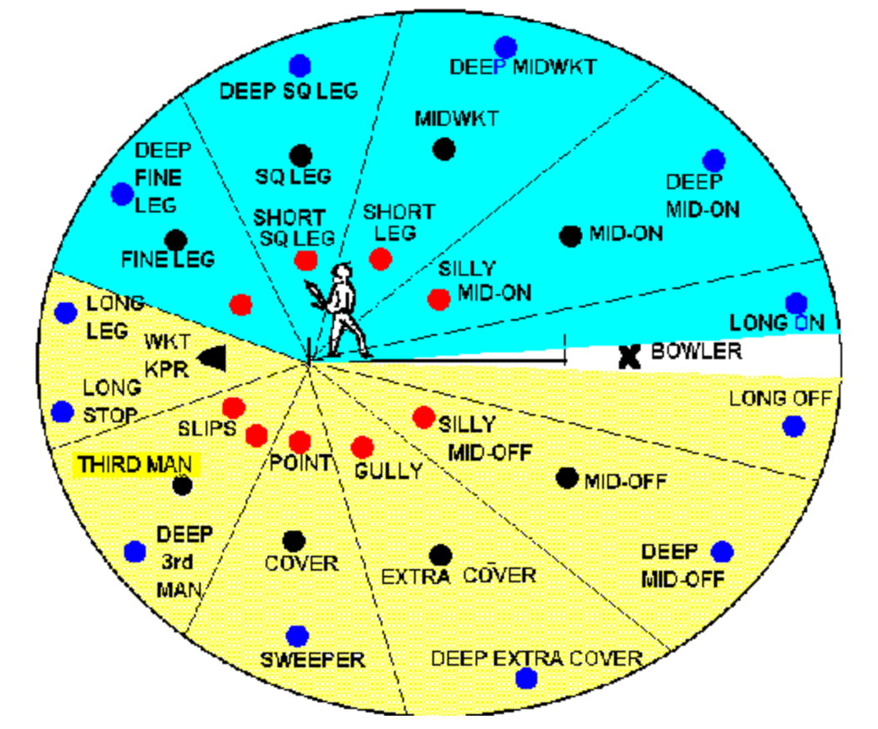
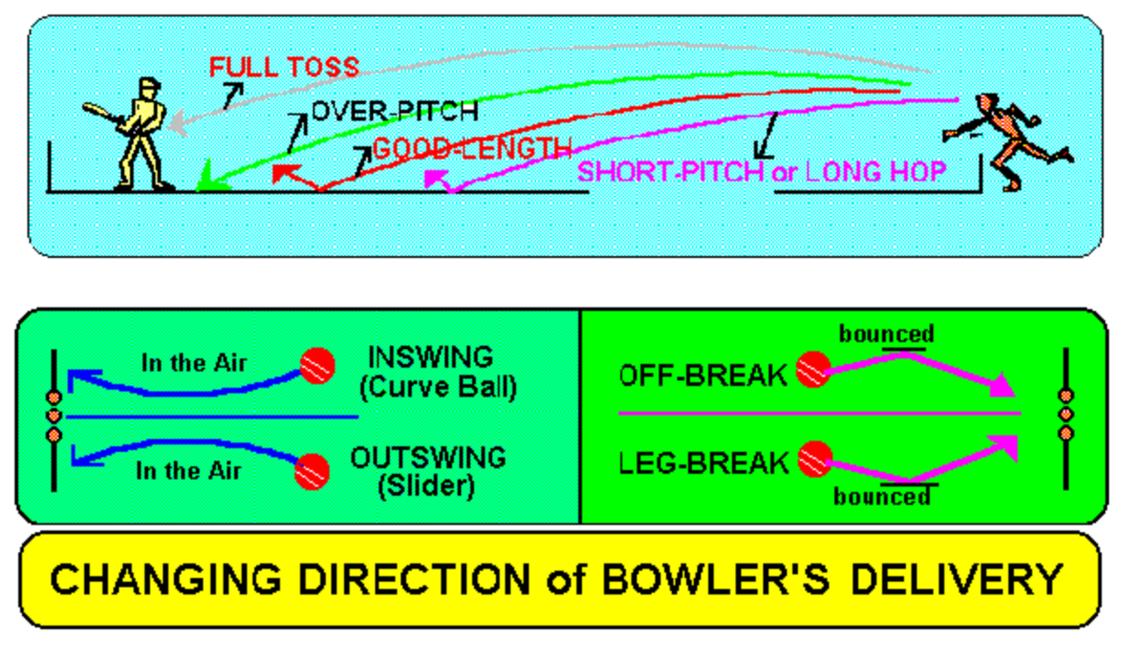
Future Work
Prediction:
teams
toss winners
match winners
Pitch Analysis
Game Strategy

Slide 17

Presented by
Samarthraj Balachandra Hegde(sh4636)
Shruthi Nemu Tandel (snt288)
Rakavee Anandan (ra2635)

