Slide 1
Reframing Motorsport Visualization for Pitstop Strategy
2026/04/09
Jake Ryals

Slide 2
Background
In many racing series, drivers must perform a pitstop to be able to finish the race
Due to fuel and tire degradation margins, there is usually a window of multiple laps during which the driver can decide to stop
Depending on the situation, which lap the stop is made on can significantly affect the race result
Decisions have to be made quickly, necessitating task optimized visualizations

Slide 3
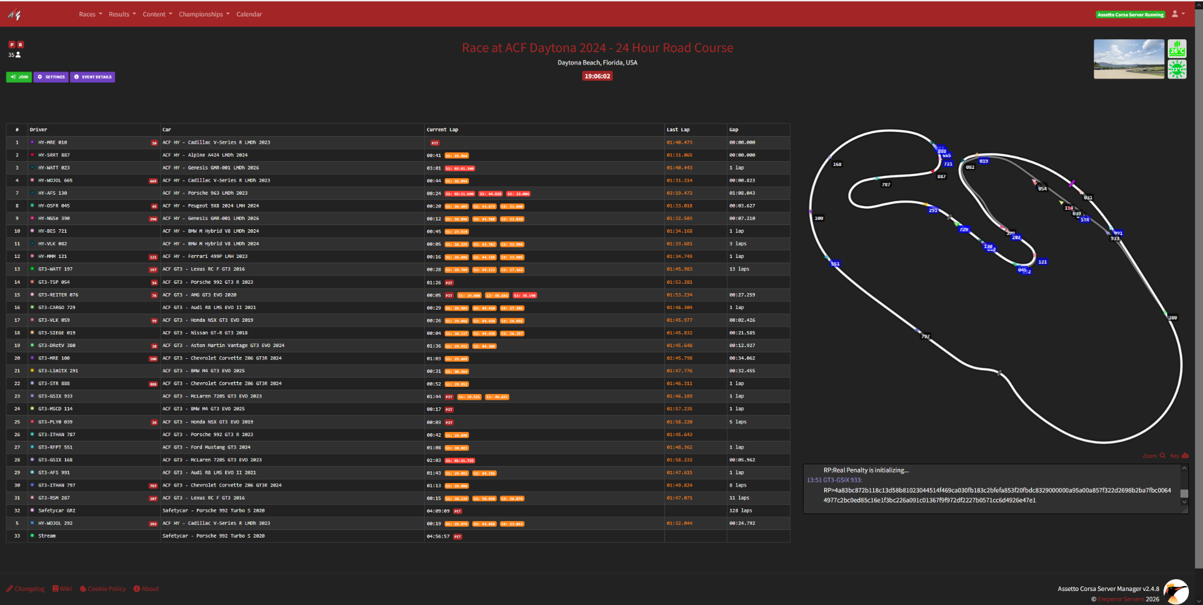
Problems with Existing Visuals
Existing motorsport visualizations are difficult to parse
Data is often displayed in tabular form
Visualizations only show the gist of the data and are not designed to facilitate tasks necessary to make strategic decisions
To make decisions, users must bear significant cognitive load
Source: Emperor Servers - Assetto Corsa

Slide 4
Methods
Semistructured interviews with five esports racing drivers, determining:
What tasks were relevant and difficult to accomplish
What data is relevant to the tasks
Overall user preferences
Five Design Sheets - Used to assess feasibility and intuitiveness of visualization prototypes at low fidelity

Slide 5

Reframing the Track Map

Slide 6
Reframing the Track Map
Opposite side of reference point
Stretch into a circle

Slide 7
Reframing the Track Map
Opposite side of reference point
Keep reference car in the center to simplify browsing
Stretch into a circle
Cut and flatten the Circle

Slide 8
Data & Design Considerations
Data:
Gap to Focused Car
Difference in Laptime
Difference in Laps Completed
Laps Until Forced Pitstop
Class of Car
Predicted exit after pitstop
Mapped To:
X position
Width of Mark - Coincides with future gap
Hue
Opacity/lightness
Shape
Overlaid Rectangle
Design choices were made to match user intuitions and prioritize salience of important data

Slide 9
Visualization Demonstration

Slide 10
Findings
It is difficult to successfully fit all relevant features into one visualization
There is a tradeoff between screen space and readability
Novel visualizations require additional effort to onboard new users

Slide 11
End Slide 2 – White

