Slide 1
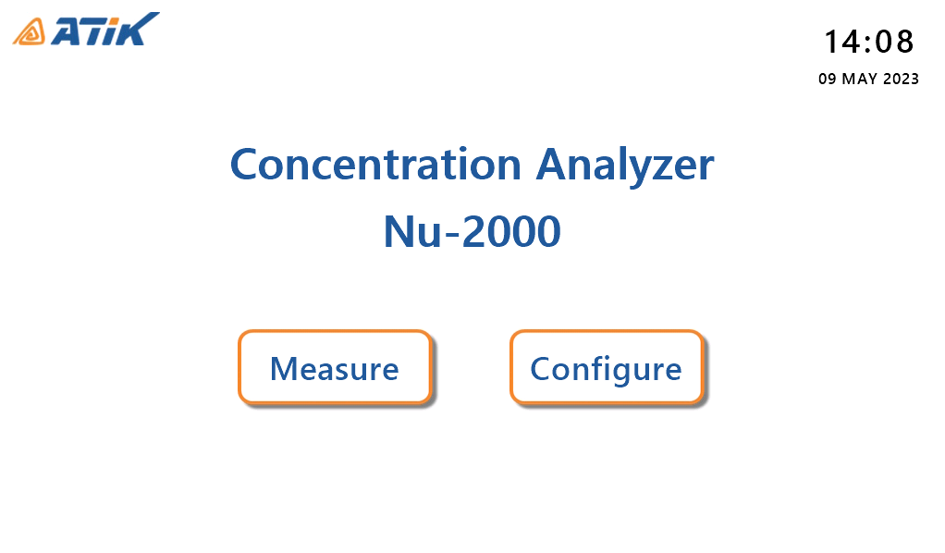
1. Main

Slide 2

2. Loading

Slide 3
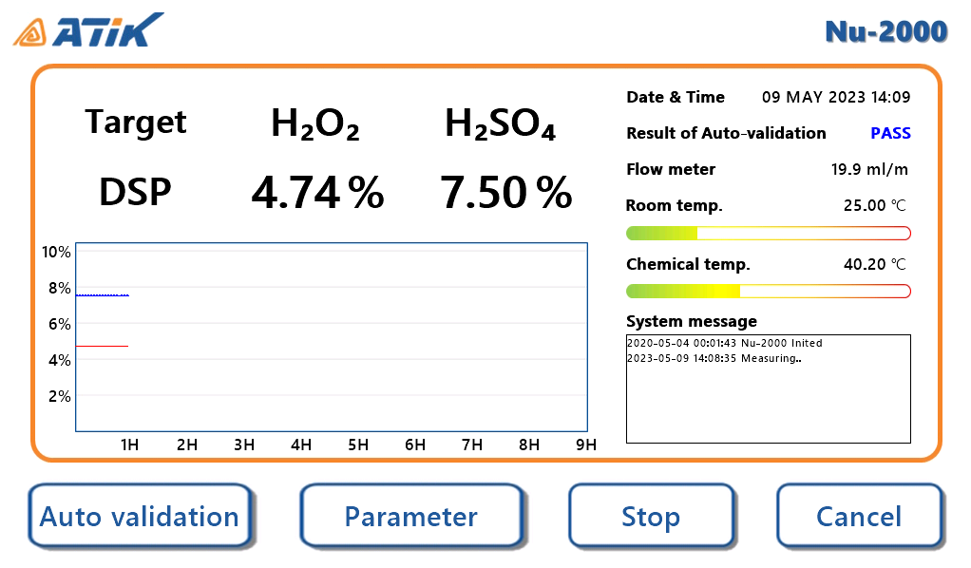
3. Measure (start)

Slide 4
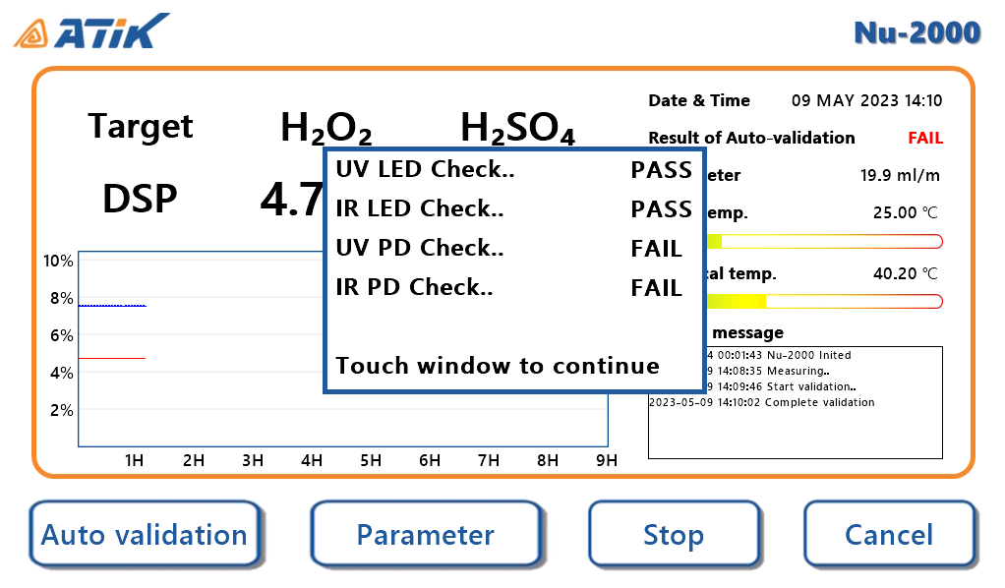
4. Auto validation

Slide 5
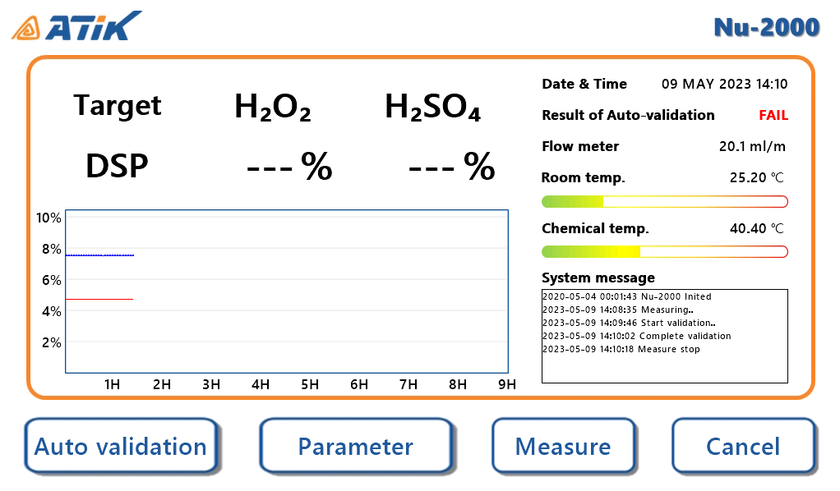
5. Measure (stop)

Slide 6
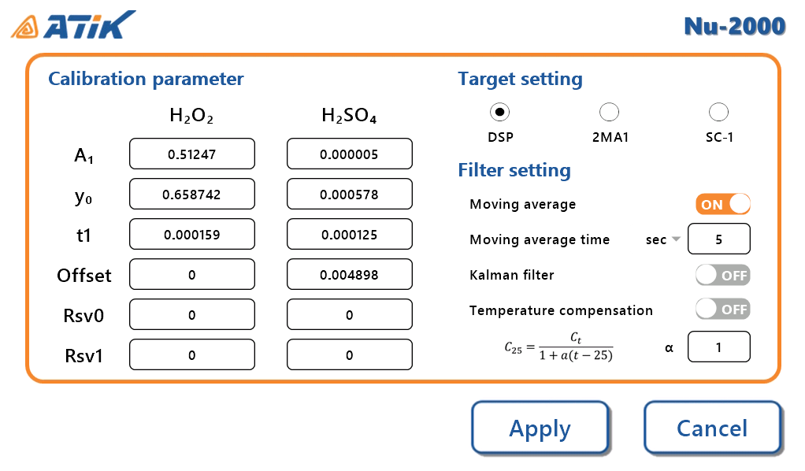
6. Parameter setting

Slide 7
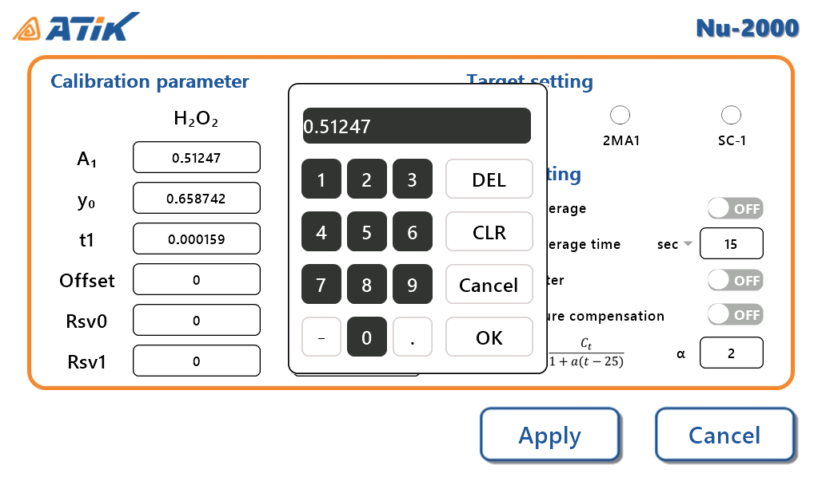
6. Parameter setting(key pad)

