Slide 1
ATIK Jig Board 개발
Creativity & Confidence
www.atikorea.com

Slide 2
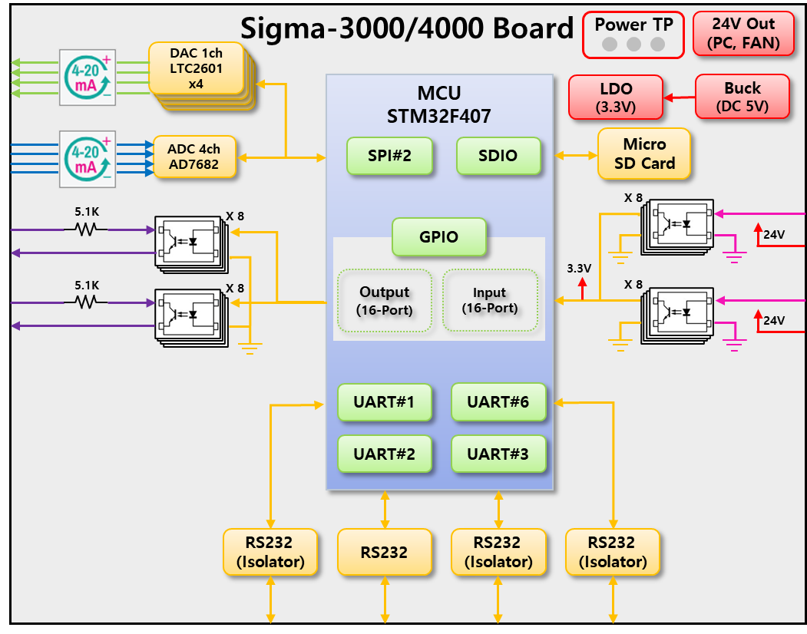
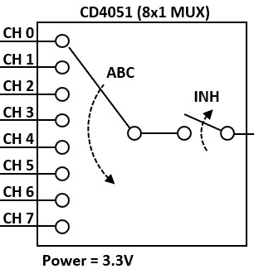
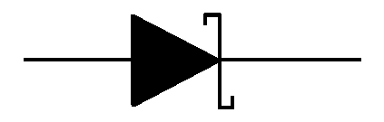


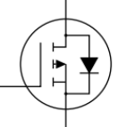
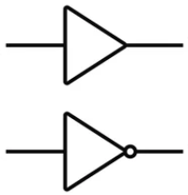
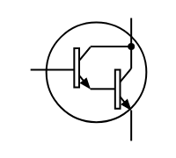
2. Test 항목 - 1) calibration - HF
■ ATIK JIG BOARD Block Diagram : Sigma-3000/4000
24V, 12V, 5V, 3.3V
ATIK JIG Board Rev0.1
SPI#2
AD7689
(ADC)
4-20mA
4ea
CD4051BM
MUX 8ch
ADC#1-3
0-10V
4ea
4ea
4-20mA
8ea
24V
LTC2601
(DAC)
24V
GPIO
0-10V
8ea
KTC3875S-Y
(1ch)
0-10V
8ea
Output
(8-Port)
Bus net
74HC563
Voltage
summing
GPIO
12V
x 16ea
24V
74LVC540
(8ch)
O.C Input
SI2319
Input
(8-Port)
Bus net
74LVC540
10k
8ea 16ea
Divide
12V ← 24V
10k
24k
24V Output
x 2ea
74LVC540
(8ch)
12V Input
16ea
x 2ea
74LVC574
(8ch)
150k
8ea
ULN2803
(8ch)
16ea
47k
74LVC540
(8ch)
3.3V Input
O.C Output
x 2ea
8ea
16ea
74LVC574
(8ch)
24ea
24ea
x 3ea
3.3V
Relay Input
x 8ea
74LVC540
(8ch)
UART#4
(RS232)
UART#6
(RS232)
24V
UART#3
(RS232)
8ea
ULN2803
(8ch)
UART#5
(RS232)
I2C#3
x 8ea
UART#1
(DEBUG)
UART#2
(HMI)

Slide 3
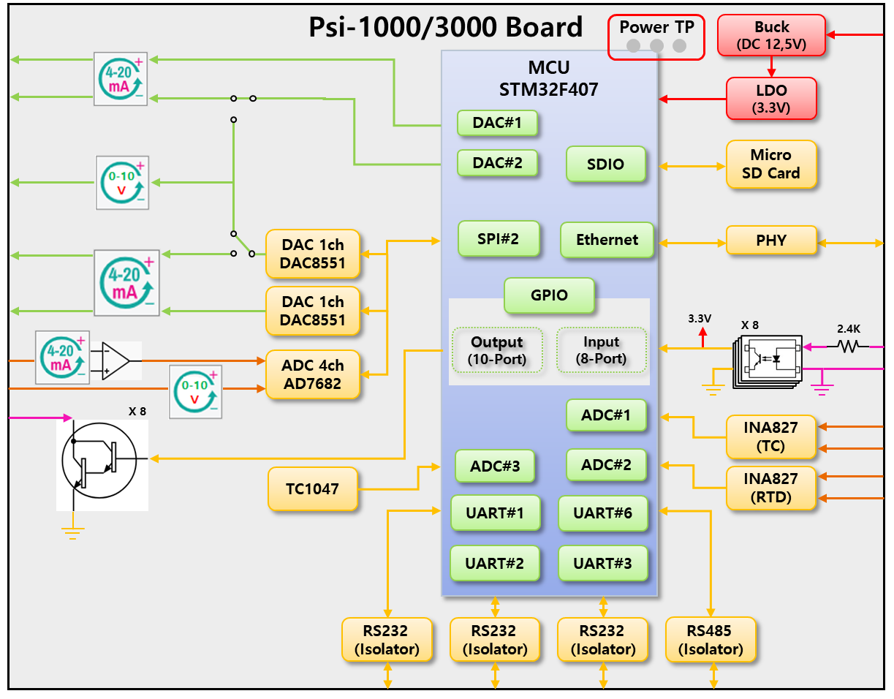
2. Test 항목 - 1) calibration - HF
■ ATIK JIG BOARD Block Diagram : Psi-1000/3000
24V, 12V, 5V, 3.3V
ATIK JIG Board Rev0.1
SPI#2
AD7689
(ADC)
4-20mA
4ea
CD4051BM
MUX 8ch
ADC#1-3
0-10V
4ea
4ea
4-20mA
8ea
24V
LTC2601
(DAC)
24V
GPIO
0-10V
8ea
KTC3875S-Y
(1ch)
0-10V
8ea
Output
(8-Port)
Bus net
74HC563
Voltage
summing
GPIO
12V
x 16ea
24V
74LVC540
(8ch)
O.C Input
SI2319
Input
(8-Port)
Bus net
74LVC540
10k
8ea 16ea
Divide
12V ← 24V
10k
24k
24V Output
x 2ea
74LVC540
(8ch)
12V Input
16ea
x 2ea
74LVC574
(8ch)
150k
8ea
ULN2803
(8ch)
16ea
47k
74LVC540
(8ch)
3.3V Input
O.C Output
x 2ea
8ea
16ea
74LVC574
(8ch)
24ea
24ea
x 3ea
3.3V
Relay Input
x 8ea
74LVC540
(8ch)
UART#4
(RS232)
UART#6
(RS232)
24V
UART#3
(RS232)
8ea
ULN2803
(8ch)
UART#5
(RS232)
I2C#3
x 8ea
UART#1
(DEBUG)
UART#2
(HMI)

Slide 4
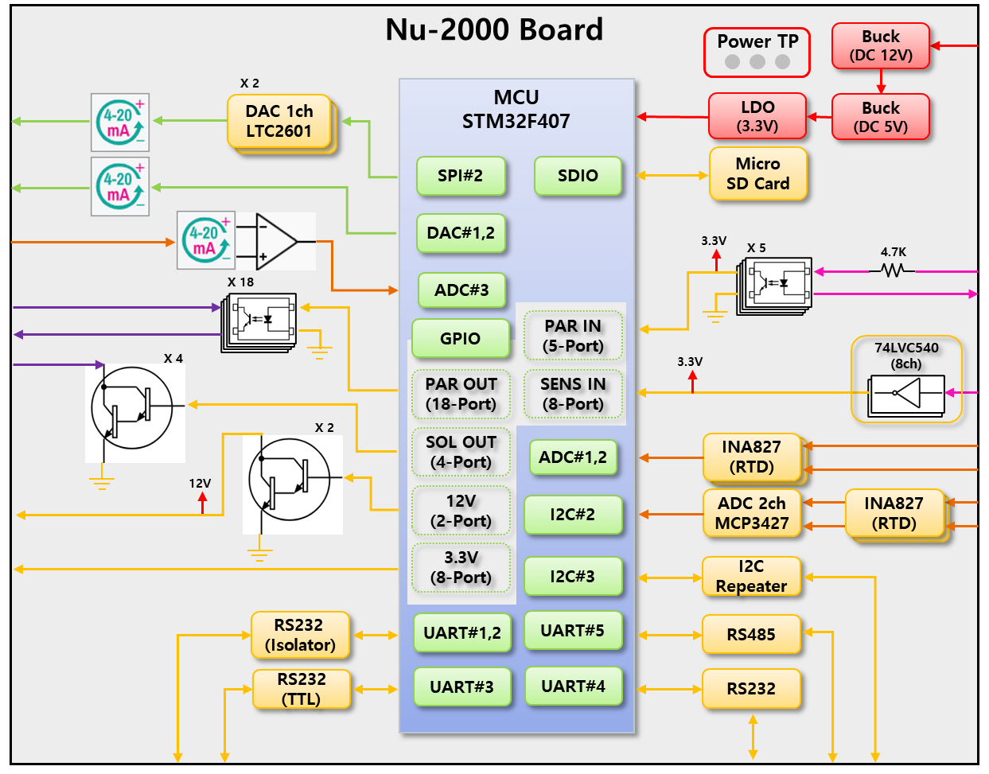
2. Test 항목 - 1) calibration - HF
■ ATIK JIG BOARD Block Diagram : Nu-2000
24V, 12V, 5V, 3.3V
ATIK JIG Board Rev0.1
SPI#2
AD7689
(ADC)
4-20mA
4ea
CD4051BM
MUX 8ch
ADC#1-3
0-10V
4ea
4ea
4-20mA
8ea
24V
LTC2601
(DAC)
24V
GPIO
0-10V
8ea
KTC3875S-Y
(1ch)
0-10V
8ea
Output
(8-Port)
Bus net
74HC563
Voltage
summing
GPIO
12V
x 16ea
24V
74LVC540
(8ch)
O.C Input
SI2319
Input
(8-Port)
Bus net
74LVC540
10k
8ea 16ea
Divide
12V ← 24V
10k
24k
24V Output
x 2ea
74LVC540
(8ch)
12V Input
16ea
x 2ea
74LVC574
(8ch)
150k
8ea
ULN2803
(8ch)
16ea
47k
74LVC540
(8ch)
3.3V Input
O.C Output
x 2ea
8ea
16ea
74LVC574
(8ch)
24ea
24ea
x 3ea
3.3V
Relay Input
x 8ea
74LVC540
(8ch)
UART#4
(RS232)
UART#6
(RS232)
24V
UART#3
(RS232)
8ea
ULN2803
(8ch)
UART#5
(RS232)
I2C#3
x 8ea
UART#1
(DEBUG)
UART#2
(HMI)

Slide 5
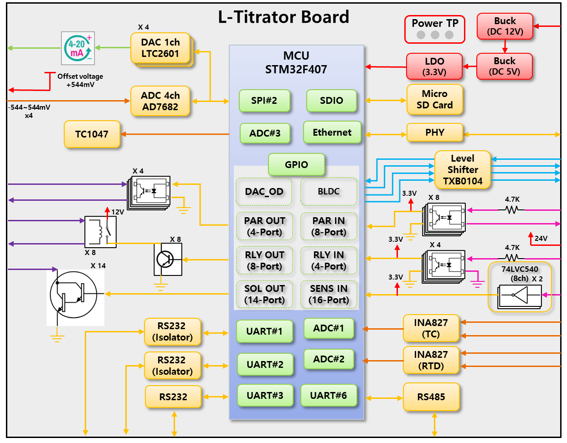
2. Test 항목 - 1) calibration - HF
■ ATIK JIG BOARD Block Diagram : L-Titrator
24V, 12V, 5V, 3.3V
ATIK JIG Board Rev0.1
SPI#2
AD7689
(ADC)
4-20mA
4ea
CD4051BM
MUX 8ch
ADC#1-3
0-10V
4ea
4ea
4-20mA
8ea
24V
LTC2601
(DAC)
24V
GPIO
0-10V
8ea
KTC3875S-Y
(1ch)
0-10V
8ea
Output
(8-Port)
Bus net
74HC563
Voltage
summing
GPIO
12V
x 16ea
24V
74LVC540
(8ch)
O.C Input
SI2319
Input
(8-Port)
Bus net
74LVC540
10k
8ea 16ea
Divide
12V ← 24V
10k
24k
24V Output
x 2ea
74LVC540
(8ch)
12V Input
16ea
x 2ea
74LVC574
(8ch)
150k
8ea
ULN2803
(8ch)
16ea
47k
74LVC540
(8ch)
3.3V Input
O.C Output
x 2ea
8ea
16ea
74LVC574
(8ch)
24ea
24ea
x 3ea
3.3V
Relay Input
x 8ea
74LVC540
(8ch)
UART#4
(RS232)
UART#6
(RS232)
24V
UART#3
(RS232)
8ea
ULN2803
(8ch)
UART#5
(RS232)
I2C#3
x 8ea
UART#1
(DEBUG)
UART#2
(HMI)

