Slide 1
ATIK Reservoir Board
Creativity & Confidence
www.atikorea.com

Slide 2
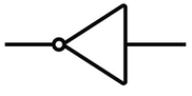
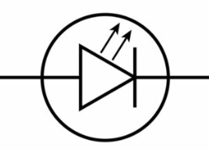
2. Test 항목 - 1) calibration - HF
■ Reservoir Board Block Diagram
Reservoir Board
Step down
(24V → 5V)
MCU
STM32G031
(20-TSSOP)
LDO
(5V → 3.3V)
GPIO
74LVC540
(8ch)
4.7K
LED
(3-Port)
SENS IN
(8-Port)
3.3V
X 3
Interface
RS232
(DEBUG)
UART#1
UART#2
RS485
(Main board)
Spare
ADC
I2C

