Slide 1

Revature P2 Onboarding
Authors:
Nicolas Bauer, Alexandra Nance, Paul Leugemors, Nick Martin, Oscar Guerrero, Ahrik Corley

Slide 2
The Goal Of Our Project:
Efficiently onboard customers for 6 different customer companies into a ServiceNow instance
Before working in our instance, we needed a functional requirement specification document to help map out all the requirements in our process

Slide 3

What is ServiceNow?
a cloud-based company that provides software as a service (SaaS) for technical management support
What can it do?
ServiceNow provides over 180 features in their software for company management and operations.
How is it useful?
ServiceNow allows you to automate and standardize business processes.

Slide 4
FRS Document
What is an FRS Document?
FRS Document - Functional Requirement Specifications Document
It's a document that provides a step-by-step sequence of all operations required to develop a product from start to finish.
The customer gives a Requirements Document that the FRS Document is drafted from
In our project, we created an FRS Document and after many modifications and improvements, used the final draft as a guide throughout the onboarding process

Slide 5
Domain Separation
With domain separation you can separate data, processes, and administrative tasks into logically defined groupings called "domains" while still working in the same instance
We separated each of our customer companies into their own domains and began the onboarding process while following the structure of our FRS document

Slide 6
Our Customer Companies
Each of our companies would be separated using Domain Separation
Our domains and companies were:
Frozen Split Domain (AN) - Frozen Split – Frozen Yogurt Company
Bench Baseball Domain (PL) - Bench Baseball – Fantasy Baseball Company
Awareness Zen Domain (NM) - Awareness Zen – Yoga Company
Estate Accelerate Domain (OG) - Estate Accelerate – Real Estate Company
Binary Platform Domain (AC) - Binary Platform – AI Company
Electric Bird Domain (NB) - Electric Bird – RC Planes Company

Slide 7
Data
Includes user profiles, company departments, and various personalizations.
Is uploaded/inserted into the ServiceNow Platform.
It can be used to represent many different aspects of a company.
Can also represent the hierarchy or organization of a company.
The next few slides show some of the information that we have uploaded into each customers' domain.

Slide 8
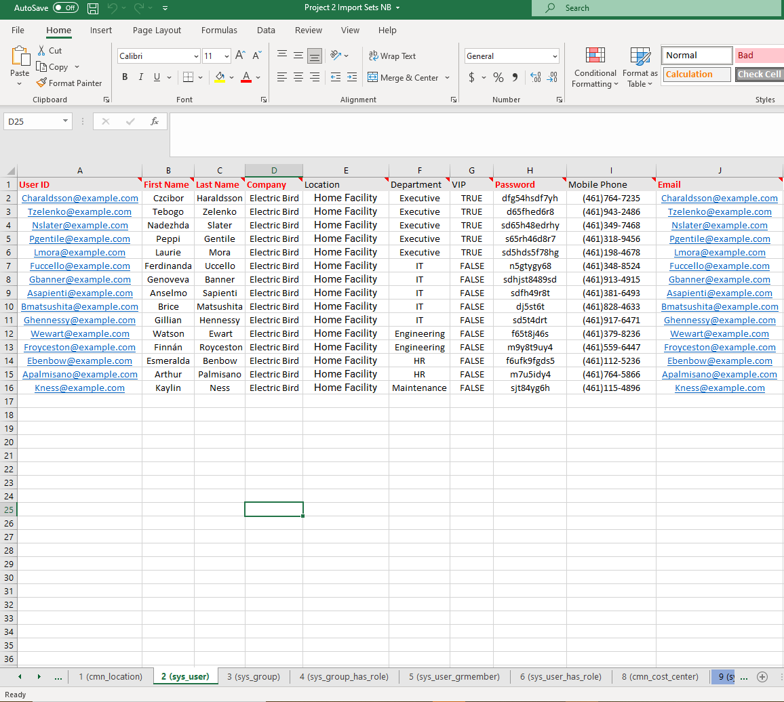
User Onboarding
Users can be onboarded to ServiceNow through Import maps, and these users were separately onboarded into their respective companies in our project.
The import maps take in an excel sheet like the one shown here and take in the information based on the header rows allowing easy integration of information of what could be thousands of users.

Slide 9
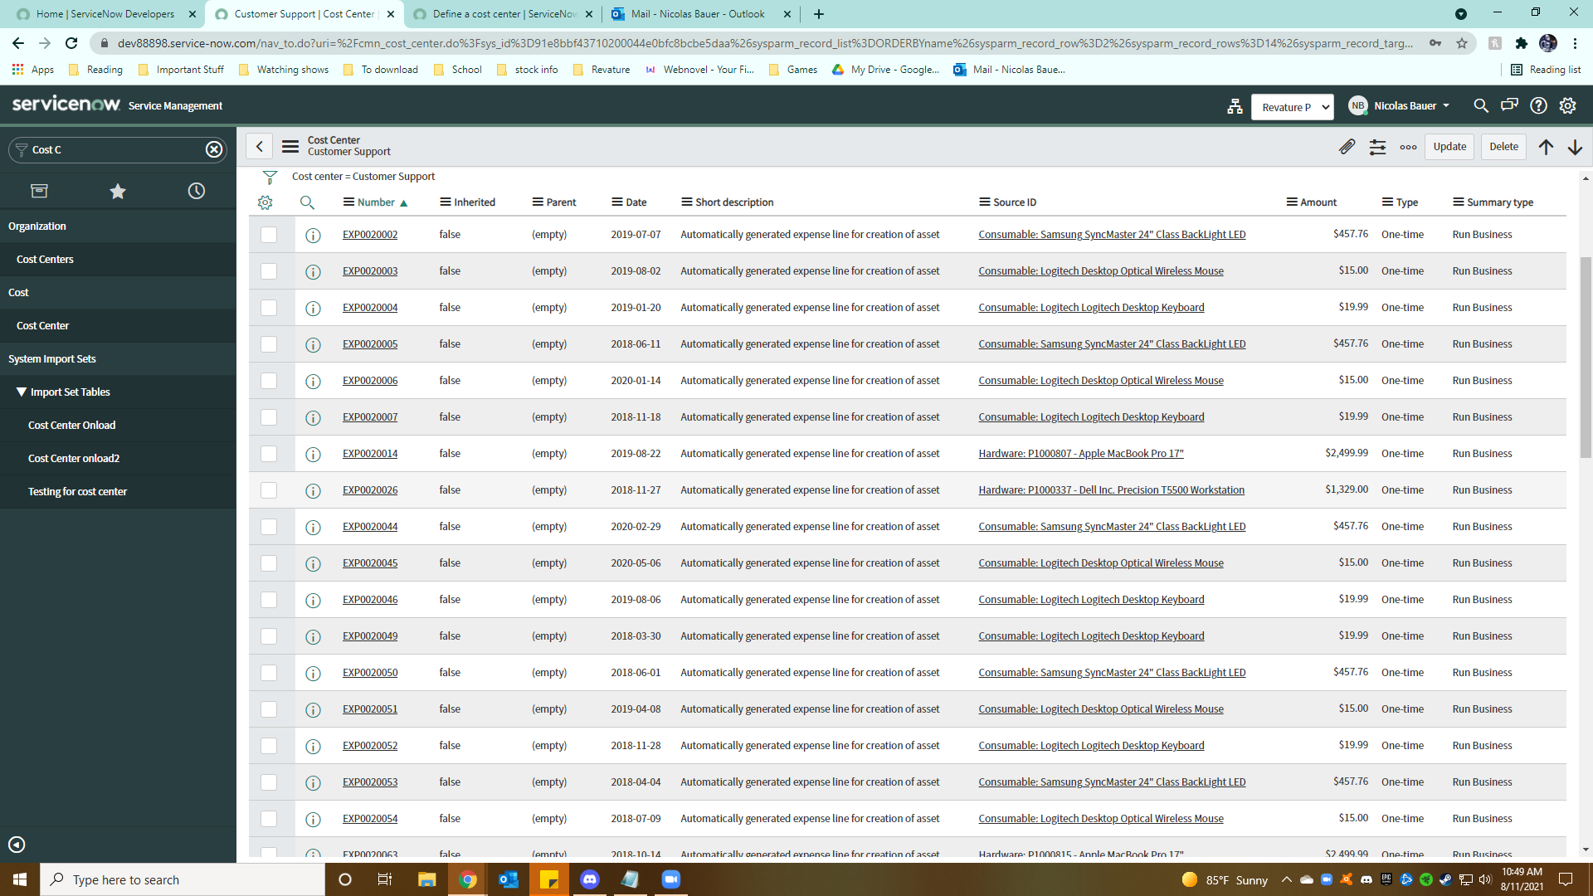
Cost Centers
To streamline accounting ServiceNow provides the ability to create Cost Centers which we have created for the companies.
Each of these is based on a certain service or aspect of the company which is tied to an account number, with each expense on that account tied to an expense number.
The common Cost Centers are Customer Support, Engineering, Finance, Human Resources, and IT.
Cost Centers allow easy recording of finances down to the item level. This allows easy reporting of costs, and assets as they are integrated with the purchases.

Slide 10
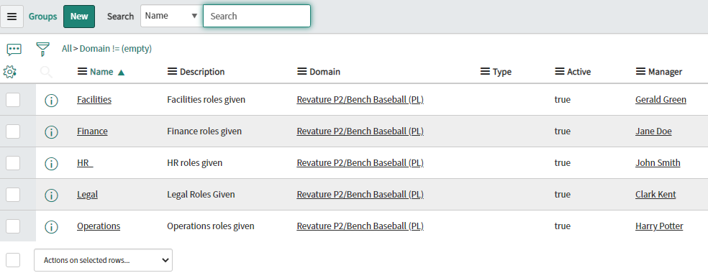
Groups
Groups is another data format that associates users with different parts of the organization.
Useful in giving many different users the same role.

Slide 11
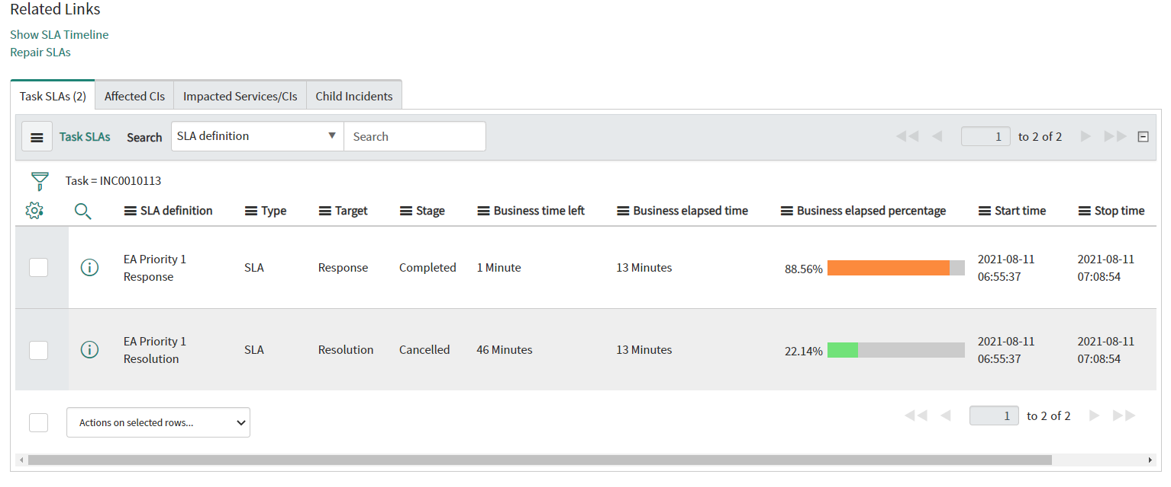
SLA (Service Level Agreements)
SLA is a record which defines a set amount of time that a service must be provided to you, the customer.
Depending on the percentage of business time elapsed, a notification will be sent to the appropriate users.

Slide 12
Schedules
Schedules are made for SLA work times.
Depending on the priority of the incident, it will follow the 24/7 schedule or the 9/5 schedule.
If the SLA work time follows the 9/5 schedule, it will also follow the holiday calendar.
24/7 | 9/5
24/7 | 10am - 7pm EST weekdays

Slide 13
Holiday Calendar
Holiday Dates​ | Holiday Names​
January 1, January 2 ​ | Holiday 1, Holiday 2 ​
February 3, February 4 ​ | Holiday 3, Holiday 4 ​
March 5, March 6 ​ | Holiday 5, Holiday 6 ​
April 7, April 8 ​ | Holiday 7, Holiday 8 ​
May 9, May 10 ​ | Holiday 9, Holiday 10 ​
June 11, June 12 ​ | Holiday 11, Holiday 12 ​
July 13, July 14 ​ | Holiday 13, Holiday 14 ​
August 15, August 16 ​ | Holiday 15, Holiday 16 ​
September 17, September 18 ​ | Holiday 17, Holiday 18 ​
October 19, October 20 ​ | Holiday 19, Holiday 20 ​
November 21, November 22 ​ | Holiday 21, Holiday 22 ​
December 23, December 24 ​ | Holiday 23, Holiday 24 ​

Slide 14
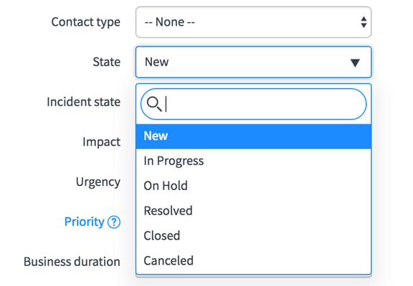
Choice Lists
A choice list is a type of field that lets the user select from a pre-defined set of choices. These are used in forms for inputting specific types of data
There are 6 main elements to define choices.
Table
Language
Element
Value
Label
Dependent Value (Optional)

Slide 15
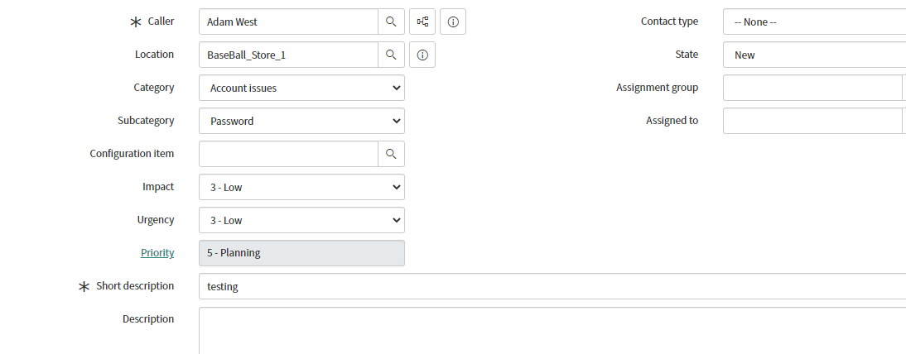
Incidents
Incidents let us know that there is a problem within the system
When an incident is started it will automatically start an SLA depending on priority level
Priority levels range from 1 to 5
This allows us to make sure we are following our agreements

Slide 16
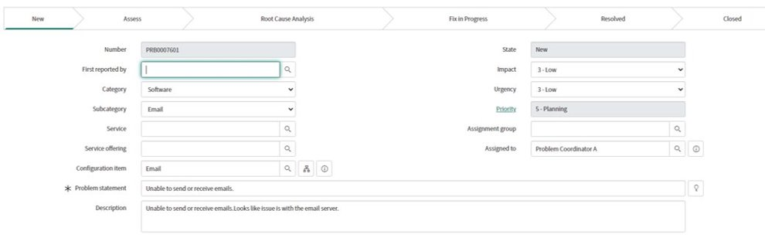
Problem
Problem Management seeks to prevent problems from occurring.
Proactive Problem Management identifies areas of potential weakness.
Reactive Problem Management identifies what caused an incident to occur
A problem is any actual or potential cause of one or more incidents.

Slide 17
Change
With the help of Change Management, we can minimize the risk of changes to the instance.
Different ways to request changes include:
A user with the 'itil' role can request a change through the Service Catalog or directly on the change form.
A change can also be requested from an incident or problem.
Standard change - a planned change that follows a pre-defined path.
Normal change – a planned change requires different levels of approval.
Emergency change – an unplanned change that requires emergency approval.

Slide 18
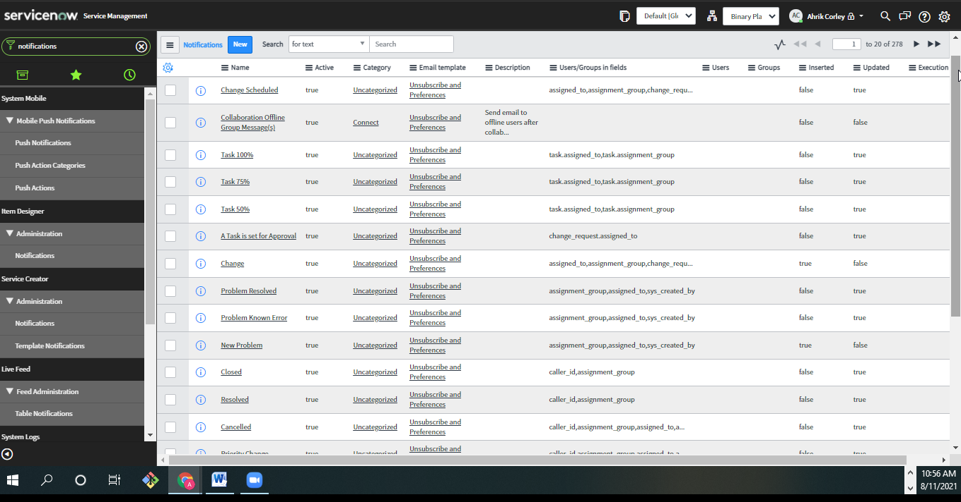
Notifications
We use notifications to manage system email, create system notifications, and configure how your system responds to inbound email.
Notifications can be sent as an email or push notification to mobile devices.
Each notification allows you to select under what condition it will be sent.

Slide 19
ServiceNow
As you can see ServiceNow offers a multitude of different features and functions
The personalization options make it the perfect platform for any company.
While we didn't get too deep into branding and personalization, just the organization and integration tools make ServiceNow a powerful business tool for any company.

Slide 20

Thank you for listening! Any Questions?

