Slide 1

Apache Spark
Ladle Patel

Slide 2
Apache Spark
• Started as a research project at UC Berkeley in 2009 .
• Open Source License (Apache 2.0) .
• Latest Stable Release: Spark 2.1.0 released on Dec 28, 2016.
• 1130634 lines of code (68% Scala,16% Java,8% Java,8 % Other).
• Built by 1300+ developers from 200+ companies .

Slide 3
Unified Engine
Apache Spark is an open-source distributed general-purpose cluster computing framework with in-memory data processing engine that can do ETL, analytics, machine learning and graph processing on large volumes of data at rest (batch processing) or in motion (streaming processing) with rich high-level APIs for the programming languages: Scala, Python, Java and R

Slide 4
Main Abstraction in Spark
Input Data
Splitting into blocks
Block 1 on Data node 1
Block 2 on Data node 1
Block 3 on Data node 3
Block 4 on Data node 4
Disk
Partition 1
Partition 2
Partition 3
Partition 4
RAM
RDD

Slide 5
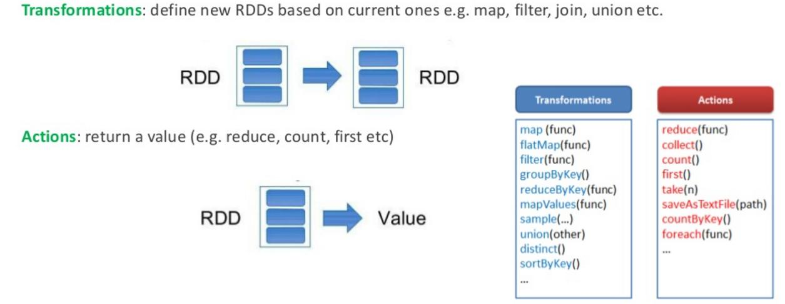
Operation on RDD

Slide 6
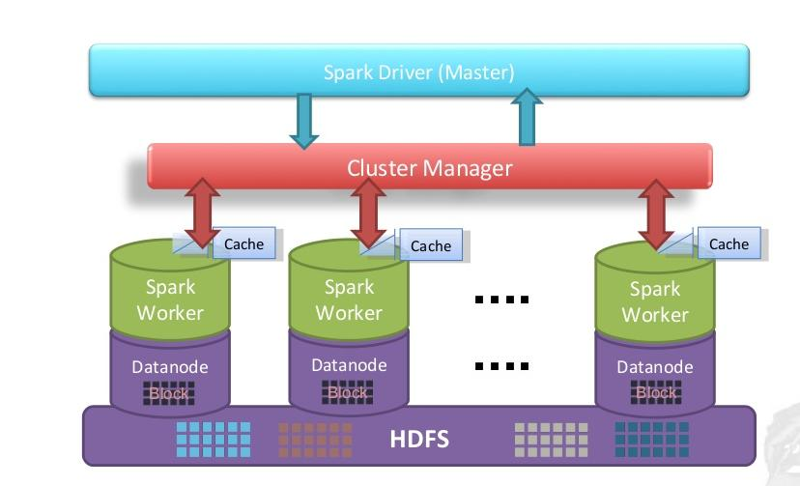
Architecture

Slide 7
Architecture Cont..

Slide 8
Architecture Cont..

Slide 9
Terminologies
Job: A piece of code which reads some input from HDFS or local, performs some computation on the data and writes some output data.
Driver: The program/process which has main() method and responsible for running the Job over the Spark Engine.It also Creates SparkContext to schedule jobs execution and negotiate with cluster manager
Spark context: Object which sets up internal services and establishes a connection to a Spark execution environment.Once a SparkContext is created you can use it to create RDDs, accumulators and broadcast variables, access Spark services and run jobs (until SparkContext is stopped).Its an entry point in Spark application.
RDD :Is a resilient and distributed collection of records spread over one or many partitions.

Slide 10
Terminologies Cont..
Master: The machine on which the Driver program runs.
Slave: The machine on which the Executor program runs.
Executor: The process responsible for executing a task.It runs tasks scheduled by driver.Stores computation results in memory, on disk or off-heap interact with storage systems.
Cluster Manager:Cluster Manager is responsible for monitoring the cluster and provides the resources for executors. Ex : Mesos, YARN and Spark Standalone

Slide 11
Thank You.

