Slide 1

Apache Spark Internals
Ladle Patel

Slide 2
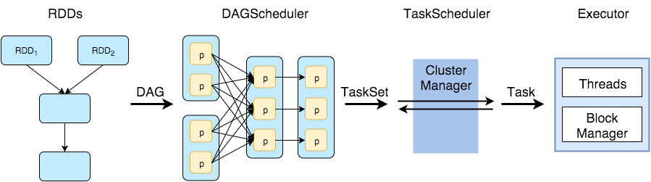
Job Flow

Slide 3
DAG(Logical plan)
Logical-view.png

Slide 4
Splitting DAG into
Stages
(Physical plan)

Slide 5
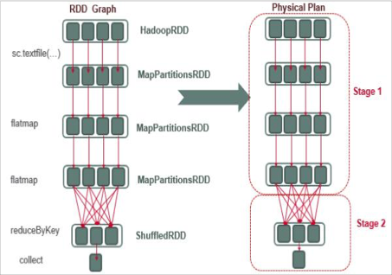
Logical and Physical plan

Slide 6
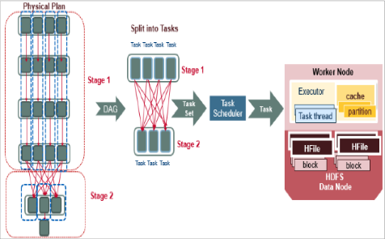
Logical and Physical plan Cont..

Slide 7
Directed Acyclic Graph
Graph :Structure consisting of nodes, that are connected to each other with edges.
Directed :The connections between the nodes (edges) have a direction: A -> B is not the same as B -> A.
Acyclic :Non-circular moving from node to node by following the edges, you will never encounter the same node for the second time.

Slide 8
Narrow and Wide Transformation
Narrow transformation : Transformation which doesn't require the data to be shuffled across the partitions. for example, Map, filter etc..
Wide transformation : Transformation which requires the data to be shuffled for example, reduceByKey etc..

Slide 9
Terminologies
DAGScheduler :Computes a DAG of stages for each job and submits them to TaskScheduler.
TaskScheduler:Responsible for sending tasks to the cluster, running them, retrying if there are failures, and mitigating stragglers.
BlockManager:Provides interfaces for putting and retrieving blocks both locally and remotely into various stores (memory, disk, and off-heap)
Shuffle:The Transfer of Data between stages.

Slide 10
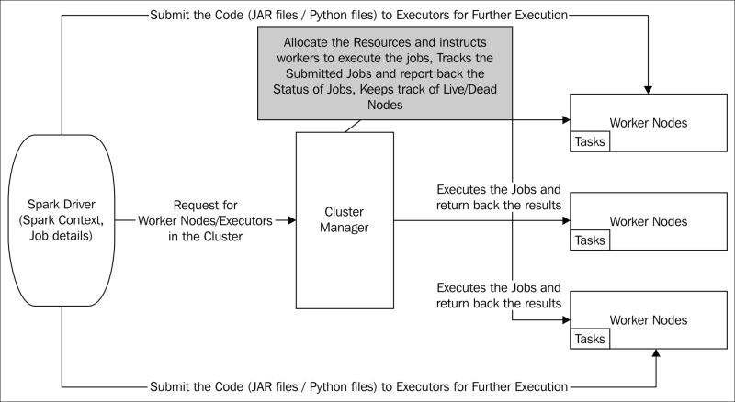
Jar Execution

Slide 11
For more details.
https://github.com/JerryLead/SparkInternals
https://github.com/JerryLead/SparkLearning

Slide 12
Thank You.

