Slide 1

SMART INDIA HACKATHON 2026
TITLE PAGE
Problem Statement ID –
Problem Statement Title-
Theme-
PS Category- Software/Hardware
Team ID-
Team Name (Registered on portal)

Slide 2
CVASSURE — INTEGRITY YOU CAN PROVE
Team Name
Prove the data, the model and the answer — offline, for computer-vision pipelines fed by many contributors · PS 26228
Proposed Solution
How it addresses the problem
Three questions, answered before anything goes into service:
▸ Names the source, not 900 files. Beta-Binomial risk per contributor — an order an officer can act on.
▸ Works black-box. Detects a swapped model from its answers alone; refuses checks above the tier.
▸ Proof for the log. Signed, hash-chained receipts — cryptography, not statistics.
1. Was the training data tampered with — and who sent it?
2. Is this the model we were given, or has it been swapped or edited?
3. Is the record of what the model answered trustworthy?
cvassure audit --dataset data/ --model m.onnx --out results/
Innovation and uniqueness
▸ Plain English, enforced in code. A finding with jargon or no number is rejected at construction.
▸ The detectors cannot see the answer key. A test reads the source and fails the build if they could.
▸ It publishes its own weaknesses. Coverage is generated from measurements, never hand-written.
One command → one self-contained HTML report, a traffic-light verdict, and a coverage table that also lists what we cannot detect.
1.00
0.93
100%
0.20
273
duplicate floods &
foreign images caught
pasted markers &
label flips caught
log tampering caught,
right failure named
blended triggers — we
report this as a gap
tests · 0 network calls
225 measured cells
Measured over 225 swept cells (5 attacks × 5 poison rates × 3 access tiers × 3 seeds) plus 12 tampering attempts — graded on the median cell, never the best.

Slide 3
TECHNICAL APPROACH
Team Name
Technologies to be used
Access tiers — declared, and enforced
Core
Python 3.11 · NumPy · SciPy · scikit-learn · Pillow
Tier 0
answers only → fingerprint + every data check
Vision
PyTorch / TorchScript · ONNX Runtime · bundled ResNet-18
Tier 1
+ weights → per-layer digest, weight statistics
Crypto
Ed25519 (cryptography) · SHA-256 hash chains · pHash
Tier 2
+ internals → spectral signature, trigger reconstruction
Formats
COCO · YOLO · ImageFolder | ONNX · TorchScript
The handle refuses anything above the declared tier — even when the file format would allow it.
Output
Matplotlib · Jinja2 · single-file offline HTML
Methodology — one pass over the intake, then one report
1 INGEST
2 CHECK
3 AGGREGATE
4 SCORE
5 REPORT
COCO · YOLO · folder
ONNX · TorchScript
signed receipt log
data · model · shift
eleven detectors
graceful at every tier
per-contributor risk
Beta-Binomial interval
accept / review / quarantine
AUROC · TPR@1%FPR
ECE + calibration
bootstrap intervals
traffic-light verdict
coverage + limitations
hash-chained audit log
Validated blind: a seeded attack harness poisons the data and keeps the answer key in a separate folder. detect/ cannot import attack/ — a test reads the source and fails the build if it ever could.
No retraining anywhere in the audit (PS 2.2.6) · --offline-assert replaces the socket layer and fails the run if anything reaches the network · encoder weights bundled in the repo.
The eleven checks, and the tier each one needs
near_duplicate
ood
label_noise
trigger_freq
contributor
shift
fingerprint t0
weight_digest t1
weight_stats t1
spectral_signature t2
trigger_recon t2
Every one degrades to a clean 'we could not check this, and here is why' at a lower tier — never a crash, never an invented number. A test runs the whole suite at tier 0 and asserts zero crashes.

Slide 4
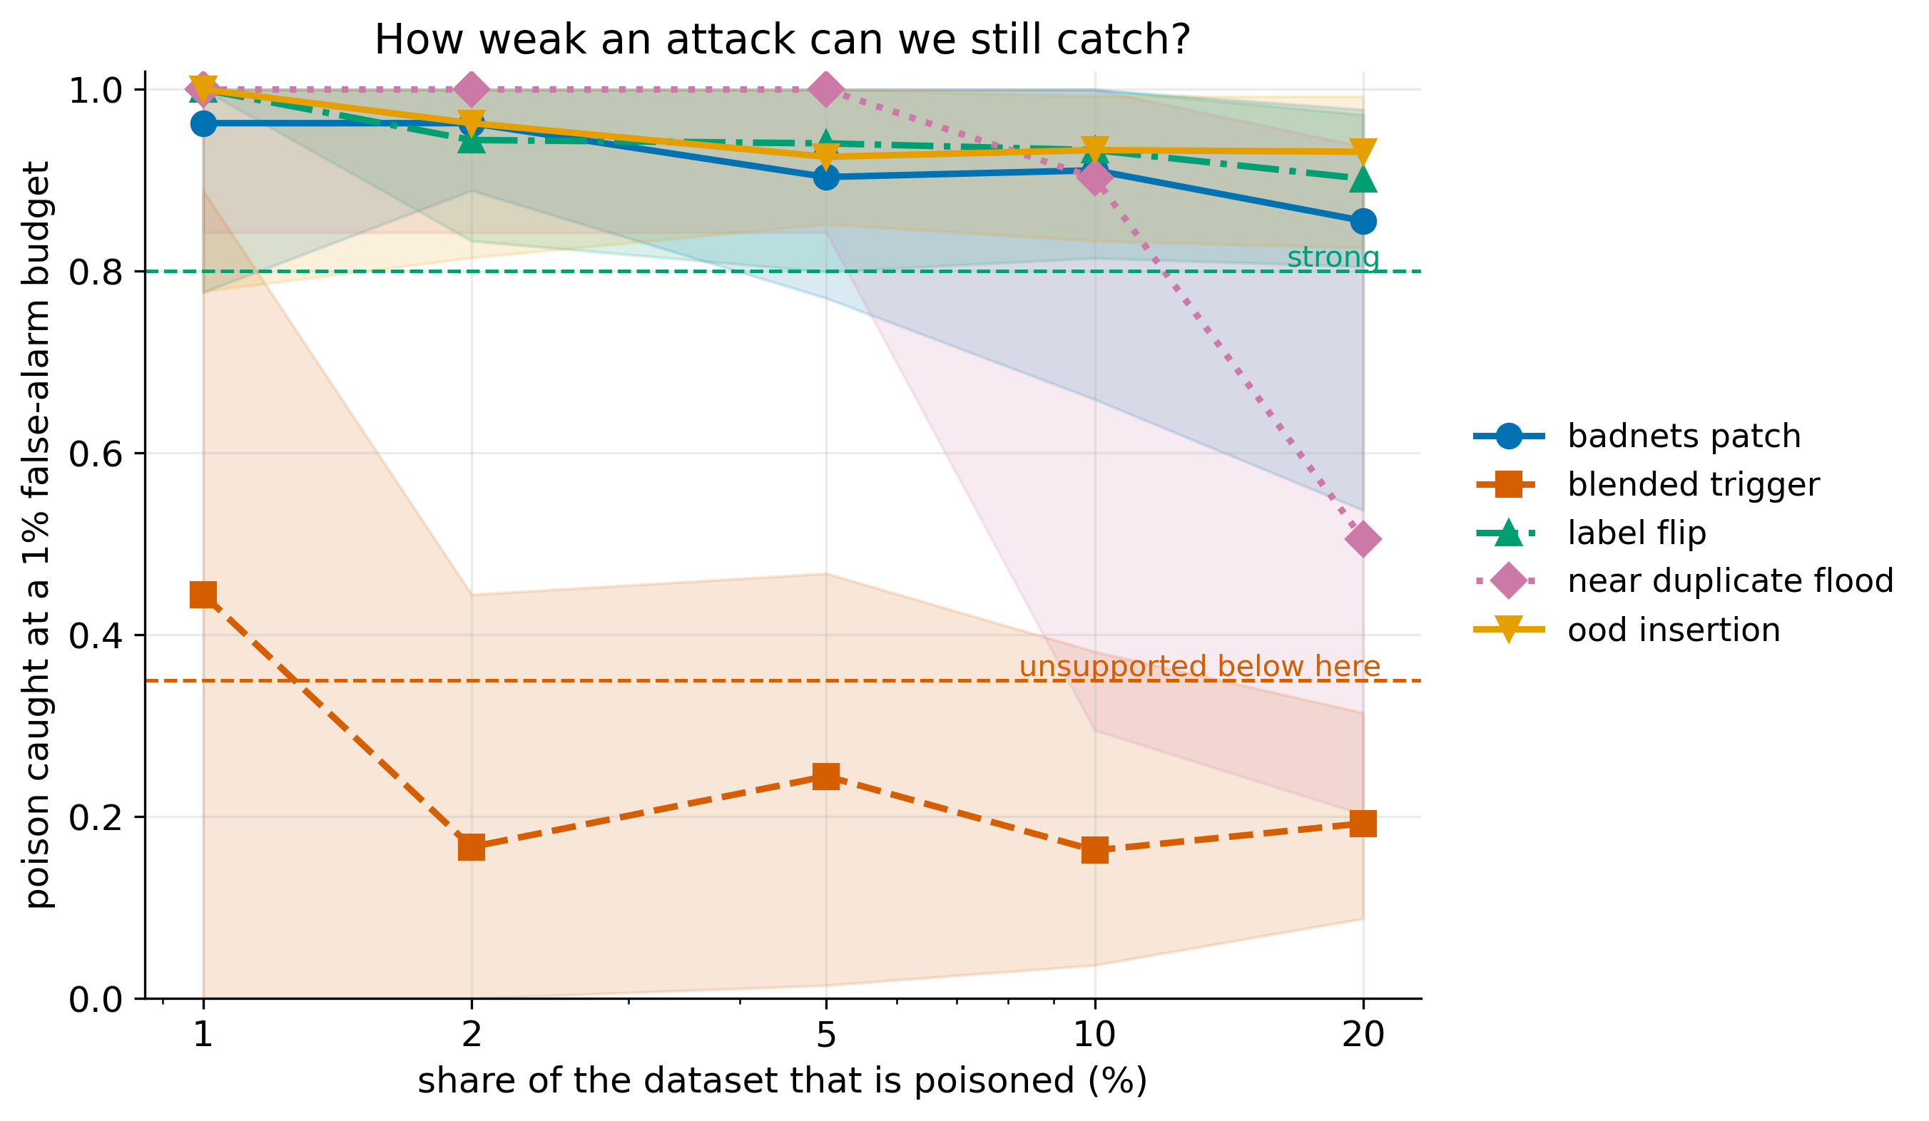
FEASIBILITY AND VIABILITY
Team Name
Measured, not asserted — 225 cells, 3 seeds each
Analysis of the feasibility
✓ Already built and measured. Not a concept — 273 tests, 225 swept cells, four results tables.
✓ Commodity hardware. 347 images audited in 13 s on a laptop CPU. No GPU, no cluster, no cloud.
✓ Deploys into an air-gap. Encoder weights ship inside the repository; nothing is downloaded.
Potential challenges and risks → strategies
! Faint blended triggers evade us (0.20).
→ Reported as unsupported, not hidden. Tier-2 spectral check is the next build.
! No contributor metadata in the intake.
→ Regex fallback on paths; otherwise the report says so instead of guessing.
! Vendor supplies a black box.
→ Fingerprinting still proves substitution at tier 0; coverage marks the rest.
! An attacker who knows our checks.
→ Stated in every report. The detector set is pluggable and instantly measurable.
Four attacks hold above 'strong' down to 1% poison. Blended triggers do not — and we say so.
Measured coverage — graded on the median cell, never the best
What an attacker did | Typical TPR@1%FPR | Range | False alarms | Status
The same photograph submitted many times | 1.00 | 0.45 – 1.00 | 3.0% | strong
Images from a completely different source | 1.00 | 0.73 – 1.00 | 1.3% | strong
A marker pasted onto the image | 0.93 | 0.67 – 1.00 | 1.7% | strong
The picture is fine, the label is wrong | 0.93 | 0.83 – 1.00 | 1.0% | strong
A faint pattern over the whole image | 0.20 | 0.00 – 0.67 | 1.1% | UNSUPPORTED
Any tampering with the inference log | 1.00 | proof, not an estimate | 0.0% | strong

Slide 5
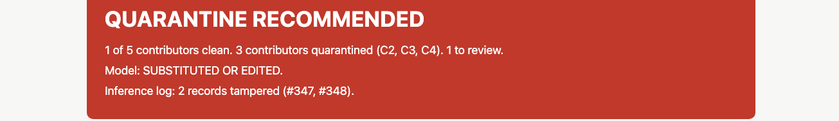
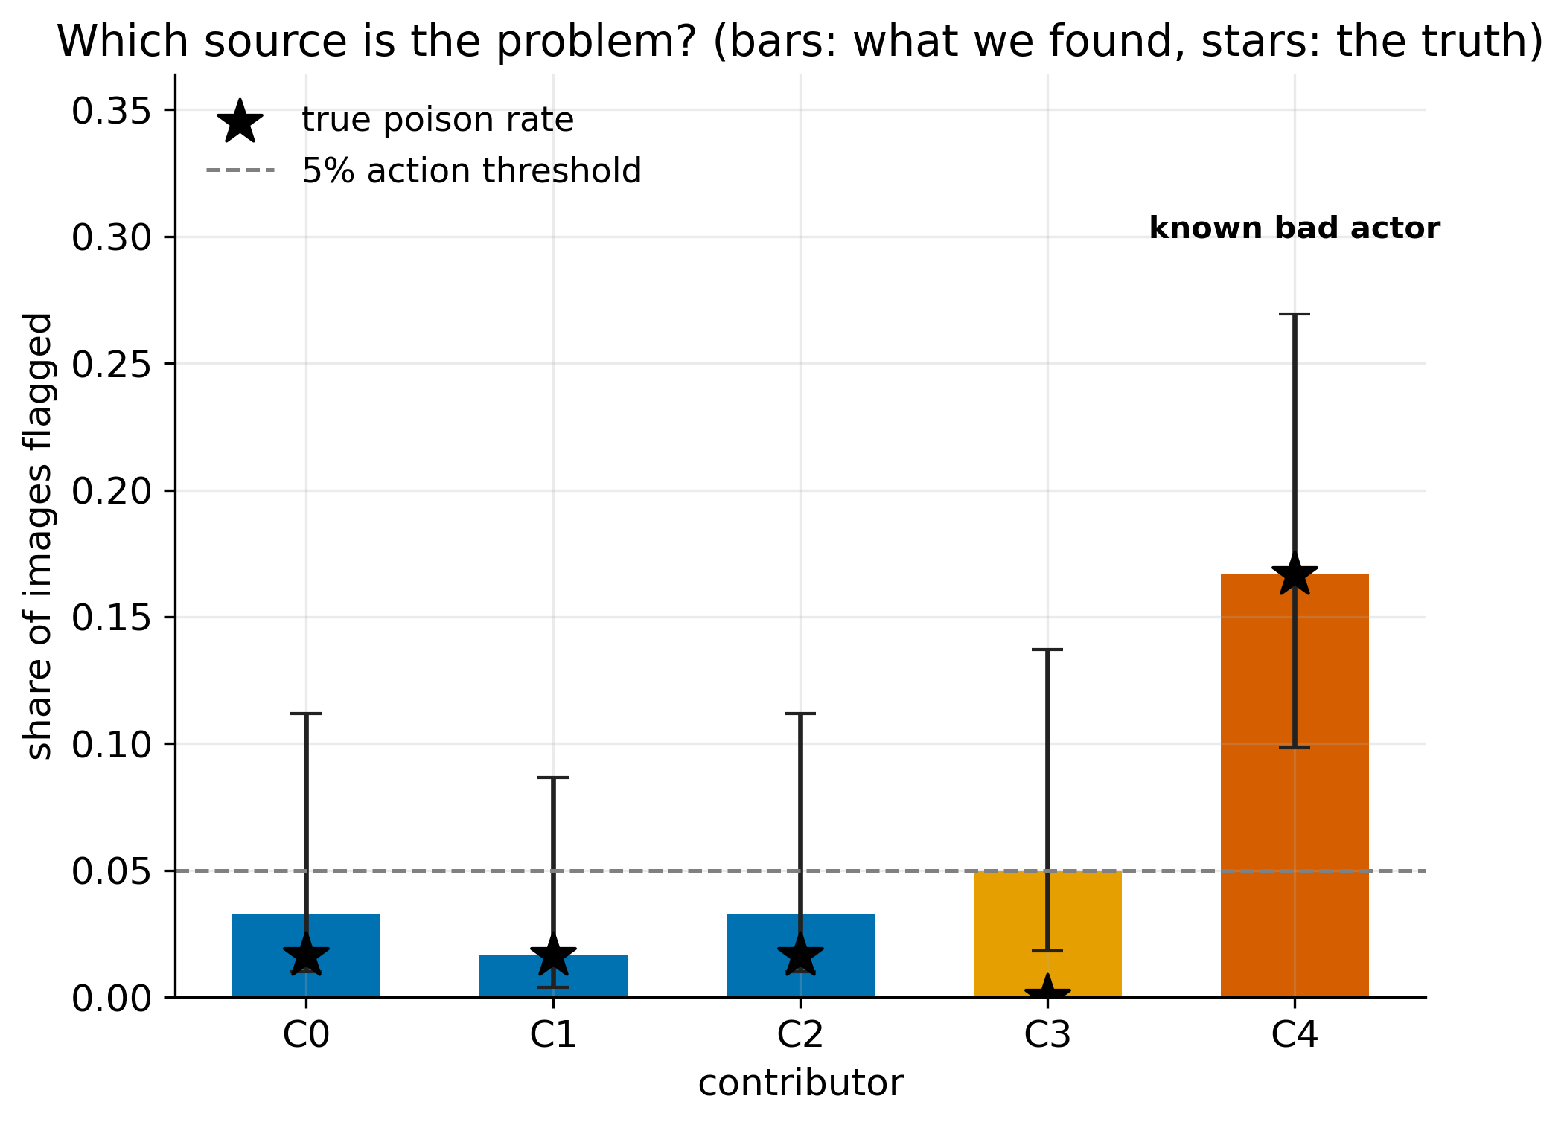
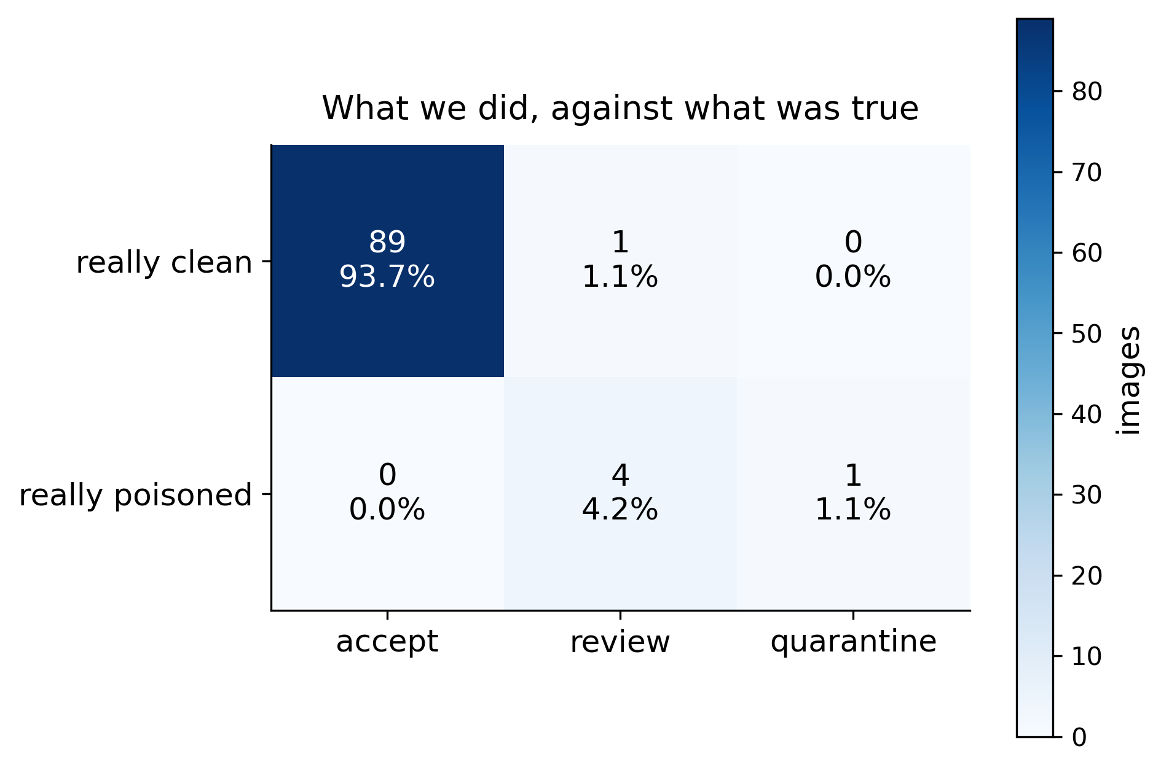
IMPACT AND BENEFITS
Team Name
What an analyst actually receives
Potential impact on the target audience
▸ Intake officer gets an order — 'quarantine Contributor D' — not 900 IDs to triage.
▸ Model reviewer can prove a vendor model is the enrolled one, from its answers alone.
▸ Investigator gets a named failure mode on the exact record that was edited.
▸ Commander sees one traffic light, and an honest list of what was not checked.
Real output. One offline HTML file — no dashboard to host, nothing to install on the analyst's machine.
Benefits of the solution
Operational · Triage collapses from every image to a handful of sources — minutes, not days.
Security · Poisoned data and swapped models are caught before they reach a model that guides a decision.
Legal / audit · Every inference is provable after the fact; the audit trail is itself tamper-evident.
Economic · Contributions are salvaged, not binned — quarantine one source instead of discarding a whole intake.
Ethical · The system states its own limits in every report, so nobody over-trusts a clean result.
Bars: what we found. Stars: the truth.
What we did, against what was true.
Before: an analyst is handed 900 suspect image IDs and no way to rank them.
After: one line — quarantine Contributor C3, whose true poison rate was 51% and whom we scored 45% with a 36–54% interval.

Slide 6
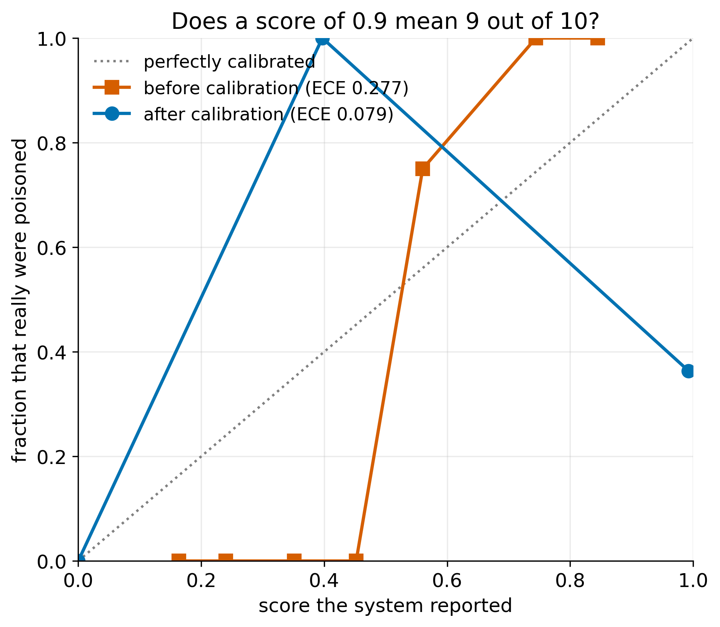
RESEARCH AND REFERENCES
Team Name
Attack literature we test against
Our own measured results
BadNets — Gu, Dolan-Gavitt & Garg, 2017. Patch triggers. arXiv:1708.06733
Blended / invisible triggers — Chen et al., 2017. The attack we measure worst on. arXiv:1712.05526
Spectral Signatures — Tran, Li & Madry, NeurIPS 2018. Our tier-2 check. arXiv:1811.00636
Neural Cleanse — Wang et al., IEEE S&P 2019. Trigger reconstruction, MAD anomaly index.
Dataset poisoning survey — Goldblum et al., TPAMI 2023. Multi-contributor threat model.
Calibration works. Expected Calibration Error falls from 0.277 to 0.079 once the combined score is calibrated as a quantity in its own right.
Sanity-checked first. Random scores must give AUROC 0.5, perfect scores 1.0 — both are tests, written before any detector existed.
Methods and standards
Ed25519 — RFC 8032. Keys generated locally, never transmitted.
Isotonic calibration — Zadrozny & Elkan, KDD 2002. Score → probability.
Benjamini–Hochberg — JRSS-B 1995. Controls false alarms across the nine shift measurements.
COCO / YOLO — Lin et al., ECCV 2014; Ultralytics data.yaml. Both ingest formats PS 2.2.6 requires.
Every headline number carries a bootstrap 95% interval; every swept cell runs at three seeds.
Repository and reproduction
make reproduce regenerates every number and figure from scratch, offline.
make verify runs 273 tests plus the assertion that nothing touched the network.
make demo the four-minute judge sequence, laptop in airplane mode.
Full source, the seeded attack harness and all four results tables ship in the repository.
Datasets
SYNTH-10 — procedural, ships with the repo so every result reproduces air-gapped · CIFAR-10 · GTSRB · VisDrone / DOTA subset, in both COCO and YOLO form.
PS 26228 covered:
✓ 2.2.1 data integrity
✓ 2.2.2 model integrity
✓ 2.2.3 provenance
✓ 2.2.4 calibration + shift
✓ 2.2.5 analyst report
✓ 2.2.6 formats · tiers · offline

