Slide 1
DIABETESPREDICTION
Rakesh Kasire nadukuda
Shyam reddy
Harini reddy
akhila

Slide 2
ABSTRACT :
Diabetes is considered as one of the deadliest and chronic diseases which causes an increase in blood sugar. Many complications occur if diabetes remains untreated and unidentified. The tedious identifying process results in visiting of a patient to a diagnostic Center and consulting doctor. But the rise in machine learning approaches solves this critical problem. The motive of this study is to design a model which can prognosticate the likelihood of diabetes in patients with maximum accuracy. Therefore three machine learning classification algorithms namely Decision Tree, SVM and Naive Bayes are used in this experiment to detect diabetes at an early stage. Experiments are performed on Pima Indians Diabetes Database (PIDD) which is sourced from UCI machine learning repository. The performances of all the three algorithms are evaluated on various measures like Precision, Accuracy, F-Measure, and Recall. Accuracy is measured over correctly and incorrectly classified instances. Results obtained show Naive Bayes outperforms with the highest accuracy of 76.30% comparatively other algorithms. These results are verified using Receiver Operating Characteristic (ROC) curves in a proper and systematic manner.

Slide 3
INTRODUCTION :
the problem statement is given to us develop a model to predict the risk level of diabetes in the patients using machine learning algorithms. this dataset contains 8 features (independent variable) and 1 label (dependent variable).
the 8 features are pregnancies, Glucose, Blood Pressure,Skin Thickness, Insulin, BMI, Diabetespedegreefunction,Age.
And label is Outcome The outcome contains 1 and 0 1 means the patient have diabetes and 0 means the patient don’t have diabetes.

Slide 4
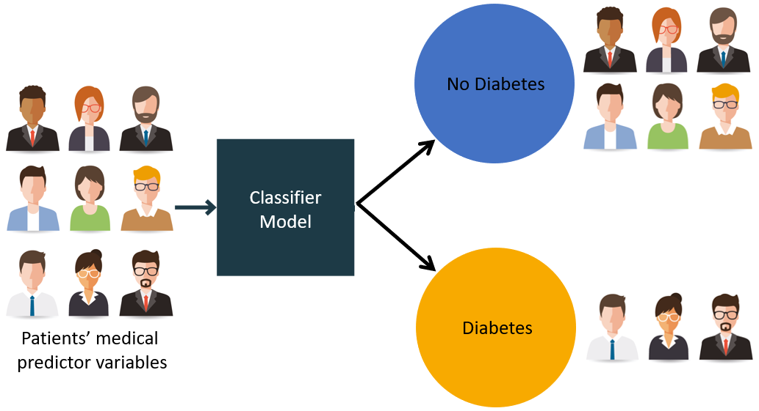

Slide 5
STEPS: The following are the steps used to Solve these Problem.
1.Data Pre-processing Tools
2.Model Representation
3.importing the Libraries
4.importing the Dataset
5.Encoding Categorical Data
1.Encoding Independent Variable
2.Encoding Dependent Variable
6.Extracting The Features and Labels
7.Handling missing Data
8.Splitting Dataset into Training and Test Set
9.Feature Scaling

Slide 6
1.Importing The Libraries 2.Importing The Dataset
import numpy as np
import pandas as pd
import matplotlib.pyplot as plt
import seaborn as sns
import warnings
warnings.filterwarnings('ignore’)
dataset=pd.read_csv("D:\Projectgs.csv")
s=dataset.copy()
s

Slide 7
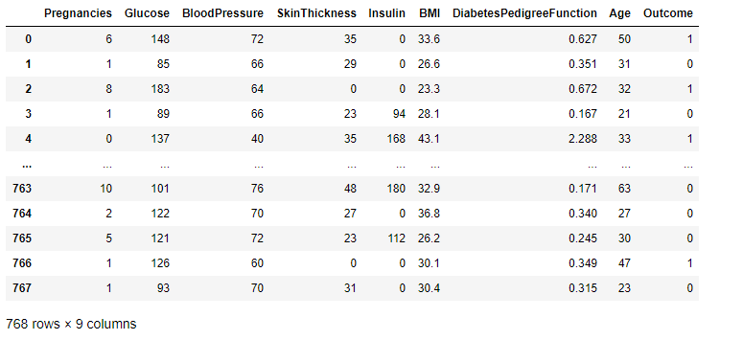
Importing The Libraries Importing The Dataset import numpy as np import pandas as pd import matplotlib.pyplot as plt import seaborn as sns import warnings warnings.filterwarnings('ignore’) dataset=pd.read_csv("D:\Projectgs.csv") s=dataset.copy() s

Slide 8

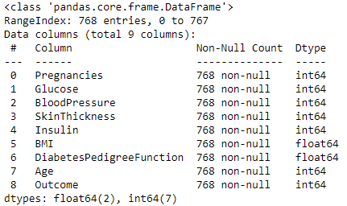
#Basic Information About Dataset : s.Shape print(s.groupby('Outcome').size()) s.info()

Slide 9
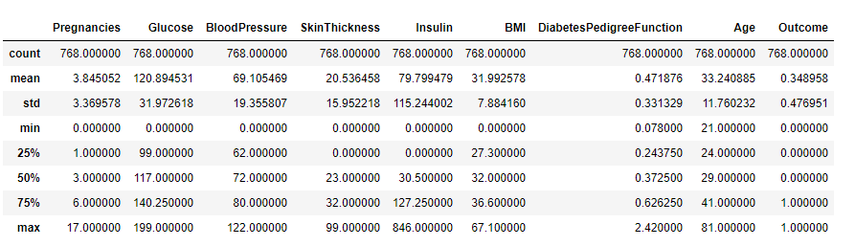
s.describe()

Slide 10
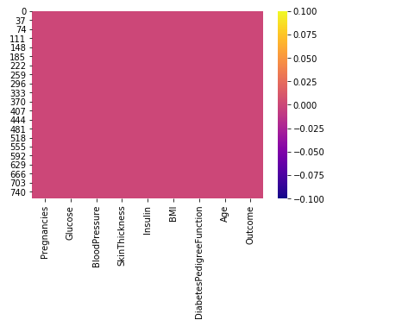
#Data Visualization : sns.heatmap(s.isnull(),cmap='plasma')

Slide 11
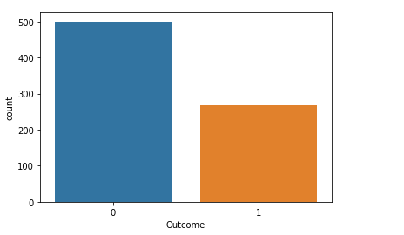
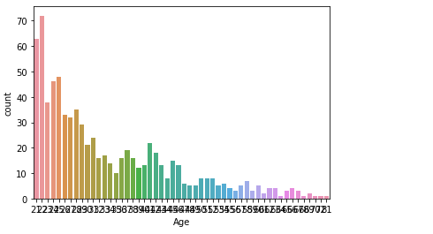
sns.countplot(x='Outcome',data=s) sns.countplot(x='Age',data=s)

Slide 12
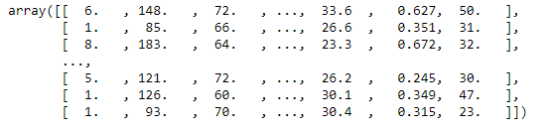
Extract Features and Lables : X=s.drop('Outcome',axis=1).values y=s['Outcome'].values X

Slide 13
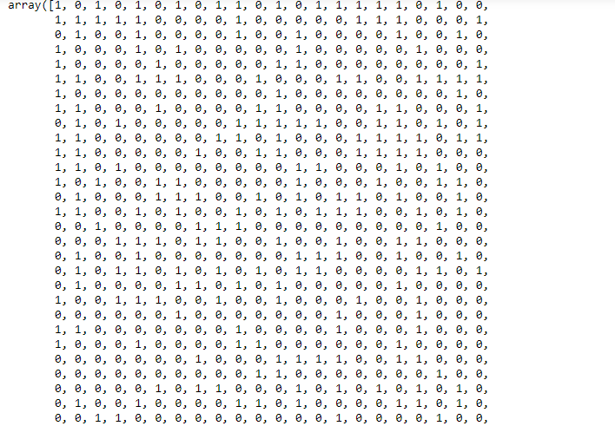
y

Slide 14
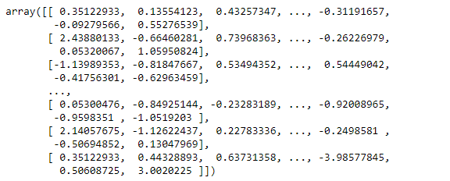
Split the Train and Test dataset : from sklearn.model_selection import train_test_split X_train,X_test,y_train,y_test=train_test_split(X,y,test_size=1/3,random_state=0) Feature Scaling : from sklearn.preprocessing import StandardScaler sc=StandardScaler() X_train[:,0:8]=sc.fit_transform(X_train[:,0:8]) X_test[:,0:8]=sc.transform(X_test[:,0:8]) X_train

Slide 15
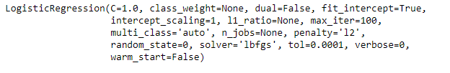
Apply Algorithms : LogisticRegression : from sklearn.linear_model import LogisticRegression classifier=LogisticRegression(random_state=0) classifier.fit(X_train,y_train)

Slide 16
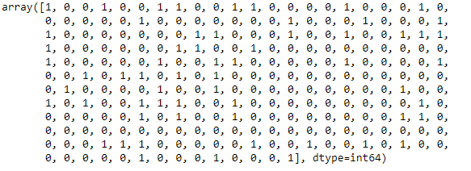


y_pred=classifier.predict(X_test) y_pred from sklearn.metrics import confusion_matrix, accuracy_score cm = confusion_matrix(y_test, y_pred) print(cm) accuracy_score(y_test, y_pred)

Slide 17
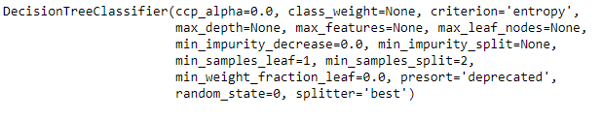
DecisionTreeClassifier: from sklearn.tree import DecisionTreeClassifier tre=DecisionTreeClassifier(criterion='entropy',random_state=0) tre.fit(X_train, y_train) print("accuracy :{:.3f}".format(tre.score(X_train,y_train)))

Slide 18
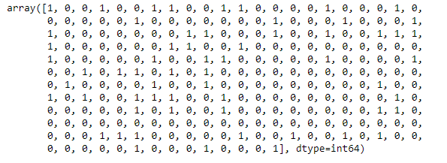

y_pred=classifier.predict(X_test) y_pred from sklearn.metrics import confusion_matrix, accuracy_score accuracy_score(y_test, y_pred)

Slide 19
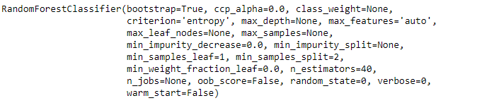
RandomForestClassifier: from sklearn.ensemble import RandomForestClassifier rf=RandomForestClassifier(n_estimators=40,criterion='entropy',random_state=0) rf.fit(X_train,y_train) y_pred=c.predict(X_test) accuracy_score(y_test,y_pred)

Slide 20
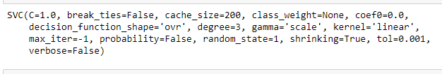
Support Vector Mchine: from sklearn.svm import SVC c=SVC( kernel='linear', random_state=1) c.fit(X_train,y_train) y_pred=c.predict(X_test) accuracy_score(y_test,y_pred)

Slide 21


Kneighborsclassifier: from sklearn.neighbors import KNeighborsClassifier classifier=KNeighborsClassifier(n_neighbors=9,metric='minkowski',p=2) classifier.fit(X_train,y_train) y_pred=classifier.predict(X_test) accuracy_score(y_test,y_pred)

Slide 22


