Slide 1
Breast Cancer cell classification(Benign or Malignant)
By: Rakesh Nagaraju (014279304)

Slide 2
Introduction
Breast cancer - most common diseases found in women with 271,270 new cases expected in the United States in 2019.
Also according to global statistics, Breast cancer represents the majority of cases of cancer-related deaths - a significant public health problem in today’s society.

Slide 3
Diagnosing cancer at the early stages can improve the prognosis and chance of survival, significantly, as it can, in turn, promote the timely treatment of patients.
Additionally, accurate classification of Benign tumors can prevent patients from undergoing unnecessary treatments.
Thus, the correct diagnosis of the disease and the right classification of Breast cancer cells as either Malignant or Benign is a subject of research.
In this project, applying 7 algorithms on “Wisconsin Breast Cancer” dataset and then compare the accuracy of all the approaches.

Slide 4
Dataset
Dataset used is “Wisconsin Breast Cancer Dataset”
Downloaded from Kaggle.
Contains 569 (rows), 32 (columns)
Column 1 &2 : Patient ID and Diagnosis
Rest(30 columns) : features
357 Benign (63%) and 212 Malignant (37%).

Slide 5
Next, remove Categorical data (convert diagnosis values to 0,1) - Label encoder()
Next, Analyzing the data by plotting a bar graph for each features and using different colors for Malignant and Benign cases.
k- cross validation (default used in this project = 5)

Slide 6
Implementation
Support Vector Machine (SVM): SVM runs on 4 main ideas: Separating hyperplane (to separate training data into two classes), Maximizing minimum separation between classes (choosing hyperplane such that to maximize the margin), working in a higher-dimensional space (project data to higher dimensional space) and Kernel trick (used to project data into higher dimension).
Sklearn SVC() package.
Using Kernel: Linear, RBF and Polynomial, with c = 3.

Slide 7
K-Nearest Neighbor (k-NN): a supervised learning technique, classify a sample based on a majority vote of the k nearest samples in the training set, no training is required.
In this implementation, we keep k = 5 value as p is set to 2(equivalent to using Euclidean distance), metric used is ’minkowski’.
Decision Tree: It creates a Tree that is used to make decisions, kind of like a flow chart. Each node is a test condition and each branch is an outcome of the test represented by the corresponding node.
In this implementation, we choose criterion as “entropy” and the random state as 0 and the rest of the parameters are kept as default.
Notes:
Criterion is the function to measure the quality of a split. Supported criteria are “gini” for the Gini impurity and “entropy” for the information gain.

Slide 8
Random Forest: Random Forest (RF) is a generalization of a decision tree. This training algorithm uses heuristic to do smart bagging.
In this implementation, criterion = “entropy”, random state as 0 and estimators=10(default).
Naive Bayes: Naive Bayes classifier assumes that the presence of a particular feature in a class is unrelated to the presence of any other feature.
In this implementation, we use the sklearn GaussianNB() package with all parameters kept as default.
Logistic Regression: Logistic regression uses an equation as the representation similar to linear regression.
In this implementation, we keep penalty as 'l2', solver as 'lbfgs', random_state as 0 and max_iter = 1000.
Notes:
olver is taken as ‘lbfgs’ after comparing the accuracy of the models trained on other solvers: ‘sag’, ‘saga’ and ‘newton-cg’

Slide 9
Neural Network: In this project, using a Multilayer Perceptron(MLP).
In our implementation, we are using the sklearn Keras package.
Sequential() model is implemented, which is a linear stack of layers.
We are using 2 hidden layers, one input layer, and one output layer.
We are calculating the Stochastic Gradient Descent SGD with a learning rate as 0.01, decay as 1*e-6, momentum as 0.9 and use it as an optimizer.
For the first 3 layers, the activation function used is the Rectified Linear unit (ReLu) and for the output layer, “sigmoid” is used. The loss used here is the mean squared loss.

Slide 10
Results:
Predict the trained model.
classification_report() and Balanced_accuracy_score().
TP, FP, TN, FP are calculated.
This is done for each fold.
Mean accuracy is calculated FPR all folds.

Slide 11
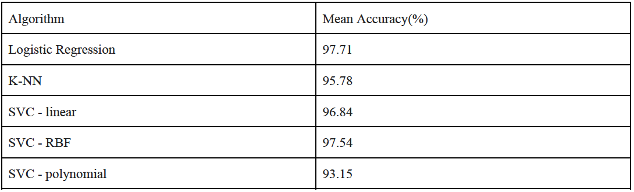
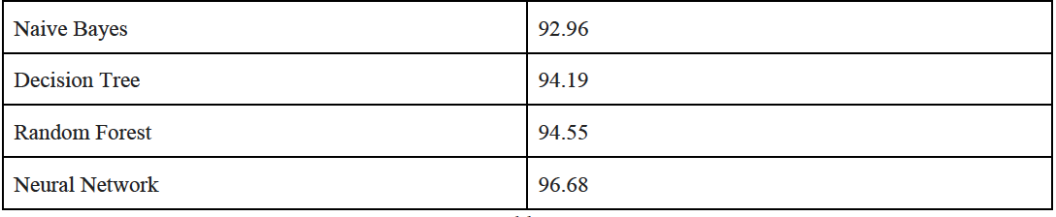
Comprison between all approaches:

Slide 12
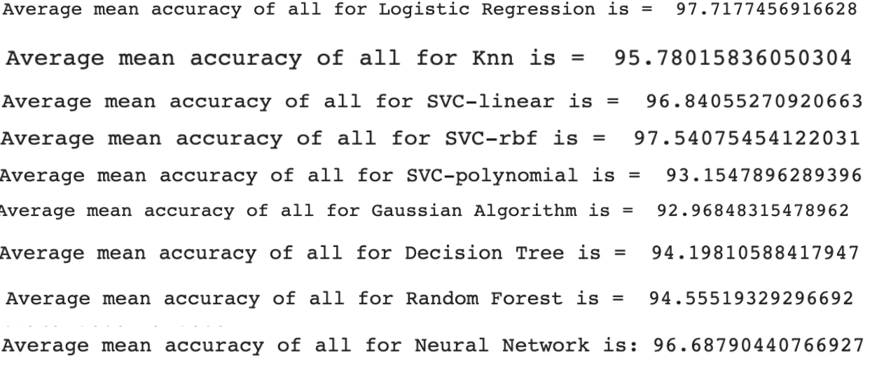

Slide 13
Next, recall, precision is calculated.
Precision_recall_curve().
ROC curve is plotted for each fold. AUC is calculated.
PR curve is plotted for each fold. AUC is calculated.
Mean ROC and PR curves are also plotted and AUC is generated.

Slide 14
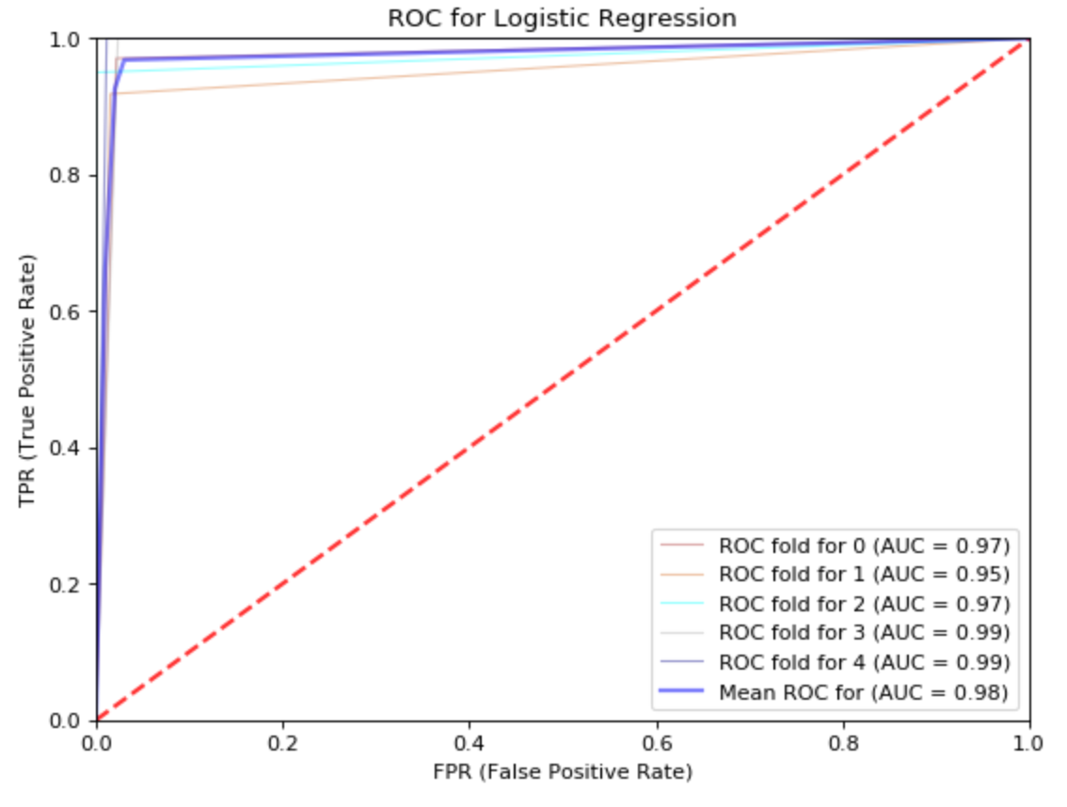
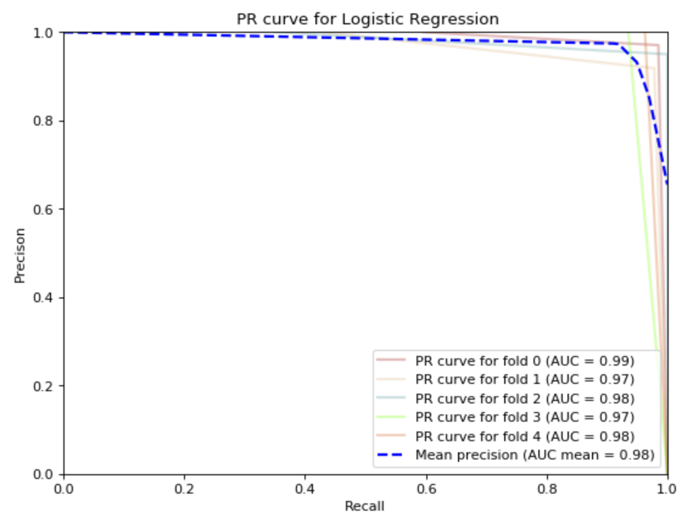

Slide 15
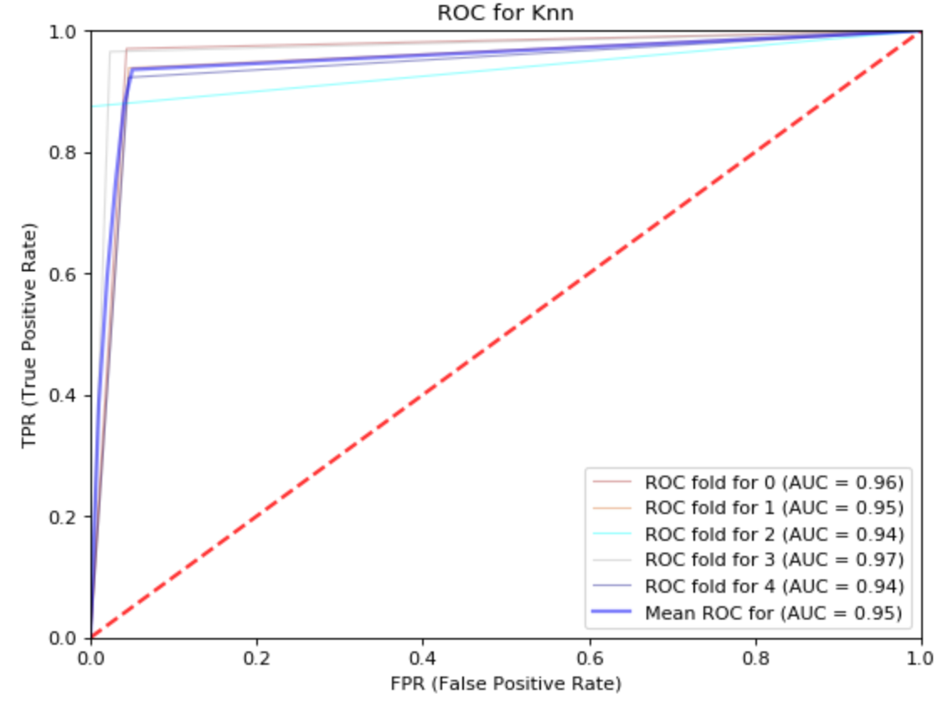
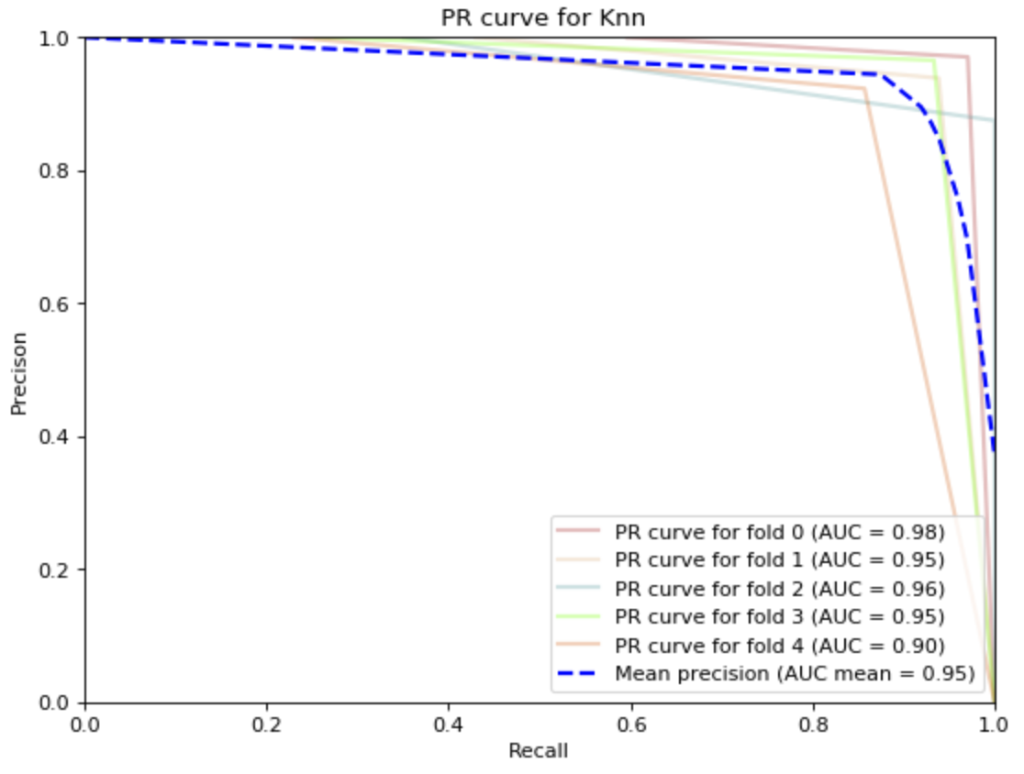

Slide 16
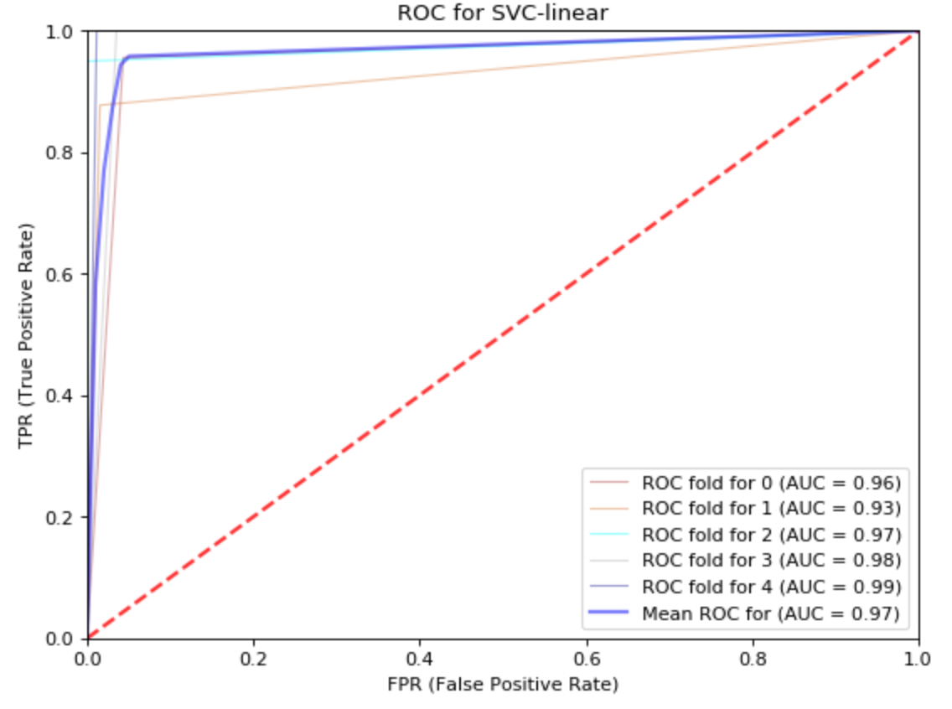
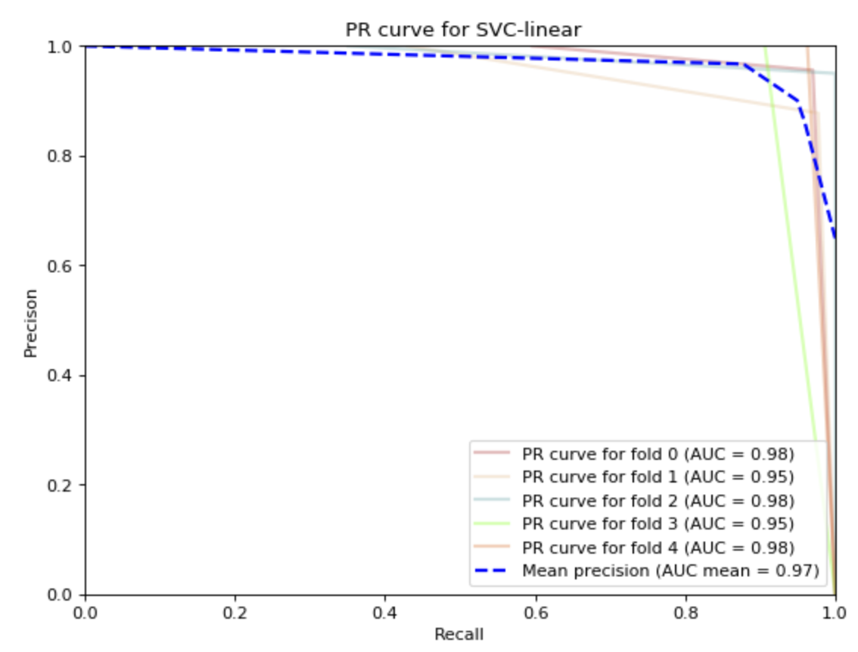

Slide 17
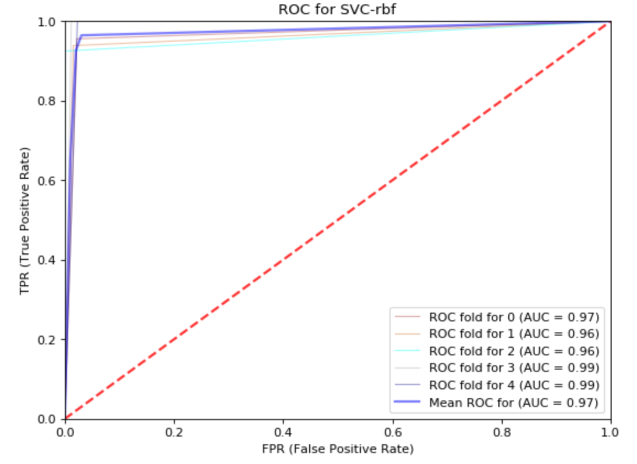
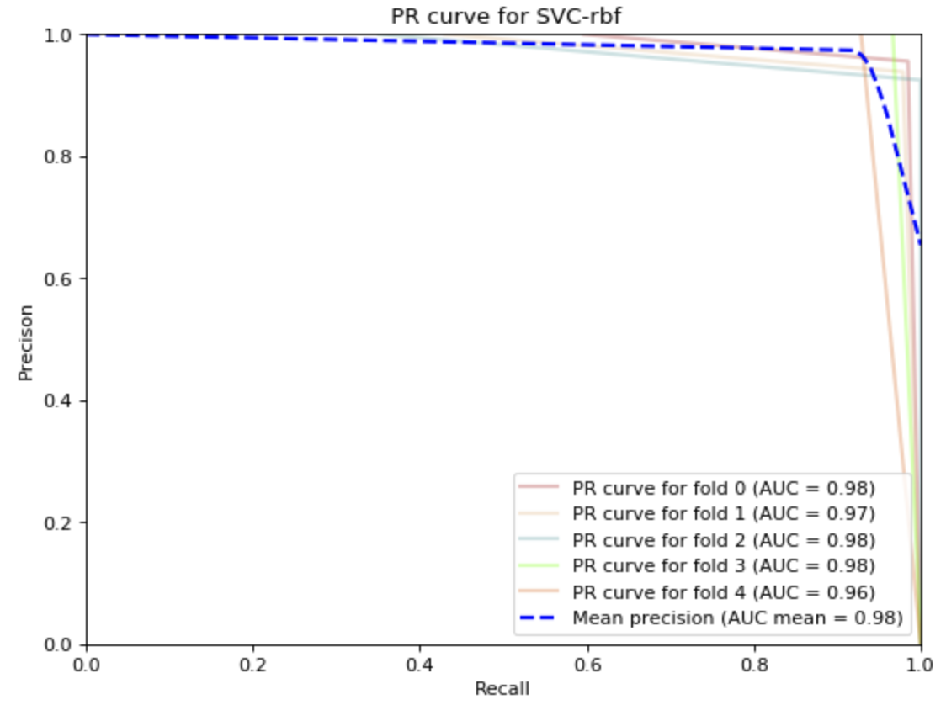

Slide 18
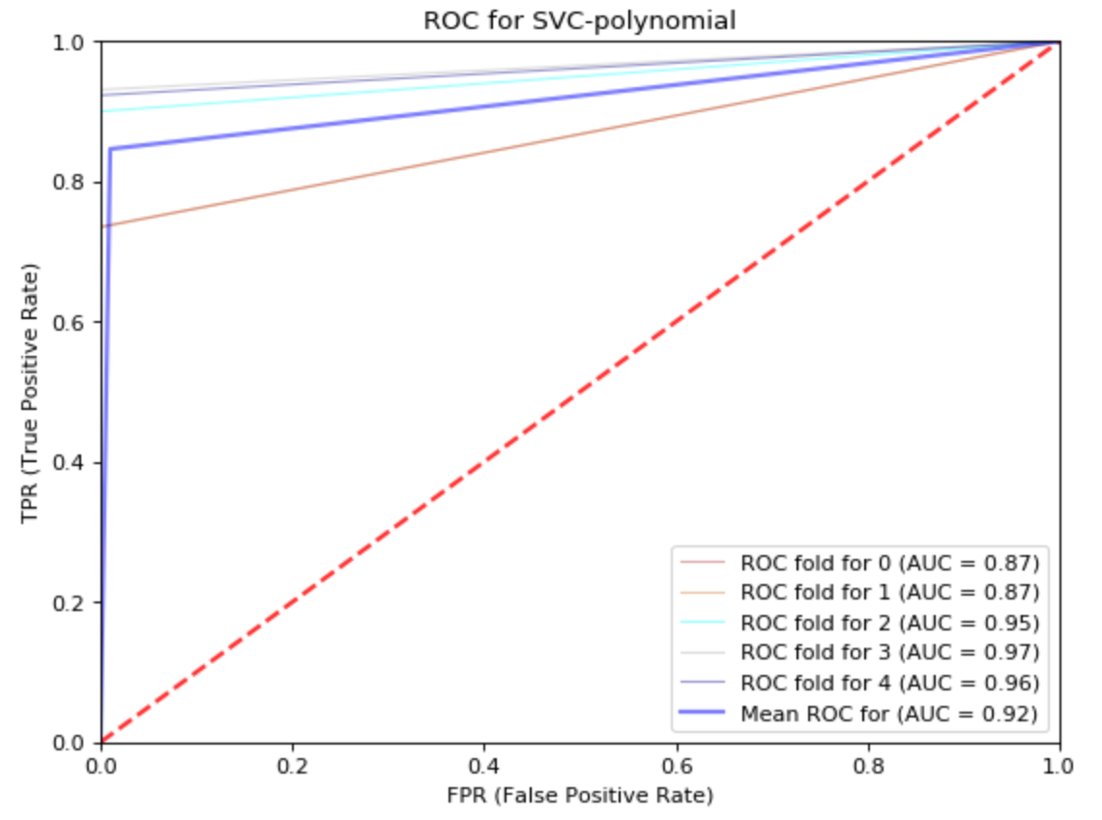
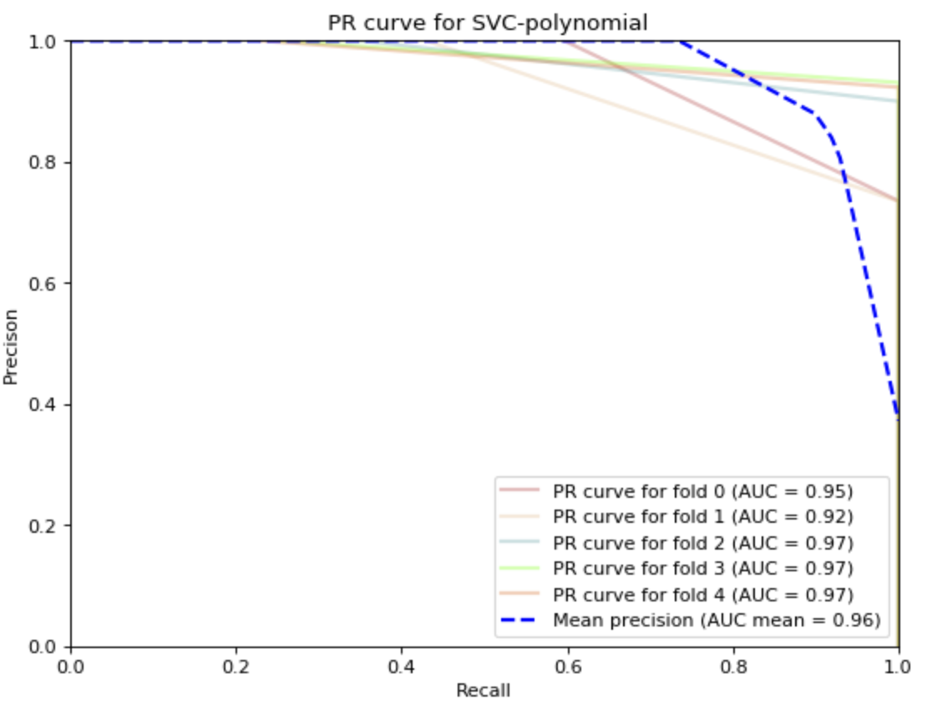

Slide 19
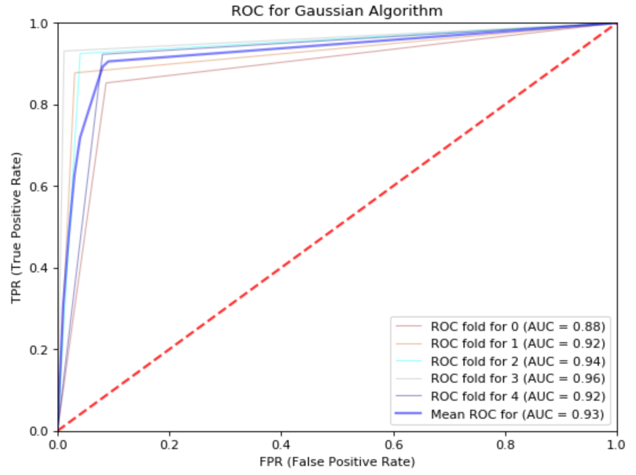
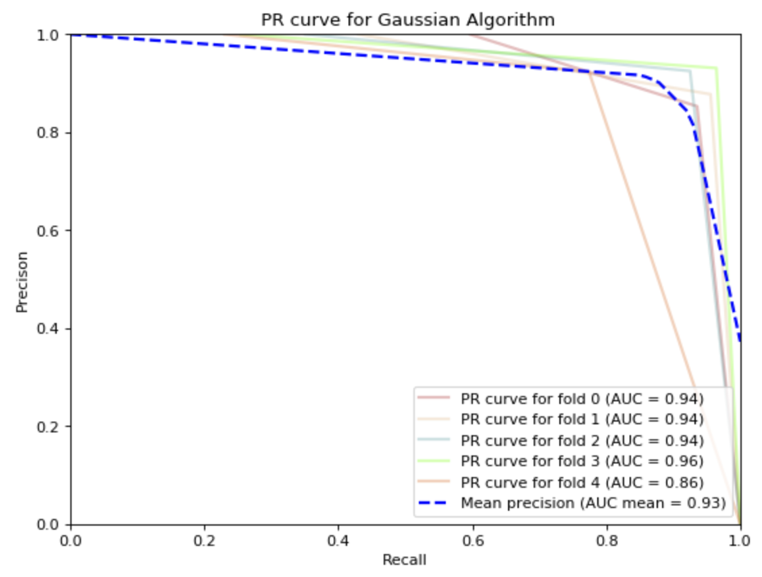

Slide 20
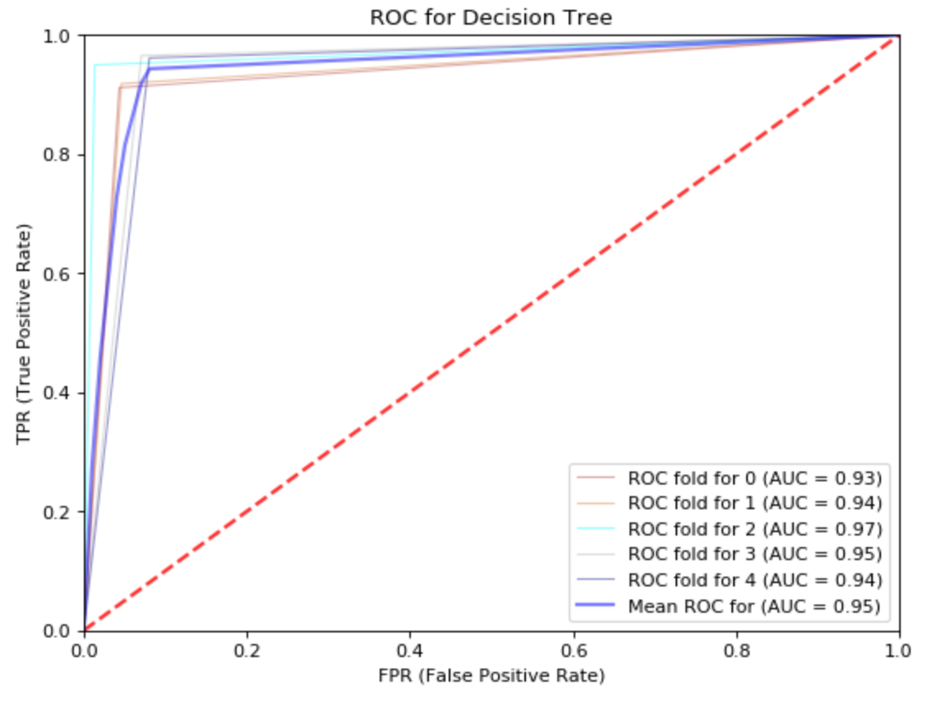
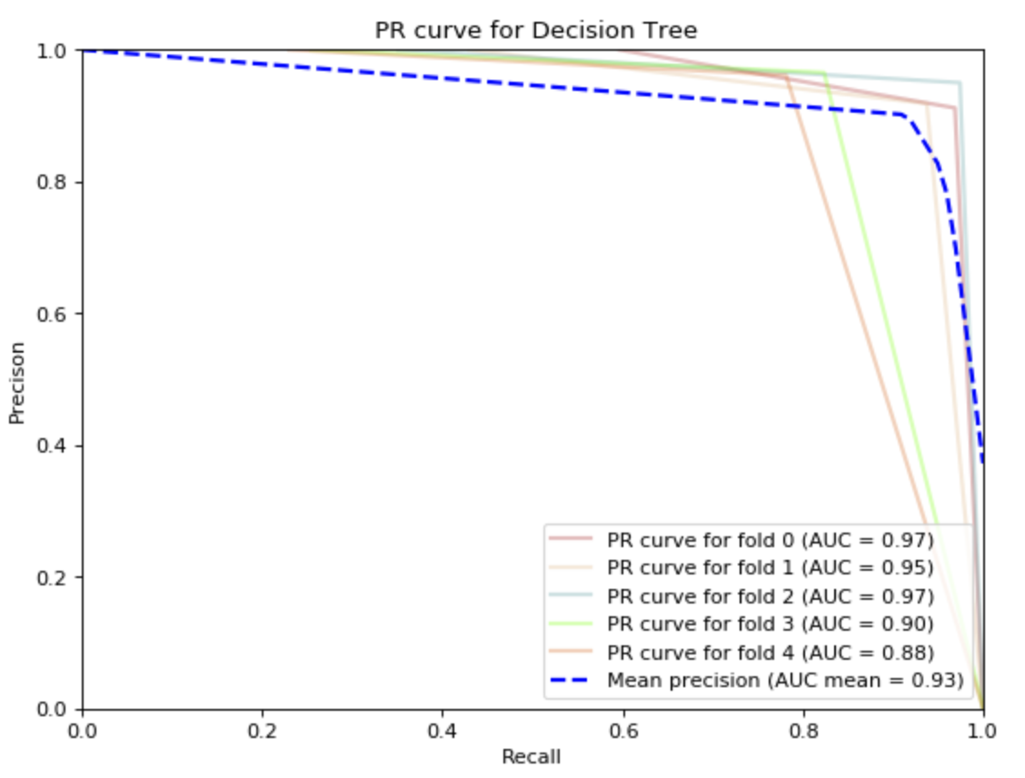

Slide 21
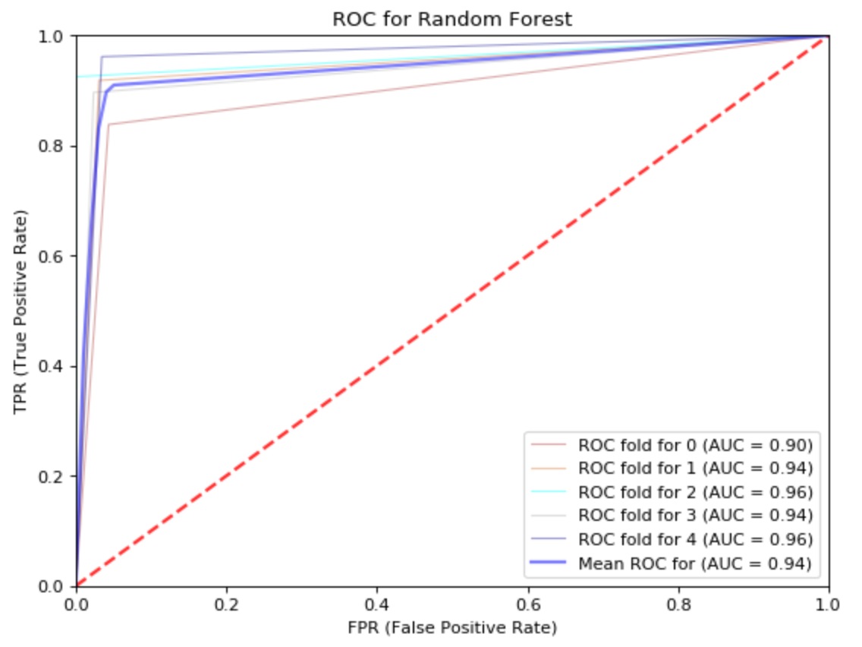
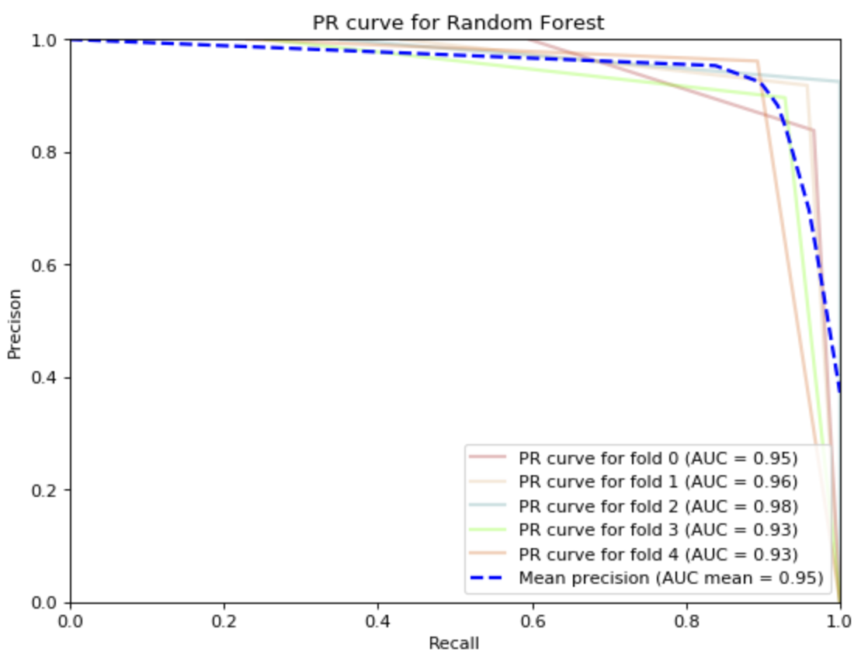

Slide 22
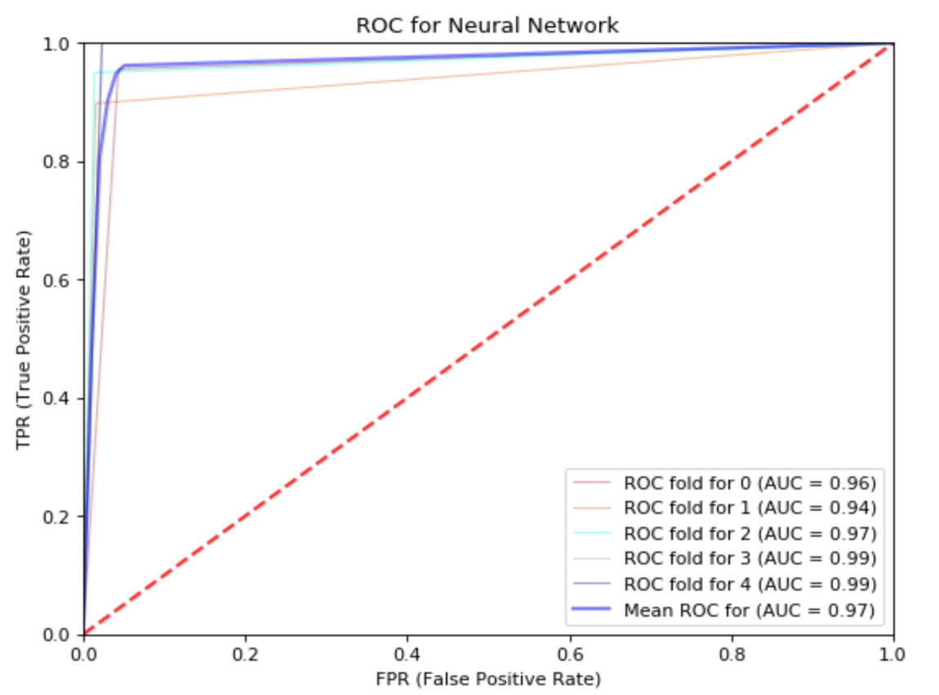
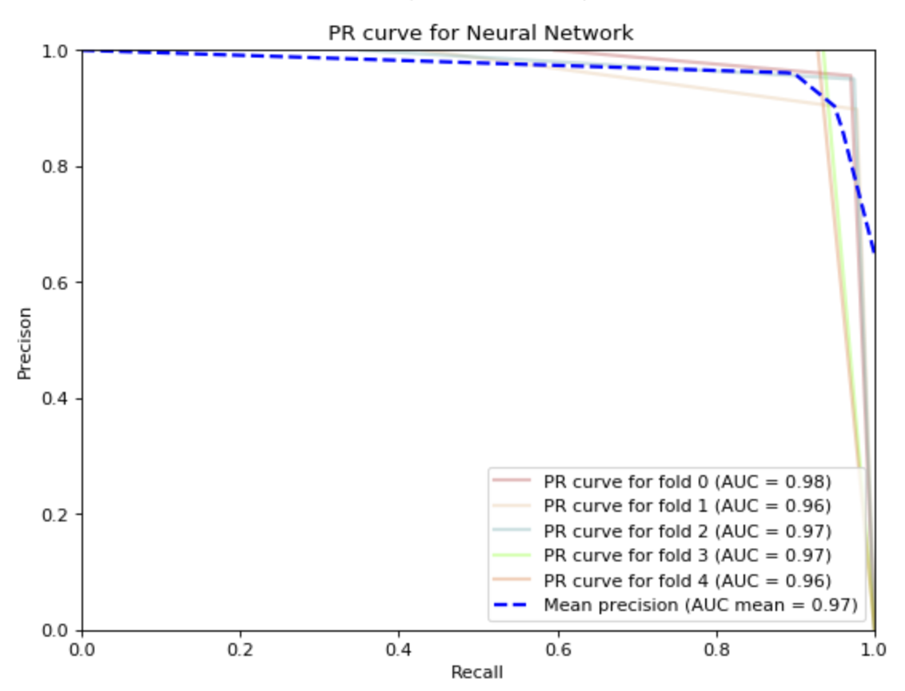

Slide 23
Thank You!!!

