Slide 1
Rabin Cipher
CS 265
Final Project Presentation
Presented By: Rakesh Nagaraju

Slide 2
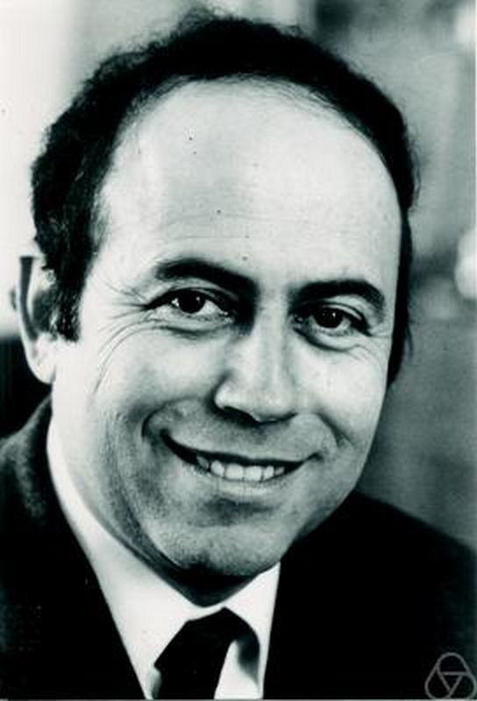
Rabin Cipher - A brief History
Invented by Michael O. Rabin in January 1979 in his journal entitled "Digitalized Signatures and Public-Key Functions as Intractable as Factorization".
It was the first asymmetric cryptosystem
whose security was proved equivalent
to the intractability of integer factorization.

Slide 3
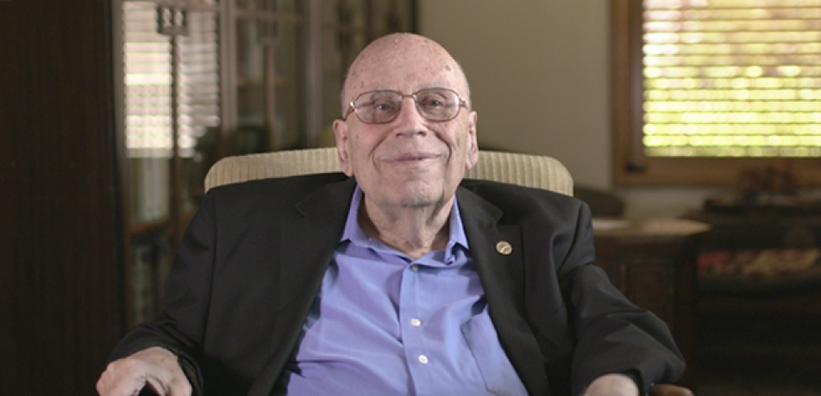
Rabin Cipher - A brief History
Born on September 1, 1931 in Breslau, Germany.
Rabin was an Israeli mathematician
& computer scientist.
Received of the Turing Award in 1976.

Slide 4
Rabin Cipher - Overview
Type of Cipher: Asymmetric-Public Key.
Unit of operations: Big-Integer
Plain Block size: Variable
Cipher Block size: Variable
Input Key length: Variable
Implementation type: Software
Kerckhoffs' principle: Not-Satisfied
Known attacks: Vulnerable against chosen Ciphertext Attacks
Status of lifecycle: Dead

Slide 5
Rabin Cipher - Required Background
Chinese Remainder Theorem: Chinese remainder theorem states that “when the remainders of the Euclidean division are known, then one can determine uniquely the remainder of the division of n by the product of these integers, under the condition that the divisors are pairwise coprime” [6].
x ≡ a1 (mod m1), x ≡ a2 (mod m2), ..., x ≡ ak (mod mk) have a solution, and the solution is unique modulo m, where m = m1.m2⋅⋅⋅mk .

Slide 6
Rabin Cipher - Required Background
Example: Solve the simultaneous congruences x ≡ 6 (mod 11), x ≡ 13 (mod 16), x ≡ 9 (mod 21), x ≡ 19 (mod 25).
Solution: Since 11, 16, 21, and 25 are pairwise relatively prime, the Chinese Remainder Theorem tells us that there is a unique solution modulo m, where m = 11⋅16⋅21⋅25 = 92400.
Length of set = k = 4; m1 = 11, m2 = 16, m3 = 21, m4 = 25 ; a1 = 6, a2 = 13, a3 = 9, a4 = 19.
Compute z1 = m / m1 = m2.m3.m4 = 16⋅21⋅25 = 8400
z2 = m / m2 = m1.m3.m4 = 11⋅21⋅25 = 5775
z3 = m / m3 = m1.m2.m4 = 11⋅16⋅25 = 4400
z4 = m / m4 = m1.m3.m3 = 11⋅16⋅21 = 3696

Slide 7
Rabin Cipher - Required Background
y1 ≡ z1 –1 (mod m1) ≡ 8400–1 (mod 11) ≡ 7–1 (mod 11) ≡ 8 (mod 11)
y2 ≡ z2 –1 (mod m2) ≡ 5775–1 (mod 16) ≡ 15–1 (mod 16) ≡ 15 (mod 16)
y3 ≡ z3 –1 (mod m3) ≡ 4400–1 (mod 21) ≡ 11–1 (mod 21) ≡ 2 (mod 21)
y4 ≡ z4 –1 (mod m4) ≡ 3696–1 (mod 25) ≡ 21–1 (mod 25) ≡ 6 (mod 25)

Slide 8
Rabin Cipher - Required Background
w1 ≡ y1.z1 (mod m) ≡ 8⋅8400 (mod 92400) ≡ 67200 (mod 92400)
w2 ≡ y2.z2 (mod m) ≡ 15⋅5775 (mod 92400) ≡ 86625 (mod 92400)
w3 ≡ y3.z3 (mod m) ≡ 2⋅4400 (mod 92400) ≡ 8800 (mod 92400)
w4 ≡ y4.z4 (mod m) ≡ 6⋅3696 (mod 92400) ≡ 22176 (mod 92400)
The solution, which is unique modulo 92400, is x ≡ a1w1 + a2w2 + a3w3 + a4w4 (mod 92400) ≡ 6⋅67200 + 13⋅86625 + 9⋅8800 + 19⋅22176 (mod 92400) ≡ 2029869 (mod 92400) ≡ 51669 (mod 92400)

Slide 9
Rabin Cipher - Key Generation
Computationally secure ⇒ chosen plaintext attack
Provided that the modulus n = pq can not be factored.
Chooses two large primes P and Q , such that: P ≡ Q ≡ 3 mod 4.
Comput N = P * Q.
P and Q are the Private-Key.
N is the Public-Key.

Slide 10
Rabin Cipher - Key Generation Example
We have to select P and Q such that it satisfies the condition: P ≡ Q ≡ 3 mod 4. Say : P = 7 and Q =11
Now, calculate N,
N = P * Q = 7 * 11 = 77.
Public Key : (N = 77)
Private Key : (P = 7 , Q = 11)

Slide 11
Rabin Cipher - Encryption
Suppose you want to encrypt a plaintext m.
Convert m into array of Integer, M
Get N from Public Key.
Compute , C = M² mod N and return C.
Convert Ciphertext C to hex string and send .

Slide 12
Rabin Cipher - Encryption Example:
Example: N = 77 such that P =7, Q = 11 .
Suppose the message to be sent is 10.
Encryption:
C = 10² mod 77 ⇒ 100 mod (77) = 23
Ciphered-Text = 23

Slide 13
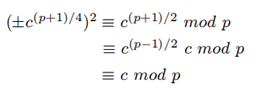

Rabin Cipher - Decryption
Suppose we want to decrypt a ciphertext.
Convert hex ciphertext to array of Integer, C.
Calculate: sqrt(C) mod N.
When , there is a simple Formula called Extended Euclidean, to find the root of C mod P:
Therefore,

Slide 14


Rabin Cipher - Decryption Contd.
Hence, the first 2 roots are calculated as:
The other 2 roots are:
Then we use Chinese Remainder Theorem to obtain four roots of C mod N.
Out of the four one is the correct message.

Slide 15
Rabin Cipher - Decryption Example:
Ciphered-Text = 23
P = 7, Q = 11
Calculate roots as:
23^{(7+1)/4} ≡ 2² ≡ 4 mod 7 and 23^{(11+1)/4} ≡ 1³ ≡ 1 mod 11
Using Chinese Remainder algorithm, we get roots:
10 mod 77, -10 mod 77, 32 mod 77, -32 mod 77
Finally, we get roots:
R1 = 10, R2 = 67, R3 = 32, R4 = 45.

Slide 16
Rabin Cipher - Decryption Contd.
How to find the Correct plaintext among 4 roots??
One way is to repeat the plaintext twice before encrypting.
Encrypt this message and send it.
During decryption, out of the possible four results,
Divide every result to equal halves and compare them.
The pair which matches is the correct recovered plaintext.

Slide 17
Rabin Cipher - Decryption Contd.
How to find the Correct plaintext among 4 roots??
Suppose plaintext is “10”, before encrypting we make it “1010”.
Encrypt this message and send it.
During decryption, we get four results,
For our example one of the roots will be “1010”,
we divide into 2 halves and compare them.
“1010” = 10:10. Therefore 10 is correct text.

Slide 18
Rabin Cipher - Conclusion
Advantages:
The security of Rabin algorithm relies on the difficulty of factoring very large numbers, so the greater the private keys are used, the better the security becomes.
Another advantage of Rabin cipher is its encryption, where the calculation is done by square modulo N making it more efficient than RSA, as the calculation required is at least of a cube.
Disadvantages:
Decrypting produces four outputs out of which only one is correct. Thus increasing computation.
Vulnerable to chosen ciphertext attacks.

Slide 19
References:
[1] Rabin, M. O. (1979). Digitalized signatures and public-key functions as intractable as factorization (No. MIT/LCS/TR-212). Massachusetts Inst of Tech Cambridge Lab for Computer Science.
[2] M. O. Rabin, "Digitized signatures and public-key functions as intractable as factorization,", MIT Lab. for Computer Science, Technical Report LCS/TR-212, 1979.
[3] H. C. Williams, "A Modification of the RSA Public-Key Encryption Procedure," IEEE Transactions on Information Theory, Vol IT-26, No. 6, November 1980.
[4] Henk C. A. van Tilborg, An Introduction to Cryptology. Boston: Kluwer Academic Publishers, 1988.
[5] Jennifer Seberry and Josef Pieprzyk, Cryptography: An Introduction to Computer Security. Sydney, Australia: Prentice Hall, 1989.
[6] https://en.wikipedia.org/wiki/Chinese_remainder_theorem.
[7] https://en.wikipedia.org/wiki/Extended_Euclidean_algorithm.

