Slide 1
Template Editor
User Guide
Latest update:
Katarzyna Frasunkiewicz
25.08.2020
1.0

Slide 2
Purpose and Field of Application
Template Editor …

Slide 3
Table of Contents
Main menu – Home – slide 4
Main menu – Import – slide 5
Main menu – Export – slide 6
Main menu – Model – slide 7
Main menu – Solution – slide 8
Main menu – Help – slide 9
Left search bar – slide 10
Left Sidebar - toolbar - slide 11
Start edition – slide 12
Object edition – slide 13
Object copy and inheritance – slide 16
Table editor – slide 17
Dependency Explorer – slide 18
Inheritance Explorer – slide 19
Model configuration – slide 20

Slide 4
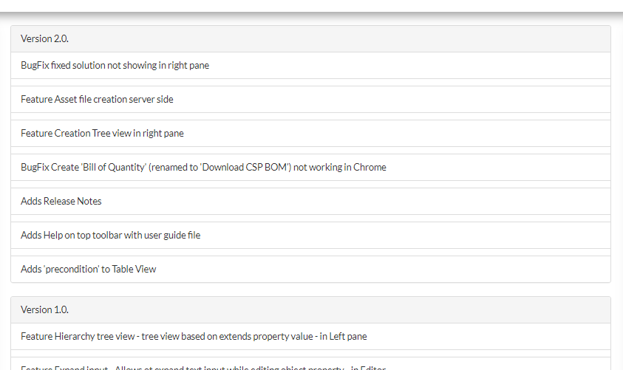
Template Editor
Main menu - Home
Under Home you can select Release Notes with information about
latest changes to the application. Current version number is visible next to application name in left corner

Slide 5
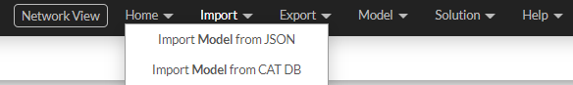
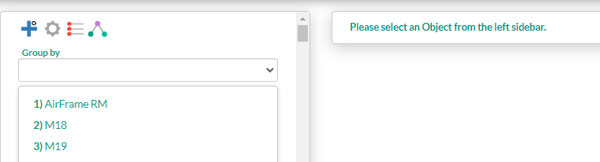
Template Editor
Main menu - Import
Under Import you can select:
-Import Model from JSON – select a json file from your drive
-Import Model from CAT DB – you can select model from list !connection to Nokia network is necessary!
Imported model object will be visible in left sidebar.

Slide 6
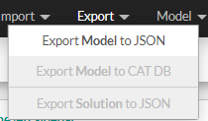
Template Editor
Main menu - Export
Under Export you can select:
-Export Model to JSON – creates JSON file with model objects
-Export Model to CAT DB – //TO DO//
-Export Solution to JSON – !start configuration to make this option active!

Slide 7

Template Editor
Main menu - Model
Under Model you can select:
-Clear objects list– Objects visible in left sidebar will be deleted

Slide 8
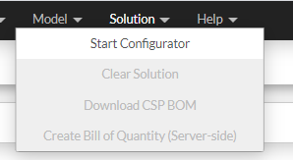
Template Editor
Main menu - Solution
Under Model you can select:
-Start Configuration – Starts configuration in center pane, configuration activates other Solution menu options
-Clear Configuration – Clears configuration settings, all selected options will be revoked
-Create CSP BOM - allows to download CSP BOM file .xml format
-Create Bill Of Quantity - allows to download Asset File in excel format (.xlsx) !connection to Nokia network is necessary!

Slide 9
Template Editor
Main menu - Help
Under Help you can select:
-User guide – Download user guide

Slide 10
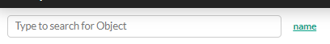
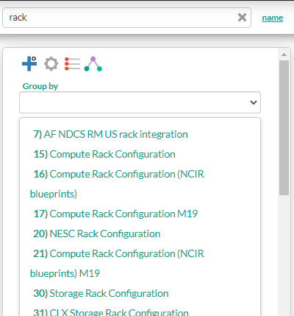
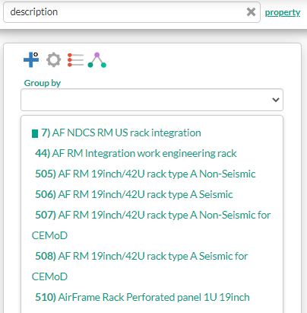
Template Editor
Left Search bar
Use search bar to search in model objects list. Click on word on the right po change search mode
-name – phrase is searched among objects name attribute
-property – list is limited to objects having this property ( it must be exact full name i.e. description, but not desc)

Slide 11

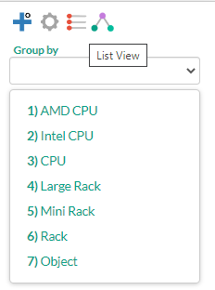
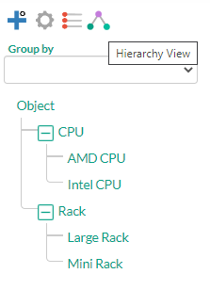
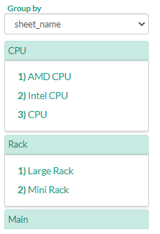
Template Editor
Left Side bar - Displays List of objects in current model.
Adds new object to model
Setting allows to change model name
There are three ways to display models objects :
List view (default)
Hierarchy view – based on extends property
Grouped view – select property from dropdown list (it’s crated dynamically based on objects attributes)

Slide 12
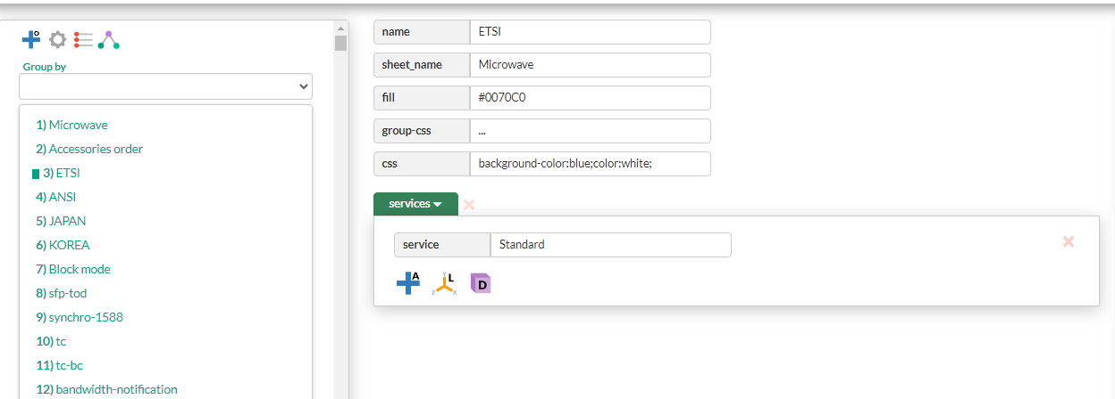
Template Editor
Start edition
When object is selected in Left sidebar, Editor in central pane becomes visible.

Slide 13



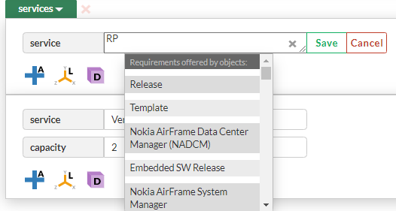
Template Editor
Object Edition - attributes
To Edit an attribute value click on input .
Select Save button to save. Cancel to reject changes !clicking outside edited field will also reject changes!
If text is long you can drag right bottom corner to enlarge input
To delete attribute click x in right upper corner ( visible on hover)
Suggestions for services and requirements.
List displays requirements or suggestions
existing in model.

Slide 14


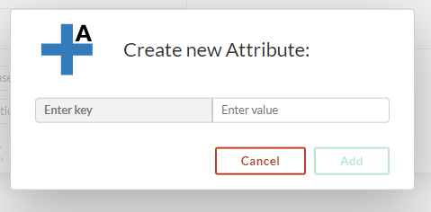
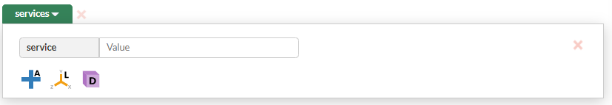

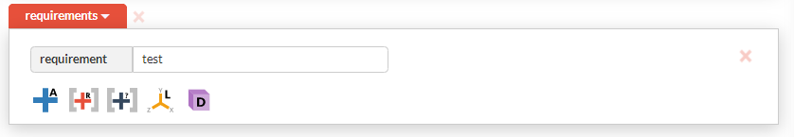
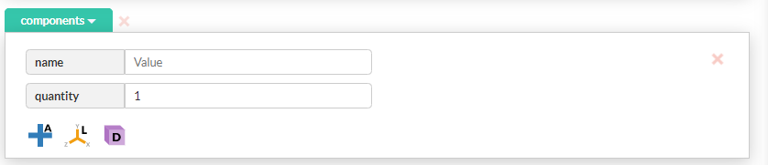


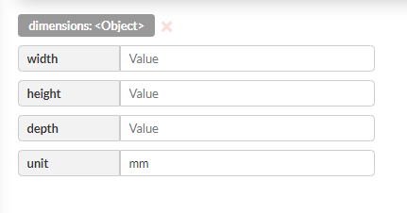
Template Editor
Object Edition - toolbar
Adds new attribute, launches modal . Providing a key is necessary to create an attribute
Adds new service, it’s visible under Services tab
Adds new requirement, it’s visible under Requirements tab
Adds new component, it’s visible under Component tab
Adds dimension, only one dimension per object

Slide 15
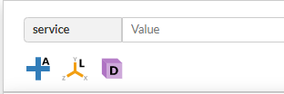
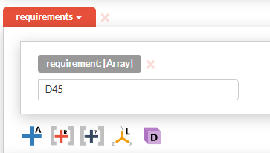


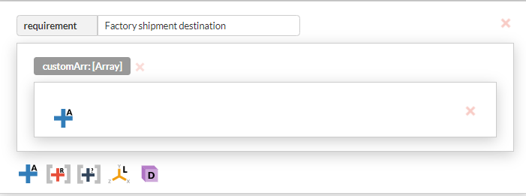
Template Editor
Object Edition - category toolbars
For each Service, Component or Requirement it’s possible to add one Location ,one Dimension and multiple Attributes, using this toolbar
Requirements have additional options allowing to:
transform requirement into array, then with same button add array items.
add custom requirement array nested inside requirement, to add another item to custom array click same button and provide array name

Slide 16
Template Editor
Object Edition - deletion
To delete edited object select on main toolbar

Slide 17
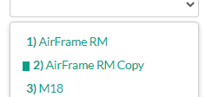


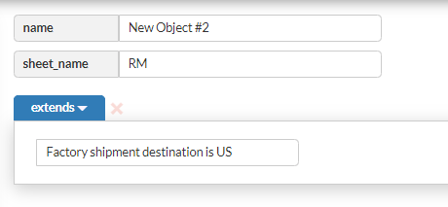
Template Editor
Object copy and inheritance
Select object in left sidebar then click to create a copy.
New object will appear underneath on the list
Select object in left sidebar then click to create object which inherits from it.
New object will appear on the top of list
It contains extends array pointing to extended object , and same sheet_name

Slide 18

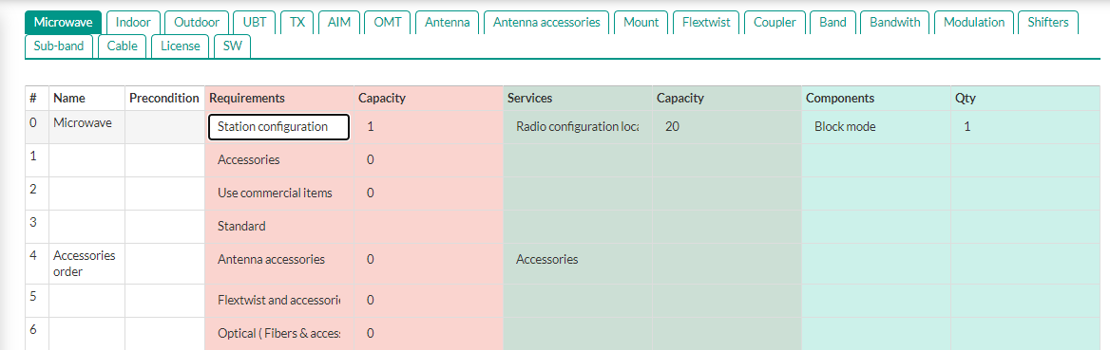

Template Editor
Table Editor
To view model in table editor select
Object are assigned to their tabs (sheet_name)
To update a value click on
table cell and modify it.
To go back to single
object edition select

Slide 19


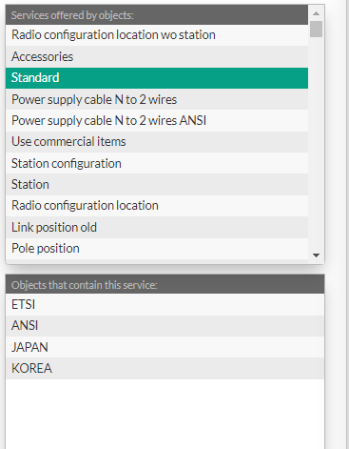
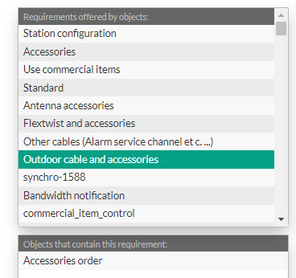
Template Editor
Dependency Explorer
To launch dependency explorer click icon on main toolbar
Select requirement or services
Select service to see which object offer this service .
Select requirement to see which object require it

Slide 20

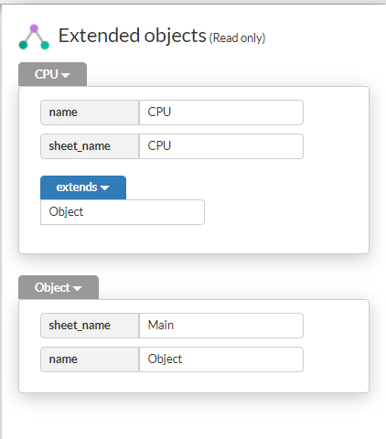
Template Editor
Inheritance Explorer
To preview attributes inherited from other objects,
Select an object from left Sidebar and click on main toolbar.
Extended objects attributes will be visible on right side.

Slide 21

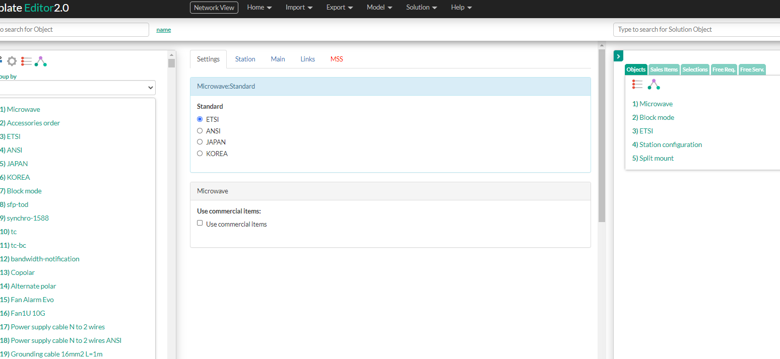
Template Editor
Model Configuration
To start configuration go to Solution menu and select Start Configuration or Select on main toolbar
Configurator will be launched in central pane .

Slide 22
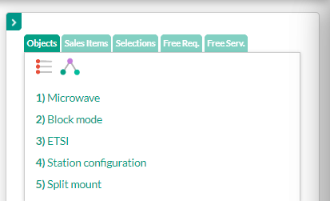
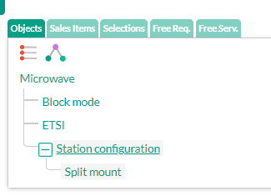
Template Editor
Model Configuration
In right sidebar Solution object twill appear,
it can be view as a:
- list
- creation tree (each object is below object which created it)

Slide 23
Appendix
Any references related to research, document links, git links for user to get information
Reference | Related to Feature | Added by | Added date
For internal use Application Name

Slide 24
Template Version History
Version # | Description of changes | Date | Author | Status | Approver | Approver Date

