Slide 1

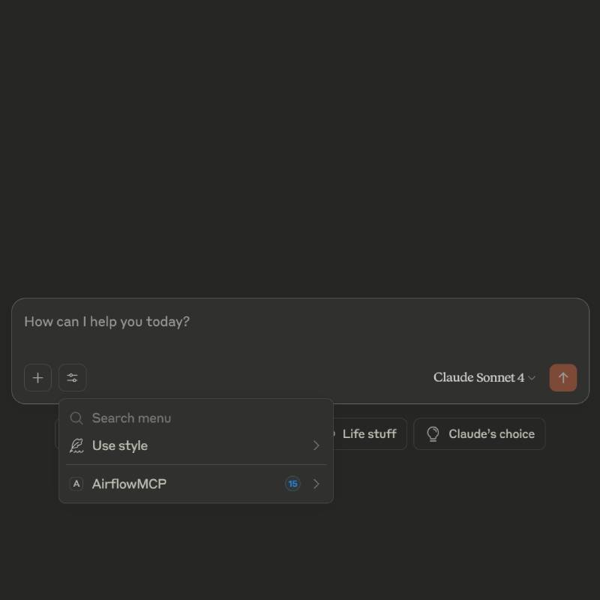

mcp-server-airflow
Bridging workflow automation with natural language querying for easy Airflow DAG insights.
Rakesh

Slide 2

Introduction: The Problem and Solution
The Problem
The Solution
Apache Airflow is a powerful tool to manage and monitor workflows, but for many users, especially non-developers, it’s hard to access information like DAG status or logs easily.
integrating Claude AI and the Model Context Protocol with Airflow, we allow users to ask simple questions—like ‘What’s the status of the data pipeline?’—and get quick answers from Airflow. This makes data operations faster and more user-friendly.

Slide 3





Technologies Used
Apache Airflow
Model Context Protocol (MCP)
Workflow automation platform managing DAGs.
Middleware for contextual data modeling and communication.
Claude Desktop App
Python & APIs
AI assistant for natural language input and output.
Integration logic connecting all components.

Slide 4
Architecture Diagram
Data Flow
Communication
User prompt → Claude → MCP → Airflow API → MCP → Claude → User
Uses APIs and protocols for seamless data exchange.

Slide 5
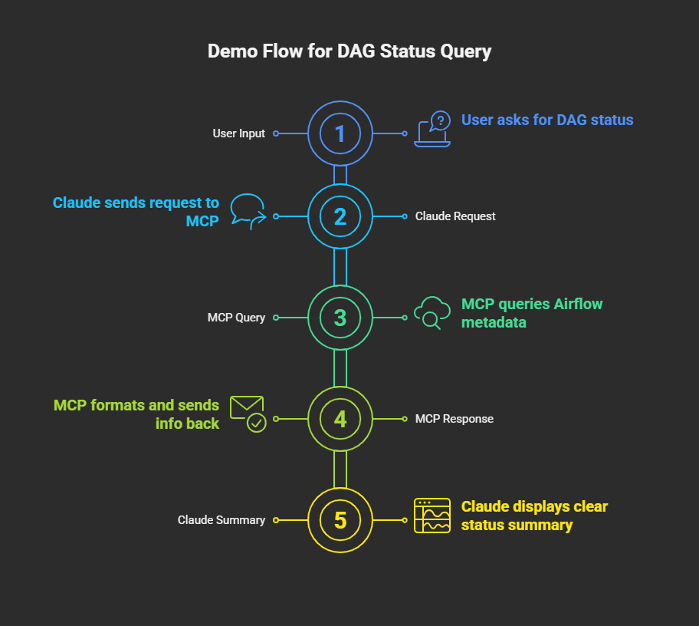



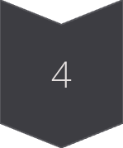
User Query
Types: "What is the status of DAG XYZ?"
Claude Sends Request
Forwards prompt to MCP layer.
MCP Queries Airflow
Fetches DAG metadata from API or database.
Response Delivered
Claude shows clear summary to user.

Slide 6
Challenges and Solutions
Authentication
Prompt Understanding
Used token-based auth between Claude and Airflow via MCP.
Added normalization and fallback queries for vague inputs.

Slide 7
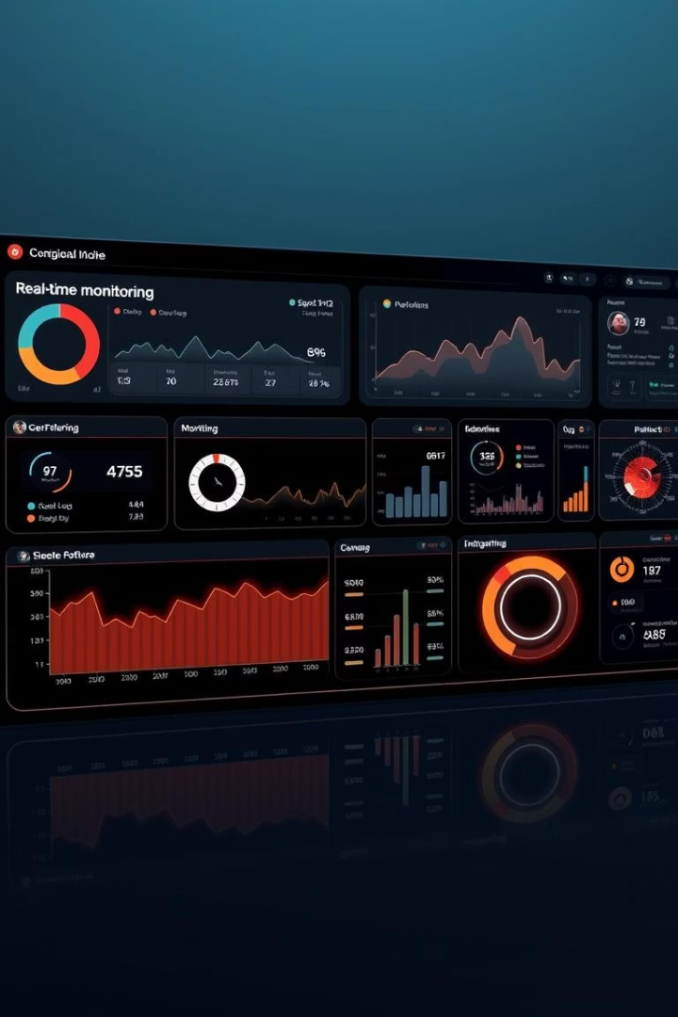
Future Scope
Feature Expansion
Include task logs, schedule editing, and real-time alerts.
LLM Integration
Support other models like GPT and Mixtral.

Slide 8

Q&A
Thank you for listening. I’m happy to answer your questions.

