Slide 1

Jashore University of Science and Technology
Department of Computer Science and Engineering
EV Charging Load Demand Prediction
Using Machine Learning in a SUMO-Based Simulation Environment
Supervised By:
Monishanker Halder
Assistant Professor
Presented By:
Rakesh Biswas
ID: 200112
Session: 2020-21
27 April 2026

Slide 2
Presentation Outline
01
Introduction & Background
05
Dataset & Feature Analysis
Problem context, EV growth, Bangladesh perspective
Generated dataset, correlation, feature importance
02
Problem Statement & Objectives
06
ML Models & Results
Research gap, goals, and research questions
Seven models evaluated, comparative analysis
03
Literature Review
07
Implications & Conclusion
Prior work in load modeling, ML forecasting, SUMO
Key findings, limitations, future work
04
Methodology & Simulation Setup
SUMO environment, road network, charging stations

Slide 3
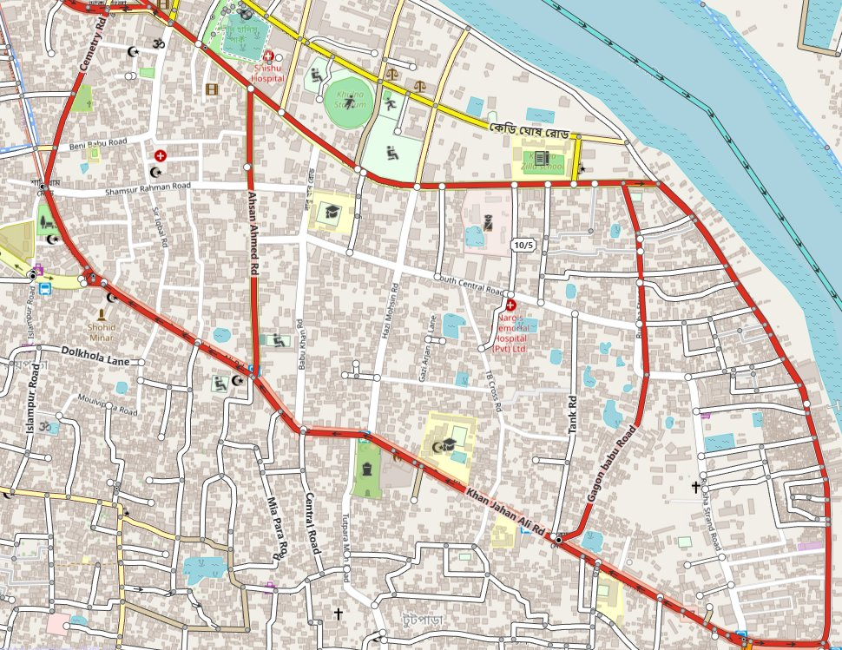
Introduction & Background
Why EV charging load prediction matters
Global EV Growth
Over 26 million EVs worldwide in 2022 (IEA). Rapid adoption reshapes power grids.
Bangladesh Context
Electric three-wheelers (Easy Bikes, E-Rickshaws, E-Vans) dominate urban mobility in cities like Khulna and Jashore.
Grid Pressure
Uncoordinated charging causes voltage violations, transformer overloads, and peak-hour congestion on already stressed distribution networks.
Research Need
Accurate spatiotemporal load prediction is essential for smart grid planning, station placement, and demand response.
Khulna City Road Network (OSM)

Slide 4
Problem Statement & Objectives
Problem Statement
Rapidly growing EV adoption, especially electric three-wheelers in Bangladesh, creates highly dynamic and nonlinear charging load patterns. Existing approaches lack comprehensive simulation-based datasets and multi-model benchmarks tailored to developing-country urban environments.
Research Objectives
Design & implement a SUMO-based EV simulation with realistic charging stations, queue management and smart rerouting logic.
Generate a comprehensive ML-ready dataset capturing per-vehicle and system-level features across a 600 s simulation run.
1
4
Implement a rule-based smart charging system based on proximity, slot availability and SOC priority.
Analyze model performance using MAE, RMSE, R², MAPE, Accuracy, and Weighted F1-Score.
2
5
3
Simulation execution with TraCI
6
Train & evaluate 7 ML / DL models (LR, DT, RF, XGBoost, ANN, LSTM, GRU) for predicting system-level EV charging load.

Slide 5
Literature Review
Reference | Journal Metrics | Existing Systems / Methods | Key Contributions | Research Gaps
Vulfovich et al. (2021) | Journal: Simulation Modelling Practice and Theory Quartile:Q1 Impact Factor: 4.719 (2022) | - Modified First Harmonic Approximation (MFHA) modeling - SN-compensated inductive power transfer links - Load-independent-voltage-output frequency systems | - Advanced modeling of power transfer links - Load-independent voltage output techniques - Simulation frameworks for inductive charging | - Focused on component-level analysis rather than system-level - Limited scalability for grid integration - Insufficient consideration of multiple charging scenarios
Schreiber & Ulbig (2023) | Journal: Energy and AI Quartile:Q1 Impact Factor: 7.762 (2022) | - Model selection, adaptation, and combination - Transfer learning for renewable forecasts - Wind and PV power prediction | - Transfer learning techniques for power systems - Model adaptation methodologies - Renewable energy integration framework | - Focus on generation rather than load prediction - Limited application to BPV charging load profiles - Insufficient integration of charging behavior patterns

Slide 6
Literature Review
Reference | Journal Metrics | Existing Systems / Methods | Key Contributions | Research Gaps
Klausmann et al. (2023) | Journal: Energy and AI Quartile:Q1 Impact Factor: 3.252 (2022) | - Ensemble deep learning for hour-ahead load forecasting - Feature selection approach - Comparative analysis with state-of-the-art methods | - Novel ensemble deep learning architecture<br>- Effective feature selection methodology<br>- Comparative benchmarking of forecasting models etc. | - Not specifically focused on BPV charging loads - Limited temporal resolution (hour-ahead only) - Lack of spatial distribution consideration in grid impact
Rath et al. (2024) | Journal: Electric Power Systems Research Quartile:Q1 Impact Factor: 4.630 (2022) | - Reduced complexity model predictive direct power control - Systems for unbalanced grid conditions - Grid stabilization techniques | - Grid stabilization under unbalanced conditions - Reduced complexity control algorithms - Direct power control methodologies | - Limited focus on demand-side prediction - Insufficient consideration of BPV charging patterns - Lack of machine learning integration for prediction

Slide 7
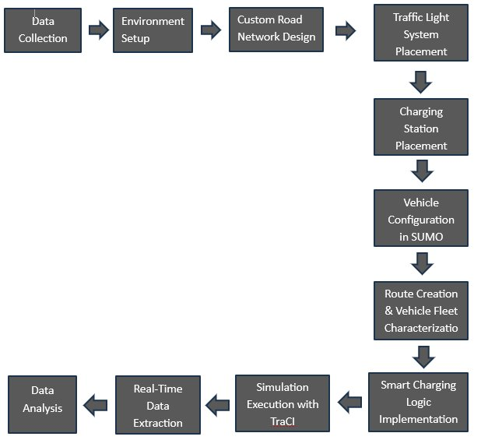
Methodology & Research Design
"Monitor – Predict – Control" framework
Data Collection
Vehicle specs, charging patterns, road layout of Khulna & Jashore cities
Environment Setup
SUMO v1.25 + TraCI, Python 3.10, Windows 10 workstation
Custom Road Network
9 nodes, 11 bidirectional edges, 8,654 m, based on Khulna arterials
Charging Station Placement
10 stations (25–50 kW), 62 charging + 49 waiting slots across 5 edges
Vehicle Configuration
100 EVs: 34 Easy Bikes, + 33 E-Rickshaws + 33 E-Vans; heterogeneous fleet
Smart Charging Logic
SOC-based routing (30% threshold → 70% target), FIFO queue promotion
Simulation Execution via TraCI
600 s run, 1-step monitoring; 34,020 records generated

Slide 8

SUMO Simulation Environment
Custom Khulna road network with traffic signals and charging stations
8,654 m
10
49
600 s
34,020
Total Road Network
Charging Stations
Electric Vehicles
Simulation Duration
Records Generated
SUMO netedit – Custom Microscopic Road Network
Route Definitions and Edge Sequences
Direction | Route ID | Edge Sequence
Forward | route1_forward | E0 → E1 → E2 → E3
Forward | route2_forward | E0 → E1 → E9 → E8
Forward | route3_forward | E4 → E5 → E6 → E7 → E8
Forward | route4_forward | E0 → E10 → E7 → E8
Reverse | route1_reverse | -E3 → -E2 → -E1 → -E0
Reverse | route2_reverse | -E8 → -E9 → -E1 → -E0
Reverse | route3_reverse | -E8 → -E7 → -E6 → -E5 → -E4
Reverse | route4_reverse | -E8 → -E7 → -E10 → -E0

Slide 9
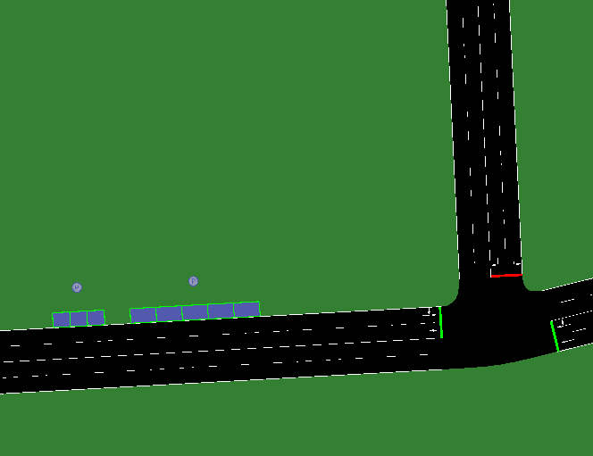
SUMO Simulation Environment
Custom Khulna road network with traffic signals and charging stations
Charging Station Implementation in SUMO
Charging Station Configuration
Station ID | Edge ID | Power (kW) | Charging Slots | Waiting Slots
pa_2 | E0 | 30 | 6 | 6
pa_2_rev | -E0 | 30 | 6 | 3
pa_3 | E1 | 25 | 5 | 4
pa_3_rev | -E1 | 30 | 6 | 6
pa_6 | E5 | 30 | 6 | 6
pa_6_rev | -E5 | 30 | 6 | 3
pa_7 | E6 | 30 | 6 | 6
pa_7_rev | -E6 | 30 | 6 | 6
pa_8 | E7 | 25 | 5 | 3
pa_8_rev | -E7 | 50 | 10 | 6
Total | – | – | 62 | 49
SUMO netedit – Custom Microscopic Road Network

Slide 10
Vehicle Fleet & Smart Charging Logic
Smart Charging Decision Logic
SOC < 30%
Triggers re-routing to nearest station
Rule 1
Nearest station has free charging slot → route there
Rule 2
Nearest full → check 2nd nearest
Rule 3
2nd nearest has charging slot → route there
Rule 4
2nd nearest has waiting slot → enqueue (FIFO)
Rule 5
All full → no reroute; continue current route
Target SOC
Charge session ends at 70% SOC
Parameter | Easy Bike | E-Rickshaw | E-Van
Battery (Wh) | 12,000 | 5,760 – 7,200 | 5,760
Mass (kg) | 345 – 354 | 198 – 218 | 198 – 219
Max Power (W) | 1,000 – 1,200 | 900 – 1,000 | 800 – 900
Max Speed (km/h) | 40 – 50 | 40 – 50 | 40 – 50

Slide 11
Vehicle Fleet & Smart Charging Logic
Vehicle Parameter Configuration in SUMO (Averaged Values)
Parameter | Easy Bike | E-Rickshaw | E-Van
Body Dimensions (L×W×H) | 2.5×1.5×1.4 m | 2.3×1.0×1.8 m | 2.4×1.3×0.8 m
Vehicle Mass (kg) | 345 – 354 | 198 – 218 | 198 – 219
Battery Capacity (Wh) | 12,000 | 5,760 – 7,200 | 5,760
Max Power (W) | 1,000 – 1,200 | 900 – 1,000 | 800 – 900
Acceleration (m/s²) | 1.15 – 1.31 | 0.58 – 0.71 | 0.68 – 0.81
Deceleration (m/s²) | 2.45 – 2.58 | 2.48 – 2.67 | 2.58 – 2.77
Air Drag Coeff. (Cd) | 0.727 – 0.760 | 0.804 – 0.910 | 0.754 – 0.860
Avg. Propulsion Eff. | 0.890 – 0.896 | 0.830 – 0.834 | 0.820 – 0.826
Avg. Recup. Eff. | 0.745 – 0.751 | 0.650 – 0.656 | 0.550 – 0.556
Const. Power Intake (W) | 80 – 96 | 29 – 33 | 24 – 30
Front Surface Area (m²) | 2.41 | 1.51 | 1.01
Reaction Time (τ) | 1.88 – 1.94 s | 1.72 – 1.76 s | 0.87 – 0.92 s
Visual Color (SUMO-GUI) | Magenta | Green | Blue

Slide 12
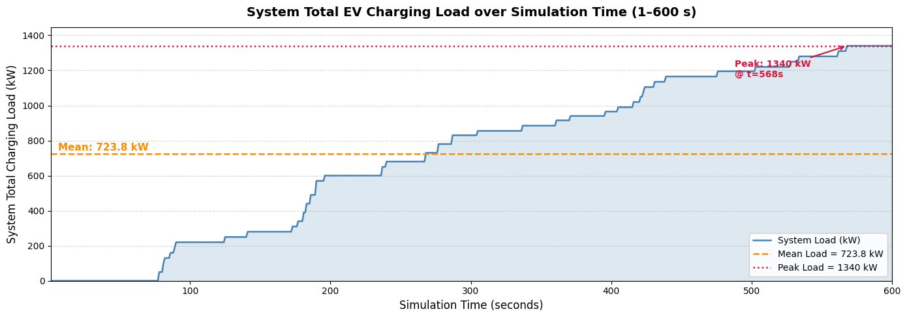
Dataset & System Load Profile
34,020 records from a 600-second SUMO simulation
34,020
25
600
1,340 kW
723.8 kW
Raw Records
Features
Time Steps (s)
Peak Load
Mean Load
Figure: System Total EV Charging Load over Simulation Time (1–600 s)

Slide 13
Dataset & System Load Profile
34,020 records from a 600-second SUMO simulation
EV Charging Load Demand Dataset Summary
Property | Value
Total records | 34,020
Number of features | 25
Unique vehicles | 49
Simulation duration (s) | 1 – 600
Status: Driving | 19,710 (57.9%)
Status: Charging | 11,980 (35.2%)
Status: Waiting | 1,720 (5.1%)
Status: Idle | 610 (1.8%)
System load: Minimum (kW) | 0.00
System load: Mean (kW) | 723.82
System load: Maximum (kW) | 1,340.00

Slide 14
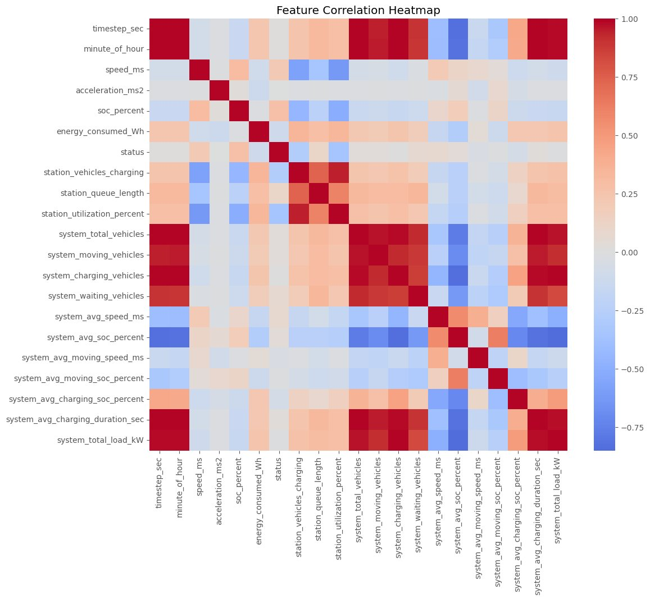
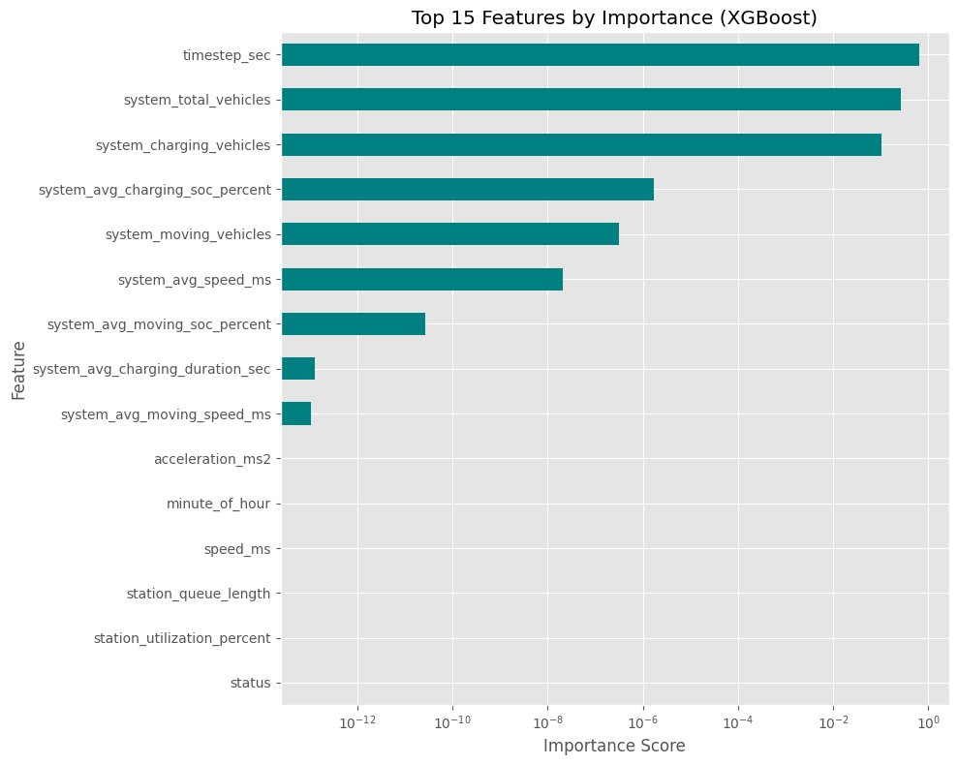
Feature Correlation & Importance Analysis
Pearson Correlation Heatmap
● timestep_sec, system_total_vehicles → top XGBoost features
● Speed, acceleration, SOC → low marginal importance

Slide 15
Machine Learning Models
Seven models evaluated
Linear Regression
ANN (Best Model)
★ BEST
Config: Ridge (α=100)
Config: 128→64→32, BN+Dropout(0.2)
MAE 25.7 / R²=0.9946
MAE 19.2 / R²=0.9967
Decision Tree
LSTM
Config: max_depth=3, min_samples=30
Config: 64+32 units, W=5 lookback
MAE 33.5 / R²=0.9904
MAE 84.2 / R²=0.9365
Random Forest
GRU
Config: 50 trees, max_depth=3
Config: 64+32 units, W=5 lookback
MAE 39.7 / R²=0.9878
MAE 81.5 / R²=0.9444
XGBoost
Config: lr=0.05, depth=2, L1+L2 reg
MAE 41.7 / R²=0.9854

Slide 16
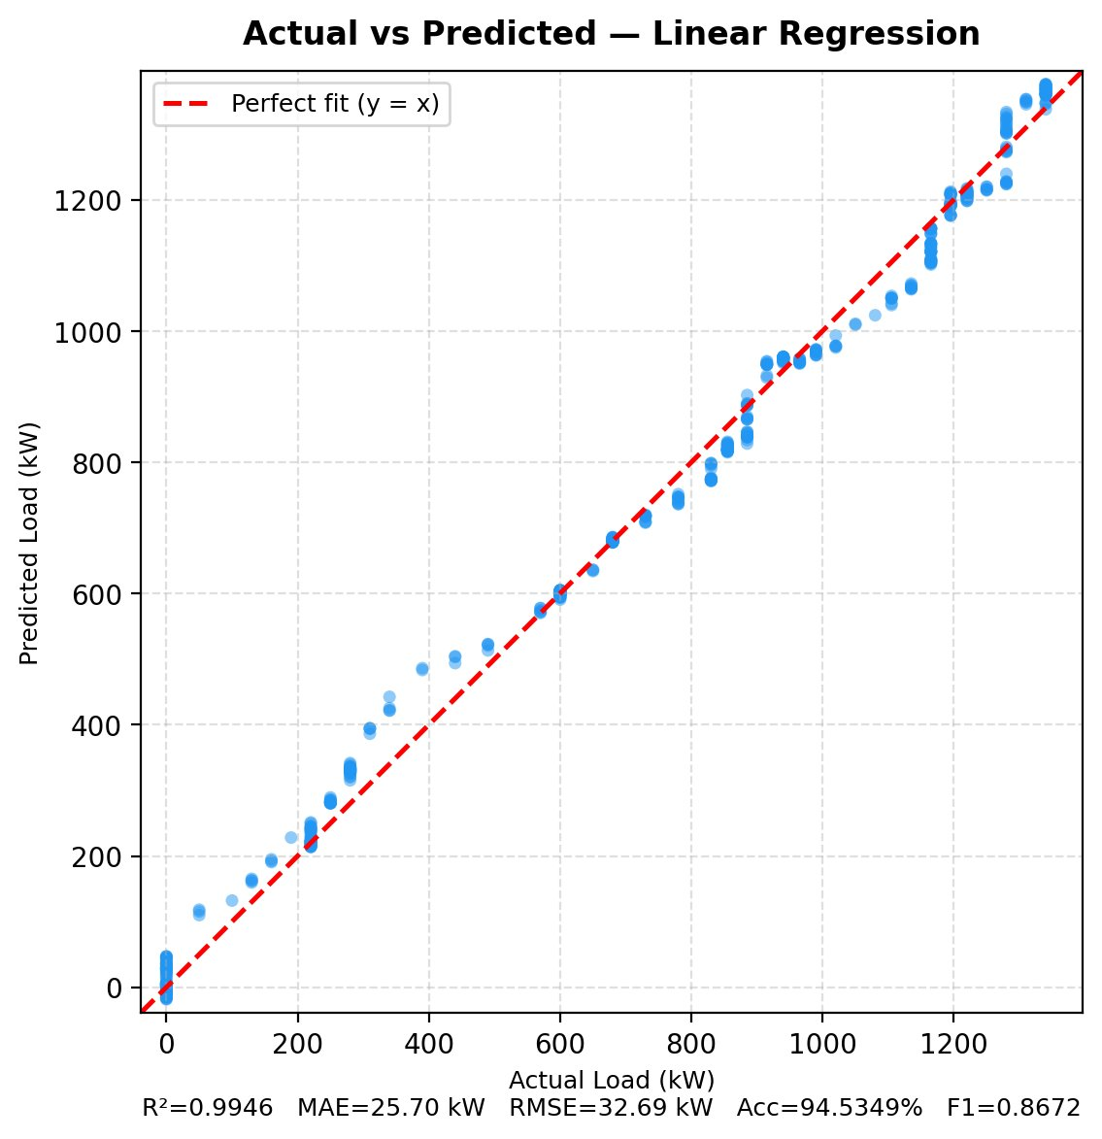
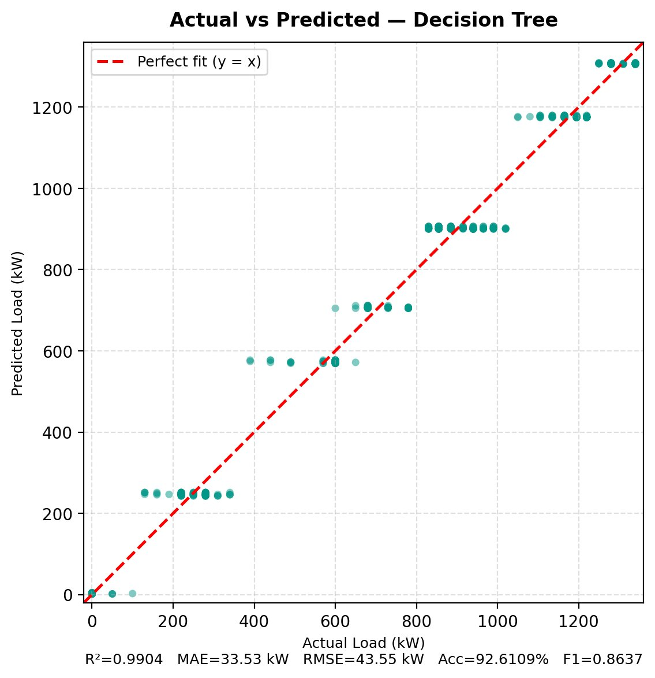
Actual vs. Predicted — Classical Models (5-Fold CV)
Linear Regression
Decision Tree
R²=0.9946 | MAE=25.70 kW | RMSE=32.69 kW | Acc=94.53%
R²=0.9904 | MAE=33.53 kW | RMSE=43.55 kW | Acc=92.61%
• Points hug y=x tightly across full 0–1340 kW range.
• Ridge regularization (α=100) prevents overfit.
• Confirms strong linear structure in charging load data.
• Stepped horizontal bands — signature of max_depth=3 leaf nodes.
• High R² but limited prediction granularity.
• Weakest scatter density among classical models.

Slide 17
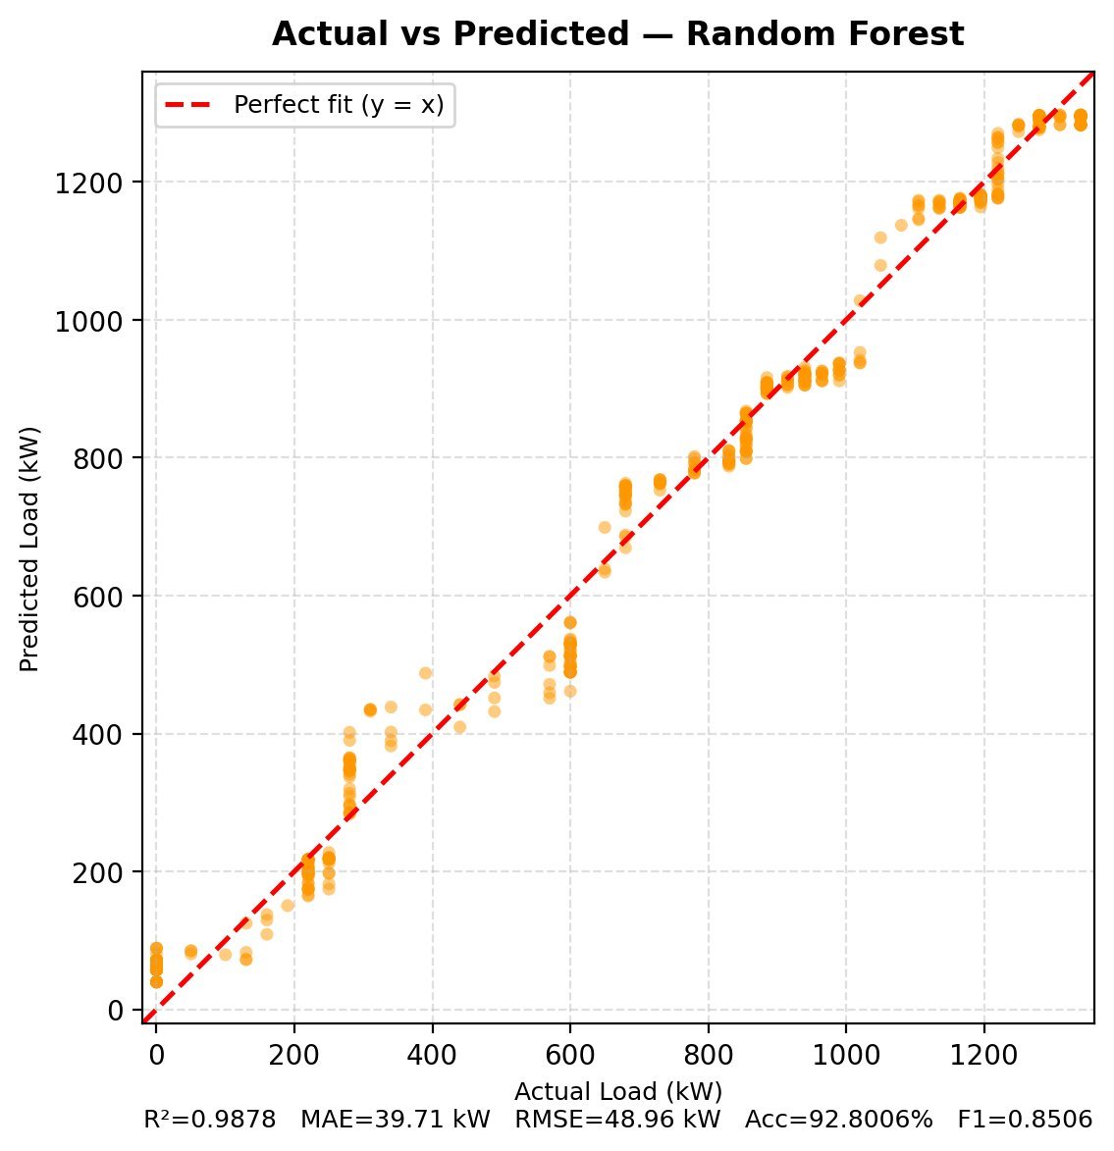
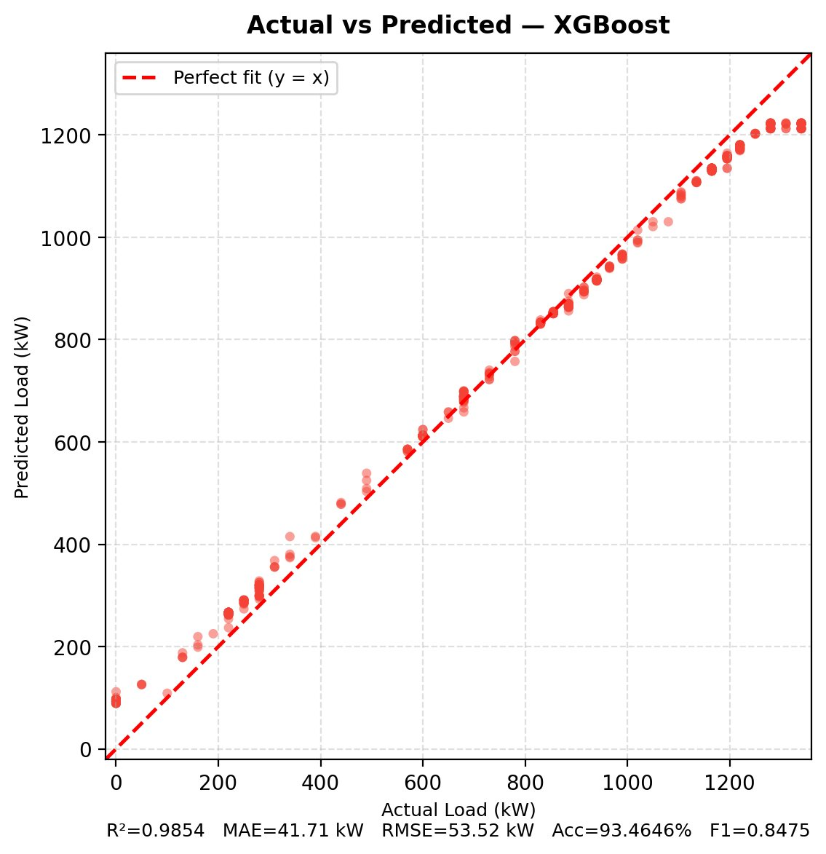
Actual vs. Predicted — Classical Models (5-Fold CV)
Random Forest
XGBoost
R²=0.9878 | MAE=39.71 kW | RMSE=48.96 kW | Acc=92.80%
R²=0.9854 | MAE=41.71 kW | RMSE=53.52 kW | Acc=93.46%
• Ensemble averaging smooths Decision Tree stepped pattern.
• Mild spread visible in the 800–1100 kW region.
• Constrained depth & features ensure honest generalization.
• Diagonal trend with slight spread in mid-load (400–800 kW).
• Heavy regularization (subsample=0.55, λ=5) prevents overfit.
• Lowest R² among classical models on this 600-sample dataset.

Slide 18
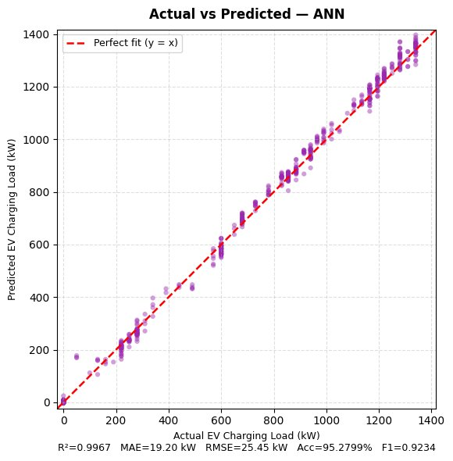
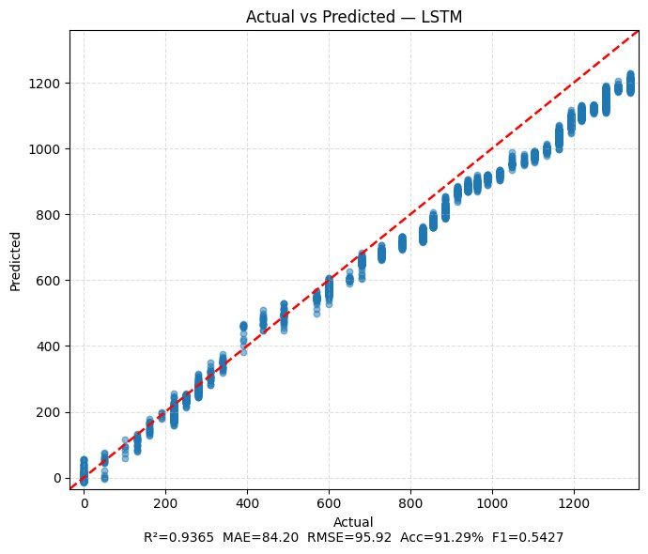
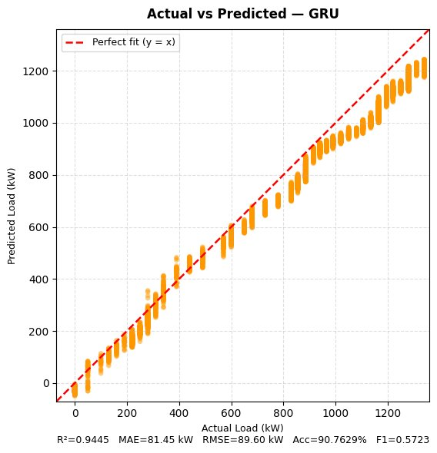
Actual vs. Predicted — Deep Learning Models (5-Fold CV)
ANN ★ Best Model
LSTM
GRU
R²=0.9967 | MAE=19.20 kW | RMSE=25.45 kW | Acc=95.28% | F1=0.9234
R²=0.9365 | MAE=84.20 kW | RMSE=95.92 kW | Acc=91.29% | F1=0.5427
R²=0.9444 | MAE=81.45 kW | RMSE=89.50 kW | Acc=90.76% | F1=0.5723
• Tightest fit across all 7 models.
• Points hug y=x from 0 to 1400 kW.
• BatchNorm + Dropout(0.2) stabilize training.
• Best in all regression & classification metrics.
• Diagonal trend with visible vertical spread.
• Used per-vehicle sequences (W=5, MinMaxScaler).
• Different input vs ANN drives higher error.
• EarlyStopping (patience=5) applied in training.
• Mirrors LSTM; slightly tighter in mid-range.
• Gated architecture gives marginal gain over LSTM.
• Same per-vehicle sequence input (W=5).
• Best recurrent model among the two.

Slide 19
Actual vs. Predicted Load — All Models
Linear Regression
Decision Tree
Random Forest
XGBoost
R²=0.9946
R²=0.9904
R²=0.9878
R²=0.9854
ANN ★ Best
LSTM
GRU
R²=0.9967
R²=0.9365
R²=0.9444

Slide 20
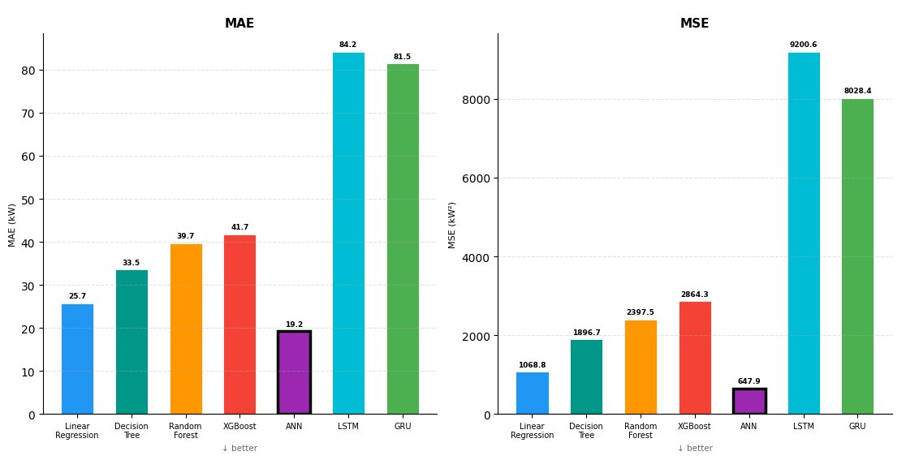
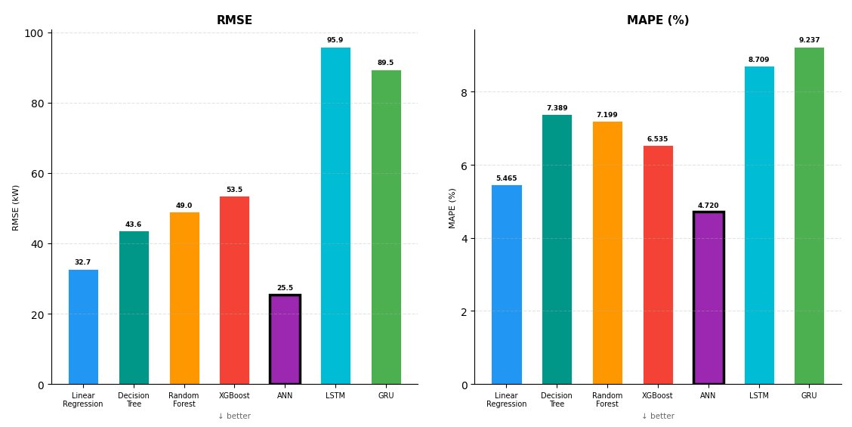
Model Performance Comparison
Error Metrics: MAE, MSE, RMSE, MAPE (lower is better)
MAE & MSE
RMSE & MAPE
Key Insight: ANN achieves the lowest error across all metrics (MAE=19.2 kW, RMSE=25.5 kW, MAPE=4.72%). Linear Regression ranks 2nd (MAE=25.7 kW), outperforming tree-based ensembles. LSTM and GRU show the highest errors due to their sequential input format.

Slide 21
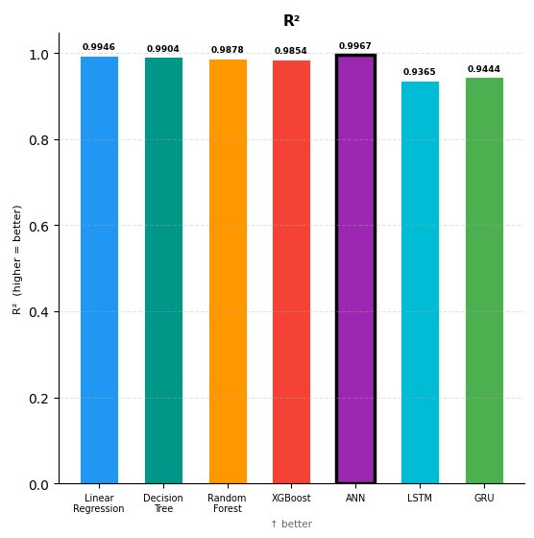
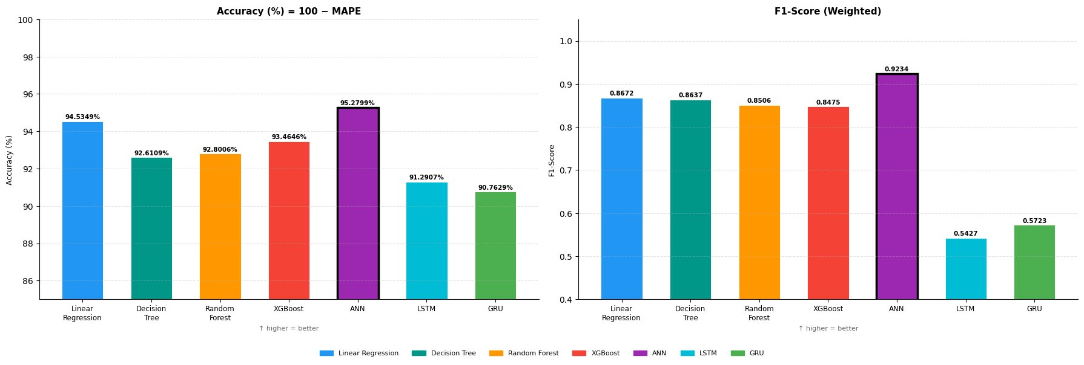
Model Performance Comparison
Fit & Classification Metrics: R² Score, Accuracy, Weighted F1-Score (higher is better)
R² Score
Accuracy & F1-Score
Key Insight: ANN leads with R²=0.9967, Accuracy=95.28%, and F1=0.9234 — best across all fit and classification metrics. All models achieve R² above 0.93. LSTM and GRU show notably lower F1-Scores (0.54 / 0.57), indicating weaker load-category discrimination compared to non-sequential models.

Slide 22
Model Performance Comparison (All Metrics)
MAE, MSE, RMSE, MAPE, R², Accuracy, F1-Score
MAE & MSE
RMSE & MAPE
R² Score
Accuracy & F1-Score

Slide 23
Comprehensive Results Summary
5-Fold Cross-Validation — System Load Prediction
Model | MAE (kW) | MSE | RMSE (kW) | MAPE (%) | R² | Acc (%) | F1-Wtd
Linear Regression | 25.70 | 1068.8 | 32.69 | 5.465 | 0.9946 | 94.53 | 0.8672
Decision Tree | 33.53 | 1896.7 | 43.55 | 7.389 | 0.9904 | 92.61 | 0.8637
Random Forest | 39.71 | 2397.5 | 48.96 | 7.199 | 0.9878 | 92.80 | 0.8506
XGBoost | 41.71 | 2864.3 | 53.52 | 6.535 | 0.9854 | 93.46 | 0.8475
ANN ★ | 19.20 | 647.9 | 25.45 | 4.720 | 0.9967 | 95.28 | 0.9234
LSTM | 84.20 | 9200.6 | 95.92 | 8.709 | 0.9365 | 91.29 | 0.5427
GRU | 81.45 | 8028.4 | 89.50 | 9.237 | 0.9444 | 90.76 | 0.5723
★ ANN achieves best performance across all key metrics

Slide 24
Key Findings & Implications
ANN Outperforms All Models
Linear Relationships Dominate
R²=0.9967, MAE=19.2 kW, Acc=95.28% — best precision for EV load forecasting in this simulated environment.
Linear Regression achieved R²=0.9946, outperforming tree-based ensembles — confirming strong linear structure in the charging load data.
Recurrent Models Underperform
Key Predictors Identified
LSTM/GRU showed highest errors (MAE ~82–84 kW), suggesting instantaneous features carry more information than temporal sequences at this scale.
system_charging_vehicles, timestep_sec, and system_total_vehicles dominate load prediction; individual vehicle features contribute minimally.
Smart Charging Reduces Peaks
Simulation as Digital Twin
1,169 charging recommendations distributed load across stations, reducing bottlenecks and improving dataset realism for ML training.
SUMO-based synthetic dataset generation is effective for developing countries where real EV charging data is scarce or unavailable.

Slide 25
Limitations & Recommendations for Future Work
Current Limitations
Future Research Directions
Simulation-only dataset — real-world stochastic behavior not fully captured
1
Real-World Data Integration
Deploy IoT sensors at actual charging stations in Khulna/Jashore
Weather, electricity tariff & driver behavior not modeled
2
Hybrid Deep Learning (CNN-LSTM)
Capture spatial + multi-scale temporal dependencies
Static infrastructure (no station failures or capacity changes)
3
Reinforcement Learning
Adaptive station assignment & autonomous load balancing
Short 600-second window limits temporal generalization
4
Renewable Energy Integration
Model solar-powered stations with energy storage
5
Larger Simulation Environment
Expand to full-city scale with diverse vehicle types

Slide 26
Conclusion
A comprehensive SUMO-based EV simulation modeled Bangladesh's urban mobility (Easy Bikes, E-Rickshaws, E-Vans) with realistic charging infrastructure.
34,020 records across 25 features generated — ready for ML-based system-level load prediction.
ANN achieved the highest precision: R²=0.9967, MAE=19.2 kW, Accuracy=95.28%, F1=0.9234.
Linear Regression also excelled (R²=0.9946), confirming linear structure in EV charging load demand.
SUMO simulation serves as an effective digital twin for generating EV datasets in data-scarce developing regions.
The "Monitor–Predict–Control" framework provides a practical path to smart grid integration in cities like Khulna.

Slide 27
Thank You
Questions & Discussion
EV Charging Load Demand Prediction Using ML in a SUMO-Based Simulation Environment

