Slide 1
VerbaSense
AI-Powered Communication & Sentiment Analysis Platform
Rakesh Biswas
ID: 200112 | CSE, JUST
Full-Stack Developer Intern

Slide 2
Table of Contents
Project Overview
Problem Statement
Objectives
System Architecture
Key Features
Technologies Used
Implementation
Challenges & Solutions
Results / Output
Skills Gained
Future Improvements
Conclusion

Slide 3
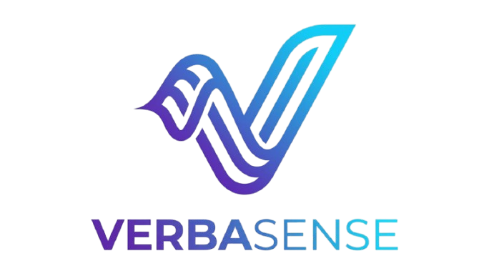
Project Overview
VerbaSense is an advanced AI communication tool.
Designed to analyze textual data for emotional intelligence.
Provides real-time sentiment scoring and linguistic patterns.
Bridging the gap between raw text and human understanding.

Slide 4
Problem Statement
Traditional tools lack deep emotional context analysis.
High complexity in processing real-time communication flows.
Difficulty in visualizing sentiment trends over time.
The need for an integrated full-stack solution for AI interaction.
Current Gap: Text is abundant, but understanding is scarce.

Slide 5
Objectives
Develop a robust NLP pipeline for emotion detection.
Create a high-performance Full-Stack dashboard.
Implement secure user authentication and data persistence.
Ensure horizontal scalability for enterprise-level data.

Slide 6
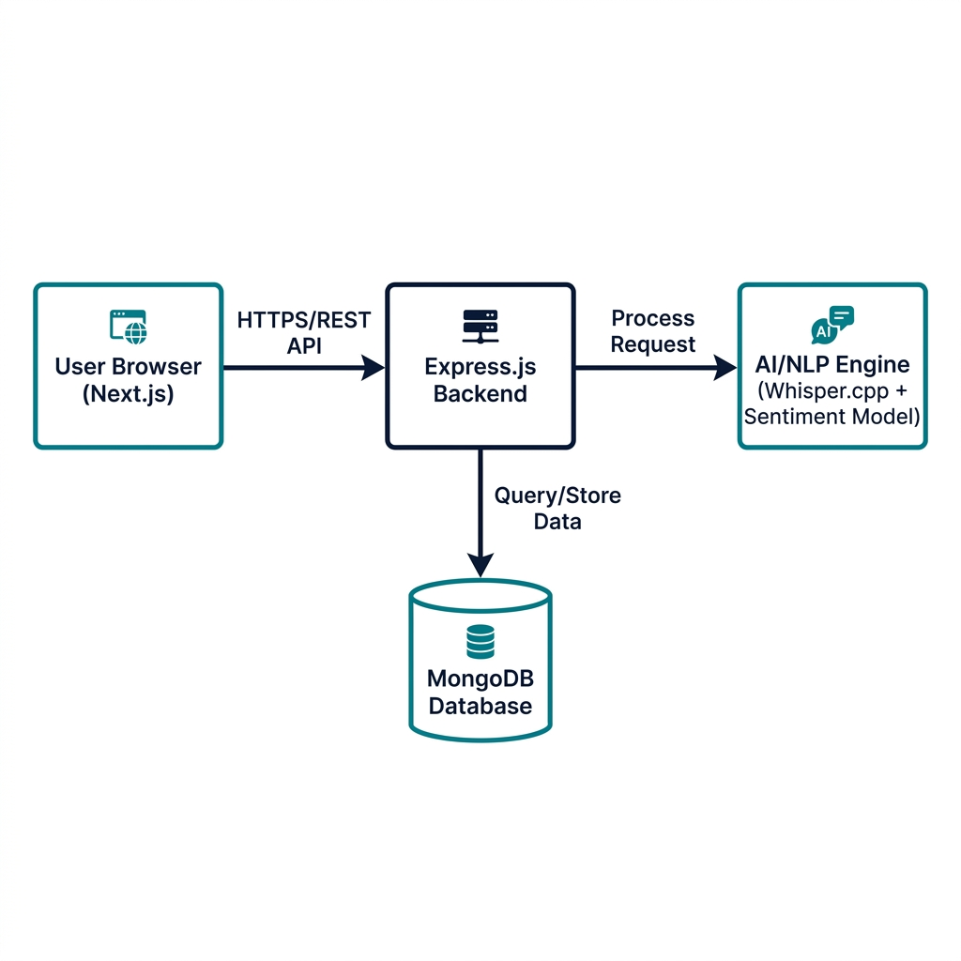
System Architecture

Slide 7
Key Features
Sentiment Analysis
Dynamic Dashboard
Real-time AI processing
Interactive visual metrics
Secure Auth
Scalable API
JWT & Google Integration
RESTful Express backend

Slide 8






Technologies Used
Next.js
Node.js
MongoDB
Tailwind
JWT
React

Slide 9
Implementation Details
Backend built with Express.js and Node.js for scalability.
Frontend utilizing Next.js for SSR and SEO optimization.
State management handled via React Context/Redux.
AI models integrated as microservices for modularity.

Slide 10
Challenges & Solutions
Challenge: Latency in AI inference. -> Solution: Web Workers & Caching.
Challenge: Data Security. -> Solution: Robust JWT + Bcrypt encryption.
Challenge: UI Performance. -> Solution: Framer Motion for smooth transitions.

Slide 11
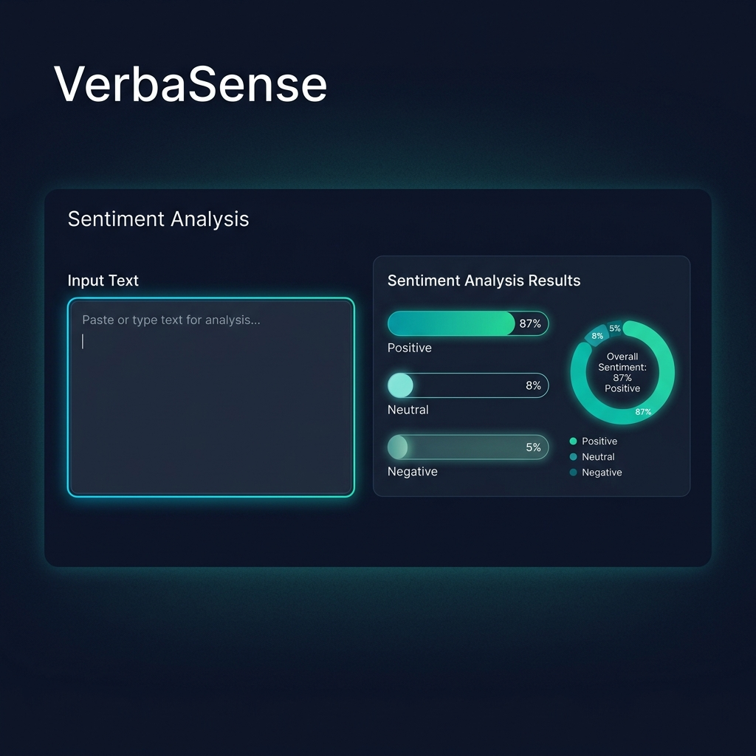
Results / Output

Slide 12
Skills Gained
Mastery of MERN stack development.
Practical experience with AI/NLP integration.
Modern UI/UX design principles.
Production deployment & CI/CD workflows.

Slide 13
Future Improvements
Support for Multilingual Sentiment Analysis.
Real-time voice-to-sentiment processing.
Advanced predictive analytics for conversation flows.
Mobile app integration (React Native).

Slide 14
Conclusion
Successfully built a functional AI communication platform.
Achieved project goals within the internship timeframe.
Gained invaluable industry experience in full-stack engineering.
Ready to scale VerbaSense for real-world applications.

Slide 15
THANK YOU
Questions? I'd love to discuss more.
rakesh.biswas@example.com | github.com/Rakesh01999

