Slide 1

AI-ML Driven Blood Supply Chain Optimization
Connecting Donors, Blood Banks, and Hospitals through Intelligent Systems
NAME: Allu Rakesh
ROLL.NO: 322129512003

Slide 2


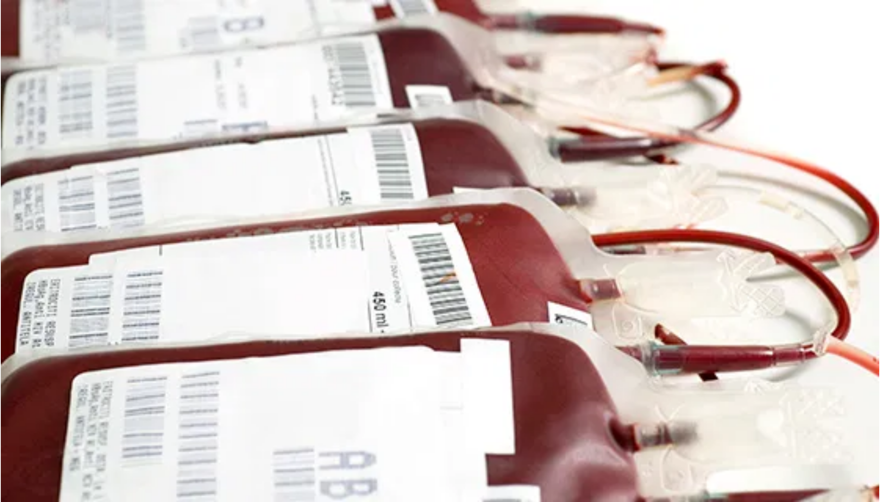
Problem Statement
Fragmented Information:
Existing systems rely on manual outreach and static registries that are slow to update.
Unpredictable Demand:
Blood banks struggle to forecast inventory needs across blood groups, components, and geographies.
Delayed Donor Identification:
Critical delays in finding compatible, nearby donors during time-sensitive scenarios.
Lack of Unified Interface:
Hospitals cannot view cross-bank inventory or trigger timely requests.
Consequences:
Units expire unused in one region while shortages occur in another, leading to avoidable morbidity and mortality.

Slide 3


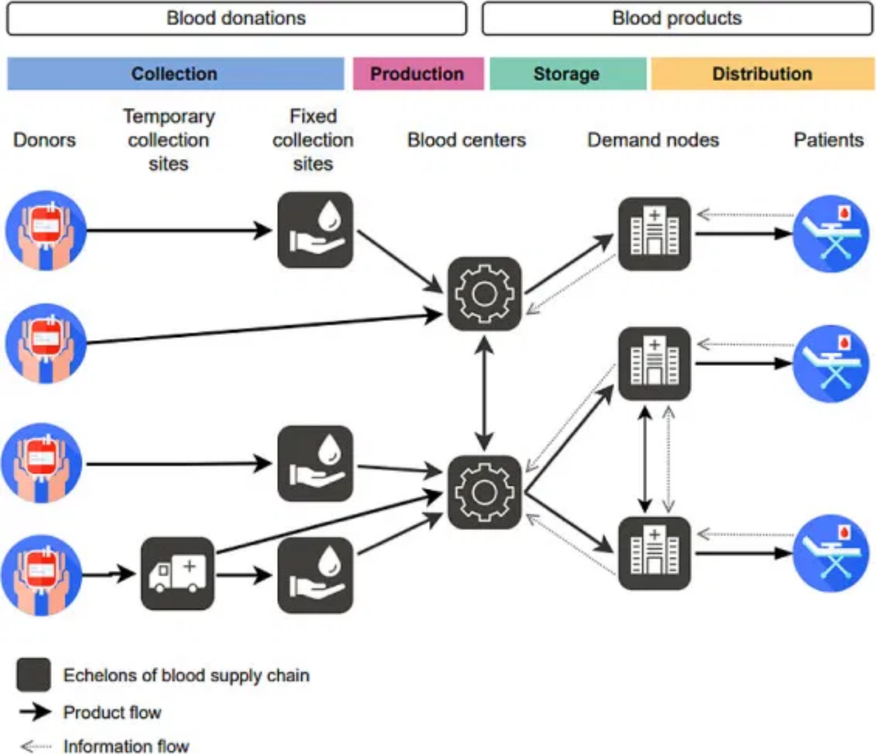


Target Community & User Needs
Willing Donors
Proactive engagement at the right time
Optimal routing to nearest donation center
Transparent donation impact tracking
Blood Banks
Accurate inventory forecasting by blood group/component
Real-time inventory synchronization
Efficient donor management and scheduling
Hospitals
Unified interface to view cross-bank inventory
Ability to trigger timely blood requests
Fast, equitable access to blood components

Slide 4



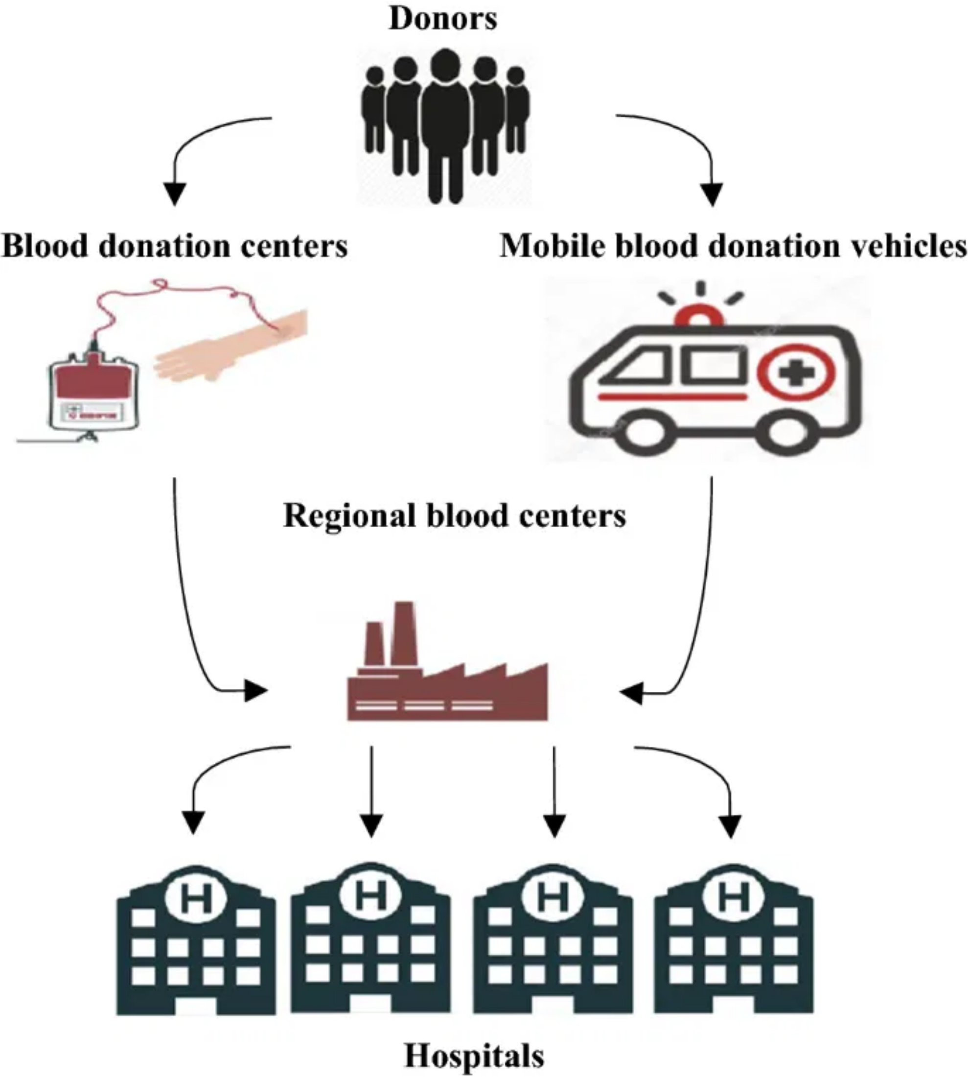











Solution Blueprint
Presentation Layer
Donor Mobile Application
Blood Bank Web Portal
Hospital Web Portal
Application Layer
User Management Service
Inventory Management Service
Demand Prediction Service (AI/ML)
Donor Engagement Service (AI/ML)
Matching & Prioritization Service
Data & Infrastructure
Relational & NoSQL Databases
Cloud-based Deployment
End-to-End Security

Slide 5


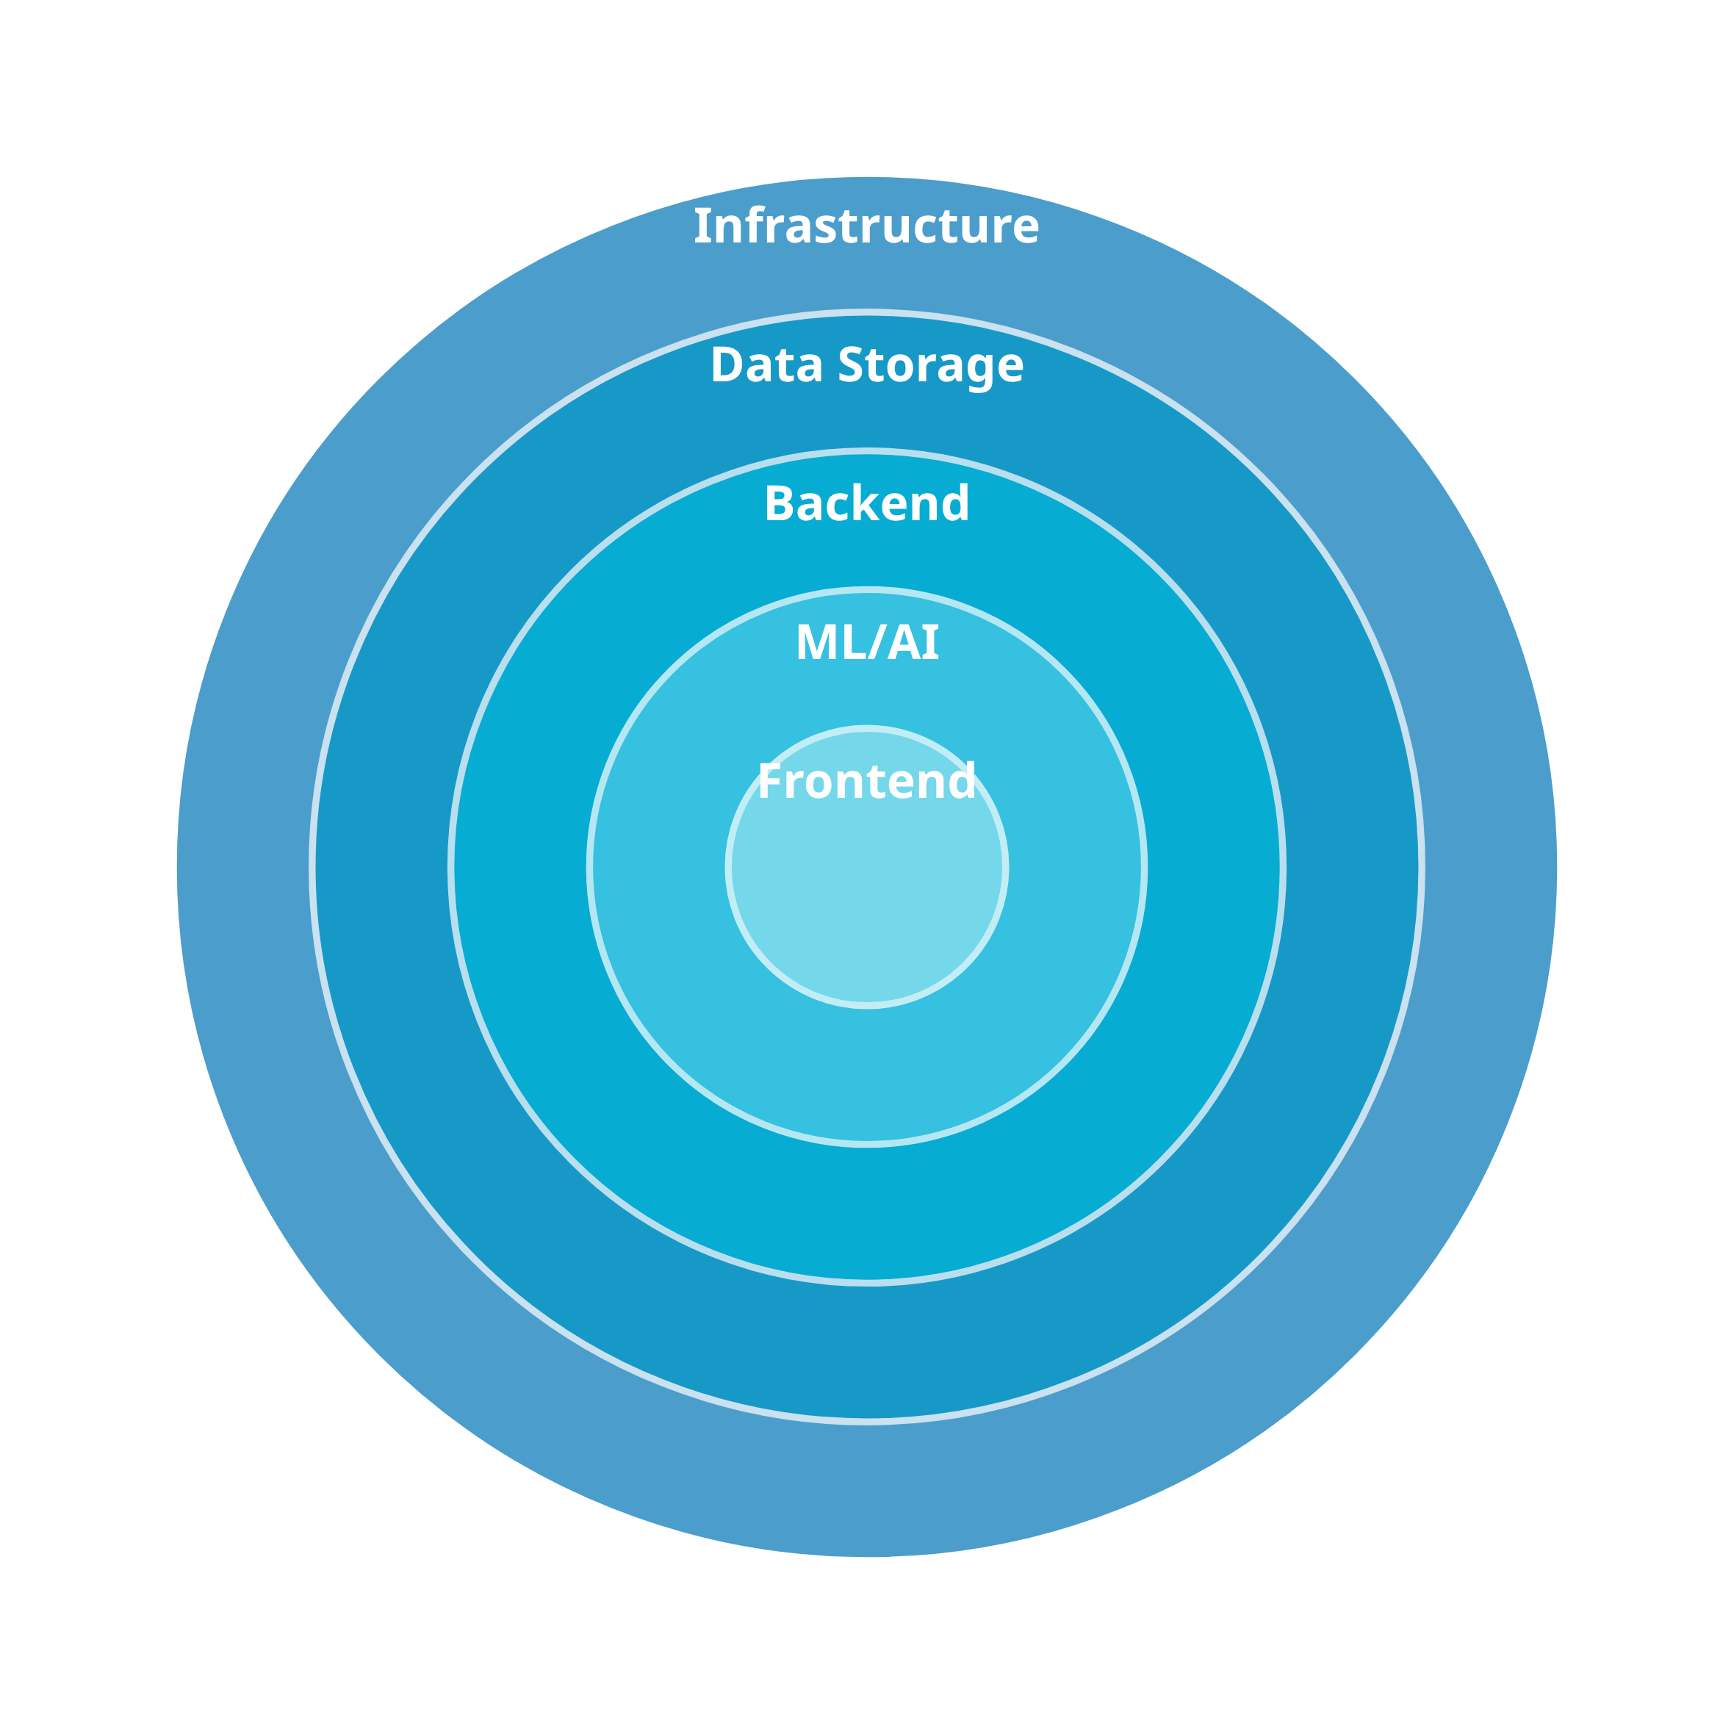




















Technology Stack
Backend
Python
FastAPI
Flask
Celery
Machine Learning
TensorFlow
PyTorch
Scikit-learn
Pandas
Frontend
React.js
React Native
Tailwind CSS
Data Storage
PostgreSQL
MongoDB
Redis
Infrastructure
Google Cloud
Docker
Kubernetes

Slide 6












AI/ML Components
Demand Prediction Model
Time-series forecasting model that predicts blood demand at hospital and blood bank levels for short-term and medium-term planning.
Seasonal patterns analysis
Hospital-specific demand factors
Surgical schedule integration
Blood group/component stratification
Donor Likelihood Model
Classification model that estimates donor availability and probability of donation based on historical patterns and contextual factors.
Donation recency analysis
Geographical proximity scoring
Eligibility window tracking
Response rate optimization

Slide 7





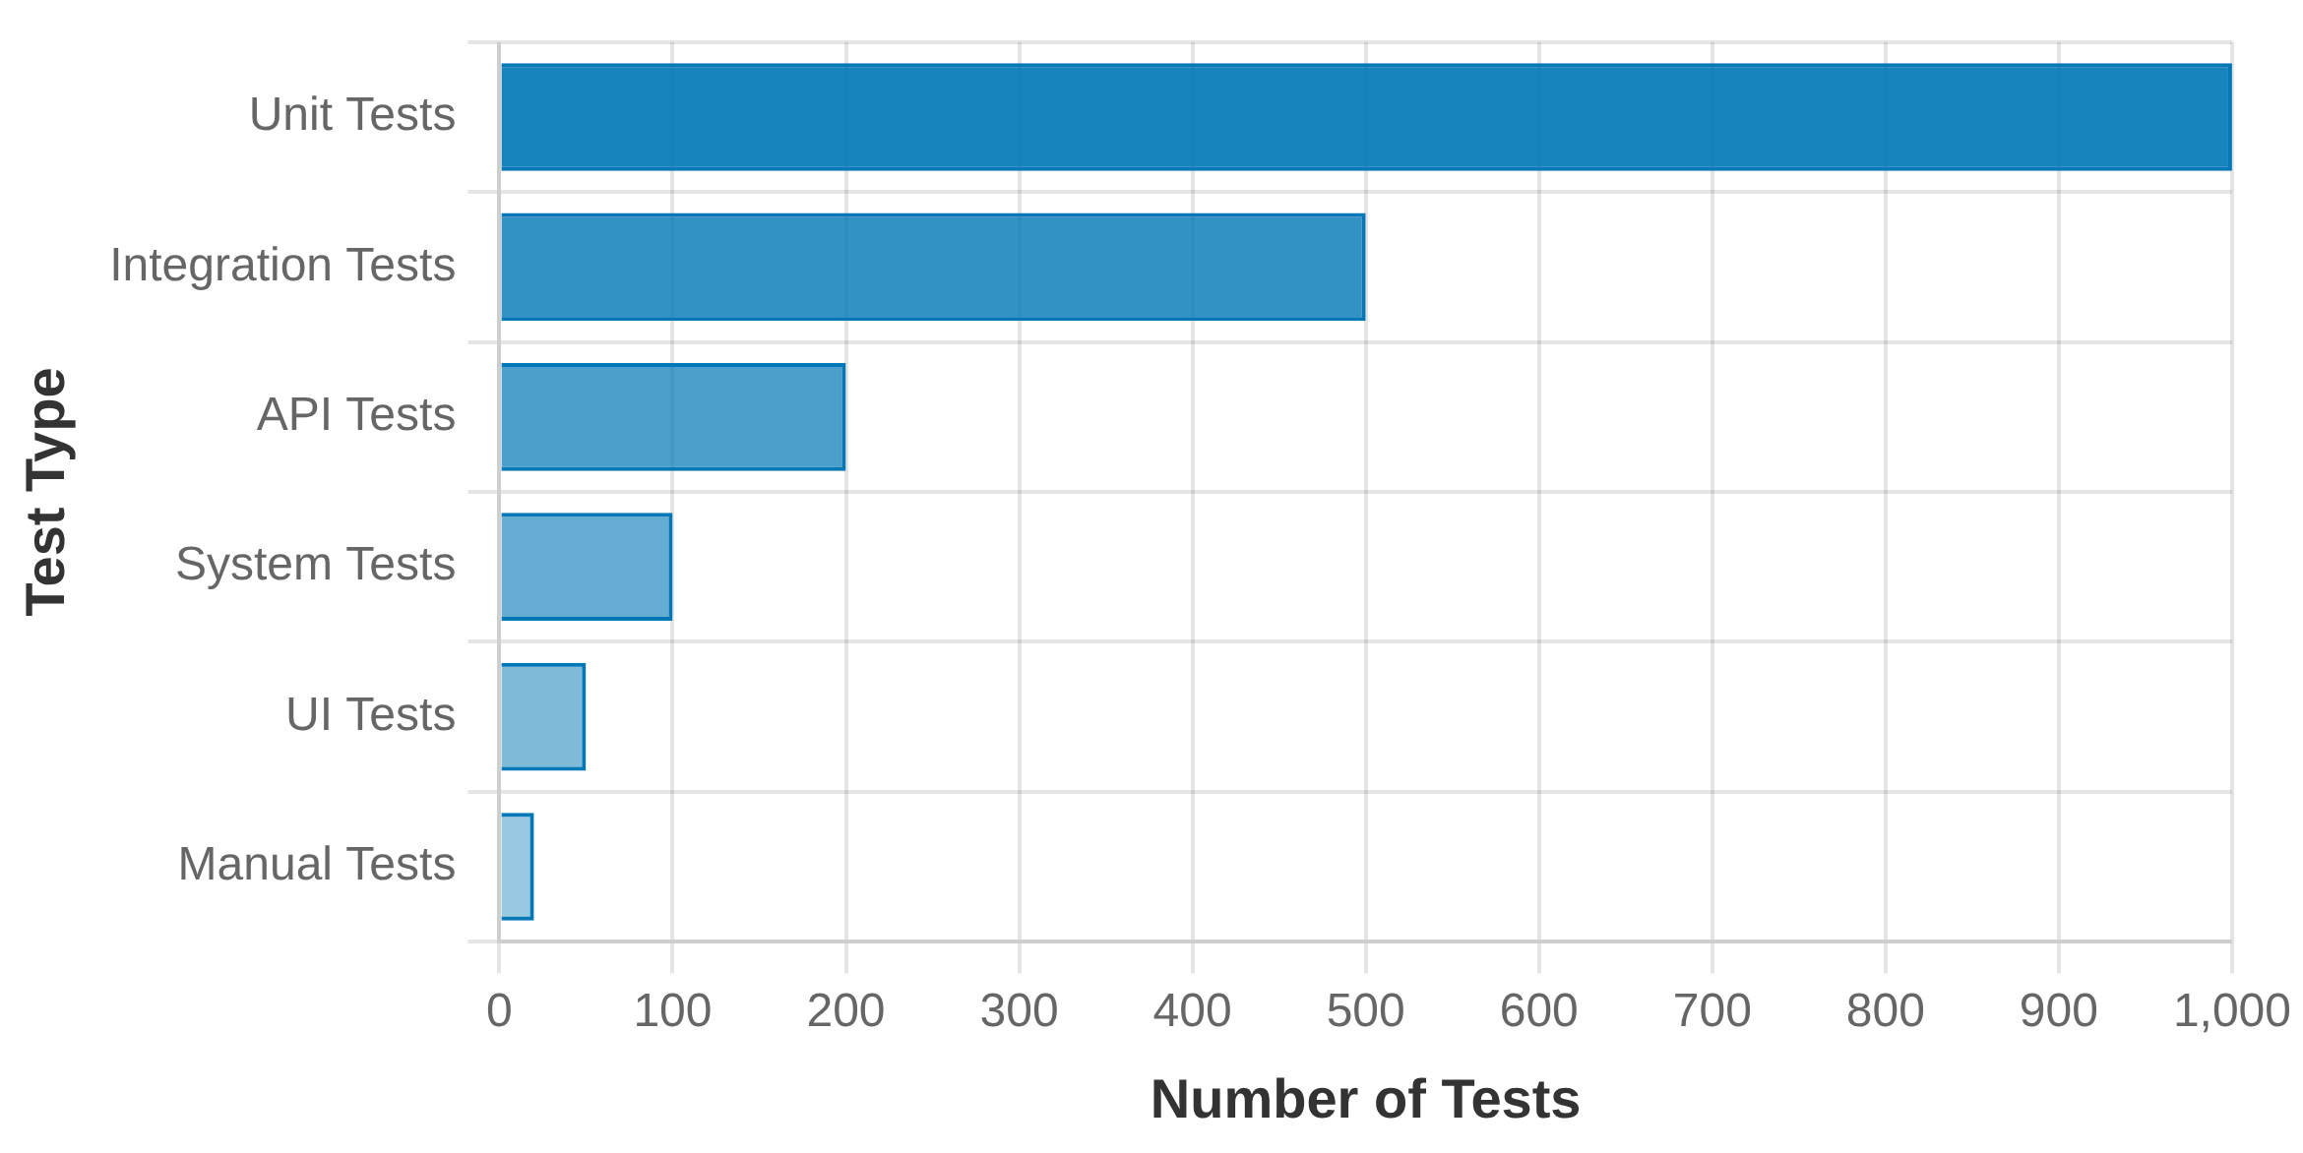










Testing & Performance Evaluation
Testing Methodologies
Unit Testing
Integration Testing
System Testing
Performance Testing
Testing Pyramid
Security Testing
User Acceptance Testing
ML Model Performance Metrics
Mean Absolute Error (MAE) for demand prediction
Root Mean Squared Error (RMSE) for forecast accuracy
Precision/Recall for donor likelihood model
F1-Score for balanced classification performance
Operational Metrics
Blood shortage reduction percentage
Wastage reduction from expired units
Donor engagement rate improvement
Time to fulfill blood requests

Slide 8

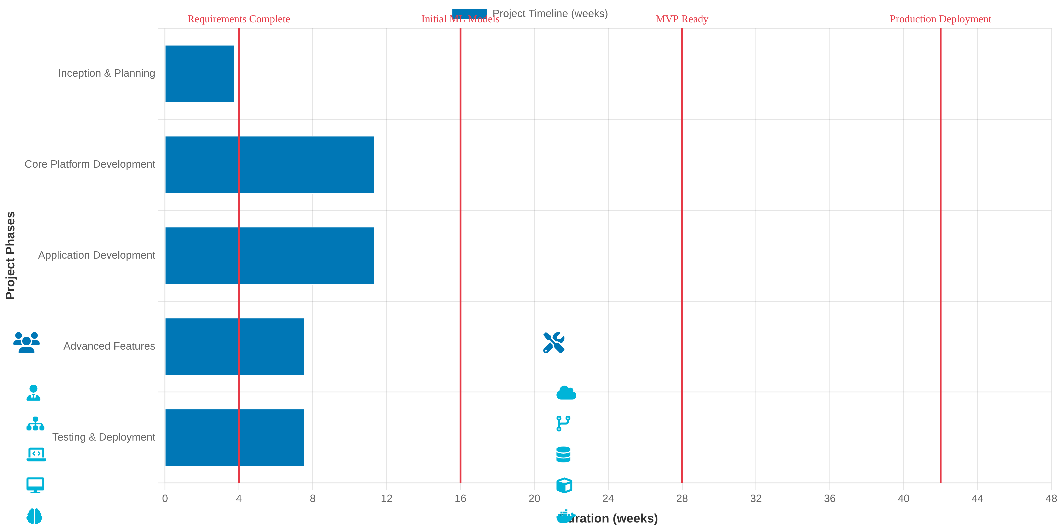










Implementation Plan
Team Structure
Technology Resources
Project Manager (1)
Cloud Computing Platform
Solution Architect (1)
Development Tools
Backend Developers (3-4)
Database Systems
Frontend & Mobile Developers (4-5)
ML Frameworks
ML Engineers/Data Scientists (2)
Containerization & Orchestration

Slide 9


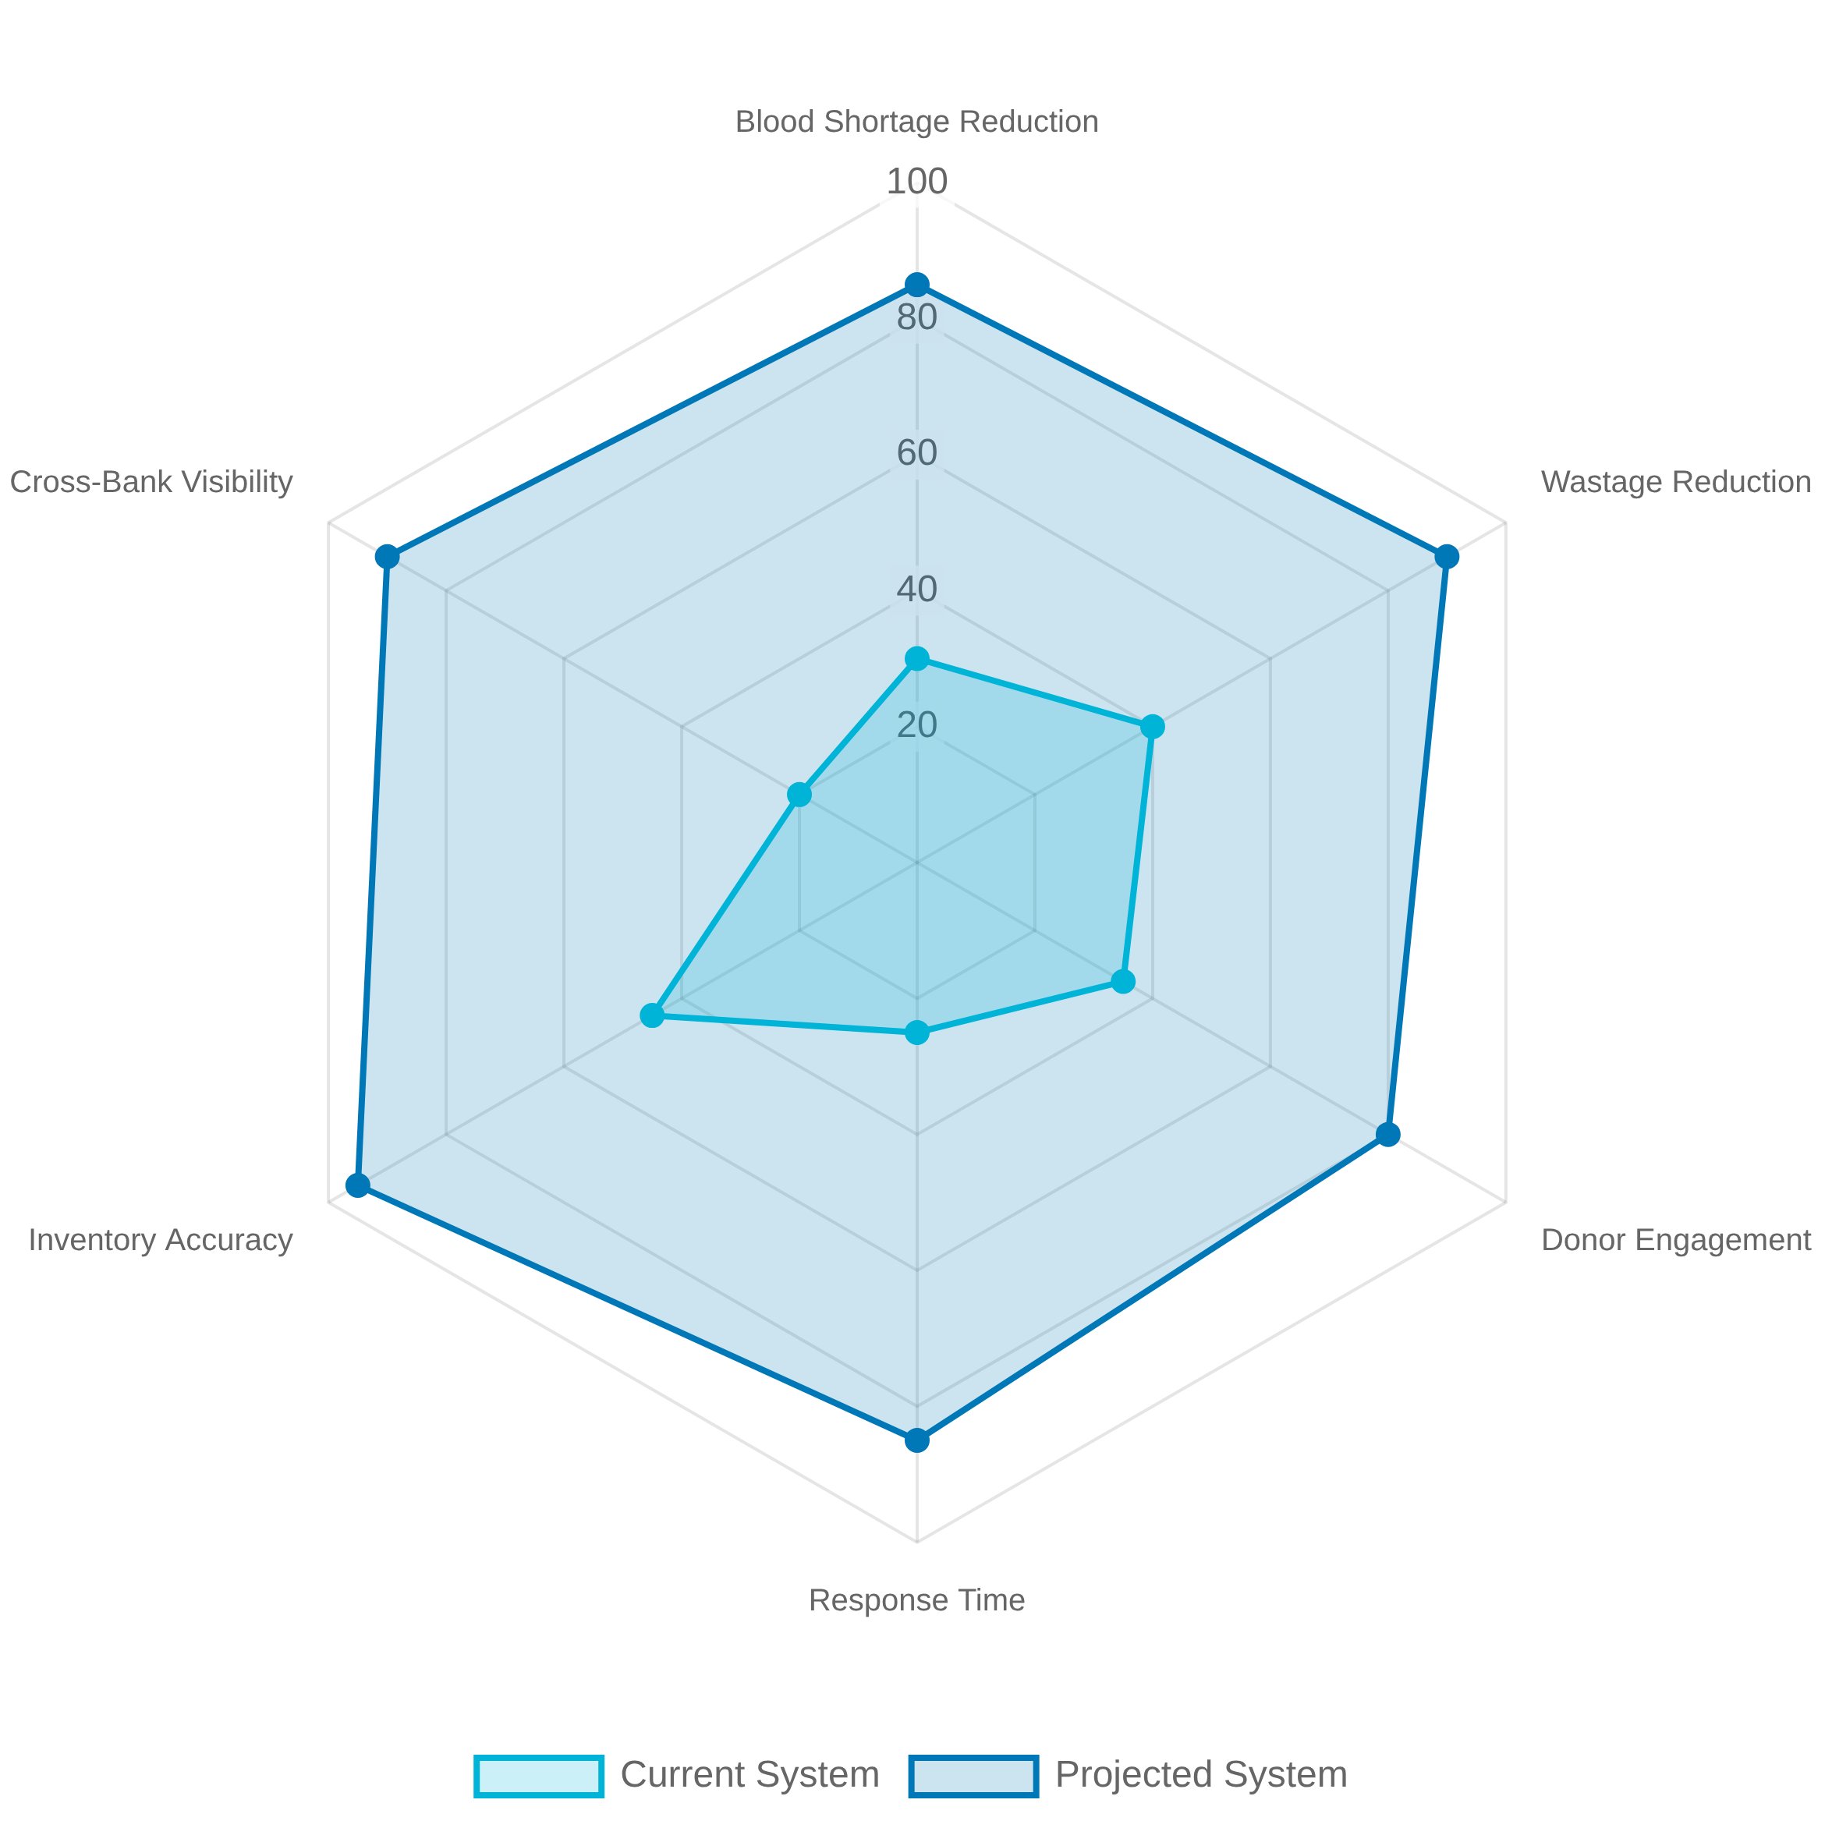

Expected Impact
Healthcare Outcomes
Improved patient outcomes through
faster access to compatible
blood
during emergencies, surgeries, and critical care. Reduction in
Projected Impact Metrics
morbidity and mortality rates associated with blood shortages.
Operational Efficiency
Reduced wastage
of blood units through better inventory
management and demand forecasting.
Optimized resource
allocation
across blood banks and hospitals.
Donor Engagement
Increased donor participation
through targeted, timely outreach.
Enhanced donor experience with convenient routing and meaningful
impact tracking.
Systemic Improvement
Creation of a
unified blood supply ecosystem
that connects all
stakeholders through intelligent, data-driven processes. Potential for
regional and national scaling.

Slide 10

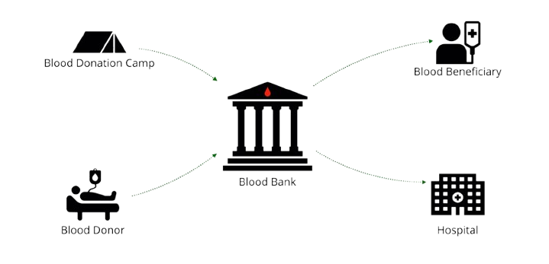





Conclusion & Next Steps
The AI-ML driven blood supply chain optimization platform addresses critical healthcare challenges by connecting donors, blood banks, and hospitals through an intelligent interface. By leveraging advanced machine learning models for demand prediction and donor engagement, the system aims to reduce shortages, minimize wastage, and ultimately improve patient outcomes.
Future Enhancements
Integration with Electronic Health Records
Blockchain for Supply Chain Transparency
Advanced Analytics & Predictive Insights
Geographic Expansion & Scaling
Mobile Collection Units Optimization

